Slide 1
SEC Cybersecurity regulations
Technical implementation Guidance to detect cyber-risks in the software supply chain for process disclosure requirements

Slide 2
About REA
Software Engineering Company, Established 2018
Developer of Cybersecurity Risk Assessment Tools for the Software Supply Chain (C-SCRM), SAG-PM™ and SAG-CTR™ for tamper-proof evidence preservation
Active participant within CISA ICT_SCRM Task Force, JCDC, Critical Manufacturing Sector Coordinating Council(CMS CC) and Internet Engineering Task Force (IETF) Supply Chain Integrity Transparency and Trust (SCITT) initiative
Cybersecurity Mentor Mass Tech Collaborative

Slide 3
Understanding the Risk
The newly adopted SEC cybersecurity rules are now codified into Federal Regulations
Require current reporting about material cybersecurity incidents within 4 business days on Form 8-K;
Require periodic disclosures regarding, among other things:
A registrant’s processes and practices to identify and manage cybersecurity risks;
Management’s important role in implementing cybersecurity policies and procedures;
Board of directors’ cybersecurity oversight of cybersecurity risk; and
Updates about previously reported material cybersecurity incidents; and
The proposed amendments are designed to better inform investors about a registrant’s risk management, strategy, and governance and to provide timely notification of material cybersecurity incidents. See CISA Advisory Council Report

Slide 4
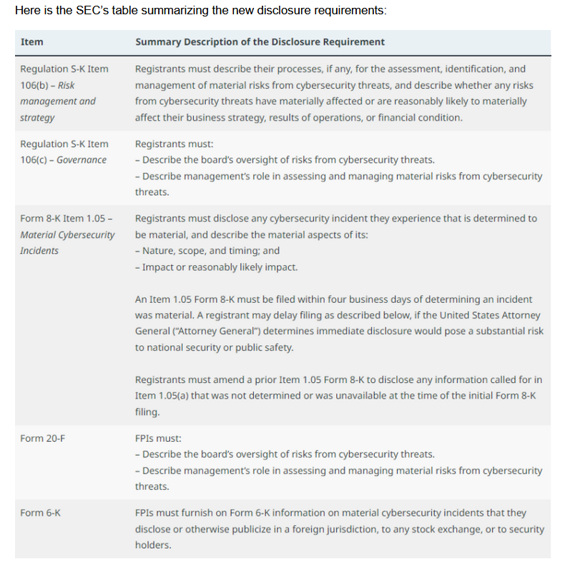
Source: https://corpgov.law.harvard.edu/2023/08/09/sec-adopts-final-rules-on-cybersecurity-disclosure/

Slide 5
Goals of this talk
Describe the processes and practices for cyber-risk detection within the software supply chain
Describe process documentation for software cyber-risk assessment practices and the preservation of tamper-proof evidence
Implementation Time Estimation
The SEC Disclosure Requirement covers more than just software supply chain cyber-risks

Slide 6
Management IS Responsible for Cybersecurity
A failure to properly manage and mitigate known cyber-risks (CISA Known Exploited Vulnerabilities (CISA KEV) could indicate inadequate cyber-risk processes
Directors and Officers could be held personally liable in a shareholder lawsuit resulting from a cyber-incident that results in shareholder losses
Directors and Officers need to provide proof that cybersecurity controls are documented and functioning properly, including supply chain cyber-risk detection
Documented processes (disclosures) and tamper-proof evidence of these controls will be vital in any shareholder lawsuits aiming to hold officers with fiduciary duties personally liable

Slide 7
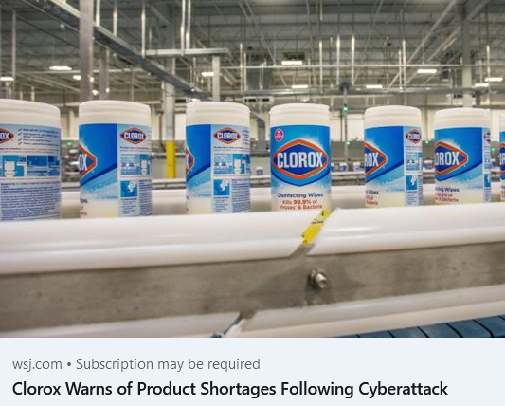

Cyber-Risk is Business Risk

Slide 8
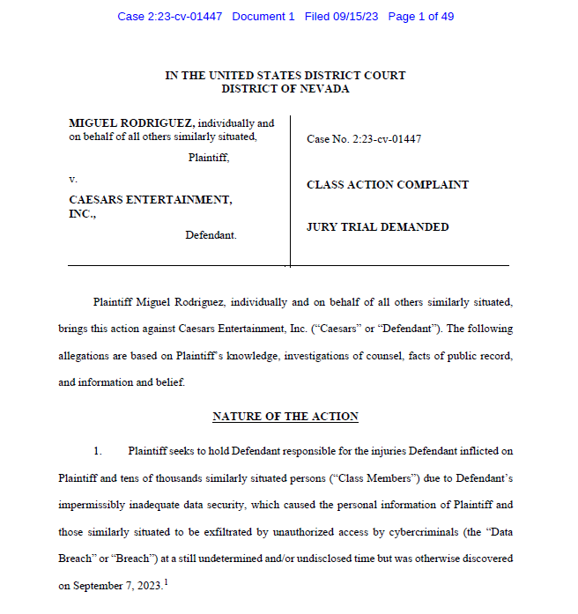
Caesars Lawsuit IS PROOF

Slide 9
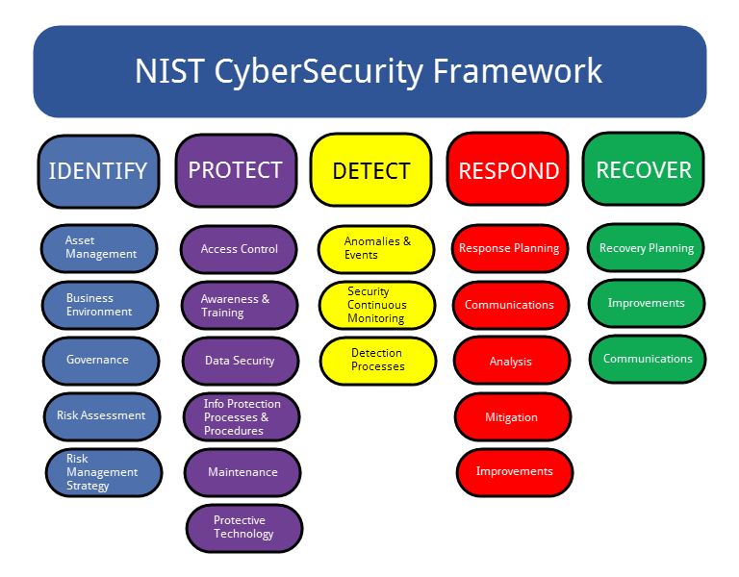
Cybersecurity Processes and Practices are Broad and Deep

Slide 10
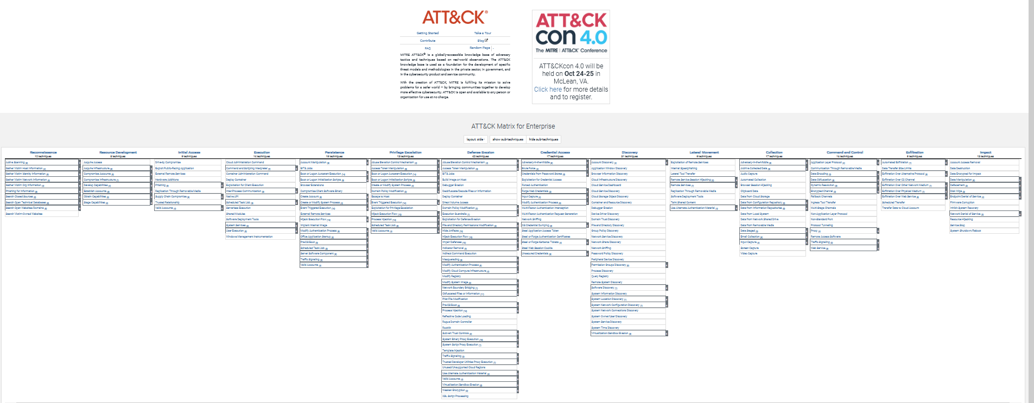
Provided by MITRE: https://attack.mitre.org/

Slide 11
C-SCRM is only one area to cover
Identification of cyber-risks associated with the software supply chain
Focusing on highest potential cyber-risks, CISA Known Exploited Vulnerabilities (CISA KEV)
Software Supply Chain is also broad
Software vulnerabilities and exploits
Software Supplier Risks
Provenance Concerns
Use of Open Source software includes works from potentially 1000’s of developers into a product
Vulnerability Disclosure Reporting (VDR) by Software Producers is invaluable, see ISO/IEC 29147:2018 and NIST Guidance

Slide 12
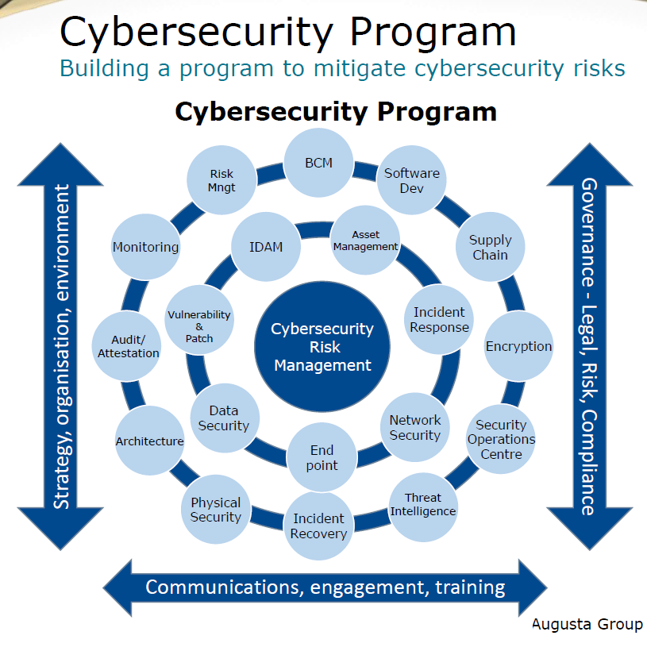
Copied with permission from

Slide 13
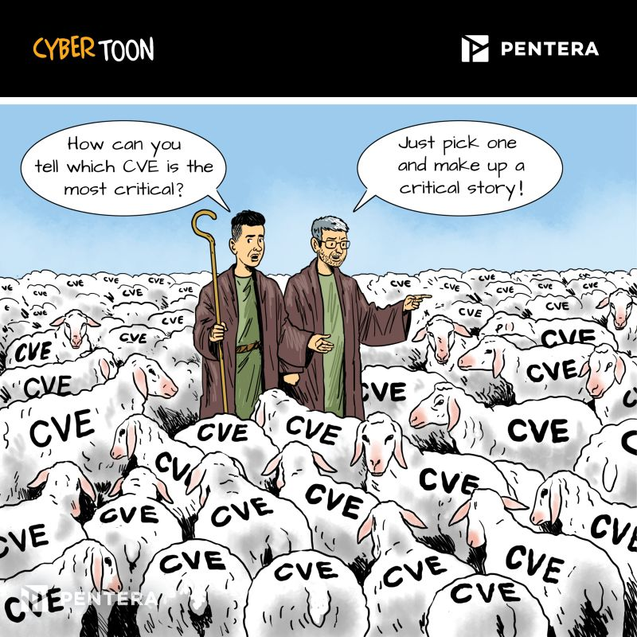
Know your priorities (CISA KEV’s)

Slide 14
Software Supply Chain Risk Detection Process Following NIST Guidance and SEC Regulations
Perform introspection and process SBOM data
Verify Download Server Source Location/Certificate
Perform Virus Scan
Verify Digital Signature of software object
Perform CISA KEV detection and Vulnerability (CVE) Search using NIST NVD and Vendor supplied Attestation data (SBOM VDR)
Perform Vendor Verification using Attestation data
Perform Provenance Check
Generate SAGScore™ (Trustworthiness Score)
Generate Risk Assessment and Detection Evidence Data
Save evidence in a tamper-proof form
IF a cyber risk is detected:
Notify management immediately
Discuss materiality and decide if a Form 8-K is required, under the protection of Client-Attorney privilege
File a Form 8-K if required, within four business days of determining materiality of the cyber-risk/incident

Slide 15

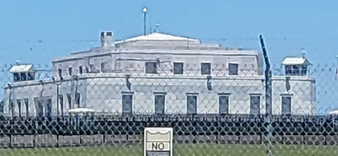
Preservation of Tamper-Proof Evidence
Software Consumer performs a NIST C-SCRM compliant SAG-PM Risk Assessment using supplied materials producing evidence data
Evidence data produced by SAG-PM is submitted to SAG-CTR to be stored in tamper-proof format
Software Vendor provides SBOM and other Supply Chain Artifacts (VRF) to consumer
Tamperproof
Evidence Data is
Produced
SAG-CTR Evidence Locker
SAG-CTR ™
Tamperproof evidence stored in an evidence locker is presented in court when needed

Slide 16
SEC Process Documentation Materials
Needs to cover “broad swath” of cyber-risk detection and risk management processes
"Software vulnerabilities are not some mundane part of the tech ecosystem. Hackers often rely on these flaws to compromise their targets.“
Show alignment with best practices, such as the NIST Cybersecurity Framework
Need to address both PROACTIVE and REACTIVE cyber-risk detection processes and practices
REA provides process documentation mapping the SAG™ process and methods to the NIST CSF for inclusion in SEC process documentation disclosures

Slide 17
Implementation Timeline C-SCRM ONLY
Minimum Implementation (Typical Case: 40 Hours with Customer Commitment)
Initial planning and preparation (includes platform and SAG-PM database setup)
Update process documentation, with assistance from Legal
Install and Setup SAG-PM™ and SAG-CTR™ Evidence Locker
Setup one Software Product for Risk Assessment, without help from software vendor
Conduct software risk assessment and preserve tamper-proof evidence
Integrate results of risk assessment with “Change Management System”
Generate Form 10-K with cybersecurity process disclosure
Examine Risk Assessment evidence data and determine if a Form 8-K incident report is required

Slide 18
Recommendations
Implement PROACTIVE, Left of Bang” software supply chain risk assessment and detection processes using SBOM’s
Perform a software supply chain risk assessment and detection process following best practices provided by NIST (SP 800-161)
Preserve tamper-proof evidence using a proper chain of custody protocol and process showing that these proactive and preventative risk assessment and detection controls are functioning properly and preserve this tamper-proof evidence in a secure evidence locker
Work with software suppliers to provide a Vendor Response Form (VRF) identifying product SBOM’s and an online living NIST SBOM Vulnerability Disclosure Report (VDR) for each software product and version they provide
Produce process disclosure documentation for software supply chain detection controls (CISA KEV) for SEC cybersecurity disclosure on Form 10-K and preserve tamp-proof evidence to aid with the defense of Officers and Directors, in the event of any shareholder lawsuits
Watch Joe Sullivan 9/26/23 interview, UBER convicted CISO following cyber-incident – VERY INSIGHTFUL
Never trust software, always verify and report! ™

Slide 19
SEC Enforcement Advice
To the extent that you are going through the work of really trying to analyze the potential impact of cybersecurity risk for breaches or incidents, and working hard to really think in advance of where those might occur to try to lower the likelihood of them happening, and the impact that they would have if they do occur, and you are disclosing that to your investors, those are all the sorts of things that we are encouraging.”
David Hirsch, Chief, Crypto Asset and Cyber Unit in the Division of Enforcement at U.S. Securities and Exchange Commission, at the 2022 FAIR Conference

Slide 20

Don’t count on the mercy of hackers in December 2023

Slide 21

Don’t be this guy – Avoid the Icebergs
Source: https://www.youtube.com/watch?v=CKAZAh5icPQ

Slide 22

Learn and Participate
https://www.eventbrite.com/e/critical-manufacturing-sector-classified-briefing-ttx-road-show-tickets-687413069997?aff=oddtdtcreator
Critical Manufacturing Sector Coordinating Council (CMSCC) Website is available here:
https://www.cisa.gov/topics/critical-infrastructure-security-and-resilience/critical-infrastructure-sectors/critical-manufacturing-sector

Slide 23

Thanks for your time
Dick Brooks
dick@reliableenergyanalytics.com
https://reliableenergyanalytics.com/

