Slide 1
CISA Secure By Design goals and objectives
Dick Brooks, Lead Software Engineer SAG-PM and SAG-CTR
dick@businesscyberguardian.com

Slide 2
Introduction
Dick is one of the co-authors of CISA’s Secure Software Acquisition Guide and a leading technical advisor on Software Supply Chain Risk Management practices across Critical Infrastructure
He serves on two Critical Infrastructure Sector Risk Management Agencies (SRMA) Critical Manufacturing Sector and the Healthcare Sector
He is a Co-Founder and lead software engineer for Business Cyber Guardian and the Software Assurance Guardian product line (SAG-PM and SAG-CTR)

Slide 3
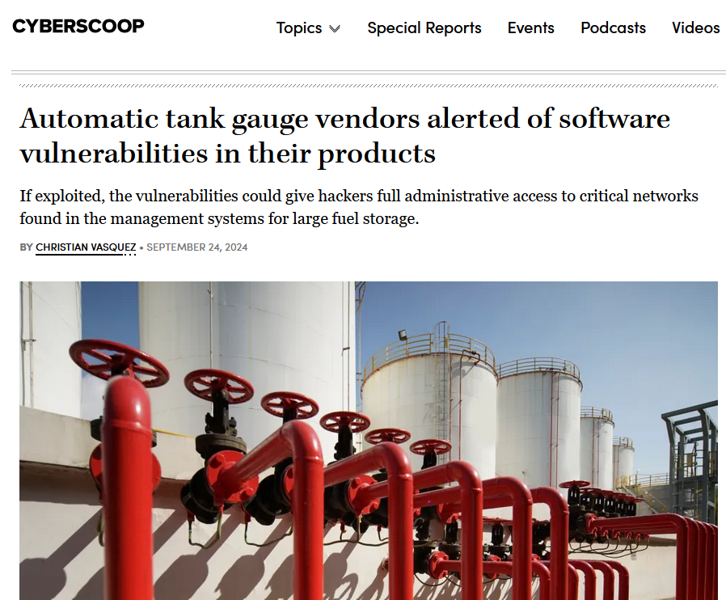

You don’t have to look far for risks in software
Many well-known attacks have exploited vulnerabilities and weaknesses in software and within software supply chains; an issue that spans both proprietary and open-source software which impacts both private sector and government enterprises.

Slide 4
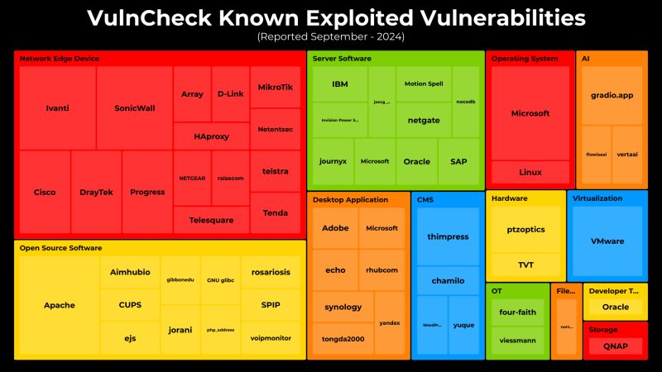
Known Exploited Vulnerabilities Heat Map

Slide 5
What it Means to Be Secure by Design
Products designed with Secure by Design principles prioritize the security of customers as a core business requirement, rather than merely treating it as a technical feature
Companies should implement Secure by Design principles to significantly decrease the number of exploitable flaws before introducing them to the market for widespread use or consumption.
Out-of-the-box, products should be secure with additional security features such as multi-factor authentication (MFA), logging, and single sign-on (SSO) available at no extra cost.

Slide 6
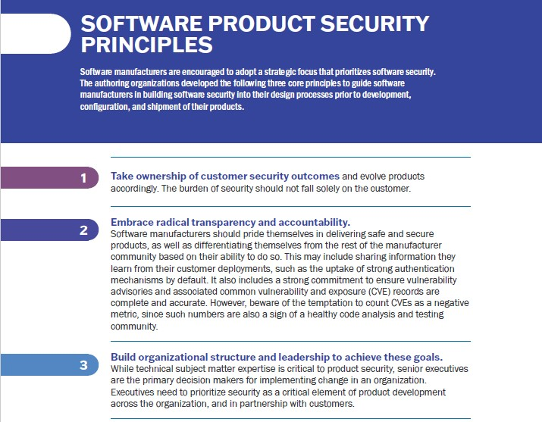
Goals – The What
Transparency of software manufacturing processes
Accountability for customer safety
Organization Commitment and Support

Slide 7
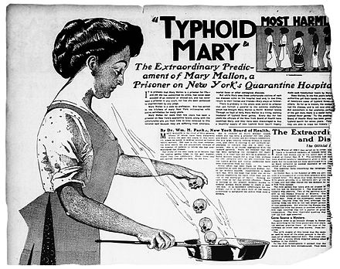
Similar to restaurant trust scoring principles
Provide consumers with visibility into trustworthiness before buying
Incentivize good practices to produce secure products
Risk always exists, but trust must be earned
Risk ALWAYS exists, but trust DOESN’T ALWAYS exist
Each year, about 1 in 6 Americans (or 48 million people) get sick, 128,000 are hospitalized, and 3,000 die of foodborne diseases
Correlates well with other industry practices for transparency and trust
New York City Restaurant Trust Scores indicating adherence to good practices provides consumers with advance warning of risky restaurants versus trustworthy establishments
“Almost everywhere she worked, there were outbreaks of typhoid.”

Slide 8
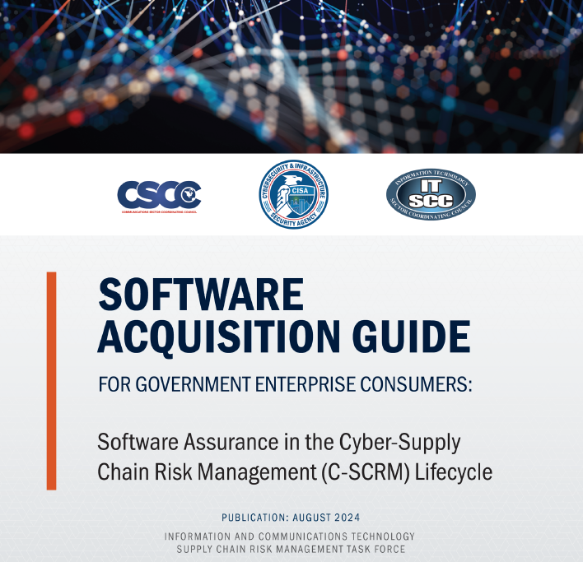
The How – Secure Software Acquisition

Slide 9
Consumers CAN determine trustworthiness
Risk always exists, but trust must be earned and awarded
How to verify software vendors and products are “Secure by Design”
Download CISA’s Software Assurance Guide Spreadsheet
Send the spreadsheet to vendors asking to answer the 19 Governance questions
Evaluate the responses to determine which vendors are following Secure by Design practices (specified in the Guide and Spreadsheet)
Determine which vendors and products are trustworthy, and which are not; award trust wisely – you own the risks and impacts that come with cyber attacks
Never trust software, always verify and report!™
Look both ways before buying and installing software products
Ask your vendors the “challenging questions” following this Schneider Electric advice: https://www.youtube.com/watch?v=mcqIDuLTvww&t=1008s
Consider attending CISA’s planned webinars for the Secure by Design Software Acquisition Guide, which you can register for here: https://cisa.webex.com/webappng/sites/cisa/webinar/webinarSeries/register/00c8832420aa4ef6946223d02da2bf21

Slide 10
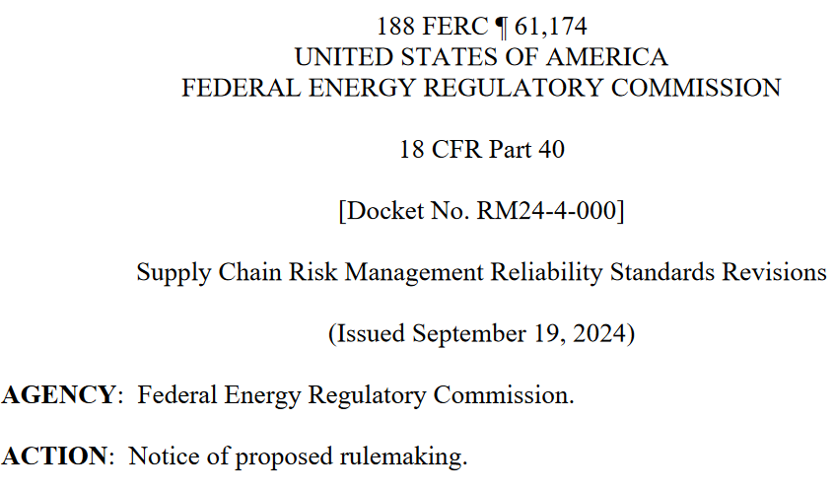
Regulations are here and more are coming
SEC: 17 CFR 229.106
FERC: Docket RM24-4-000
Comments have been filed by BCG to Docket RM24-4-000

Slide 11
Resources
https://www.cisa.gov/resources-tools/resources/software-acquisition-guide-government-enterprise-consumers-software-assurance-cyber-supply-chain
https://www.cisa.gov/securebydesign
Schneider Electric Recommendations https://www.youtube.com/watch?v=mcqIDuLTvww&t=1008s
https://www.ecfr.gov/current/title-17/chapter-II/part-229/subpart-229.100/section-229.106
https://www.ferc.gov/media/e-1-rm24-4-000
https://home.nyc.gov/site/doh/business/food-operators/letter-grading-for-restaurants.page
https://portal.ct.gov/dph/food-protection-program/be-food-safe-protect-yourself-from-food-poisoning
https://www.cisa.gov/securebydesign/pledge/secure-design-pledge-signers
Business Cyber Guardian website: https://businesscyberguardian.com/

