Slide 1
Business Activity Monitoring at ISONE
March 15, 2006

Slide 2
Topics Covered
Brief Introduction to ISO New England
Two Degrees of Separation System Design
Complex Event Processing Use Case and Pilot Project
Benefits
Lessons Learned
Presentation Title
© 2005 ISO New England Inc.

Slide 3
ISO NE Introduction
A regional transmission company (RTO) responsible for New England’s high voltage electricity grid
Main Functions:
    Minute-to-minute reliable operation of New England's bulk electric power system across the region's interstate high-voltage transmission lines
    Oversight and administration of New England's wholesale electricity marketplace
    Planning processes that address New England's future electricity needs
The ISO’s responsibility in overseeing the region’s wholesale electricity marketplace is to ensure that the markets are fair, transparent, efficient, and competitive.
Presentation Title
© 2005 ISO New England Inc.

Slide 4
Two Degrees of Separation Logging and Monitoring System Goals/Objectives
Create a Logging/Monitoring infrastructure with visibility into distributed, orchestrated business processes
Enable business users to view “real-time state of a business process”
Establish a foundation for “fact-based” information gathering and analysis
Provide correlation of Logged Events to provide administrations with greater “insight”
Create a standard log message format and content/semantics for use by all applications (Common Base Event - CBE)
Presentation Title
© 2005 ISO New England Inc.

Slide 5
Application
System
Application
System
Application
System
Application
System
Application
System
Application
System
Central
Logging
Sink
Application
System
Application
System
Application
System
Application
System
Application
System
Application
System
Application
System
Presentation Title
© 2005 ISO New England Inc.

Slide 6
Complex Event Processing Pilot Project Goals/Objectives
Fill the “Monitoring/Automated Response gaps” in ISONE’s existing Logging and Monitoring System
Evaluate COTS software for policy management and complex event processing (AptSoft Director)
Assess “plug and play” capabilities of AptSoft CEP Director
Leverage Common Base Event standard and existing investment at ISONE
Promote the pilot to IRC/ITC (the Gordon Project), if successful
Verify the feasibility of CEP for Business Activity Monitoring at ISONE
Presentation Title
© 2005 ISO New England Inc.

Slide 7
EAI Infrastructure
2. Orchestration Server launches Person_Update Business Process that contains the following steps:
2.1)Log Start Process
2.2)Invoke e-Market Person_Update Service
2.3)Log Status of service
2.4)Invoke SQL Proc on EES
2.5)Log status of SQL Proc
2.6)Invoke SQL Proc on SSO
2.7)Log status of SQL Proc
2.8)Invoke SQL Proc on SMS
2.9)Log status of SQL Proc
2.10)Log Stop Process
1. CAMS/Rights Sends Person_Update Event in CIM format to Orchestration Server
BusinessWorks
Orchestration
Server
Metadata
Management
CIM
Map/Translate
CENTRAL
LOGGING SINK
Status
Info
Subscriber/
Service Provider
Service Provider
Subscriber
All Log Messages captured in Oracle Database by Central Logging Server.
Messaging Bus
2.1
2.3
2.5
2.7
2.9
2.10
2.4
2.6
2.8
CAMS (Ext)
Or
Rights (Int)
Publisher
E-Market
SOAP Service
EES
Adapter
SQL Proc
ClearTrust
SSO
Adapter
SQL Proc
SMS
Security Realm
Adapter
SQL Proc
2.2 E-Market Person_Update SOAP service translates CIM message into local data model then interfaces with application. Logging Sensors publish CBE status messages (start/stop, success, fail)
Presentation Title
© 2005 ISO New England Inc.

Slide 8


Central Logging Sink Architecture
Adapter
Adapter
Adapter
Adapter
JMS Messaging Bus
CBE
CBE
CBE
CBE
CBE
Persistent
Event Storage
Listener
Real-time
CEP Monitor
Listener
ADMIN
Web Server
Interface
CBE
CBE
CEP
Monitor
Oracle
Monitoring
Policies
Presentation Title
© 2005 ISO New England Inc.

Slide 9
Example CBE
<?xml version="1.0" encoding="UTF-8"?>
<CommonBaseEvents >
<CommonBaseEvent
version="1.0.1"
globalInstanceId=“TibcoA_Hourly_Rollup_Service_1105002105a1c01028-7fff"
localInstanceId=“ORCH-ALL-Settlement_Services-Hourly_Rollup_Service-158000"
creationTime="2005-08-10T18:56:49.879Z"
severity="20"
msg="SUCCESS: Hourly Rollup Complete"
priority="10">
<contextDataElements
name=“TRANSACTION_ID" type=“DISPLAY:1">
<contextValue>12345</contextValue>
</contextDataElements>
<contextDataElements
name=“HOUR_NUMBER" type=“DISPLAY:2">
<contextValue>11</contextValue>
</contextDataElements>
<sourceComponentId
application=“Settlement_Services”
component=“Hourly_Rollup_Service"
subComponent=“Calculate_Average_LMP.fil_Starter_PD.process"
componentIdType="BWProcess"
executionEnvironment=“EAIPROD"
location=“TibcoA"
locationType="FQHostname"
processId="158000"
componentType=“Java_Activity"/>
<situation categoryName="ReportSituation">
<ReportSituation reasoningScope="EXTERNAL" reportCategory="STATUS"/>
</situation>
</CommonBaseEvent>
</CommonBaseEvents>
Presentation Title
© 2005 ISO New England Inc.

Slide 10
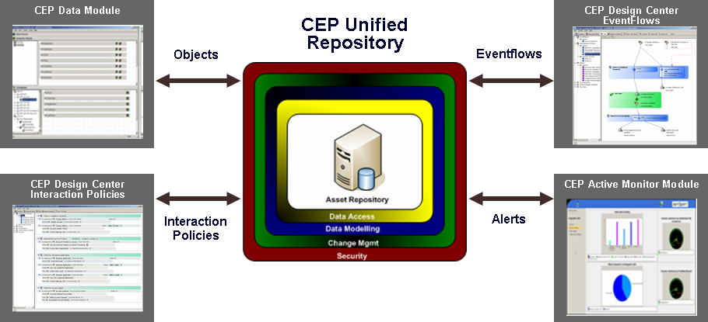

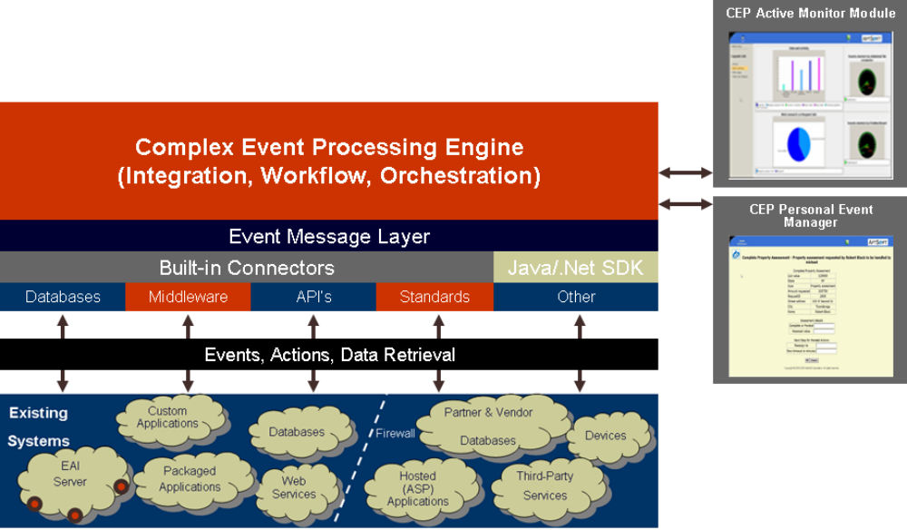
Development
Environment
JMS Messaging Bus
Execution
Environment
CBE
CBE
Real-time CEP Monitor Listener
CBE
CBE
CBE
CBE
Presentation Title
© 2005 ISO New England Inc.

Slide 11
Use Case
Extend Day Ahead Bidding Deadline
There are cases when ISONE must extend the day ahead bidding deadline in order to clear the day ahead market
This decision is based on multiple events and/or non-events
When things go “wrong” special processes and procedures must be executed to mitigate/resolve the situation
Presentation Title
© 2005 ISO New England Inc.

Slide 12
Monitoring Policy for DAM Closure/Extension
Nominal Pattern of events supporting Market Closure at 12:00 noon
Starting at 16:00 on day before closure:
  Bid/Offer activity within normal range (per 15 minute interval)
  Healthchecks reporting no anomalous conditions
  External Transactions activity within normal range
  Customer Service Activity within normal range
Simulation covers period from 11:45-12:00
Presentation Title
© 2005 ISO New England Inc.

Slide 13
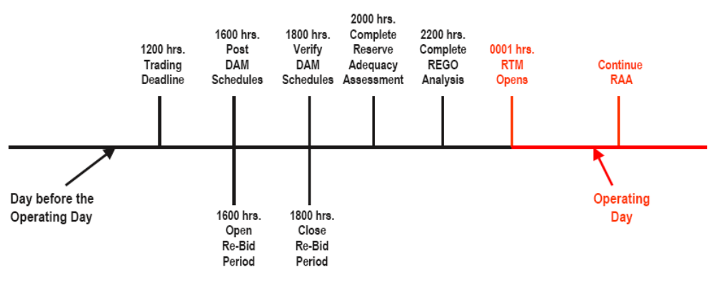
Day Ahead (DA) Market Timeline
Murphy was alive and well on January 18, 2006
At 11:42:18 AM!
Forcing ISONE to extend the trading deadline in DAM
11:40
11:45
11:50
11:55
12:00
All Systems reporting normal conditions
All Systems reporting normal conditions
No Bid/Offer activity
No XTRANS activity
Heartbeats Normal
Customer Trouble Tickets Issued on Bid/Offer System
No Bid/Offer activity
No XTRANS activity
Heartbeats Normal
No Customer Service Activity
No Bid/Offer activity
No XTRANS activity
Heartbeats Normal
Customer Trouble Tickets Issued on Bid/Offer System
Presentation Title
© 2005 ISO New England Inc.

Slide 14
Use Case Demonstration
(Live Demonstration Available Upon Request)
Presentation Title
© 2005 ISO New England Inc.

Slide 15
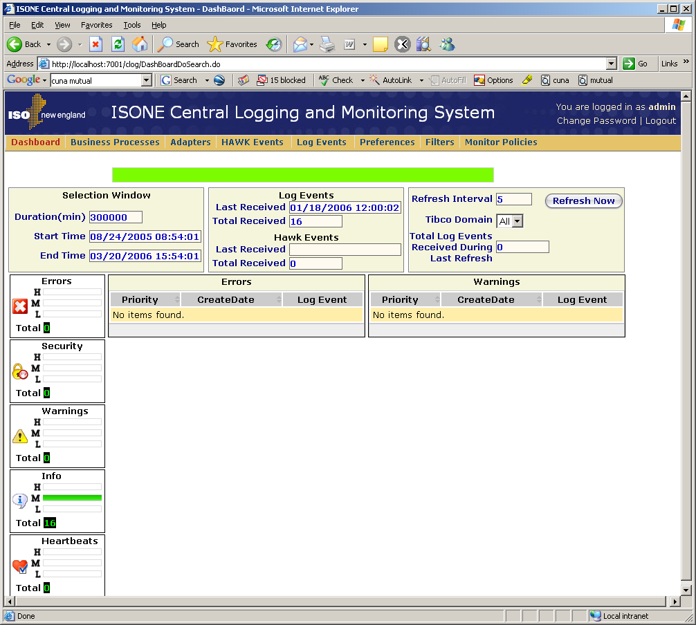
Central Logging Dashboard
No anomalies reported on any event during timeframe.
Presentation Title
© 2005 ISO New England Inc.

Slide 16
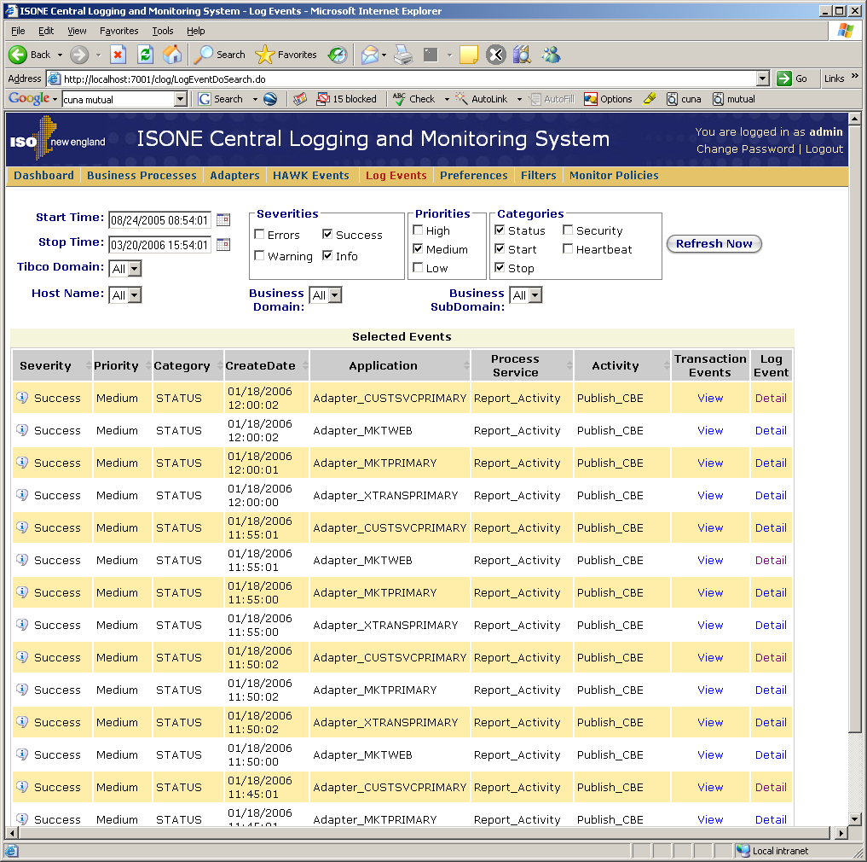
Central Logging Log Events
No anomalies reported on any event during timeframe.
Presentation Title
© 2005 ISO New England Inc.

Slide 17
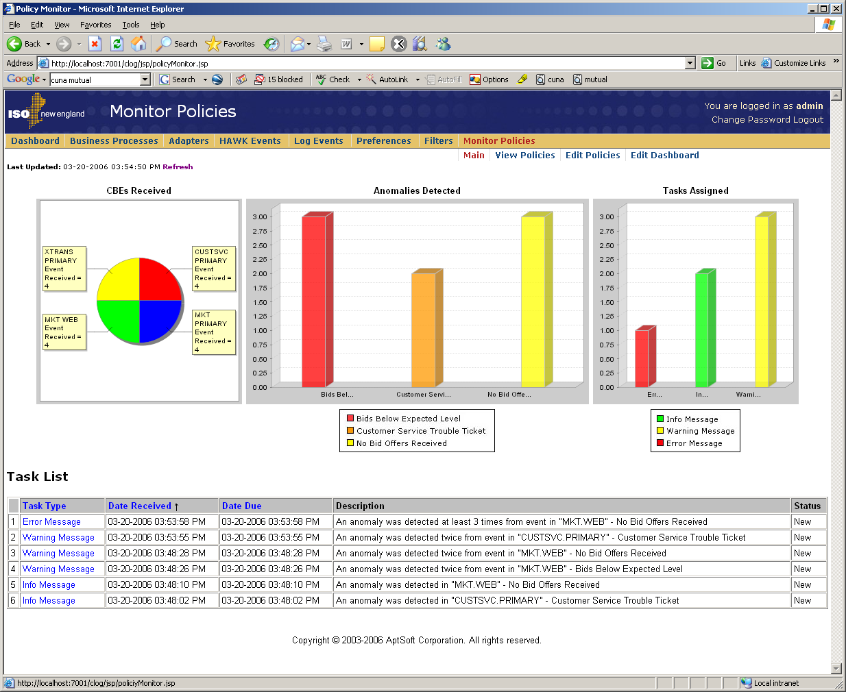
Central Logging Monitor Policies (AptSoft)
AptSoft Identifies anomalies based on Complex Event Processing analysis of the SAME
Events during SAME timeframe.
Presentation Title
© 2005 ISO New England Inc.

Slide 18
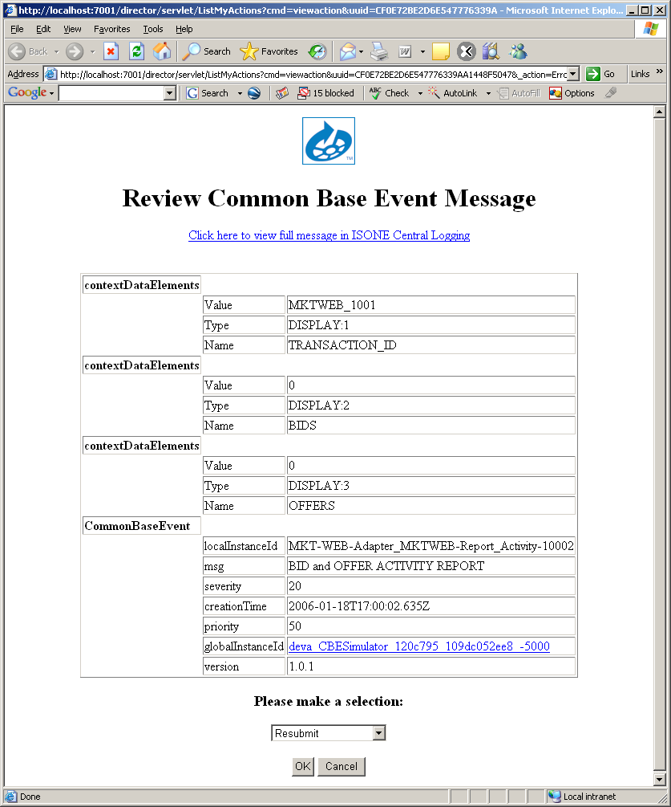
Central Logging Monitor Tasks (AptSoft)
When AptSoft detects an anomalous pattern, a follow-up task is opened and assigned along with email notification.
Presentation Title
© 2005 ISO New England Inc.

Slide 19
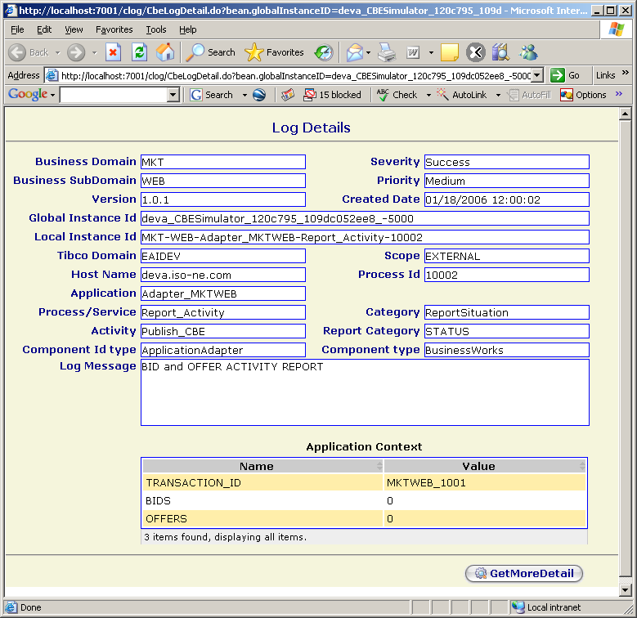
Central Logging Monitor Tasks (AptSoft)
A link to the initiating Event is included to speed investigation and resolution. Other information can be included as well.
Presentation Title
© 2005 ISO New England Inc.

Slide 20
Benefits
Consistent status reporting from across application domains
Broad oversight of multi-step integration processes
Ability to respond pro-actively to situations
Central Logging and Monitoring improves SAS 70 auditability
Ability to correlate events from across all enterprise applications and activities
CEP engine enables ISONE to monitor very complex situations and enforce strict rules/guidelines with greater efficiency than existing solution
Extremely flexible, dynamic, codeless design environment
Reusability of objects
Dynamic data retrieval (using CBE) as necessary
Contextual (timing/sequence) evaluation functions built-in
Presentation Title
© 2005 ISO New England Inc.

Slide 21
Lessons Learned
Don’t need to use ALL of the CBE to reap benefits
Some tools cannot support XML schema abstract types (e.g. CBE situationType element)
A common information model is an absolute requirement for cross enterprise logging and monitoring
Logging and Monitoring can leverage the security, reliability and publish/subscribe capabilities of JMS
Presentation Title
© 2005 ISO New England Inc.

Slide 22
Summary
If the California ISO had a CEP enabled Central Logging and Monitoring infrastructure in 2001 like the ISONE system would they have been able to:
  “Get Shorty” before Shorty got them
  Deflate “Fat Boy”
  Silence “Death Star”
  STOP the plundering of $30 Billion from the electricity market
ISONE sees significant business benefit in a Common Logging Infrastructure using the CBE standard
The Pilot Project has proven that AptSoft’s CEP monitoring engine delivered the desired results and met the pilot project goals/objectives
Presentation Title
© 2005 ISO New England Inc.

Slide 23
For More Information or a Demonstration:
Dick Brooks
ISO New England
413-540-4527
rbrooks@iso-ne.com
David Cameron
AptSoft
781.270.4900 x102
david.cameron@aptsoft.com
Presentation Title
© 2005 ISO New England Inc.

