Slide 1
CISA SCRM BEST PRACTICES SAG-CTR™ Trust Registry
Dick Brooks
April 8, 2025

Slide 2
Agenda
CISA Software Acquisition Guide SCRM Best Practices
What is a Trust Registry (IETF SCITT CONCEPT)
What is a Trust Score
How Does SAG-CTR™ work
Demonstration Dashboard and Risk Assessment Sharing
Summary Benefits

Slide 3
CISA Software Acquisition Guide SCRM Best Practices
Guiding Principles; Secure by Design/Default/Demand
Developed by CISA ICT_SCRM Task Force Members
NASA leading implementation using attestations and artifacts
Attestations and Artifacts are used in risk assessment
“Tell us what you do Mr. Vendor and we’ll decide if it’s good enough for our needs”
All products MUST pass risk assessment per OMB/GSA/NASA; FAR changes coming
NIST Guidance provides the SCRM risk assessment practices to implement (embedded in CISA Software Acquisition Guide)
Provides a method to verify software product integrity and authenticity (CIP-010 requirement)

Slide 4
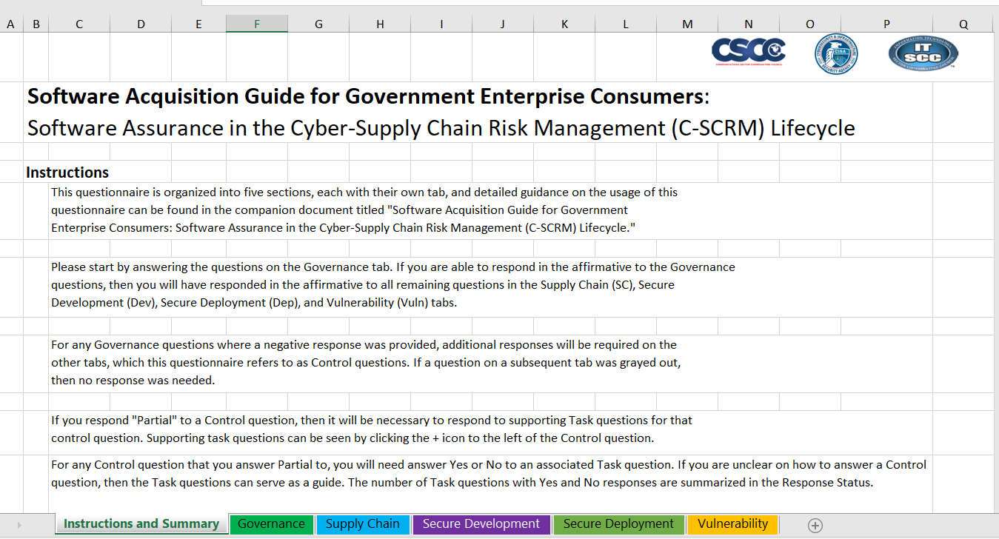
CISA SAG Spreadsheet Attestation artifact

Slide 5
Software Supply Chain Risk Detection Process Following NIST Guidance and CISA BEST PRACTICES
Perform product introspection and process SBOM data
Verify Download Server Source Location/Certificate
Perform Virus Scan
Verify Digital Signature of software object
Perform CISA KEV detection and Vulnerability (CVE) Search using NIST NVD and Vendor supplied Attestation data (SBOM VDR)
Perform Vendor Verification using Attestation data
Perform Provenance Check
Generate SAGScore™ (Trustworthiness Score)
Generate Risk Assessment and Detection Evidence Data and Final Report
Save evidence data in a tamper-proof form in SAG-CTR ™ and submit “Trust Declaration” (Statement) to “Trust Registry”, SAG-CTR™
4/6/2025

Slide 6
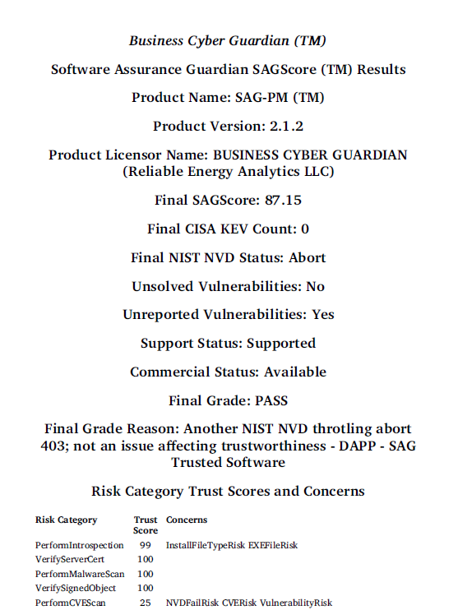
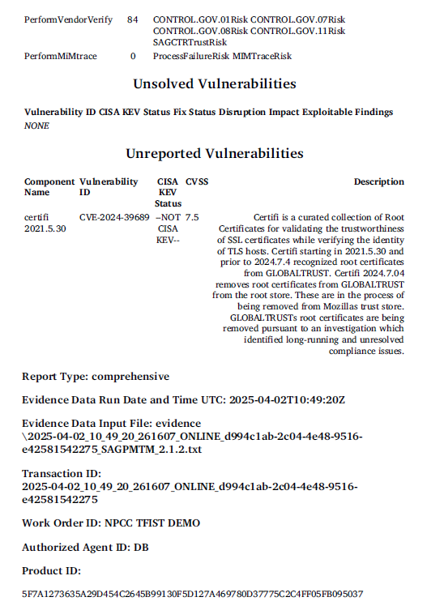
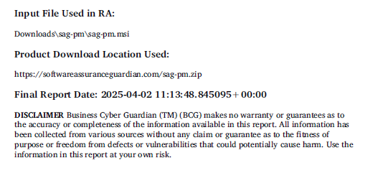
Risk Assessment Final Report

Slide 7
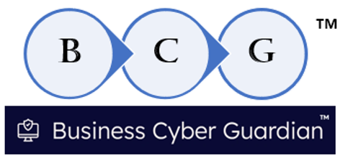
What is a Trust Registry (IETF SCITT CONCEPT)
Lists “Trusted Products” that have passed a SCRM risk assessment
Repository of verified trusted statements “Trust Declarations”
Produced by an authorized signatory (Issuer), see IETF SCITT architecture for details
Akin to a Registry of Deeds, people trust what’s in the Registry
A high Integrity registration policy process prevents unauthorized parties from placing Software Product “Trust Declarations” in the Trust Registry
Trust Registry “Registration Policies” are implemented and enforced by the Trust Registry “Gatekeeper” within the Transparency Service Provider
SAG-CTR™ is the Software Product Trust Registry operated by
Runs on the AWS cloud under SoftwareAssuranceGuardian.com

Slide 8
What is a “Trust Score”
Like a FICO score for software products and other digital objects
The higher the “Trust Score” (SAGScore™) the more trustworthy a product is
Statistically calculated using 62 risk factors across 7 risk categories
Consistent scoring algorithm applied to all products – common semantics
Uses a balanced weighted statistical algorithm
Can be dynamically adjusted based on changing conditions, i.e. new vulnerability is reported
Software risk/trust can change dynamically; like food, it can go bad overnight
Part of a CyberSecurity Label stored in SAG-CTR™

Slide 9
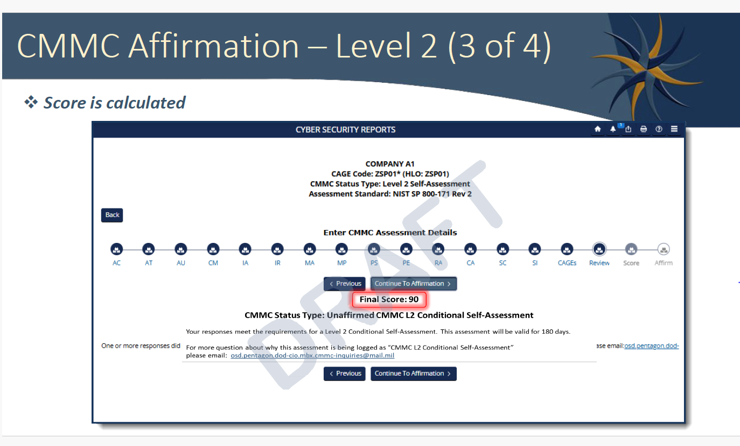
DOD Also uSing trust scores in cmmc
https://insidecybersecurity.com/sites/insidecybersecurity.com/files/documents/2025/mar/cs2025_0066a.pdf

Slide 10
How Does SAG-CTR™ Work (Sharing Risk Assessments)
A trusted, authorized party performs a comprehensive risk assessment (slide 5) on a digital product (i.e. API, Software app, etc.) producing tamper-proof evidence of the findings along with a "trust score" SAGScore (TM)
The trusted, authorized party submits a request to register a "Trust Declaration" for the trusted digital product by supplying their evidence data to the "Trust Registry Gatekeeper“ (i.e., Transparency Service Operator)
The "Trust Registry" Gatekeeper examines the submitted evidence and verifies that the party submitting the evidence is a trusted, authorized party.
If the Gatekeeper determines that the risk assessment evidence meets the strict criteria to be recorded in the "Trust Registry", based on a Registration Policy, a secure product registration process is invoked, which makes the product "Trust Declaration" accessible to the public in SAG-CTR™ as a Cybersecurity Label with a SAGScore™.
Anyone in the public can submit a query to the SAG-CTR™ "Trust Registry" to see the cybersecurity label for a product they are considering purchasing is listed in the "Trust Registry"; the consumer makes a buying decision based on the information returned from the "Trust Registry" lookup

Slide 11
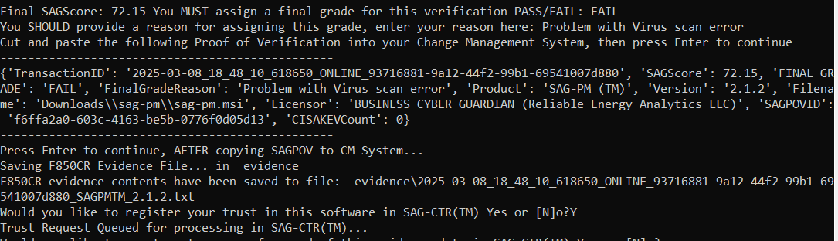
Submitting a “trust Declaration” to sag-ctr

Slide 12
Demonstration SAG-CTR Dashboard (Sharing Risk Assessments For Trusted Products)
https://softwareassuranceguardian.com/SAGCTR/

Slide 13
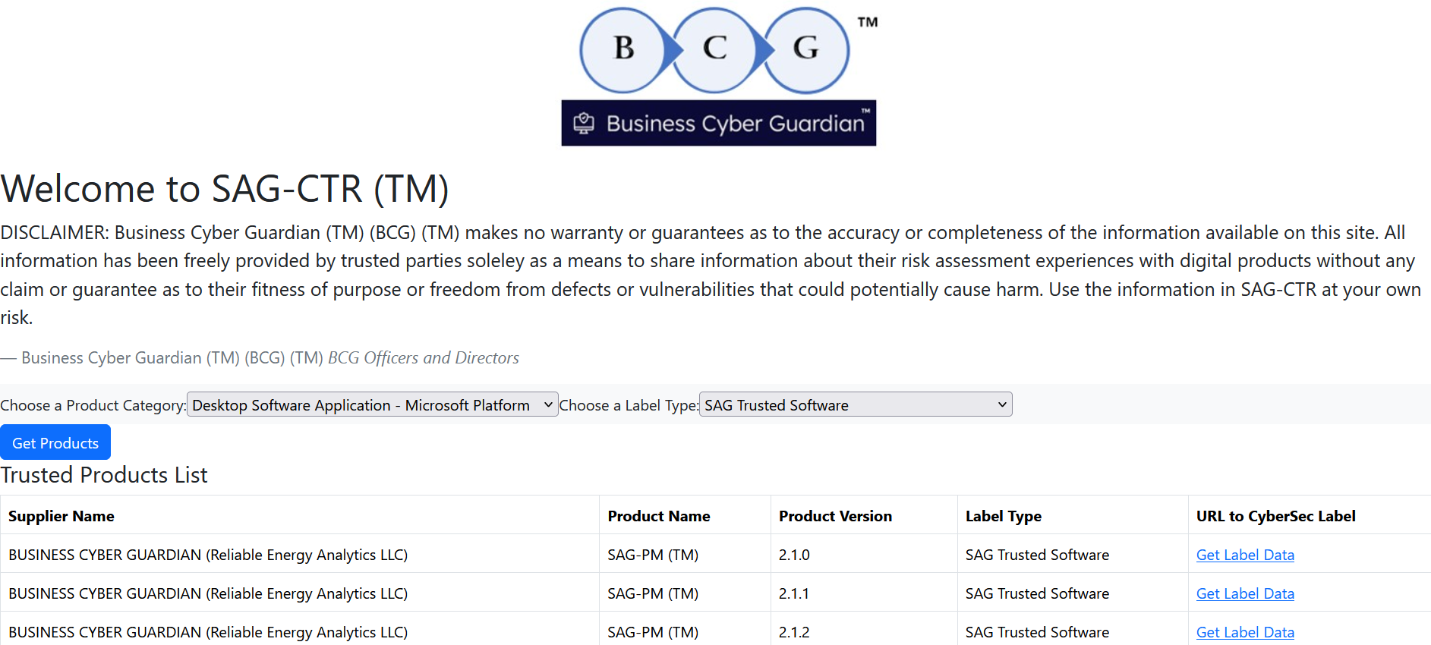

Slide 14
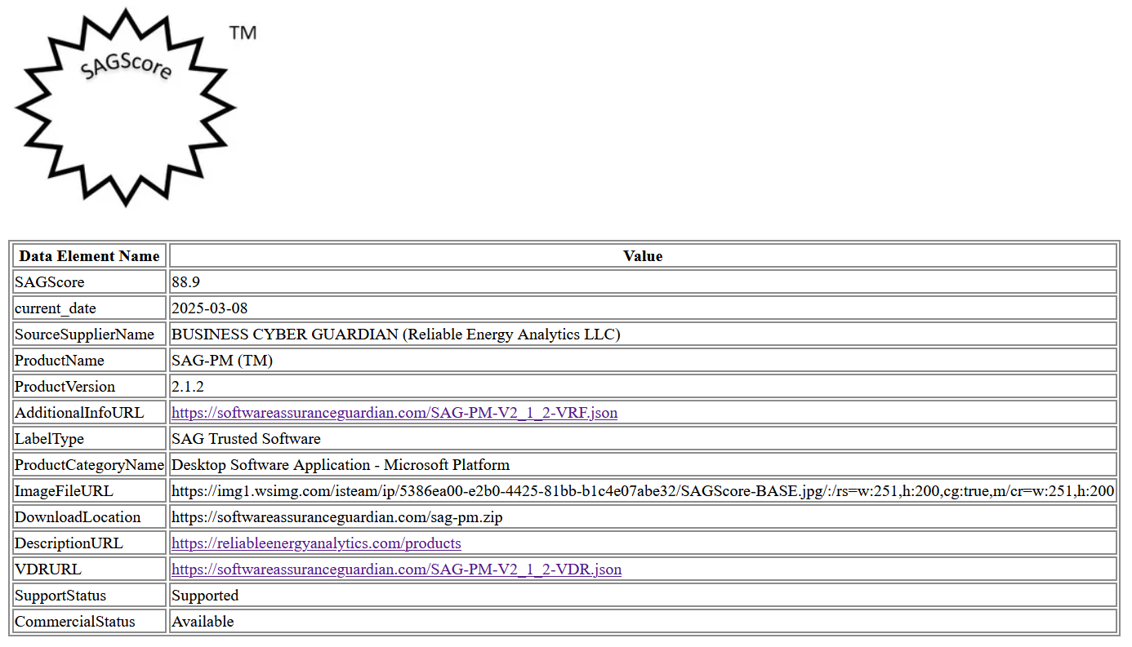
Cybersecurity Label Display in SAG-CTR

Slide 15
Summary
US Government Agencies are successfully using Vendor supplied attestation artifacts in SCRM risk assessment
Each agency applies its own risk appetite, risk tolerance and threshold during risk assessment
NERC ERO could offer industry “Trust Registry” Services to share trusted product information
The social benefits of a Trust Registry are significant;
the buying public doesn't have to invest hours performing a risk assessment before buying a product because a trusted party has already done the hard work and placed their evidence into the Trust Registry, where the product is registered as a "Trusted Product“
Prevents risky products from being installed
Some insurance carriers providing cyber insurance policies may require covered entities to only use "Trusted Products" in order to retain cyber-insurance policy coverage.
Government agencies may require attestations for "trusted products" that may be listed in a "Trust Registry" as part of procurement requirements, after passing a SCRM risk assessment per OMB M-22-18
Government regulators may want to see proof in public disclosures that a party is using a "Trust Registry" in their cyber-risk detection and cybersecurity governance process disclosures (SEC 10-K)
Some entities have already announced plans to check for "trusted products", such as Apple; https://lnkd.in/esk-njnC and the US Coast Guard NPRM
Coast Guard Final Rule implementation Timeline
The list of digital products that may be registered in a "Trust Registry" is very long including everything from IoT devices to online Web API's to Cloud product offerings.

Slide 16
Dick Brooks
dick@businesscyberguardian.com
https://businesscyberguardian.com/

