Slide 1
Web site traffic throttling using Zero Trust Identities
Dick Brooks
dick@businesscyberguardian.com
Business Cyber Guardian®

Slide 2
Controlling Traffic Flow
Business Cyber Guardian ZTBouncer for REST API’s is a Zero Trust Gateway protecting HTTP REST API’s from unwanted traffic and control (throttle) traffic based on a Zero Trust Identifier (ztdnaid)
How does the ZTBouncer Gateway for REST Work:
Implements NIST Zero Trust Gateway Architecture (SP 800-207)
Runs as a process in front of the web server REST api’s
Performs a zero trust check on a declared identity (ztdnaid) supplied by the caller as a query string parameter
Block parties that have not registered for access to the REST API website
Throttles user activity by ztdnaid using a maximum call rate factor, i.e. 5 calls in 5 minutes, adjustable in ZTBouncer properties file
Logging of all access requests, both trusted and untrusted attempts, suitable for SIEM input
Can disable access for a specific ztdnaid within seconds when trusted parties change

Slide 3
Example DDR data
ZTENTID DDR (Informational Posting Users) data examples, contains three concatenated string components separated by a delimiter:
Owner Name (i.e. Pipeline Legal Name operating Information Posting Website)
Subject Name identifier
Unique identifier assigned to subject name (easy to remember PIN CODE)
Example DDR data using / delimiter:
Snowboard Pipeline/BCG:Dick Brooks/570126254378
ZTRESID (Informational Posting Website) data
Zero Trust Domain Identifier(i.e. FQDN of website hosting Information Posting data)
Resource Name identifier
Unique identifier assigned to Resource (easy to remember PIN CODE)
Example DDR data (note different delimiter ; due to URL):
Snowboardpipeline.com;SnowBoard Pipleline Informational Posting Website; https://ipw.snowboardpipeline.com/

Slide 4
ZTBOND DDR DATA
ZTBOND Authorizing an Entity ZTENTID to Access a Resource ZTRESID
Zero Trust Domain Identifier(MUST MATCH properties file "ZeroTrustDomain":
Entity ZTENTID
Resource ZTRESID
Example DDR data (using , delimiter ; MUST match delimiter in properties file):
SnowboardPipeline.com, 03DAABB80DFC7FB83E3826B7B306CBA85E80F6A5E6FFF6801D60BF1DC9B976F5, 9BB7722139562FA03129A4016C6FE08F336D38B6C1E5D8B63E3B9254513E2977

Slide 5
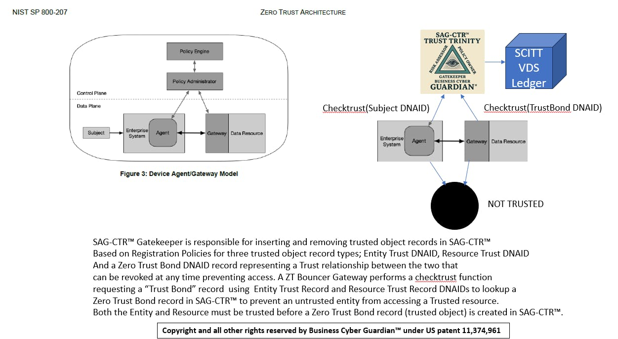
NIST Architecture – ZTBouncer Implementation
IPW
ZTBouncer

Slide 6
Required Roles
Registration Policy Owner – Snowboard Pipeline Company
Defines requirements for a ZT DNAID to be trusted and placed into SAG-CTR as a trusted object
ZTENTID – ZTDNAID for a named subject, i.e. remote user using DDR data
ZTRESID – ZTDNAID for a named Resource, i.e. Informational Posting Website using DDR data
ZTBOND – Authorizes a ZTENTID subject/entity to access a ZTRESID Resource, using DDR data
Authorized Risk Assessor – Individual authorized by Snowboard Pipeline to submit Trust Declarations to SAG-CTR
Submit risk assessment evidence data to register a ZTENDID, ZTRESID, ZTBOND
SAG-CTR Gatekeeper – Business Cyber Guardian
Enforces Snowboard Pipeline Registration Policy Owner policies by evaluating Risk Assessor evidence data against Registration Policies
Informational Posting Users
Must supply their assigned ztdnaid as a query string parameter to access the Informational Posting website
ZTBouncer verifies that supplied ztdnaid is authorized in a ZTBOND record to access Snowboard Pipeline Information Posting Website
Failed verification results in session closure
ZTBouncer enforces usage rate using “maximum calls per time window” using setting in ZTBouncer properties file
Subjects that exceed maximum call rate are rejected with a response to try later

Slide 7
ZTBouncer Properties Rate throttling
{
"ZTBouncerListenPort": 8080, - always assumes the hostname where ZTBouncer runs
"BackendBaseURL": "https://ipw.snowboardpipeline.com", - This is the informational posting website
"SAG_CTRLookupAPIURL": "https://softwareassuranceguardian.com/SAGCTR_inquiry/getZTLabel?ProductID=",
"ZeroTrustDomain": “<REDACTED>",
"HTTPResourceDNAID": “<REDACTED>",
"ZTBlogname": "ZTBouncerHTTP.log",
"CertVerify": true,
"delimiter": ",",
"ZTQueryParamName": "ztdnaid",
"TimeWindow": 1, - expressed in minutes
"MaxCallRate": 1 – maximum number of calls allowed within TimeWindow minutes
}

Slide 8
ZTDNAID Registration Process
A Party identified as an authorized Risk Assessor MUST be authorized by the Registration Policy Owner, Snowboard Pipeline
Risk Assessor must be a valid/verified registered ZTENTID in SAG-CTR to submit trust declarations on behalf of Registration Policy Owner
Performs a Risk assessment over a Digital DNA Record describing the Entity/Resource/Trust BOND
Identifies the Label Type Declaration ID assigned to the Registration Policy Owner (Snowboard Pipeline) in evidence data
Identifies type of Zero Trust entry ZTENTID, ZTRESID, ZTBOND
Each “IPW registered user” is assigned a ZTDNAID by Snowboard Pipeline that matches a registered ZTENTID record
Submit data to SAG-CTR Trust Queue using a digital chain of custody protocol
SAG-CTR Gatekeeper assess submitted evidence data (Trust Queue entries) against Registration Owner Policies
Accepted entries are placed into the SAG-CTR Trust Registry as a trusted object
Rejected entries are recorded as rejected and are not placed into SAG-CTR
Risk Assessors are informed of the result using the email address on file for the ztdnaid associated with the Assessor

Slide 9
ZTDNAID Verification Before allowing access to api
An Informational Posting User issues a REST API call containing their ztdnaid as a query string parameter to the ZTBouncer Gateway protecting the Informational Posting Website
The ZTBouncer Gateway checks for a ZTBOND record for the users ztdnaid and Information Posting Web Site ztdnaid to confirm that access is allowed
Three possible outcomes:
Zero Trust denied – there is no valid ZTBOND record for the user ztdnaid and Snowboard Pipeline Informational Posting website ztdnaid
Rate limiting warning if maximum call rate is exceeded
Snowboard Pipeline Informational Posting Website returns requested content to user

Slide 10
Reports
SAG-CTR Registered ZTDNAID’s for both Entities (web site users) and Resources (web site API’s)
SAG-CTR registered “Trust Bonds” that authorizes access to a Resource by a web site user using ztdnaids
ZTBouncer Log files

Slide 11
Demonstration ZTBouncer Gateway for REST
Example Implementation
ONLY TRUSTED
ZTDNAIDs ALLOWED
TO PASS
ZT User
Ztdnaid 1
MUST present ztdnaid
To Apache/ZTBouncer
ZTBouncer A 8080
REST API Resource A
Configured for url pass thru
Apache Webserver port 443
Encrypted
Traffic
ZT User
Ztdnaid 2
ZTBouncer B 8081
REST API Resource
B
ZTBouncer C 8082
REST API Resource
C
ZT User
Ztdnaid 3
Only one open Internet
TLS port and TLS Certificate
for all ZTBouncer Gateway
access
VERIFY ZTDNAID TRUST
SAG-CTR Trust Registry

Slide 12
Caveats
All website content MUST use relative URL’s in order to work with ZTBouncer Gateway products
ZTBouncer maintains a list of trusted ztdnaids in the event of a network failure accessing SAG-CTR; verification is performed against this list of trusted ztdnaids when SAG-CTR network failures occur
ZTBouncer processes should run behind a website product, like Apache httpd, where SSL/TLS certificates apply to all ZTBouncer Gateway processes and access
ZTBouncer Gateway is configured as an Apache pass through to the running ZTBouncer Gateway process running on its designated port, i.e. 8080 on the same host as the Apache httpd Server
Informational Posting Website SHOULD only allow connections from the ZTBouncer Gateway IP address, all others are denied to control usage
One hour to setup ZTBouncer Gateway in front of Informational Posting Website, PLUS
Customer setup (varies by customer)
ZTENTID, ZTRESID, ZTBOND DDR data risk assessment and registration into SAG-CTR (varies by customer)
Testing access, less than 30 seconds

