Slide 1
Guidance for Officers and Directors
SEC Cybersecurity Requirements Include disclosure reporting of Company Cybersecurity Processes and Material Cyber-incidents

Slide 2
Understanding the Risk
The newly adopted SEC cybersecurity rules are now codified into Federal Regulations
Require current reporting about material cybersecurity incidents within 4 business days on Form 8-K;
Require periodic disclosures regarding, among other things:
A registrant’s policies and procedures to identify and manage cybersecurity risks;
Management’s role in implementing cybersecurity policies and procedures;
Board of directors’ cybersecurity expertise, if any, and its oversight of cybersecurity risk; and
Updates about previously reported material cybersecurity incidents; and
The proposed amendments are designed to better inform investors about a registrant’s risk management, strategy, and governance and to provide timely notification of material cybersecurity incidents.

Slide 3
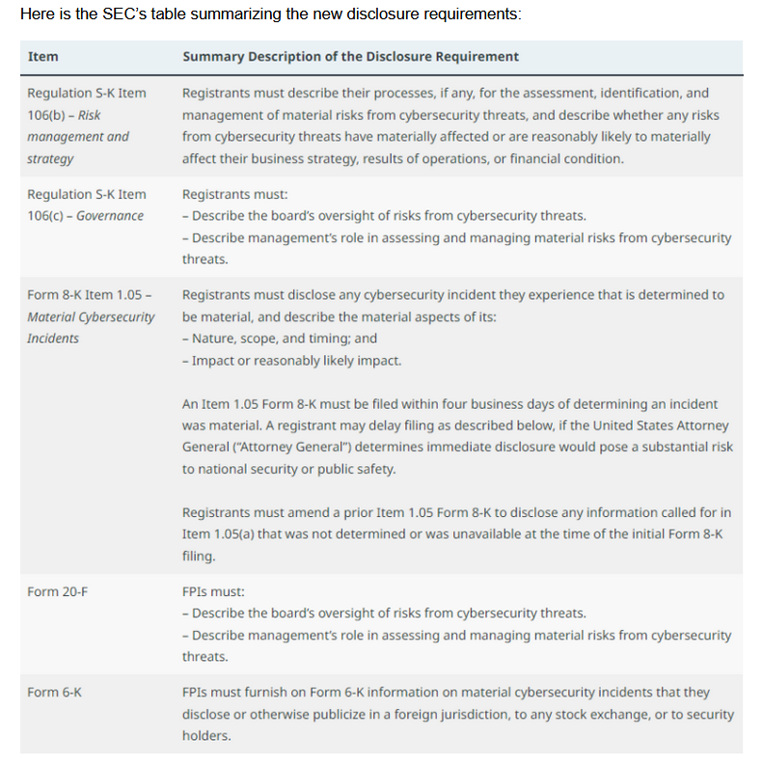
Source: https://corpgov.law.harvard.edu/2023/08/09/sec-adopts-final-rules-on-cybersecurity-disclosure/

Slide 4
SEC Expectations on Management are clear
Describe its policies and procedures, if any:
the identification and management of risks from cybersecurity threats, including whether the registrant considers cybersecurity as part of its business strategy, financial planning, and capital allocation; and
disclosure about the board’s oversight of cybersecurity risk and management’s role and expertise in assessing and managing cybersecurity risk and implementing the registrant’s cybersecurity policies, procedures, and strategies.

Slide 5
Management IS Responsible for Cybersecurity
A failure to properly manage and mitigate known cyber-risks (CISA Known Exploited Vulnerabilities (CISA KEV) could be evidence of negligence with regard to “duty of care” obligations to protect a business and a failure to satisfy good faith compliance expectations of the SEC
Directors and Officers could be held personally liable in a shareholder lawsuit resulting from a cyber-incident that results in shareholder losses
Directors and Officers need to provide proof that cybersecurity controls are documented and functioning properly, including supply chain cyber-risk detection
Documented processes (disclosures) and tamper-proof evidence of these controls will be vital in any shareholder lawsuits aiming to hold officers with fiduciary duties personally liable

Slide 6
Why Now
SEC Cybersecurity rules go into effect December 2023
SEC rules require visibility into material cyber-incidents with 96 hours exposing Officers and Directors to potential lawsuits from shareholders
SEC rules require Companies to disclose their processes for cybersecurity risk management, especially for known exploited software vulnerabilities that represent cyber-risk
SEC regulations make Officers and Directors responsible for cybersecurity processes oversight
Commercial product offerings are broadly available to proactively detect software risk and prevent harm against cyber-risks, such as CISA Known Exploited Vulnerabilities (CISA KEV)
Failure to perform proactive software supply chain risk management and cyber-risk detection controls may be considered negligent behavior with regard to duty of care fiduciary duties and fail to satisfy SEC good faith compliance expectations, opening the door to shareholder lawsuits
Software vulnerabilities are not some mundane part of the tech ecosystem. Hackers often rely on these flaws to compromise their targets.

Slide 7
How to protect yourself from Software Risks and liability
Implement PROACTIVE, Left of Bang” software supply chain risk management controls using SBOM’s
Perform a software supply chain risk assessment following best practices provided by NIST (SP 800-161) using SAG-PM ™
Preserve tamper-proof evidence showing that these proactive and preventative SAG-PM risk assessment controls are functioning properly and store this tamper-proof evidence in a secure evidence locker, such as SAG-CTR ™
Work with software suppliers to provide a Vendor Response Form (VRF) identifying product SBOM’s and an online living NIST SBOM Vulnerability Disclosure Report (VDR) for each software product and version they provide
Rely on REA to provide process disclosure documentation for software supply chain detection controls (KEV) and present SAG-CTR ™ tamper-proof evidence in court on behalf of the defense (Officers and Directors), in the event of any shareholder lawsuits
Never trust software, always verify and report! ™

Slide 8


How does this work
Software Consumer performs a NIST C-SCRM compliant SAG-PM Risk Assessment using supplied materials producing evidence data
Evidence data produced by SAG-PM is submitted to SAG-CTR to be stored in tamper-proof format
Software Vendor provides SBOM and other Supply Chain Artifacts (VRF) to consumer
Tamperproof
Evidence Data is
Produced
SAG-CTR Evidence Locker
SAG-CTR ™
Tamperproof evidence stored in an evidence locker is presented in court when needed

Slide 9

Don’t count on the mercy of hackers in December 2023

Slide 10
Next Steps
Contact REA to get started by implementing REA’s patented PROACTIVE ”Left of Bang” Software Supply Chain Risk Management (C-SCRM) Cybersecurity Controls (SAG-PM ™) to detect cyber-risks (CISA KEV, etc.) in the software supply chain and preserve the tamper-proof evidence in a secure evidence locker (SAG-CTR ™) that may be presented as evidence to help Officers and Directors defend against personal financial losses in the event of a cyber-incident that results in shareholder lawsuits claiming negligence in “duty of care” responsibilities or SEC fines
Don’t be caught unprepared when December 2023 rolls around; REA can get you ready within one week in many cases

