Slide 1
Software Supply Chain Risks and Mitigations for NERC CIP-010-3 R1, 1.6
August 12, 2020
Presented by: Energy Central

Slide 2
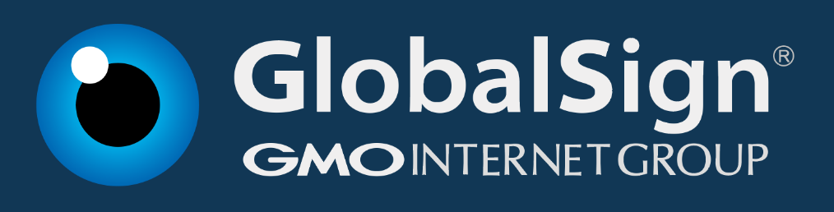
Thank you to our sponsor

Slide 3
Topics
Software Supply Chain Risks and Threats
Software Risks
Value at Risk
Risk Assessment Steps for NERC CIP-010-3 1.6
Constant improvement is REQUIRED
Summary

Slide 4
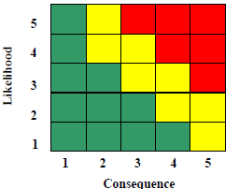
Definition of Risk
The Department of Defense (DOD) Office for the Undersecretary of Defense for Acquisition defines risk as Risk = Likelihood x Consequence of a “future root cause (yet to happen), which if eliminated or corrected, would prevent a potential consequence from occurring” (OSD/ATL-ED, 2006).
Red = High
Yellow = Medium
Green = Low
https://www.acq.osd.mil/damir/documents/DAES_2006_RISK_GUIDE.pdf

Slide 5
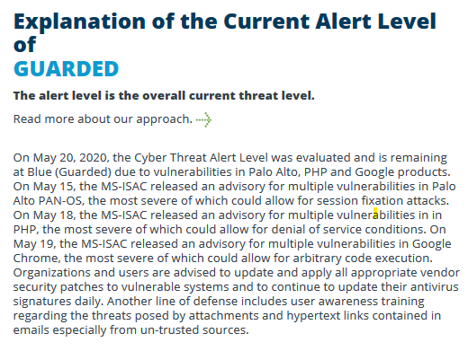
Definition of Threats
Real tactics, techniques and procedures (TTP) that are proven to successfully carry out a cyber attack, by parties at various skill levels with the intent, capability and opportunity to do so.
Some threats are known, some are not (i.e. 0-day exploits)
https://www.cisecurity.org/cybersecurity-threats/
Notes:
Rapid 7 definition: https://www.rapid7.com/research/report/2020Q1-threat-report/
What is a threat?
When there is an adversary with the intent, capability, and opportunity, a threat exists. When two or more of these elements are present (e.g., intent and capability, but no opportunity), we call it an impending threat, because there is just one missing piece before it becomes a true threat. When there is just one element present (e.g., an opportunity in the form of a software vulnerability), we call it a potential threat. There is the potential for it to turn into a true threat, although there are additional components that need to come to fruition before it has a real impact to most organizations.

Slide 6
Providing Context
ID.RA-5: Threats, vulnerabilities, likelihoods, and impacts are used to determine risk
NIST Cybersecurity Framework V1.1
https://doi.org/10.6028/NIST.CSWP.04162018
A threat actor carrying out a threat action by exploiting a vulnerability resulting in a Consequence that causes an impact in the production process.
Sinclair Koelemij
https://otcybersecurity.blog/2020/06/17/consequence-with-capital-c/
June 17, 2020
Key Concept:
The higher the risk, the lower the trust; Increased risks negatively impact trustworthiness

Slide 7
Software Supply Chain Risks
Risks that exist when acquiring a software object via an Internet Download
Spoofed download sites: http://downloads.Microsoft.con
Watering holes
Man in the middle attacks
Open Source binary distributions
Fakes
Equifax blamed its breach on a flaw in outside software it was using. It then blamed a malicious download link on its website to yet another vendor.
Software/Supplier Risks
Third Party software embedded in a Vendor offering
Embedded open source software within a vendor product
A software vendor may not be aware they have been hacked and are distributing tainted software to their customers:
ASUS March 29, 2019
Sophos Threat Report 2020
https://www.ncsc.gov.uk/collection/supply-chain-security

Slide 8
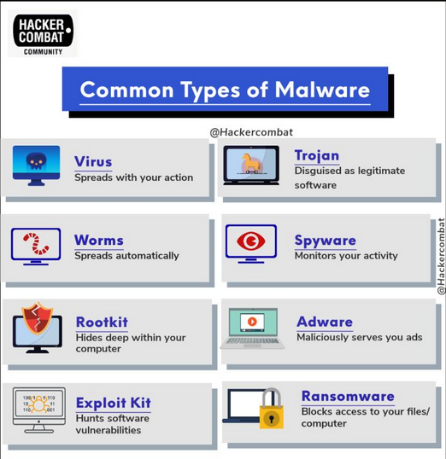

Slide 9
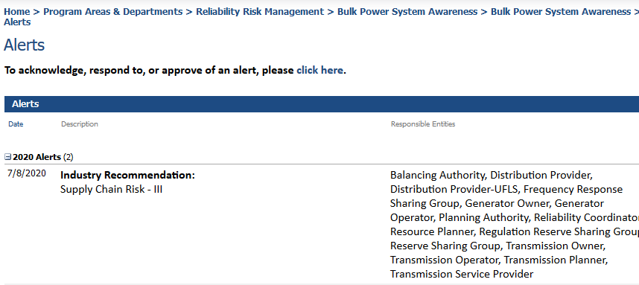
NERC Supply Chain Risk Alert

Slide 10
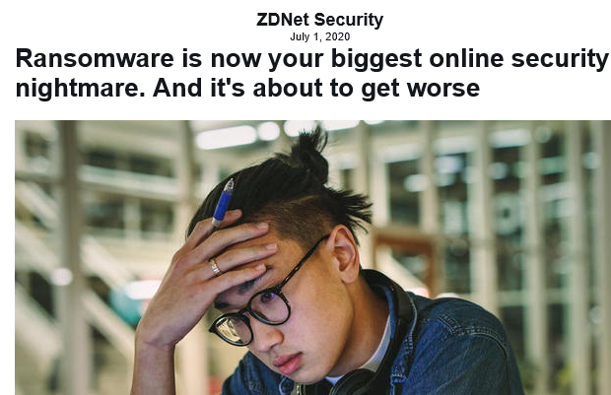
https://www.zdnet.com/article/ransomware-is-now-your-biggest-online-security-nightmare-and-its-about-to-get-worse/

Slide 11
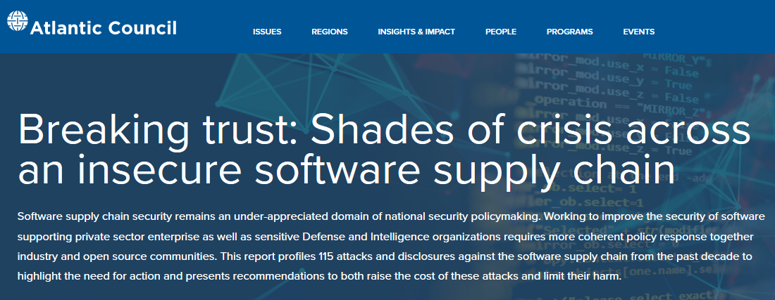
https://www.atlanticcouncil.org/programs/scowcroft-center-for-strategy-and-security/cyber-statecraft-initiative/breaking-trust/

Slide 12
Key Trends
Deep Impact from State Actors: There were at least 27 different state attacks against the software supply chain
Abusing Trust in Code Signing: These attacks undermine public key cryptography and certificates used to ensure the integrity of code
Hijacking Software Updates: 27% of these attacks targeted software updates to insert malicious code against sometimes millions of targets
Poisoning Open-Source Code: These incidents saw attackers either modify open-source code by gaining account access or post their own packages with names similar to common examples
Targeting App Stores: 22% of these attacks targeted app stores like the Google Play Store, Apple’s App Store, and other third-party app hubs to spread malware
https://www.atlanticcouncil.org/programs/scowcroft-center-for-strategy-and-security/cyber-statecraft-initiative/breaking-trust/

Slide 13
CIP-010-3 NERC Guidance
The concept of software verification (verifying the identity of the software source and the integrity of the software obtained from the software source) is a key control in preventing the introduction of malware or counterfeit software.
Processes or procedural controls that require users to obtain software directly from the developer or vendor’s preferred delivery methods.
A Responsible Entity may demonstrate compliance with CIP-010-3 R1, Part 1.6 by using processes for software updates that technically enforce that only digitally signed software is installed.
This guidance could lead to some really bad outcomes!
See Common Misconceptions later in the presentation to see why.
https://www.nerc.com/pa/comp/guidance/EROEndorsedImplementationGuidance/CIP-010-3%20R1.6%20Software%20Integrity%20and%20Authenticity.pdf
https://www.nerc.com/pa/Stand/Reliability%20Standards%20Complete%20Set/RSCompleteSet.pdf

Slide 14
FERC White Paper and NIST CSF
NIST Cybersecurity Framework V1.1, April 2018
FERC Cybersecurity White Paper 6/18/2020
NIST CSF, a framework to implement best practices
FERC WP, suggests that NIST CSF may be appropriate for “cybersecurity best practices” in the Bulk Electric System
The software risk assessment approach described in this webinar follows the NIST CSF Identify function (ID.RA, ID.RM and ID.SC) and Protect function PR.DS-6
The risk assessment approach described in this session may serve as an example of a cybersecurity control that could be eligible for additional incentive compensation (2%), if FERC proceeds with it’s proposal in the white paper

Slide 15
Evaluating Risk and Establishing Trust Triangulating Corroborating Evidence
Software SBOM/Digital Signature
TRUST
Vendor supplied data*
Ground Truth/Vulnerabilities
* Refer to EEI Supply Chain Procurement Model for details

Slide 16
Software Risks
Risks inherent in a software object, regardless of where it was acquired
Embedded malware (i.e. RATs, Ransomware, mining, worms, etc.)
Vulnerabilities and Exploits
Fakes
Backdoors
Third Party embedded objects (Open Source)
External Dependencies, i.e. WEB API’s
Others, yet to be discovered (inevitable)

Slide 17
Value at Risk
Understanding the risk associated with your supply chain is key to ensuring security measures and mitigations are proportionate, effective and responsive
Credit Rating Agencies beginning to factor-in cybersecurity controls in GRC assessments, i.e. Moody’s/Team8 Cyber Assessments startup
Board of Directors and Executives care deeply about credit ratings!
Cost of a breach: $730k – $1.4M
Norsk Hydro, estimated at $64 - 76M
MAERSK Not Petya attack: $200-300M

Slide 18
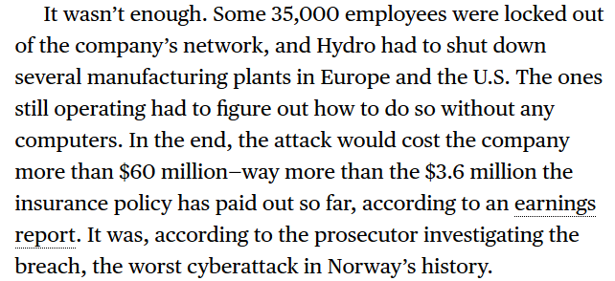
Cyber Insurance Realities
https://www.bloomberg.com/news/features/2020-07-23/how-to-survive-ransomware-attack-without-paying-ransom

Slide 19
Software Risk Assessment Steps
Perform introspection of software object (SBOM)
Verify Download Server Source Location/Certificate
Perform Virus Scan for known malware
Verify Digital Signature of software object
Perform Vulnerability (CVE) Search
Perform Vendor Verification using available data
Perform Provenance Check
Generate a Trustworthiness Score based on risk assessment
Save all findings and results in an evidence file

Slide 20
Software introspection
After acquiring a software object, perform a deep inspection
Create, download or open a software Bill of Materials (SBOM) and investigate each potentially dangerous component searching for risk
Akin to an FDA food label listing ingredients contained in a food product
Identify the Manufacturer/Developer of the SW
Determine the name of the product associated with the software along with the version
Verify that the developer and product information match the information acquired during procurement discussions with the vendor, refer to EEI model

Slide 21
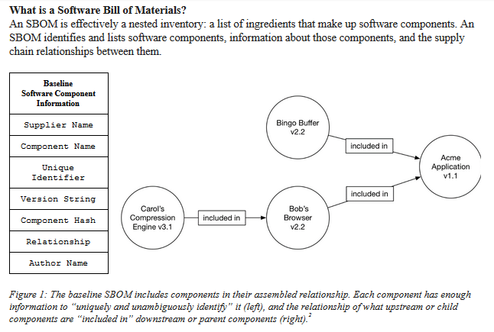
What is an SBOM (NTIA Definition)
NTIA 6/15/2020: https://docs.google.com/document/d/1IqLsYshdvnxmvAx7hhdEUMRw30PauP5QRkcZh8t1QXI/edit#

Slide 22
CycloneDX History
Origins in the OWASP community
Designed in May 2017
Initial release in March 2018
OWASP Dependency-Track was first adopter, many others followed
CycloneDX v1.1 released in March 2019
CycloneDX v1.2 released in May 2020
Formal CycloneDX working group and standardization process in 2020
Members of CycloneDX Core working group are OWASP leaders/members
CycloneDX slides provided by Steve Springett; Steve leads the OWASP
Dependency-Track project, OWASP Software Component Verification Standard (SCVS) project,
CycloneDX software bill of materials standard, and participates in several
related projects and working groups.

Slide 23
The CycloneDX Approach
Easy to adopt – easy to contribute
Identify risk to as many adopters as possible, as quickly as possible
Avoid any/all blockers that prevent the identification of risk
Continuous improvement – Innovate quickly, improve over time
Encourage innovation and competition through extensions
Produce immutabe and backward compatible releases
Facts first – Dynamic facts and observations enabled through extensions
Automation and optimization of BOM creation
Full-stack BOM specification

Slide 24
Achievable Use Cases
Describe complete and accurate inventory
Security vulnerability analysis
Integrity verification
Software package evaluation
License identification and compliance
Describe complex component assemblies
Capture dependency relationships
Describe component pedigree
Describe component provenance
Describe reliance on services

Slide 25
SBOM Examples
https://github.com/CycloneDX/sbom-examples

Slide 26
Verify Source Location/Vendor
Parse the SSL digital certificate for identification information; is the issuing CA performing thorough investigations of identity before issuing the certificate
NAESB Accredited CA’s offer the best protection; require your software vendor to acquire their digital signing and SSL/TLS certificates from a NAESB ACA, such as Globalsign
Verify the validity of the digital certificate
Confirm that the vendor and source location information match what was agreed to during procurement discussions
Source Locations that lack SSL digital certificates should never be trusted

Slide 27
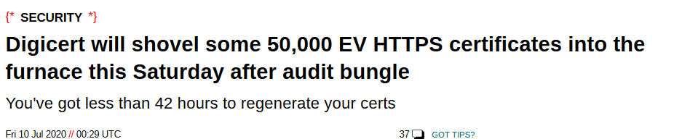
Be selective when choosing a CA
https://www.theregister.com/2020/07/10/digicert_pulls_certs/

Slide 28
Malware and Vulnerabilities
Malware is a deliberate attempt by a hacker to implant software in a victims computing ecosystem in order to gain a foothold to perform nefarious acts, Examples:
Not Petya
WannaCry
Too many to list…
Vulnerabilities are unintentional software imperfections which a hacker uses to access a victims computing ecosystem, using known exploits, in order to gain a foothold to perform nefarious acts.
OSIsoft PI vulnerabilities advisory from CISA: https://www.us-cert.gov/ics/advisories/icsa-20-133-02
Pal Alto Networks vulnerabilities from NIST: https://nvd.nist.gov/vuln/detail/CVE-2020-2018
Vulnerability exploits are often used to implant malware; They are not mutually exclusive risks

Slide 29
Malware and Vulnerabilities
Perform a malware scan using trusted and up to date antivirus software; any discovered malware automatically results in a trust score of ZERO
Perform a search for known vulnerabilities and exploits
Signup to receive CISA alerts and advisories
Search known vulnerability databases, i.e. Mitre CVE and NIST NVD
I’ve proposed changes to Rapid7 to improve AttackerKB search results
Any discovered malware or vulnerability risks results in a trust score of ZERO

Slide 30
Software Object Provenance
Look for man in the middle risks, i.e. Blacklisted IP addresses and foreign risks
Examine a digital signature, if present:
Look for any indication of expired certificates
Look for “freshness” of the digital certificate, if it’s too old then it may not be trustworthy; check timestamps
Verify digital signature information with data acquired during procurement discussions and contract signing
Lack of a digital certificate reduces trust to zero
A matching hash value will improve the integrity score, but offers no assurance for identity/authentication

Slide 31
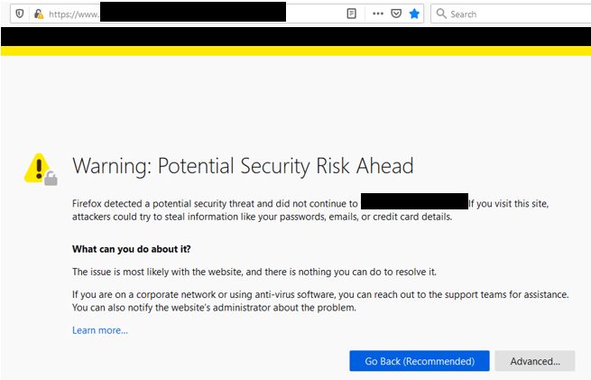
Real Experiences; Bad SSL Cert

Slide 32
Untrustworthy SSL/TLS Certs
Let’s Encrypt
Let's Encrypt issued 3,048,289 TLS certificates without checking the CAA field for the requesting domain.
https://www.zdnet.com/article/lets-encrypt-to-revoke-3-million-certificates-on-march-4-due-to-bug/

Slide 33
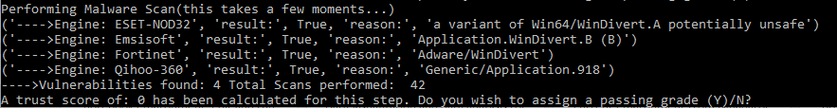
Embedded Malware

Slide 34
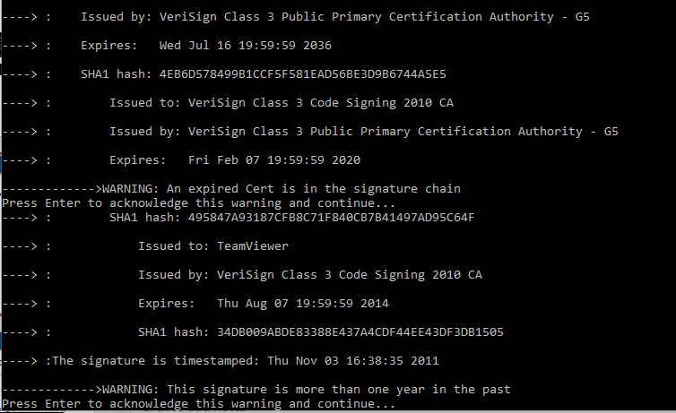
Digital Signature Risks
NOTE: Verisign is NOT a NAESB Accredited Certificate Authority

Slide 35
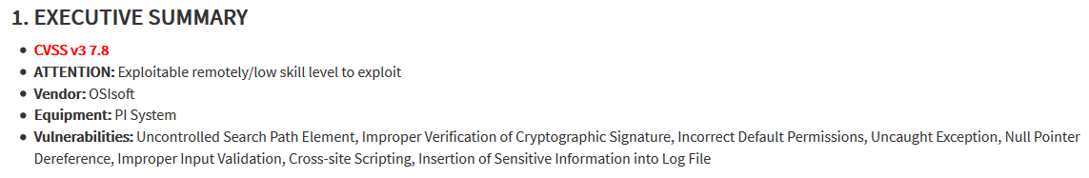
Vulnerabilities and Exploits
ICS Advisory (ICSA-20-133-02)
OSIsoft PI System
Original release date: May 12, 2020
Exploits; Top Ten List

Slide 36

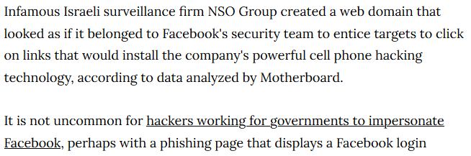
Provenance Risks
Man in the middle attacks
Watering Holes; e.g. Wordpress
Spoofed software download locations
https://www.vice.com/en_us/article/qj4p3w/nso-group-hack-fake-facebook-domain

Slide 37
Common Misconceptions
A verified digitally signed software object is always trustworthy; NOT TRUE
Digitally signed software provides a “veil” of trust that may not be justified
COMODO Fraudulent Certificates
Microsoft is aware of nine fraudulent digital certificates issued by Comodo, a certification authority present in the Trusted Root Certification Authorities Store, on all supported releases of Microsoft Windows
ASUS March 29, 2019
As Motherboard reported, researchers at Kaspersky discovered that malicious hackers had successfully planted malware posing as an official ASUS security update onto ASUS’s servers and signed it with two of the company’s legitimate digital certificates.
Sophos Threat Report 2020
Attackers may attempt to minimize detection by digitally code-signing their ransomware with an Authenticode certificate.

Slide 38
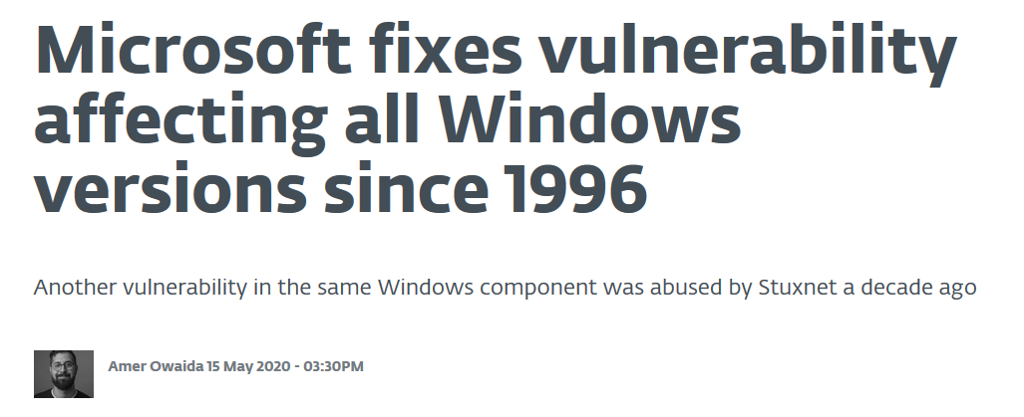
Software Vendors Always Patch Known Vulnerabilities Immediately
NOT TRUE

Slide 39
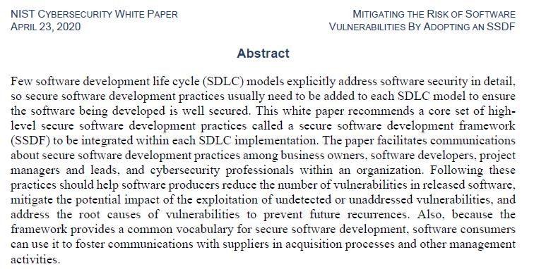
All Vendors Follow Secure Coding Standards; NOT TRUE
https://nvlpubs.nist.gov/nistpubs/CSWP/NIST.CSWP.04232020.pdf

Slide 40
You must protect yourself
You cannot be assured that a vendor is aware of the risks that are inherent in their software or the supply chain used by your Company to acquire their software
If a breach occurs in your Company, then you will be the one accountable for the damage and costs to recover (not the SW vendor/supplier), along with any non-compliance fines
You cannot “outsource” all of the cost of a breach, i.e. recovery efforts and the harm to reputation from a successful cyber attack on your Company,
But you can try to detect risks
Would you take a free drink from a stranger in a bar? Software should be viewed in the same way!
Never trust software, always verify and report!™

Slide 41
Ongoing Due Diligence
Implement software integrity and authenticity controls following the technical guidelines contained in NERC CIP-010-3 augmented by the enhanced best practices provided in the NIST Cybersecurity Framework
Follow FERC’s suggestions:
“Standards do not necessarily require entities to employ best practices”
“augmenting the current CIP Reliability Standards under FPA section 215 with an incentive-based approach under FPA section 219 that encourages utilities to undertake cybersecurity investments on a voluntary basis. This approach would incentivize a utility to adopt best practices to protect its own transmission system as well as improve the security of the BES”
The NIST CSF contains a comprehensive set of guidelines of cybersecurity best practices that are intended to protect the Bulk Electric System, above an beyond NERC CIP-010-3 standards
Cybersecurity is a cat and mouse game that requires constant vigilance
Security risks don’t stand still and neither should your software cybersecurity risk controls, in order to remain effective
FERC Order 850, Mandatory Supply Chain Standards, are scheduled to go into effect on 10/1/2020 (18 CFR 40); it can take several months to setup effective risk management controls to satisfy NERC compliance requirements and apply effective best practices following the NIST CSF

Slide 42
Summary
Software Supply Chain breaches are costly to recover from and can adversely effect Company finances and reputation (and your own career)
Apply prudent risk management controls following NIST CSF best practices and NERC CIP-010-3 to detect risks and threats to the Bulk Electric System, and meet NERC compliance requirements
No risk management control is guaranteed to protect you from harm, but some are useful
Software supply chain risk assessments should include both vendor centric (CIP-013) and software centric risk (CIP-010-3) analysis
You cannot rely on vendors to protect you from harm; you alone are accountable for your own security!

Slide 43
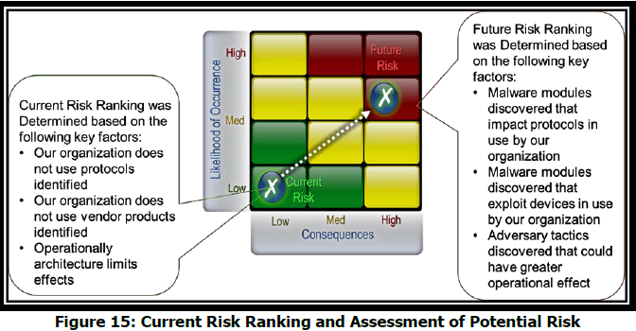
When Reality Sets In
https://ics.sans.org/media/E-ISAC_SANS_Ukraine_DUC_6.pdf

Slide 44
Questions?
Dick Brooks
dick@reliableenergyanalytics.com

Slide 45
Acknowledgements
Many thanks to Tom Alrich for providing valuable insights on NERC CIP-013-1.
I highly recommend following his NERC CIP blog postings here: http://tomalrichblog.blogspot.com/

Slide 46
Reliable Energy Analytics LLC
Established December 2018
Developer of patent pending Software Assurance Guardian™ (SAG) Methodologies and Technologies
Provider of Software Risk Management controls to meet NERC CIP-010-3 and FERC Order 850 regulations on 10/1/2020; SAG Point Man software (SAG-PM™)
Extensive Energy industry experience, since 1990, delivering secure, mission critical software solutions
14 years with ISO New England responsible for enterprise architecture, Advanced Data Analytic solutions, NAESB PKI standards and implementation
Active member of the North American Energy Standards Board (NAESB), serving as Vice Chairman on the Wholesale Electric Quadrant (WEQ) Executive Committee
Never trust software, always verify and report!™

Slide 47
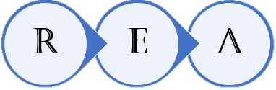
Contact Information
Dick Brooks
Reliable Energy Analytics LLC
dick@reliableenergyanalytics.com
Energy Central: https://energycentral.com/member/profile/225424/about
Tel: 978-696-1788
Never trust software, always verify and report!™

Slide 48
Thank you and thanks to our sponsor!

