Slide 1
Bead funding cyber plan requirements / CISA Secure by Design Software Acquisition Guide (SAG)

Slide 2
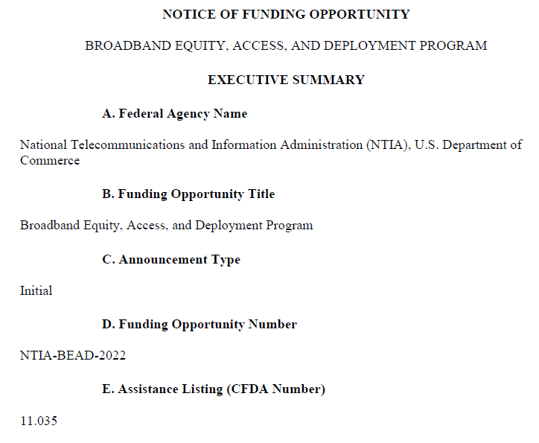
Topics
What is BEAD
State Funding Plans
What are the BEAD Cyber Plan Requirements
NTCA Guidance
What is the CISA Software Acquisition Guide (SAG)
Who created the SAG materials
How do Product Manufacturers use the SAG
How do Consumers use the SAG to assess a product for Secure by Design Best Practices
How can BEAD Implementers use NTCA and CISA Guidance
Resources
BEAD Program Website
https://broadbandusa.ntia.gov/funding-programs/policies-waivers/BEAD_Restructuring_Policy_Notice

Slide 3

What is THE BEAD PROGRAM
$42.45 billion federal grant program that aims to connect every American to high-speed internet
States and territories can use their allocated funds for these eligible uses:
Planning for the deployment of high-speed internet, including conducting research, collecting data, outreach, and training
Deploying or upgrading internet infrastructure in unserved or underserved areas, or improving service to community anchor institutions
Installing internet and Wi-Fi service in multi-unit residential buildings
Internet access, adoption and use programs
Workforce readiness programs to meet the needs of the infrastructure programs
Other activities that increase meaningful use of constructed infrastructure, at the discretion of the Assistant Secretary

Slide 4
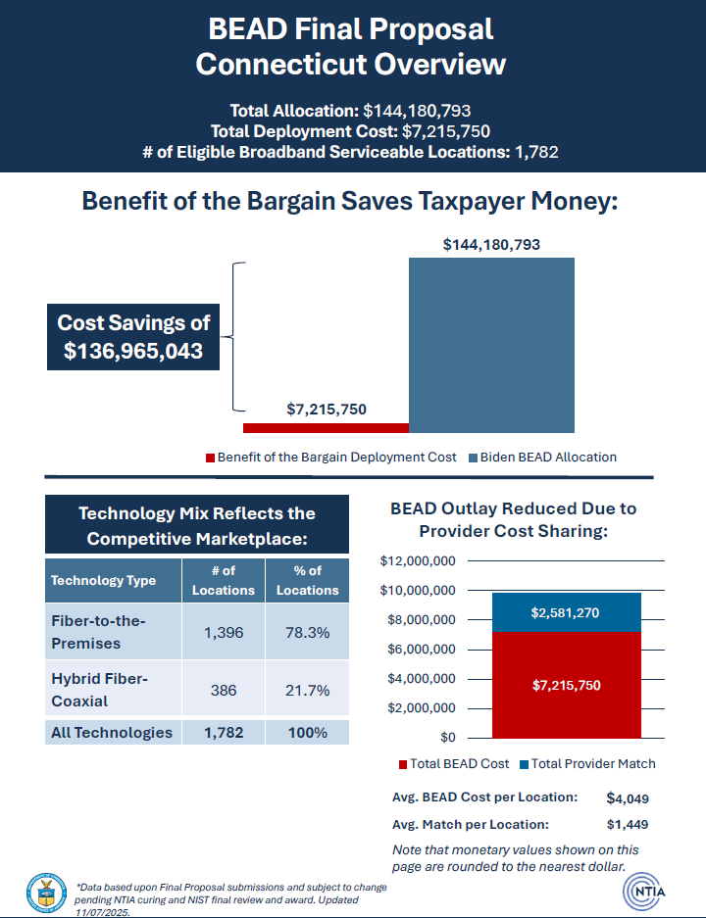
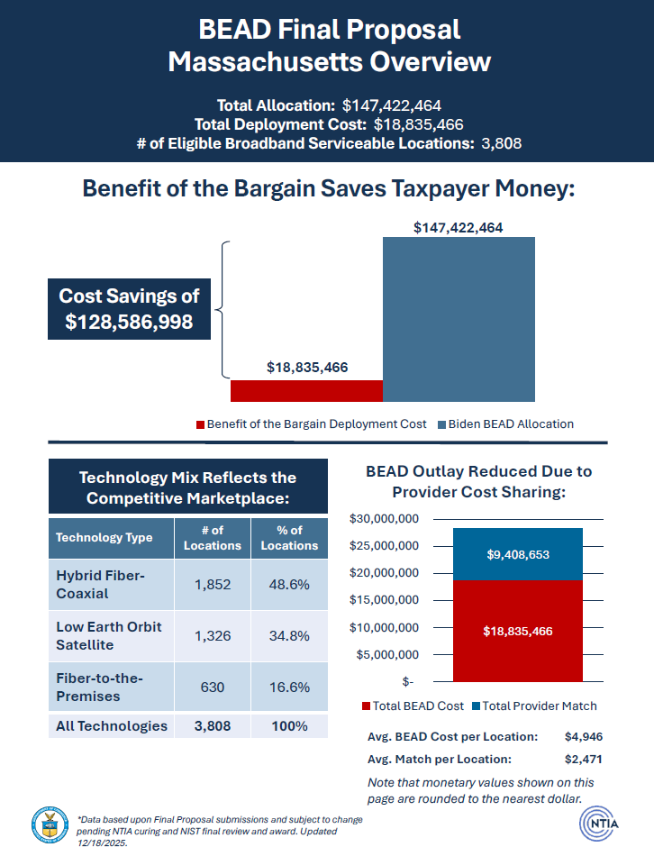
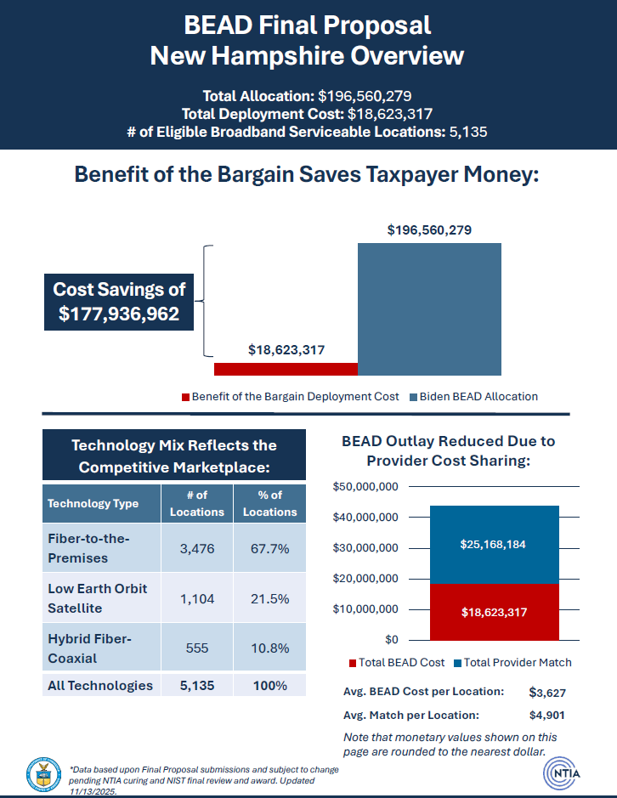
State Funding Plans

Slide 5

Sub-awardee FUNDING process
Applicants must submit:
Technical design (fiber, fixed wireless, etc.)
Cost model & budget
Matching funds documentation
Cybersecurity & supply‑chain compliance plans
Workforce plan
Environmental & permitting readiness
Affordability commitments
NTIA Special Award Condition (SAC) Review
Before funds flow, NTIA conducts a SAC meeting with the state to verify:
Compliance with BEAD rules
Subgrantee selection integrity
Cybersecurity & supply‑chain requirements
Budget and match validation
Only after SAC approval can the state issue final awards.
Meeting Topic
Meeting Topic

Slide 6
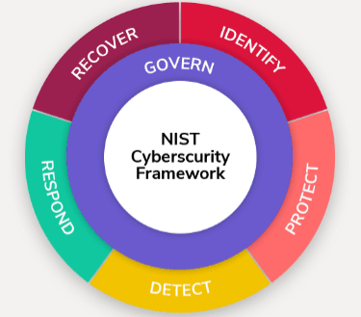
BEAD Cyber Plan Requirements
The Cybersecurity Risk Management Plan (CRMP)
A subgrantee must have a plan that is:
A. Operational or ready to be operationalized
This is the single most important gating requirement.
B. Aligned with the NIST Cybersecurity Framework (CSF)
Must reflect the latest version of the NIST CSF
This does not require full maturity or certification — only alignment.
C. Covers the CSF Core Functions
At minimum, the plan must address:
Governance
Identify (assets, risks, roles, governance)
Protect (access control, training, data security)
Detect (anomalies, continuous monitoring)
Respond (incident response processes)
Recover (restoration, lessons learned)
CISA CPG V2 alignment available now

Slide 7
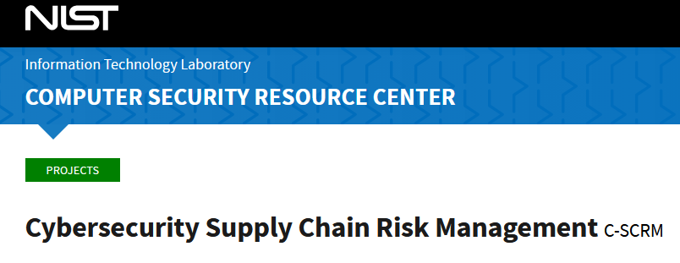
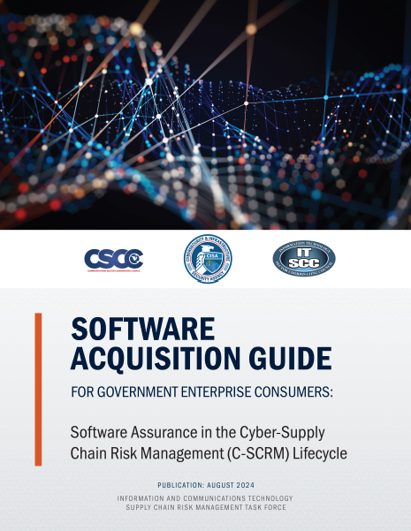
BEAD SCRM Plan Requirements
The Cyber Supply Chain Risk Management (C‑SCRM) Plan
Minimum Requirements
A subgrantee must have a plan that:
A. Aligns with NIST 800‑161 and NISTIR 8276
NTIA explicitly points implementers to these documents as the baseline for SCRM.
B. Addresses vendor and component (product) risk
At minimum:
Identification of suppliers
Vetting of vendors
Controls for product procurement
Handling of foreign‑manufactured equipment risks
Processes for monitoring supplier and product vulnerabilities
C. Is operational or ready to operationalize
Same gating rule as the cybersecurity plan.

Slide 8
Guidance FOR BEAD IMPLEMENTERS
BEAD Cybersecurity Requirements:
https://broadbandusa.ntia.doc.gov/sites/default/files/2022-05/BEAD%20NOFO.pdf (p. 70)
1. Cybersecurity and supply chain risk management plans (the ICT SCRM Task Force created this guide from small businesses: https://www.cisa.gov/sites/default/files/2023-10/Empowering%20SMBs%20-%20A%20Resource%20Guide%20For%20Developing%20A%20Resilient%20SCRM%20Plan_508_0.pdf)
a. NIST Framework for Improving Critical Infrastructure Cybersecurity^{[1]} (this Quick Start Guide for small businesses outlines the basics really well)
b. Security and privacy controls being implemented from Executive Order 14028
c. NISTIR 8276, Key Practices in Cyber Supply Chain Risk Management: Observations from Industry
d. Supply chain risk management controls being implemented from NIST 800-161, Cybersecurity Supply Chain Risk Management Practices for Systems and Organizations
2. The plans must be submitted to the Eligible Entity prior to the allocation of funds.
3. BEAD providers must reevaluate and update the plans on a periodic basis and as events warrant;
4. If the BEAD provider makes any substantive changes to the plan(s), a new version will be submitted to the Eligible Entity within 30 days.
5. If network facilities are owned or operated by a third party (e.g., purchases wholesale carriage on such facilities), the BEAD provider must obtain the above attestations from its network provider.

Slide 9
Need Help
Reach out to your State Broadband Administrators (Look on the BEAD Website for State Contact Info)
https://broadbandusa.ntia.gov/resources/states
BEAD Website https://broadbandusa.ntia.gov/funding-programs/broadband-equity-access-and-deployment-bead-program

Slide 10

How can CISA resources HELP
CISA created several useful guides to help parties implement effective cyber and C-SCRM best practices for BEAD
Cybersecurity and supply chain risk management plans (the ICT SCRM Task Force created this guide from small businesses: https://www.cisa.gov/sites/default/files/2023-10/Empowering%20SMBs%20-%20A%20Resource%20Guide%20For%20Developing%20A%20Resilient%20SCRM%20Plan_508_0.pdf)
CISA Secure by Design Software Acquisition Guide (SAG) (covered in next section)
CISA SAG Website https://cisa.gov/sag
SAG Document: https://www.cisa.gov/sites/default/files/2024-07/PDM24050%20Software%20Acquisition%20Guide%20for%20Government%20Enterprise%20ConsumersV2_508c.pdf
SAG Spreadsheet: https://www.cisa.gov/sites/default/files/2024-08/PDM24064%20Software%20Acquisition%20Guide%20for%20Government%20Enterprise%20Consumers%20Final-%2020240710_v19.xlsx
SAG FACT Sheet: https://www.cisa.gov/sites/default/files/2024-10/ICT%20SCRM%20Task%20Force%20Software%20Acquisition%20Guide%20Fact%20Sheet%20%28508%29.pdf
SAG Webtool Self Assessment: https://www.cisa.gov/software-acquisition-guide/tool
SAG Overview Webinars: https://www.youtube.com/watch?v=_RzQMXE4Df0

Slide 11
What is the CISA Software acquisition guide
Aligns with CISA Secure by Design principles but focuses on the “Secure by Demand” elements.
Identifies Secure by Design best practices across the entire software life cycle, based on NIST standards
Enables acquisition professionals to engage in more relevant discussions with their enterprise risk owners (such as Chief Information Officers and Chief Information Security Officers) and candidate suppliers
A virtual “Secure by Design” checklist for consumers and producers
View the CISA NASPO Webinar
for a comprehensive overview

Slide 12
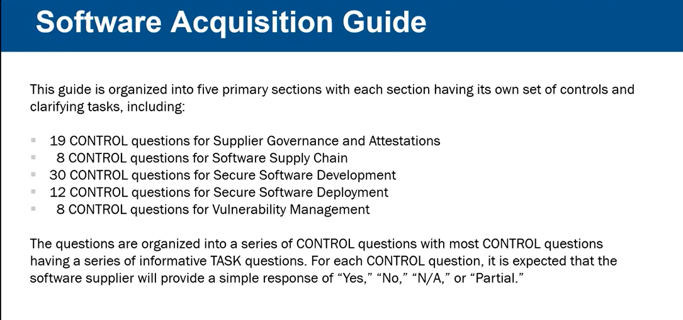

Slide 13

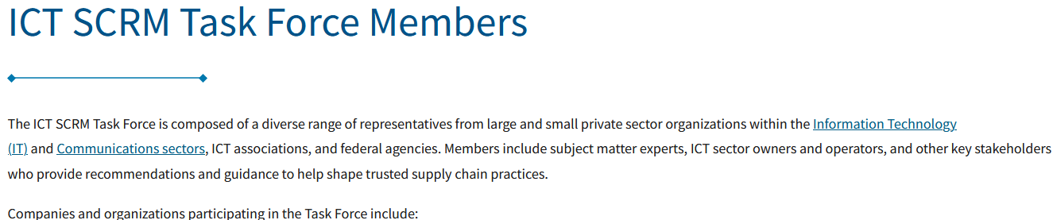
Who created the SAG materials
CISA ICT_SCRM Task Force (CIPAC partnership)
CISA National Risk Management Center
Core group of ~30 people working on the SAG document
Mostly from Government Agencies (NASA, GSA, CISA, NSA) and Private Sector https://www.cisa.gov/ict-scrm-task-force-members
Led and facilitated by CISA personnel over two years
Visionary leadership provided by an expert with decades of experience in software assurance, Joe Jarzombek, https://copilot.microsoft.com/shares/QLhY366t3XSbYmfegpXEa

Slide 14
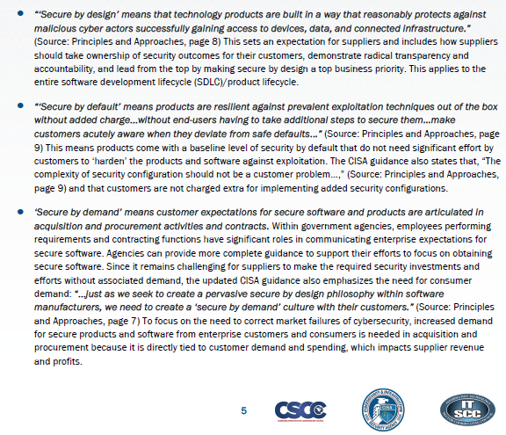
Secure by Design, Default, DEmand

Slide 15
How do Product Manufacturers use the SAG
Self Assessment of adherence to Secure by Design best practices in the SAG
Perform self assessment before submitting a product to the US Government for procurement
Answer the 19 Governance Questions, at a minimum
Address any “red flags” where lack of adherence to Secure by Design could block a product from being purchased
Create SAG Spreadsheet once and send to everyone that asks to show your Secure by Design practices
Track Secure by Design practices per product

Slide 16
How do Consumers use the CISA SAG
Assess a product and supplier for adherence to Secure by Design best practices
Five step process
Download the CISA SAG Spreadsheet
Send the spreadsheet to your suppliers with a cover letter asking them to answer the 19 governance questions, at a minimum and return the completed spreadsheet
Place the completed SAG Spreadsheets received in a permanent location for later review
Evaluate each returned spreadsheet and decide if the provided responses are acceptable within your risk threshold and tolerance – open source, free to use tools are available for this step
Keep a history of each analysis in a “log” with PASS/FAIL results – see open source tool above

Slide 17
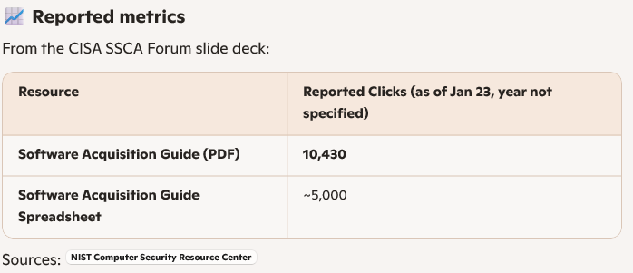
Popularity

Slide 18
Resources
BEAD Resources
https://broadbandusa.ntia.gov/sites/default/files/2022-05/BEAD%20NOFO.pdf
BEAD Website https://broadbandusa.ntia.gov/funding-programs/broadband-equity-access-and-deployment-bead-program
BEAD Restructuring Policy Notice https://broadbandusa.ntia.gov/funding-programs/policies-waivers/BEAD_Restructuring_Policy_Notice
https://www.ntia.gov/press-release/2026/statement-assistant-secretary-roth-ntia-s-approach-use-21-billion-bead-savings
State BEAD Administrators: https://broadbandusa.ntia.gov/resources/states
NIST CSF V2.0 Guidance: https://www.nist.gov/cyberframework
NTCA Resources
https://www.ntca.org/advocacy/issues/cybersecurity
NASA SCRM Process Documentation
https://www.nasa.gov/secure-software-development-self-attestation-resources-and-knowledge/
CISA SAG Videos
NASPO Webinar: https://www.youtube.com/watch?v=_RzQMXE4Df0
Tom Fanning Keynote: https://www.youtube.com/watch?v=0iYITlQfi3A
CISA Free Services and Open Source Tools
https://www.cisa.gov/resources-tools/resources/no-cost-cybersecurity-services-and-tools
https://github.com/rjb4standards/CISASAGReader/blob/main/README.md
https://www.cisa.gov/cybersecurity-performance-goals-2-0-cpg-2-0
CISA SAG Website
https://cisa.gov/sag
SAG Document: https://www.cisa.gov/sites/default/files/2024-07/PDM24050%20Software%20Acquisition%20Guide%20for%20Government%20Enterprise%20ConsumersV2_508c.pdf
SAG Spreadsheet: https://www.cisa.gov/sites/default/files/2024-08/PDM24064%20Software%20Acquisition%20Guide%20for%20Government%20Enterprise%20Consumers%20Final-%2020240710_v19.xlsx
SAG FACT Sheet: https://www.cisa.gov/sites/default/files/2024-10/ICT%20SCRM%20Task%20Force%20Software%20Acquisition%20Guide%20Fact%20Sheet%20%28508%29.pdf
LinkedIn SBOM SIG; Global Community of SBOM Implementers
https://www.linkedin.com/groups/13274064/

Slide 19
Thank you for your time
Dick Brooks
dick@businesscyberguardian.com
https://businesscyberguardian.com/

