Slide 1
Don’t just trust, Verify
A list of scams affecting Seniors
Dick and Joanne Brooks
Copyright and all other Rights Reserved Business Cyber Guardian ®

Slide 2
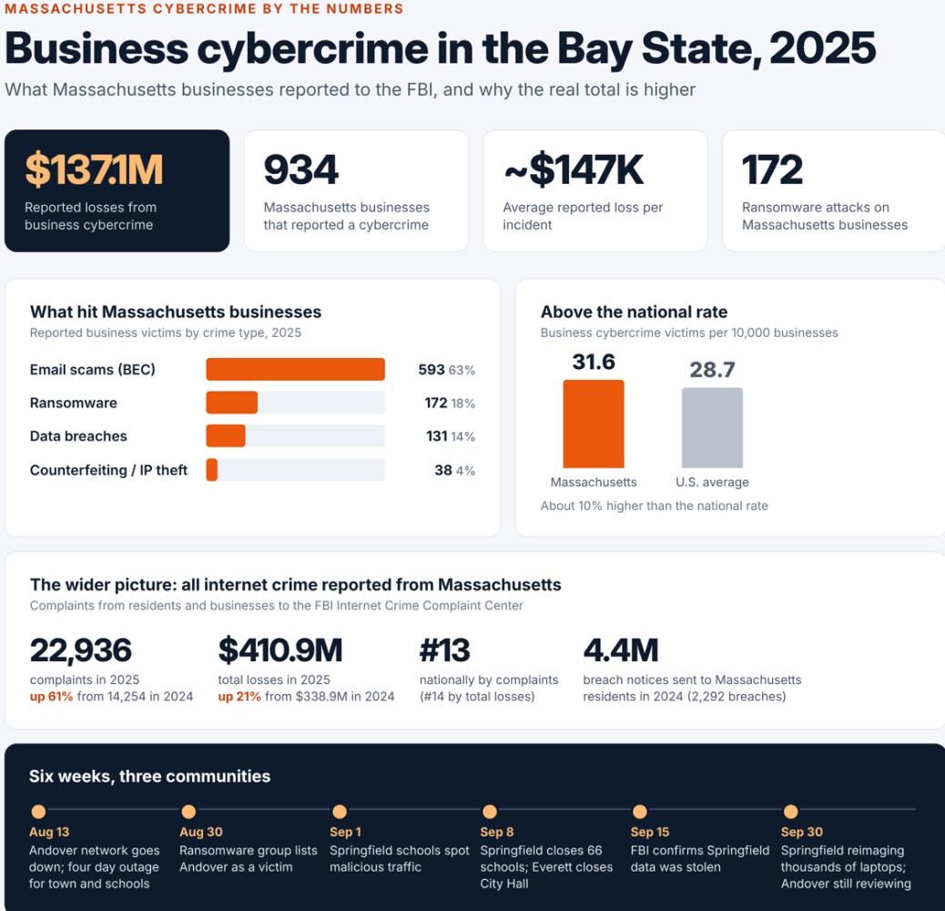
Cyber Crime in MA
Source: https://www.linkedin.com/pulse/massachusetts-businesses-lost-137-million-cybercrime-last-aldom-jzwqc/

Slide 3
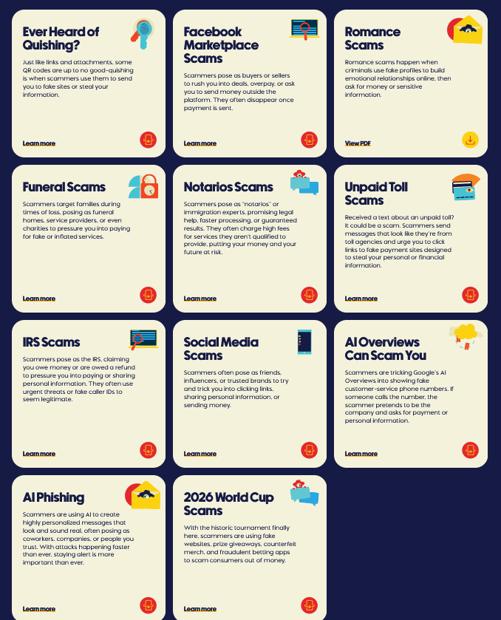
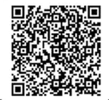


Grandparent Scams
Parking Meter Scams
QR Codes
Trusted Email Breakin Scams
Interpol Video Fake Call
https://youtu.be/em_YZaZ10c4?si=whAn3v9DSEGu2rf2
Source: https://pausetake9.org/latest/

Slide 4
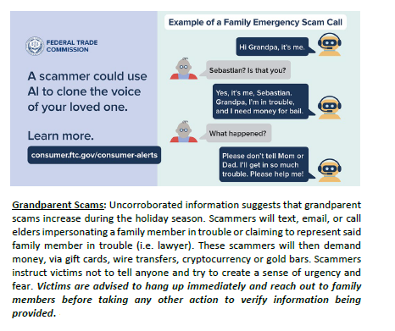
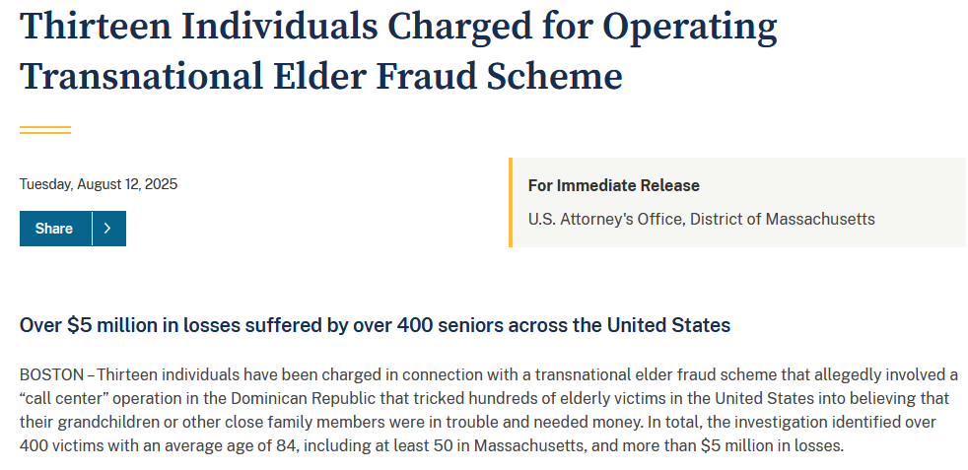
Source: Robert DeMarino
Cyber Program Coordinator
Massachusetts State Police
Division of Homeland Security and Preparedness
Commonwealth Fusion Center
https://www.justice.gov/usao-ma/pr/thirteen-individuals-charged-operating-transnational-elder-fraud-scheme

Slide 5
What about risks at home
Wi-Fi Routers
Smart Thermostats
Surveillance Cameras
Ring Doorbells
Home Assistants (i.e. Alexa, Siri, Google)
Smart TV’s
Home Computer Use
  Email
  Web Browsing
Cell phones (SMSishing)
  Bluetooth hacking
Visitors using their cell phones on your wi-fi
Neighbors within range of your wi-fi
Swatting

Slide 6
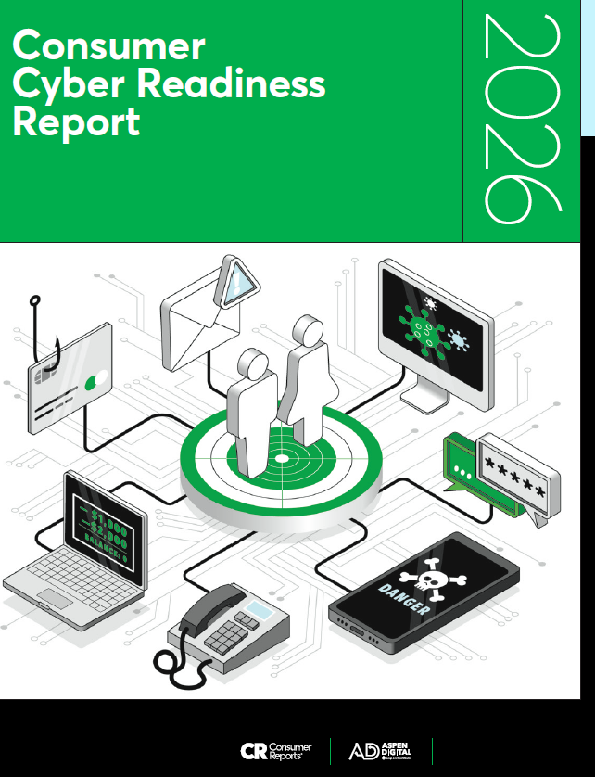
What Can you do to protect yourself
1. Always ask yourself these 2 questions:
  Does this involve money?
  Is there a sense of urgency?
If you answered yes to any of these
  STOP, this could be a scam
https://innovation.consumerreports.org/2026ConsumerCyberReadinessReport.pdf

Slide 7
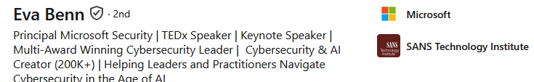
5 practical cybersecurity habits
1. If a message creates urgency, stop and give yourself a few minutes before clicking, replying, or sharing information. Urgency is a huge red flag.
2. If a legitimate institution asks you to provide a password, a verification code, or sensitive information, contact them through a phone number or app you already know instead of replying to the message you received.
3. Don’t assume a familiar voice, face or caller ID proves who you’re talking to. Deepfakes have become cheap and easy. If something feels off, hang up and call the person directly.
4. Create a family safe word that only you know and use it to verify unexpected emergency calls, especially requests involving money.
5. Limit the personal information you share publicly, including travel plans, birthdays, family names, schools, workplaces, and other details someone could use to make a scam believable.
Source: https://lnkd.in/p/gSCeEEcG

Slide 8
Contact local law enforcement If you think you’ve become a victim of cybercrime

