Slide 1


My Tasks
Ryan Britt
Clemson University
CPSC 481 – Mobile Software Design
rjbritt@clemson.edu

Slide 2
What?
Task Manager
Designed for students
Self-Help
Data Aggregator
Notes:
Editorial Guidelines on Bullets:
1. Vertical lists are best introduced by a grammatically complete sentence followed by a colon. No periods
are required at the end of entries unless at least one entry is a complete sentence, in which case a period
is necessary at the end of each entry.
Example: A university can be judged by three measures:
· The quality of its students
· The quality of it faculty
· The quality of its infrastructure
2. If a list completes the sentence that introduces it, items begin with lowercase letters, commas or semicolons
(if individual items contain commas) are used to separate each item, and the last item ends with a period.
Note that the introductory clause does not end with a colon.
Example: A university can be judged by
· the quality of its students,
· the quality of its faculty,
· the quality of its infrastructure.
3. Avoid mixing sentence and nonsentence items in a bulleted list.
2

Slide 3
Why?
Time Mismanagement
Structure
Confusion
Notes:
Editorial Guidelines on Bullets:
1. Vertical lists are best introduced by a grammatically complete sentence followed by a colon. No periods
are required at the end of entries unless at least one entry is a complete sentence, in which case a period
is necessary at the end of each entry.
Example: A university can be judged by three measures:
· The quality of its students
· The quality of it faculty
· The quality of its infrastructure
2. If a list completes the sentence that introduces it, items begin with lowercase letters, commas or semicolons
(if individual items contain commas) are used to separate each item, and the last item ends with a period.
Note that the introductory clause does not end with a colon.
Example: A university can be judged by
· the quality of its students,
· the quality of its faculty,
· the quality of its infrastructure.
3. Avoid mixing sentence and nonsentence items in a bulleted list.
3

Slide 4
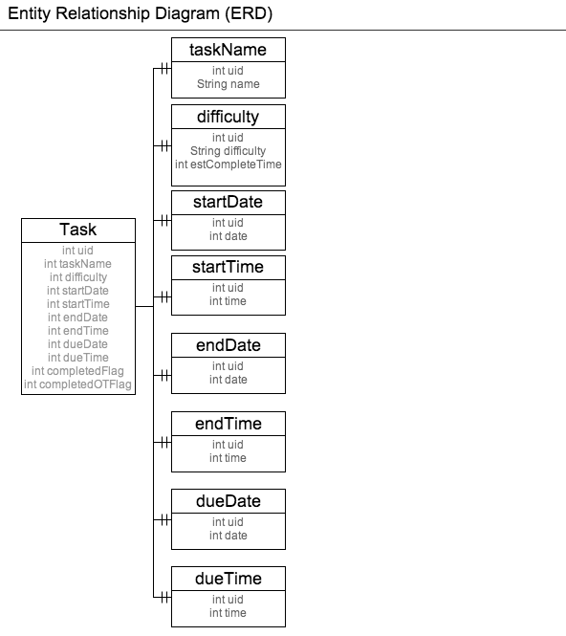
How?
Notes:
Editorial Guidelines on Bullets:
1. Vertical lists are best introduced by a grammatically complete sentence followed by a colon. No periods
are required at the end of entries unless at least one entry is a complete sentence, in which case a period
is necessary at the end of each entry.
Example: A university can be judged by three measures:
· The quality of its students
· The quality of it faculty
· The quality of its infrastructure
2. If a list completes the sentence that introduces it, items begin with lowercase letters, commas or semicolons
(if individual items contain commas) are used to separate each item, and the last item ends with a period.
Note that the introductory clause does not end with a colon.
Example: A university can be judged by
· the quality of its students,
· the quality of its faculty,
· the quality of its infrastructure.
3. Avoid mixing sentence and nonsentence items in a bulleted list.
4

Slide 5

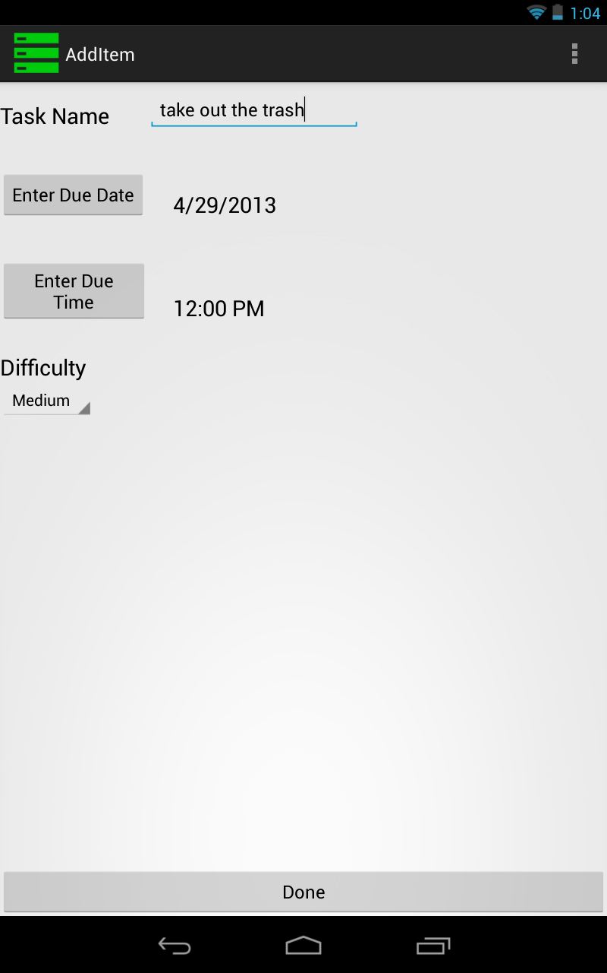
How?
Notes:
Editorial Guidelines on Bullets:
1. Vertical lists are best introduced by a grammatically complete sentence followed by a colon. No periods
are required at the end of entries unless at least one entry is a complete sentence, in which case a period
is necessary at the end of each entry.
Example: A university can be judged by three measures:
· The quality of its students
· The quality of it faculty
· The quality of its infrastructure
2. If a list completes the sentence that introduces it, items begin with lowercase letters, commas or semicolons
(if individual items contain commas) are used to separate each item, and the last item ends with a period.
Note that the introductory clause does not end with a colon.
Example: A university can be judged by
· the quality of its students,
· the quality of its faculty,
· the quality of its infrastructure.
3. Avoid mixing sentence and nonsentence items in a bulleted list.
5

Slide 6
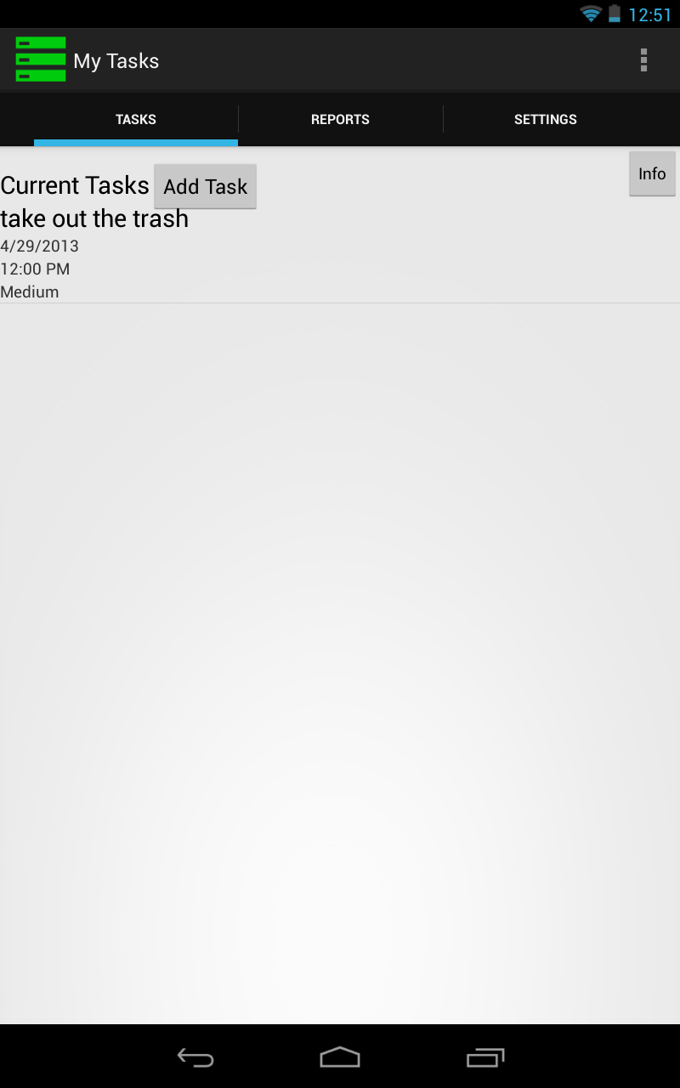
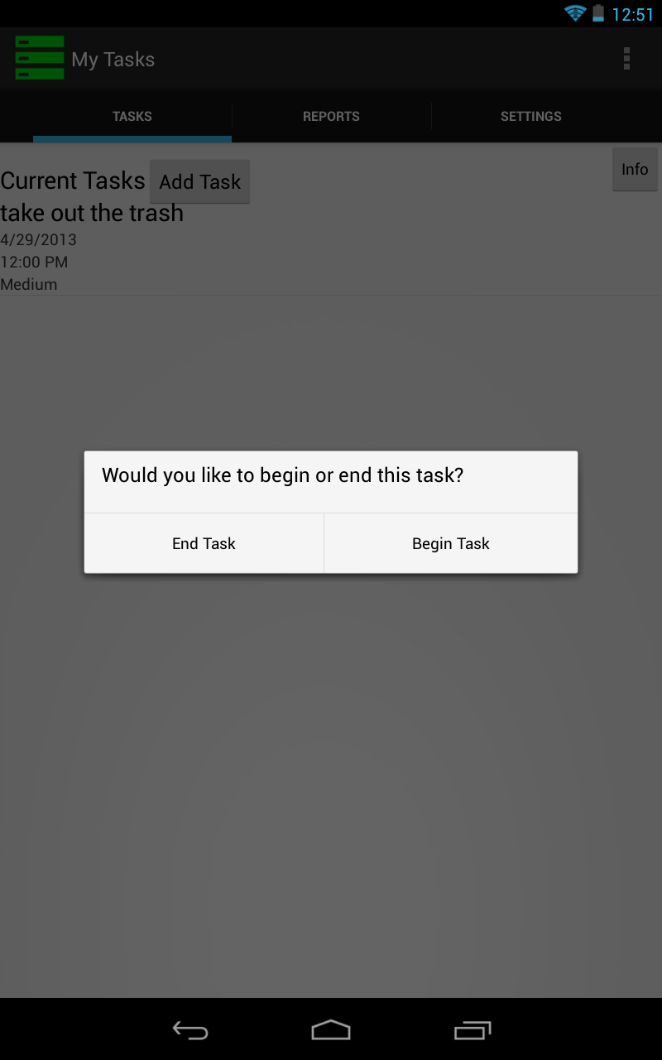
How?
Notes:
Editorial Guidelines on Bullets:
1. Vertical lists are best introduced by a grammatically complete sentence followed by a colon. No periods
are required at the end of entries unless at least one entry is a complete sentence, in which case a period
is necessary at the end of each entry.
Example: A university can be judged by three measures:
· The quality of its students
· The quality of it faculty
· The quality of its infrastructure
2. If a list completes the sentence that introduces it, items begin with lowercase letters, commas or semicolons
(if individual items contain commas) are used to separate each item, and the last item ends with a period.
Note that the introductory clause does not end with a colon.
Example: A university can be judged by
· the quality of its students,
· the quality of its faculty,
· the quality of its infrastructure.
3. Avoid mixing sentence and nonsentence items in a bulleted list.
6

Slide 7
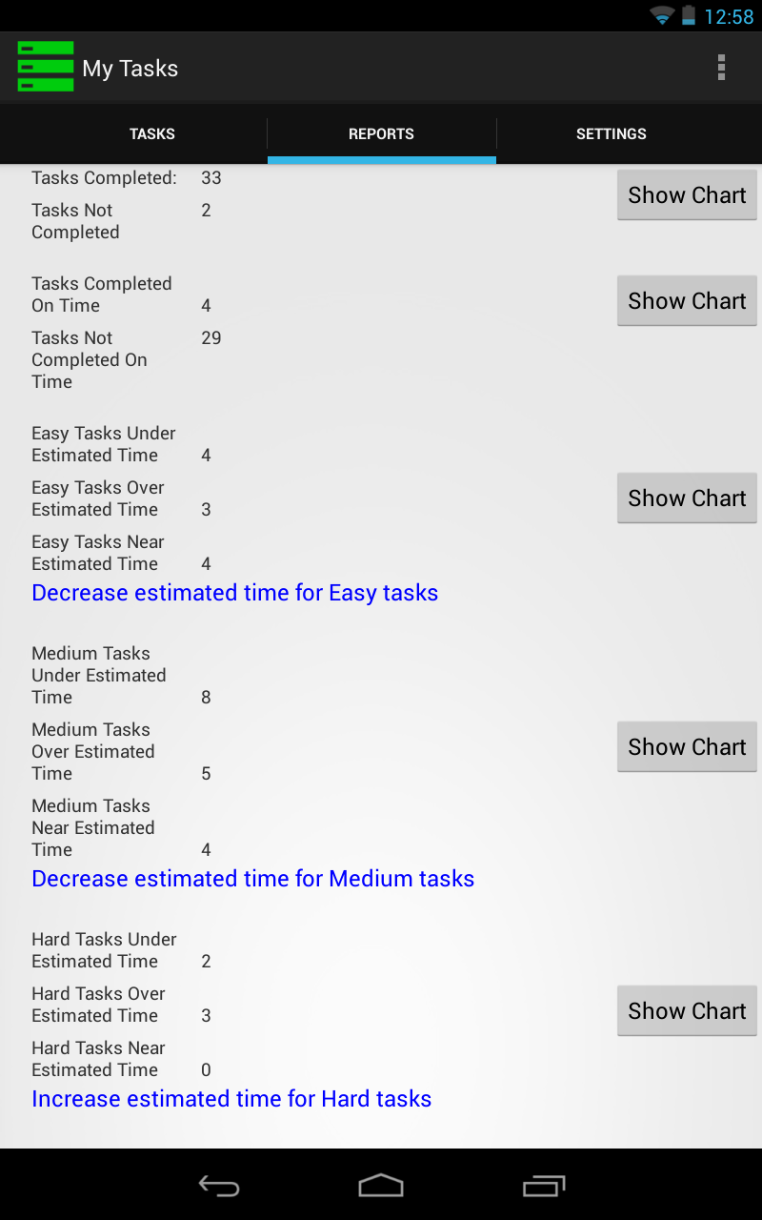
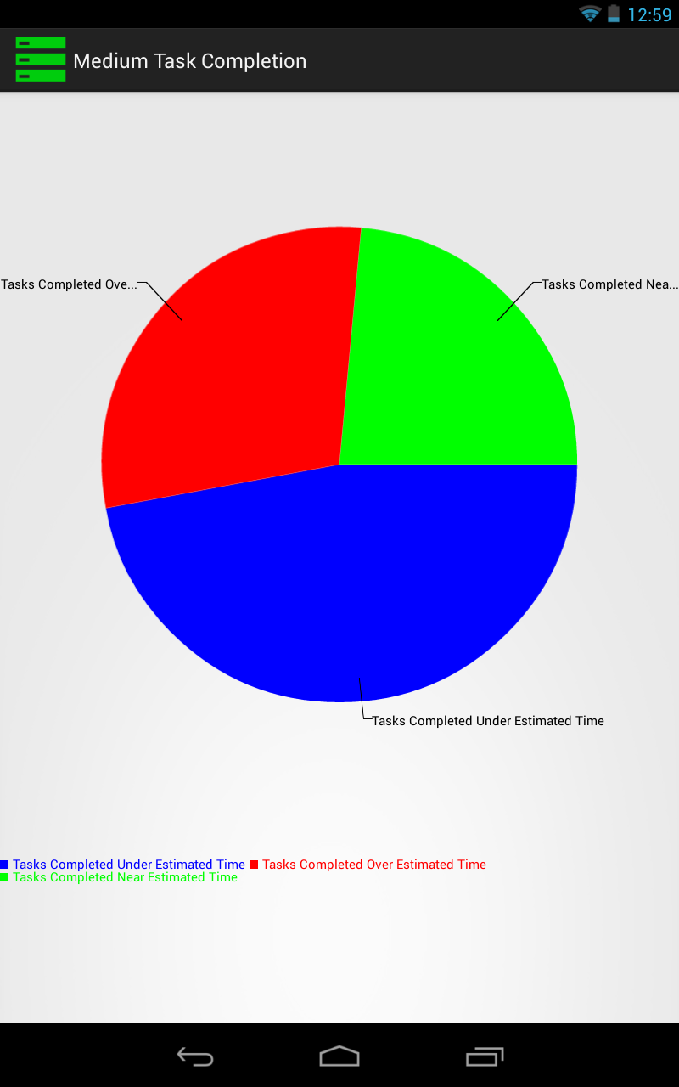
How?
Notes:
Editorial Guidelines on Bullets:
1. Vertical lists are best introduced by a grammatically complete sentence followed by a colon. No periods
are required at the end of entries unless at least one entry is a complete sentence, in which case a period
is necessary at the end of each entry.
Example: A university can be judged by three measures:
· The quality of its students
· The quality of it faculty
· The quality of its infrastructure
2. If a list completes the sentence that introduces it, items begin with lowercase letters, commas or semicolons
(if individual items contain commas) are used to separate each item, and the last item ends with a period.
Note that the introductory clause does not end with a colon.
Example: A university can be judged by
· the quality of its students,
· the quality of its faculty,
· the quality of its infrastructure.
3. Avoid mixing sentence and nonsentence items in a bulleted list.
7

Slide 8
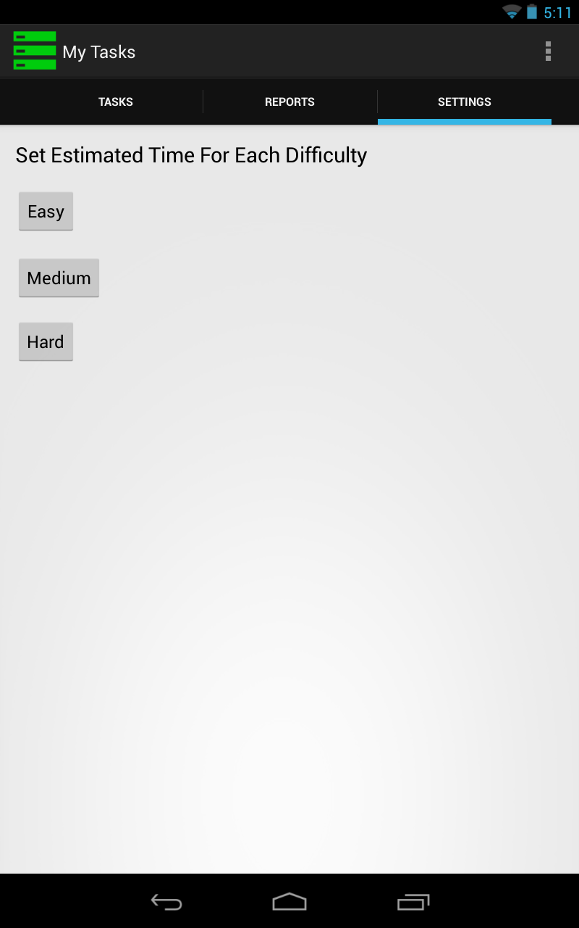
How?
Notes:
Editorial Guidelines on Bullets:
1. Vertical lists are best introduced by a grammatically complete sentence followed by a colon. No periods
are required at the end of entries unless at least one entry is a complete sentence, in which case a period
is necessary at the end of each entry.
Example: A university can be judged by three measures:
· The quality of its students
· The quality of it faculty
· The quality of its infrastructure
2. If a list completes the sentence that introduces it, items begin with lowercase letters, commas or semicolons
(if individual items contain commas) are used to separate each item, and the last item ends with a period.
Note that the introductory clause does not end with a colon.
Example: A university can be judged by
· the quality of its students,
· the quality of its faculty,
· the quality of its infrastructure.
3. Avoid mixing sentence and nonsentence items in a bulleted list.
8

Slide 9
Demo
Notes:
Editorial Guidelines on Bullets:
1. Vertical lists are best introduced by a grammatically complete sentence followed by a colon. No periods
are required at the end of entries unless at least one entry is a complete sentence, in which case a period
is necessary at the end of each entry.
Example: A university can be judged by three measures:
· The quality of its students
· The quality of it faculty
· The quality of its infrastructure
2. If a list completes the sentence that introduces it, items begin with lowercase letters, commas or semicolons
(if individual items contain commas) are used to separate each item, and the last item ends with a period.
Note that the introductory clause does not end with a colon.
Example: A university can be judged by
· the quality of its students,
· the quality of its faculty,
· the quality of its infrastructure.
3. Avoid mixing sentence and nonsentence items in a bulleted list.
9

Slide 10
Review
MyTasks
What
Why
How
Problems
Draggable lists
Time constraints
Notes:
Editorial Guidelines on Bullets:
1. Vertical lists are best introduced by a grammatically complete sentence followed by a colon. No periods
are required at the end of entries unless at least one entry is a complete sentence, in which case a period
is necessary at the end of each entry.
Example: A university can be judged by three measures:
· The quality of its students
· The quality of it faculty
· The quality of its infrastructure
2. If a list completes the sentence that introduces it, items begin with lowercase letters, commas or semicolons
(if individual items contain commas) are used to separate each item, and the last item ends with a period.
Note that the introductory clause does not end with a colon.
Example: A university can be judged by
· the quality of its students,
· the quality of its faculty,
· the quality of its infrastructure.
3. Avoid mixing sentence and nonsentence items in a bulleted list.
10

Slide 11
Future Work
Pausable Tasks
Active Task Listing
Draggable Tasks
Migrate to server based task list
Larger Audience
Platform Independence
Notes:
Editorial Guidelines on Bullets:
1. Vertical lists are best introduced by a grammatically complete sentence followed by a colon. No periods
are required at the end of entries unless at least one entry is a complete sentence, in which case a period
is necessary at the end of each entry.
Example: A university can be judged by three measures:
· The quality of its students
· The quality of it faculty
· The quality of its infrastructure
2. If a list completes the sentence that introduces it, items begin with lowercase letters, commas or semicolons
(if individual items contain commas) are used to separate each item, and the last item ends with a period.
Note that the introductory clause does not end with a colon.
Example: A university can be judged by
· the quality of its students,
· the quality of its faculty,
· the quality of its infrastructure.
3. Avoid mixing sentence and nonsentence items in a bulleted list.
11

Slide 12
Acknowledgements
Neeraj Jain
DJ Edmonson
Josh Groppe
Nick Klein
Notes:
Editorial Guidelines on Bullets:
1. Vertical lists are best introduced by a grammatically complete sentence followed by a colon. No periods
are required at the end of entries unless at least one entry is a complete sentence, in which case a period
is necessary at the end of each entry.
Example: A university can be judged by three measures:
· The quality of its students
· The quality of it faculty
· The quality of its infrastructure
2. If a list completes the sentence that introduces it, items begin with lowercase letters, commas or semicolons
(if individual items contain commas) are used to separate each item, and the last item ends with a period.
Note that the introductory clause does not end with a colon.
Example: A university can be judged by
· the quality of its students,
· the quality of its faculty,
· the quality of its infrastructure.
3. Avoid mixing sentence and nonsentence items in a bulleted list.
12

Slide 13
Questions?
Notes:
Editorial Guidelines on Bullets:
1. Vertical lists are best introduced by a grammatically complete sentence followed by a colon. No periods
are required at the end of entries unless at least one entry is a complete sentence, in which case a period
is necessary at the end of each entry.
Example: A university can be judged by three measures:
· The quality of its students
· The quality of it faculty
· The quality of its infrastructure
2. If a list completes the sentence that introduces it, items begin with lowercase letters, commas or semicolons
(if individual items contain commas) are used to separate each item, and the last item ends with a period.
Note that the introductory clause does not end with a colon.
Example: A university can be judged by
· the quality of its students,
· the quality of its faculty,
· the quality of its infrastructure.
3. Avoid mixing sentence and nonsentence items in a bulleted list.
13

