Slide 1
iStore
Ryan Britt
Chris Bobo

Slide 2
Background
Similar ideas
No pictures
Too much information

Slide 3
Why iStore?
Location finding
Loss of time
Usefulness of assistance

Slide 4
Project Overview
iStore Commercial
Client iStore

Slide 5
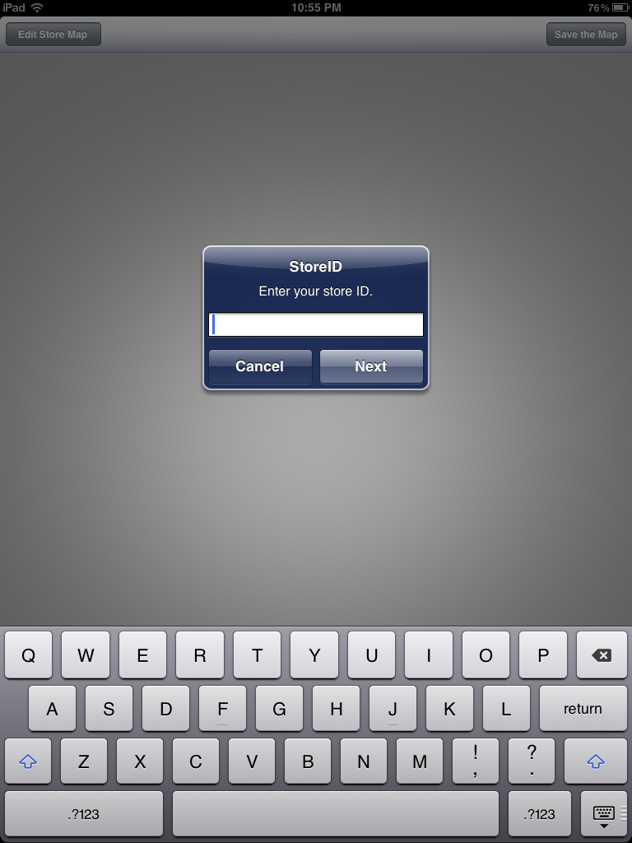
iStore Commercial
Opening Screen
Initialization
Store ID, Store Address, Store Zip

Slide 6
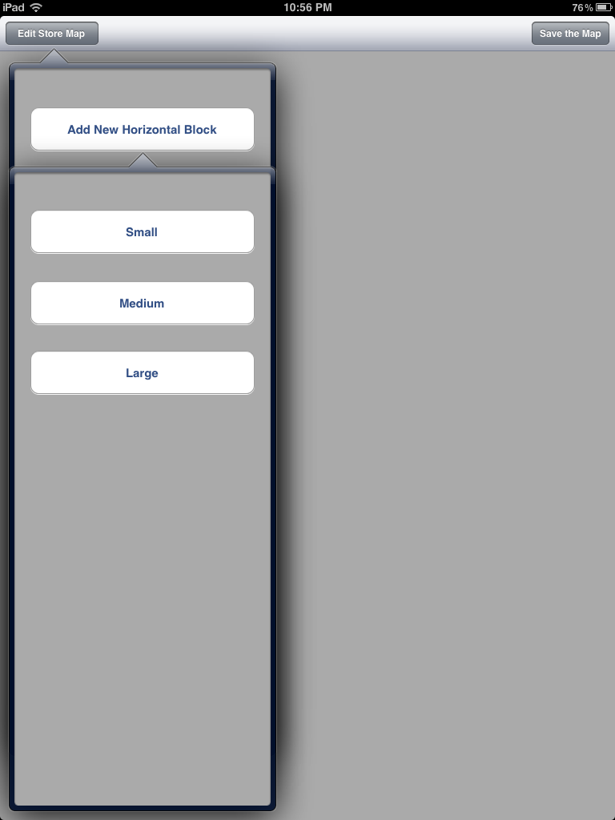
Add a Block
Add a graphical “Block”

Slide 7

iStore Commercial
Relocate Block

Slide 8
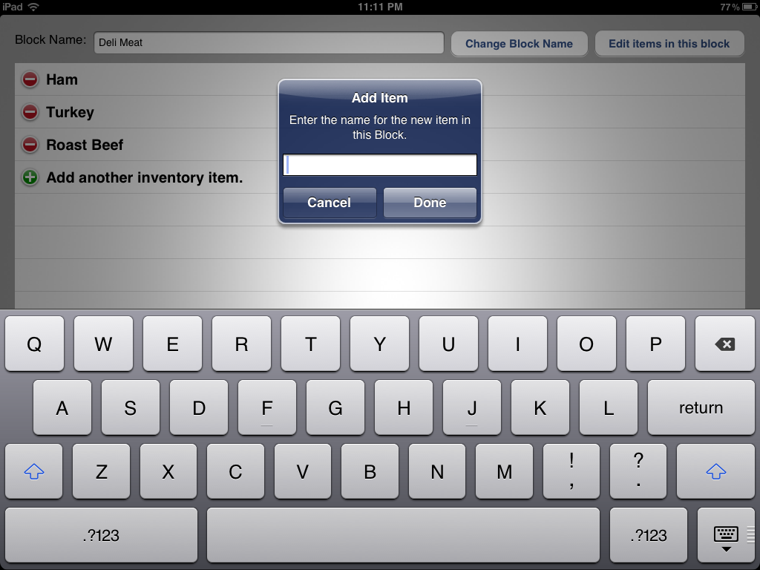
iStore Commercial
Add an Item in the Block

Slide 9

iStore Commercial
Save Store Map

Slide 10
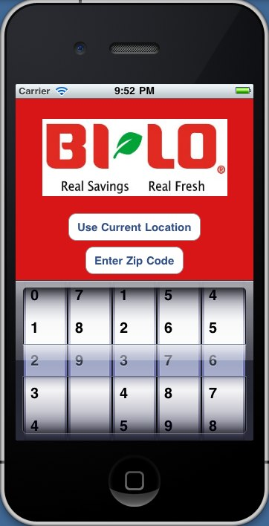
Client iStore
Two ways to input location
Use Current Location
Enter Zip Code

Slide 11
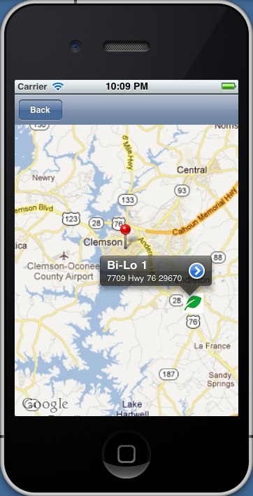
Store Located
Current Location
Drops pin on actual user location
Zip Code
Drops pin at center of postal zip code
Bi-Lo marked with trademark leaf pin

Slide 12
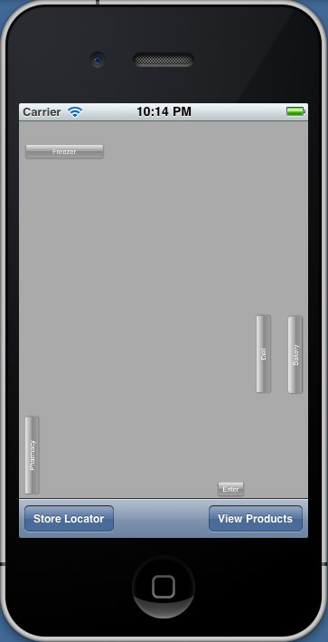
In Store Map
Store layout corresponds with the selected store
Each block represents a product category

Slide 13
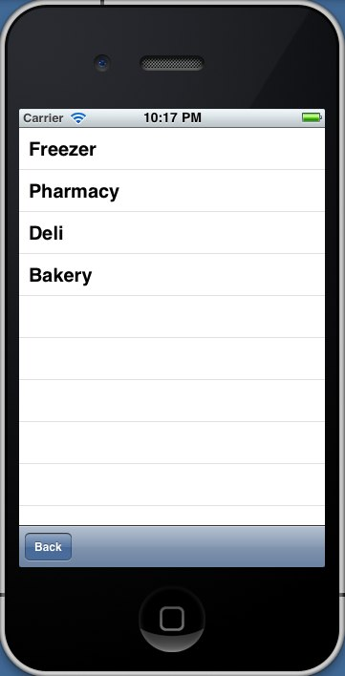
Product Categories
Block titles from previous Store Map are listed here
User selects a category to view its list of products

Slide 14
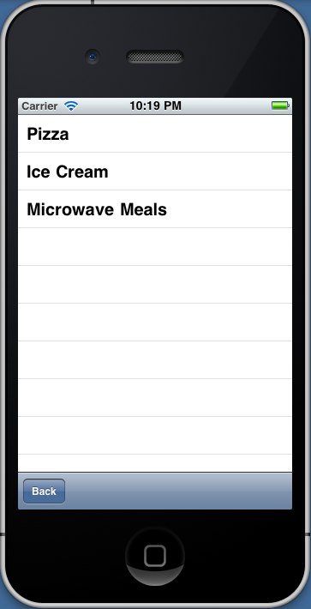
Products List
User selects a product to view its location in the store

Slide 15
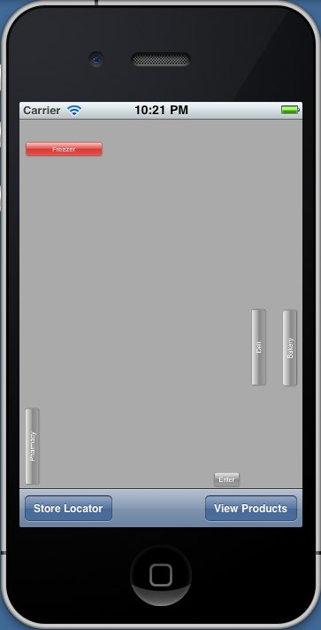
Product Category Highlighted
Highlights the category that corresponds with the selected product

Slide 16
iStore Database
Table: Inventory
UID (PK)
StoreID (FK)
SupercategoryID (FK)
SubcategoryID (FK)
Table: StoreMap
UID (PK)
StoreID (FK)
MapName
Table: StoreInformation
UID
StoreAddress (PK)
StoreZip
Table: Supercategory
UID (PK)
Name
HighlightedPictureAddress
Table: Subcategory
UID (PK)
Name

Slide 17
Demo

Slide 18
Conclusion
Multiple iStores
Locating items in a fraction of the time

Slide 19
Future Work
Search Products
Official Blocks
Doors, Rest Rooms, and other utilities
Saving Progress in iStore Commercial

Slide 20
Acknowledgements
Nick Watts
Matt Sanders
DJ Edmonson

