Slide 1
Fantasy football Predictions using ridge regression
Blake Washburn and Ryan Carney

Slide 2
Overview of Presentation
Motivation
Research Goals
Initial Experiments
Explaining the Data
Linear/Polynomial Regression
Ridge Regression
Formula exploration
Results
Conclusion

Slide 3


Why fantasy football?
Familiarity with dataset
Longtime football fans
Personal application of results
Both of us participate in fantasy football leagues
Availability of data
Fantasyfootballdatapros.com has data all the way back to 1970

Slide 4
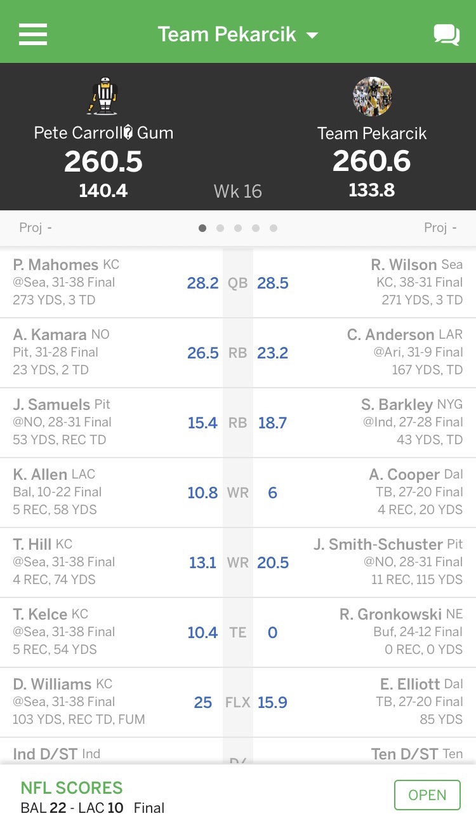
Research goals
Predict future player performance based on player statistics and league-wide trends
Apply techniques from class to compare accuracies of different prediction models
Gain insight into fantasy football trends we may not have seen

Slide 5
Overview of Presentation
Motivation
Research Goals
Initial Experiments
Explaining the Dataset
Linear/Polynomial Regression
Ridge Regression
Formula exploration
Results
Conclusion

Slide 6
The Data
Consider the data
Only including stats after 1992
Many interesting experiements – narrow field of focus

Slide 7
Linear Regression

Slide 8
Polynomial REgression

Slide 9
Overview of Presentation
Motivation
Research Goals
Initial Experiments
Explaining the Data
Linear/Polynomial Regression
Ridge Regression
Formula exploration
Results
Conclusion

Slide 10
Primary Method: Ridge regression
Multicollinearity between features
Ex: Passing Yards and Completions have correlation
More features than observations
When focusing data to one player, usually the player had less years played than statistics tracked
Applies a flexible amount of bias
Least squares regression eliminates bias and can have very high variance and overfitting

Slide 11

Ridge regression (continued)
Shrinkage estimator: Produces new estimators closer to the population parameters to deal with extreme values
L2 Regularization
Adds L2 penalty: square of the magnitude of the coefficients
All coefficients shrunk by the same factor
Tuning parameter $λ$: Flexible for the researcher
Controls the strength of the penalty term. When $λ$ = 0, you have least squares regression
$\sum_{i=1}^{M}{{{(y}_{i} − {\hat{y}}_{i})}^{2}}$ = $\sum_{i=1}^{M}{{(y_{i} − \sum_{j=0}^{p}{w_{j} x w_{ij})}}^{2}}$ + $λ\sum_{j=0}^{p}{w_{j}^{2}}$
Shrinks coefficients and helps reduce model complexity and multicollinearity

Slide 13
Overview of Presentation
Motivation
Research Goals
Initial Experiments
Explaining the Data
Linear/Polynomial Regression
Ridge Regression
Formula exploration
Results
Conclusion

Slide 14
Conclusions

Slide 15
References

