Slide 1
Classification for the Car Crashes Analysis

Slide 2
Car Crashes Data
What is our goal with the Car Crashes data?
Infer the relationship between variables and the probability of a serious injury occurring.
Why is this goal important?
Enact policy to save lives.

Slide 3
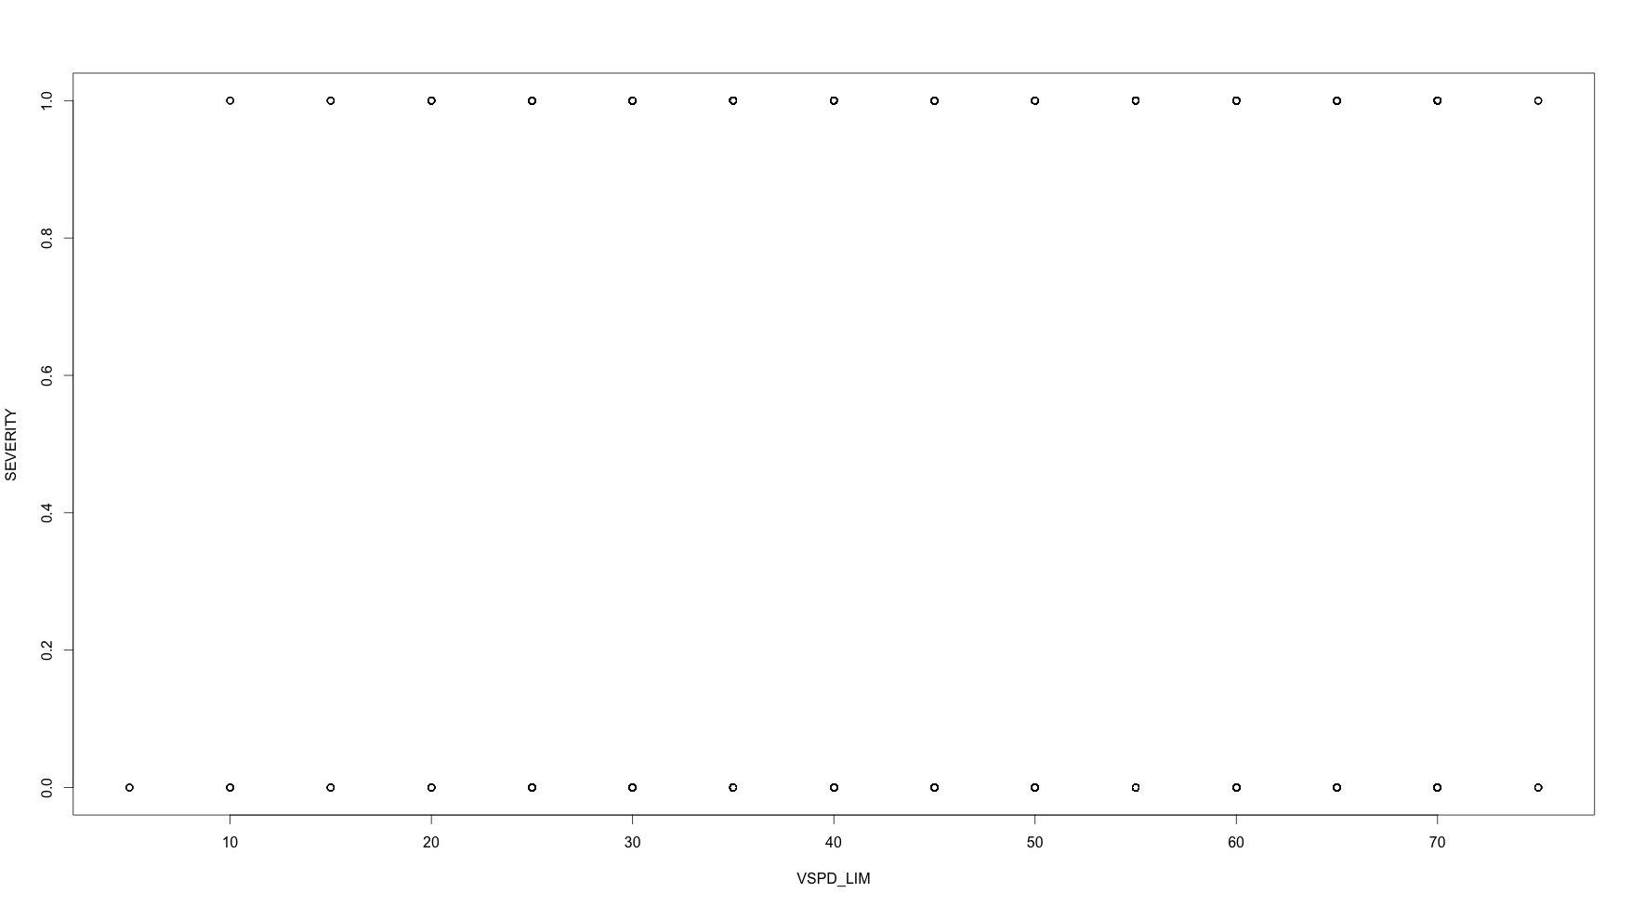
Car Crashes Data
How do we even explore the data? Scatterplots have issues.

Slide 4
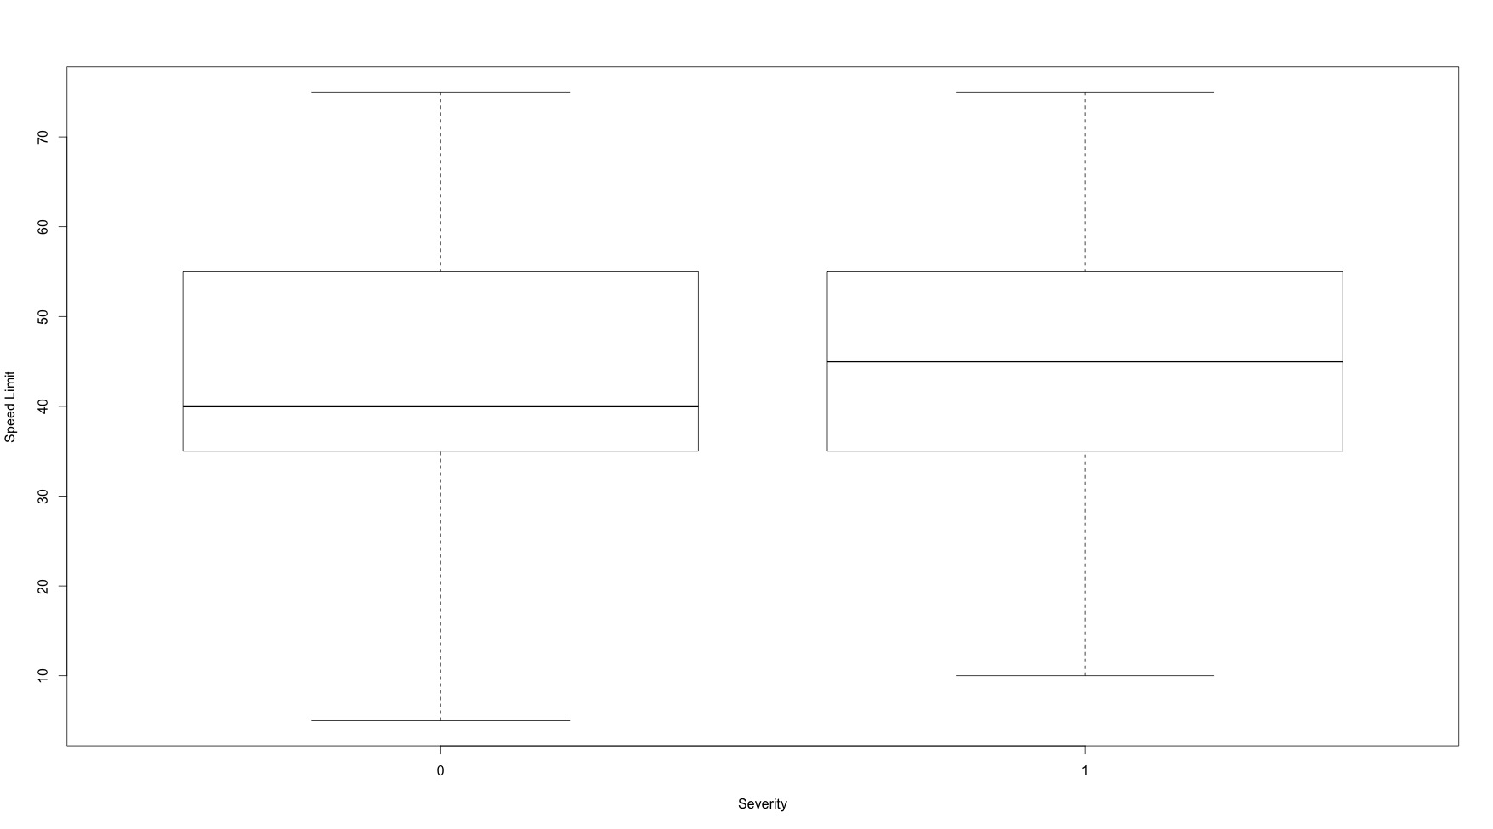
Car Crashes Data
How do we even explore the data?
Side-by-side Boxplots

Slide 5
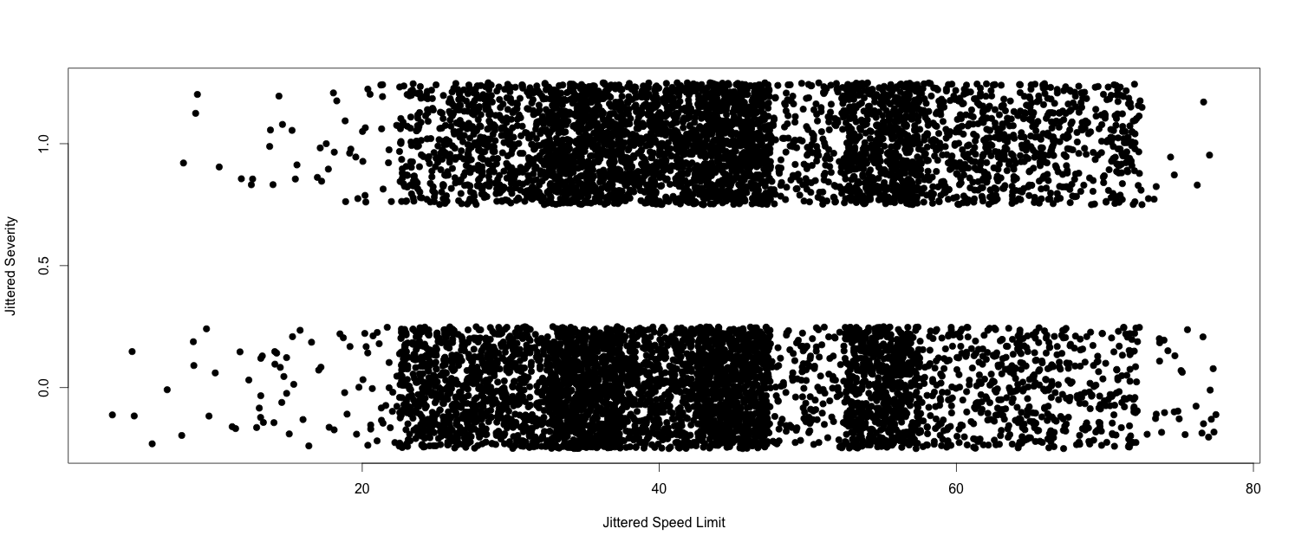
Car Crashes Data
How do we even explore the data?
Jittered Scatterplots

Slide 6
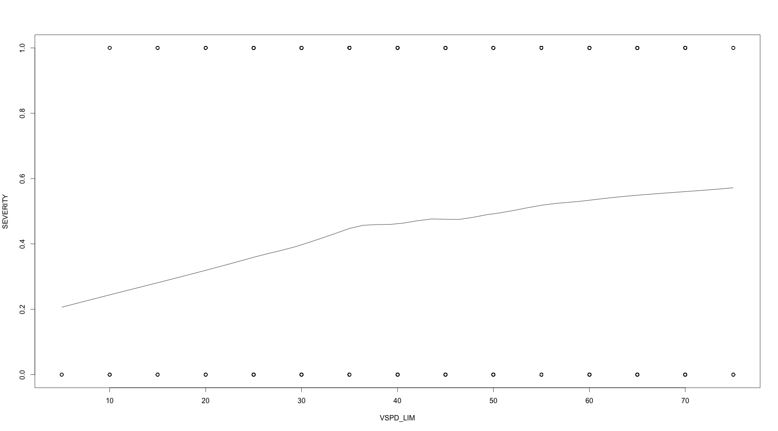
Car Crashes Data
How do we even explore the data?
Smooth fit to scatterplot

Slide 7
Car Crashes Data
How do we even explore the data?
Cross Tabulations

Slide 8
Car Crashes Data
What are the challenges with the Car Crashes data?
0/1 Categorical Response.
Lots of variables (fine line b/n quantitative and categorical).
This unit is all about dealing with binary categorical responses. This is referred to as classification.
Possible Approaches:
Logistic Regression
Probit Regression
Various Machine Learning Algorithms (next analysis)

Slide 9
Why Not Linear Regression?
Why can’t we just define:
then use:
Because:
Predictions .
Its certainly not-linear.

Slide 10
Logistic Regression
Thinking about linear regression, we have:
so, when data are continuous we use a Gaussian distribution and are interested in regressing the mean.
What’s an appropriate distribution when
Bernoulli Distribution:
When we use a Bernoulli distribution, what are we interested in?

Slide 11
Logistic Regression
So, a regression model for categorical data would be:
Problem: has to be between 0 and 1. How do we constrain our regression to be between 0 and 1?
Logistic Regression Model: (Generalized Linear Model)
Odds Ratio
Logistic Function
Logit Transform

Slide 12
Logistic Regression
Logistic Regression Model:
What are the assumptions?
Independence
Monotone in x’s.

Slide 13
Logistic Regression
Logistic Regression Model:
How do we interpret
For every unit increase in , the log-odds ratio increases by
Just interpret the sign: If , then increases as increases.
percent increase in the odds ratio.
For every unit increase in , the outcome is
more likely to occur.

Slide 14
Logistic Regression
How do we estimate
Maximum the likelihood:
In R Code: glm(y~X,family=binomial)

Slide 15
Logistic Regression
How do we get standard errors (uncertainties) associated with the MLE so we can do CIs and tests?
Asymptotics:
glm will calculate these for you. Confidence intervals can be computed by:
the.glm <- summary(glm(y~X,family=binomial))
upper <- the.glm$coef[,1] + qnorm(0.975)*the.glm$coef[,2]
lower <- the.glm$coef[,1] - qnorm(0.975)*the.glm$coef[,2]
Bootstrap it!
Be a Bayesian!

Slide 16
Logistic Regression
How do we get standard errors (uncertainties) associated with the MLE so we can do CIs and tests?
Testing multiple parameters is based on the Likelihood Ratio Tests
glm will calculate these for you:
full.glm <- glm(y~Xfull,family=binomial)
red.glm <- glm(y~Xreduced,family=binomial)
anova.glm(full.glm,red.glm)

Slide 17
Logistic Regression
How do we get predictions?
We predict the probabilities:
How do we classify from predicted probabilities?

Slide 18
Logistic Regression
How do we assess accuracy of our classifications?
Cross-Validation
Confusion Matrix
Error
Rate

Slide 19
Logistic Regression
How do we assess accuracy of our classifications?
Sensitivity (Recall): Percent of True Positives (10/12)
Specificity: Percent of True Negatives (12/16)
Positive Predictive Value (Precision): % Correctly Predicted Yes’s (10/14)
Negative Predictive Value: % Correctly Predicted No’s (12/14)

Slide 20
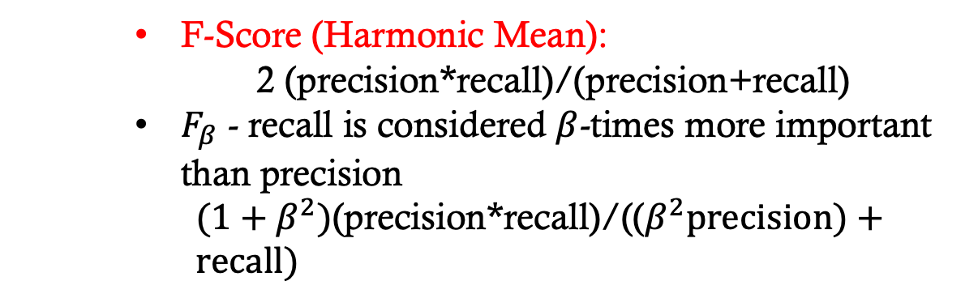
Logistic Regression
How do we assess accuracy of our classifications?
F-Score (Harmonic Mean):
2 (precision*recall)/(precision+recall)
$F_{β}$ - recall is considered $β$-times more important than precision
$(1+β^{2})$(precision*recall)/(($β^{2}precision)+recall)$

Slide 21
Logistic Regression
So, what do we choose as our cutoff value?
Classify based on highest probability (c = 0.5 is called the Bayes Classifier).
Probably want to consider cost/benefits to set a cut-off probability.

Slide 22
Logistic Regression
False Negative Rate
False Positive Rate
Overall Error

Slide 23
Logistic Regression
How do we assess accuracy of our classifications?
ROC (Receiver Operating Characteristic) Curves: Compares sensitivity to false positive rates for many thresholds.
“Coin Flip” Rate
Summarize an ROC curve by the area under the curve (AUC).
Notes:
ROC curves assess the tradeoff between classifying 1’s as 1’s but at the cost of classifying 0’s as 1’s. Ideally, we’d like to classify 1’s as 1’s with little cost of classifying 0’s as 1’s (false positives). Hence, the ideal area under the curve is 1.

Slide 24
Logistic Regression
How do we know if our model fits well?
If the likelihood is Gaussian then:
Pseudo-R²
Interpretation: Percent of best likelihood captured by your model. Warning: practical upper bound is not 1 so low R2 values are common.

Slide 25
Logistic Regression
How do we know if our model fits well?
Report the AUC of the in-sample predictions
Report the sensitivity, specificity, positive predicted value and/or negative predicted value for a given threshold
R² if you really want to (but you have been warned that good classification models may still have low R² values)

Slide 26
Logistic Regression
How do we know if our predicts well?
Report the AUC of the out-of-sample predictions
Report the sensitivity, specificity, positive predicted value and/or negative predicted value for a given threshold in out-of-sample classifications

Slide 27
Logistic Regression
How do we do variable selection in logistic regression?
The same way we do in linear regression!

Slide 28
Logistic Regression
Do we have to worry about collinearity in logistic regression?
Yes!
What can we do if we have multicollinearity?
Orthogonalize the variables.
Principal components (this is portable to GLMs).
LASSO or Ridge - glmnet(…,family=binomial).
Strong prior correlations.

Slide 29
Logistic Regression
What do we do if there is non-linearity (non-monotonicity)?
Splines
Smoothing splines - gam(…,family=binomial)

Slide 30
Logistic Regression
Logistic Regression Model:
What are the assumptions?
Independence
Monotone in x’s.

Slide 31
Probit Regression
Probit Regression Model:
In R: glm(y~X,family=binomial(link=“probit”))
What are the assumptions?

Slide 32
Probit Regression
Logistic vs. Probit Regression : Is there a difference?
Coefficients will be different, but probability curve will be about the same.

Slide 33
Probit Regression
Logistic vs. Probit Regression :
 | Advantages | Disadvantages
Logistic | Interpretability | No conjugacy
Probit | Conjugacy in Bayesian Model | Can only interpret sign of coefficients.

Slide 34
Expectation for Car Crashes Analysis
Clean the data – you’ll have to make decisions on
Should some categories be combined?
Determine a method for the car crashes dataset.
Justify which variables are in the model.
Justify linear vs. non-linear effects.
Fit your chosen model and report:
Effects and confidence intervals – be sure to interpret these appropriately.
Compare probabilities of different groups.

