Slide 1
Stat 536 Midterm: Lodgepole Pine Basal Area

Slide 2
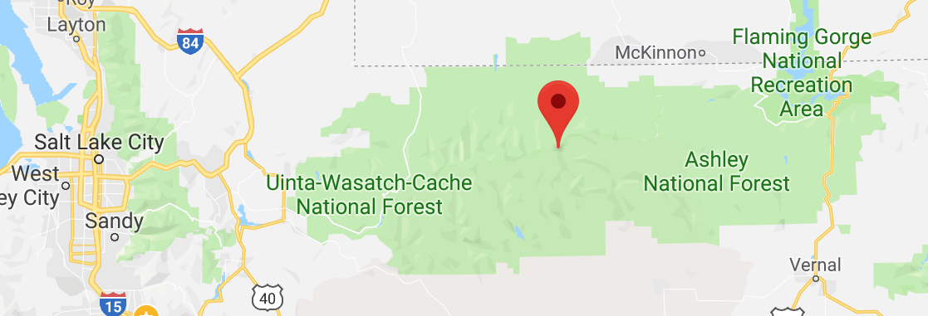
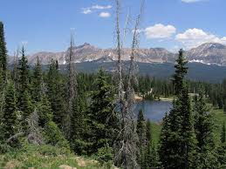
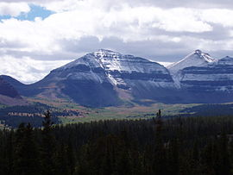
Uinta National Forest

Slide 3
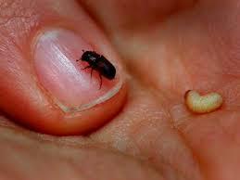
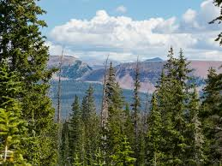
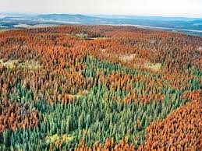
Lodgepole Pines vs. Pine Beetles

Slide 4
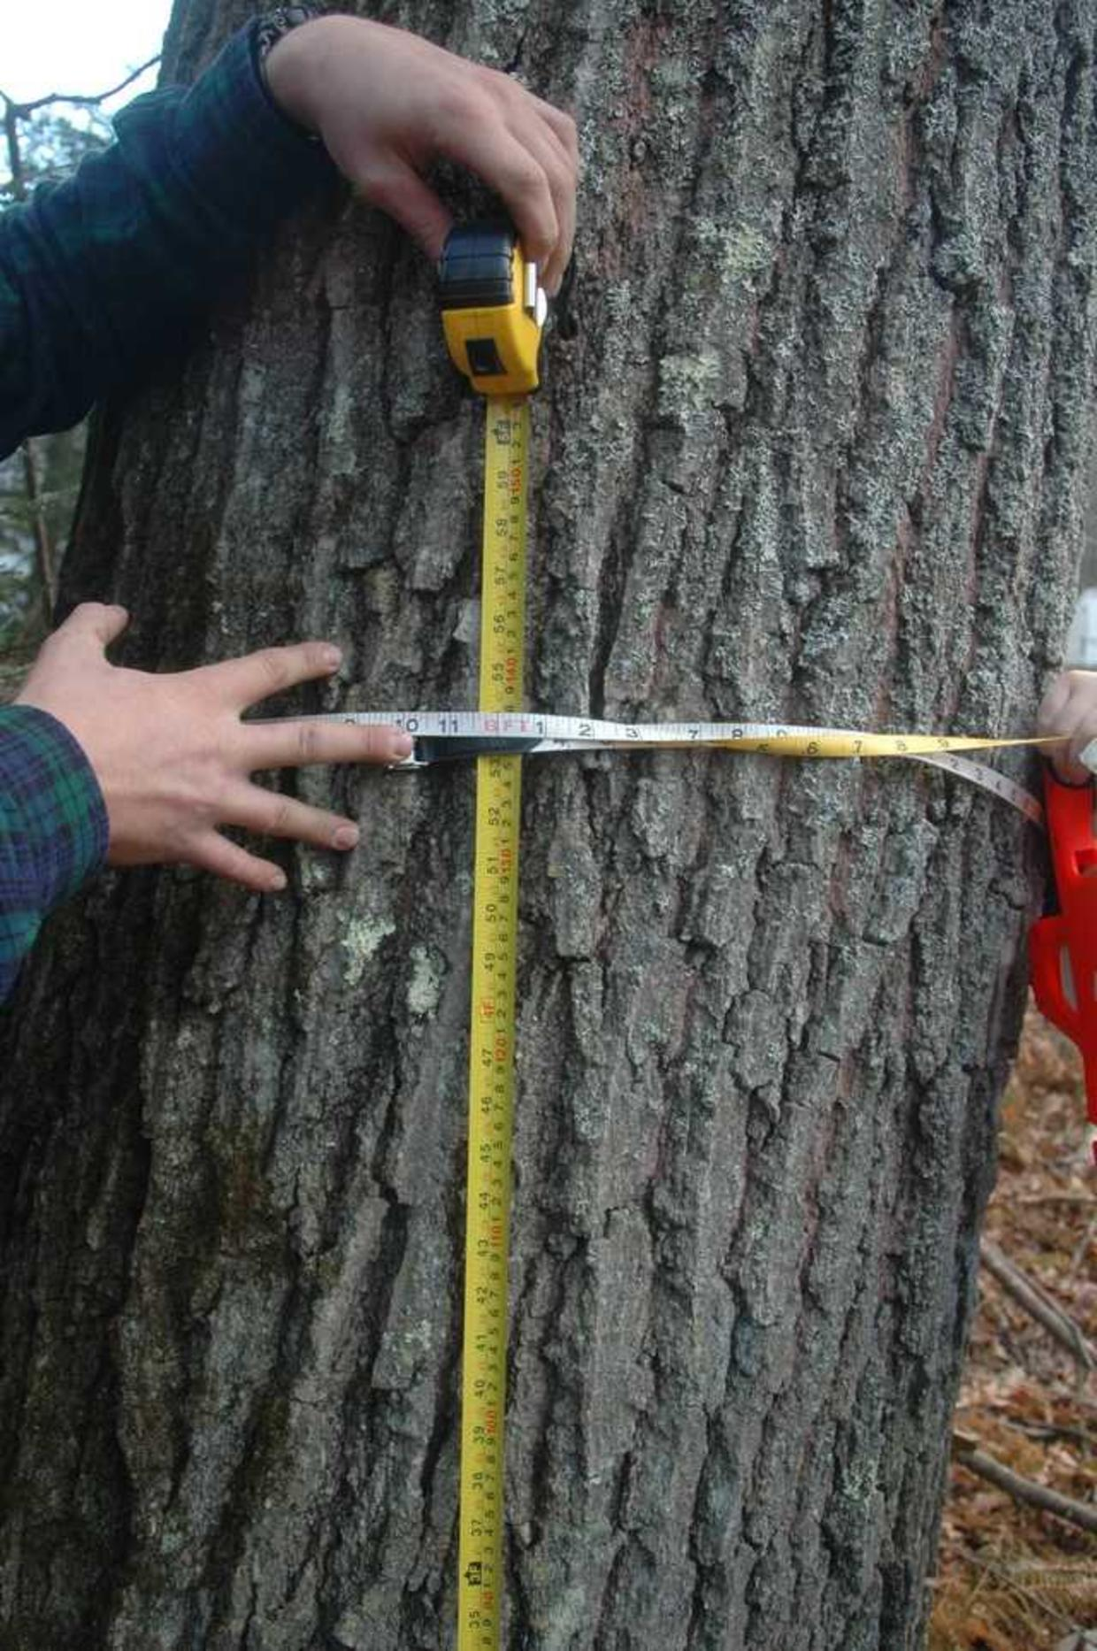

The Forest Inventory Analysis

Slide 5
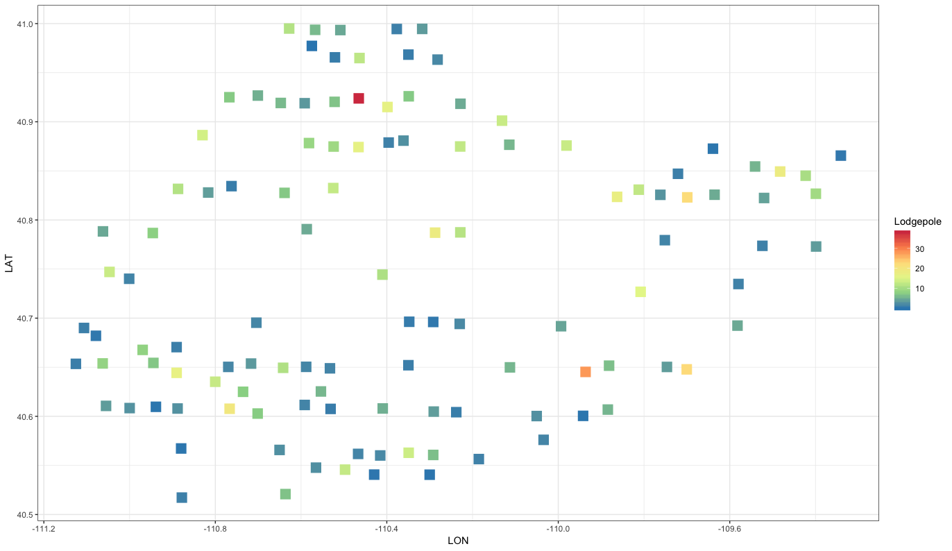
Data

Slide 6
Data
Variable | Description
LON | Longitude coordinate of the plot
LAT | Latitude coordinate of the plot
Slope | Average slope of the plot in degrees (0=flat, 90=vertical)
Aspect | Counterclockwise degrees from north facing (90 = west, 180 = south, 270 = east)
ELEV | Elevation of plot centroid in feet
Lodgepole | Cumulative basal area of lodgepole pines in square feet/acre

Slide 7
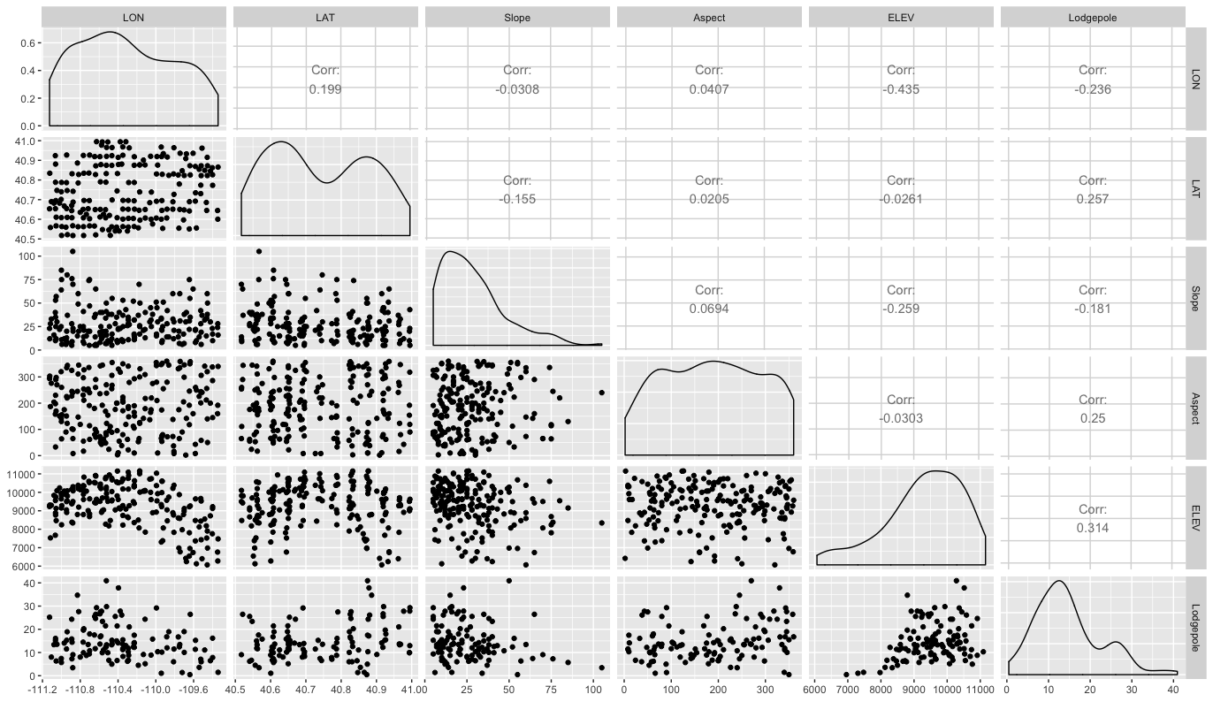
Data

Slide 8
Research Questions
How is lodgepole pine basal area affected by its environment (e.g. slope, aspect and elevation)?
What environments are conducive to lodgepole pine growth?
What is the basal area for trees at locations where the FIA wasn’t able to go?

Slide 9
Rules for the Midterm
You must work on your own – no communication between any of you.
I am available to debug coding ERRORS only, and of course clarify what the assignment is asking you to do.
Follow the same rubric that we have used on our case studies.

Slide 10
Expectations:
Audience: PhDs in environmental science/forestry/etc.
They know basic statistical methods (e.g. intervals) well and have heard the names of ML techniques.
When you finally choose a model to use, JUSTIFY it!
Tell how to use it to answer the questions
Tell how it accounts for challenges in data
Validate your model assumptions
Check prediction accuracy (i.e. CV vs. other types of models, just like the HW)
Include uncertainty in answering the research questions whenever possible.

