Slide 1
Final:
Tulip Germination

Slide 2
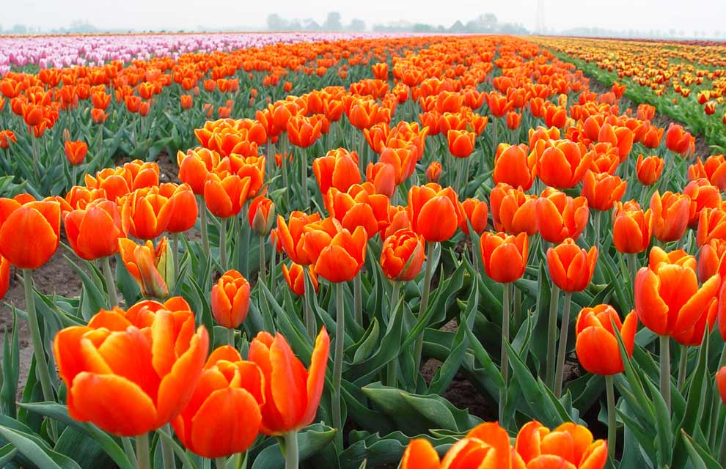
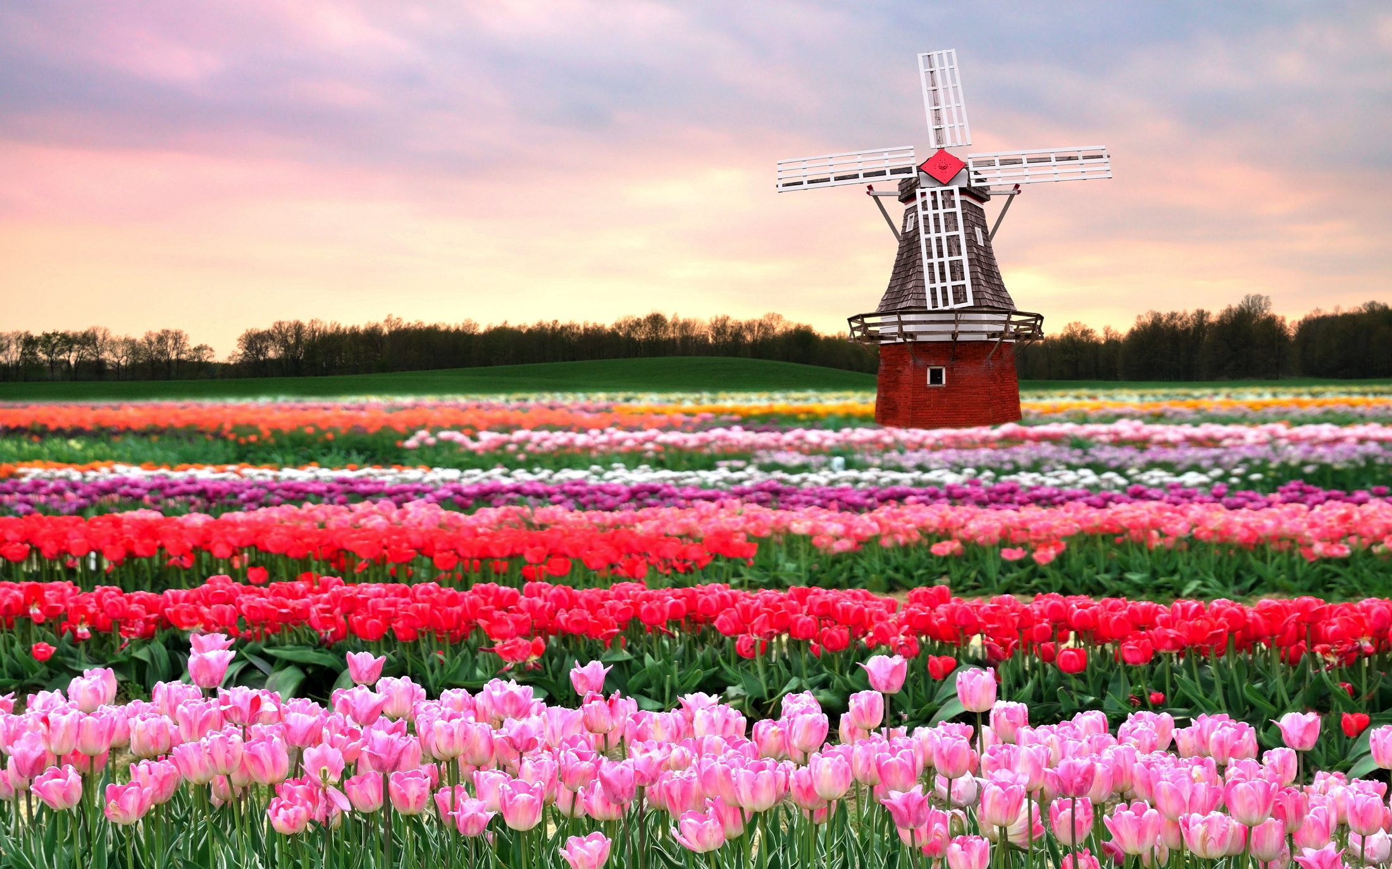
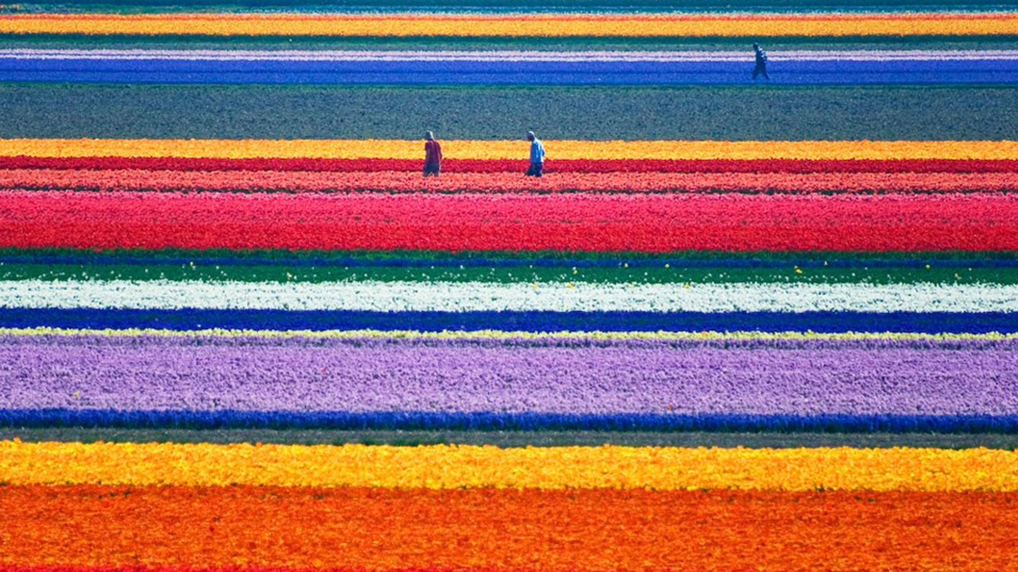
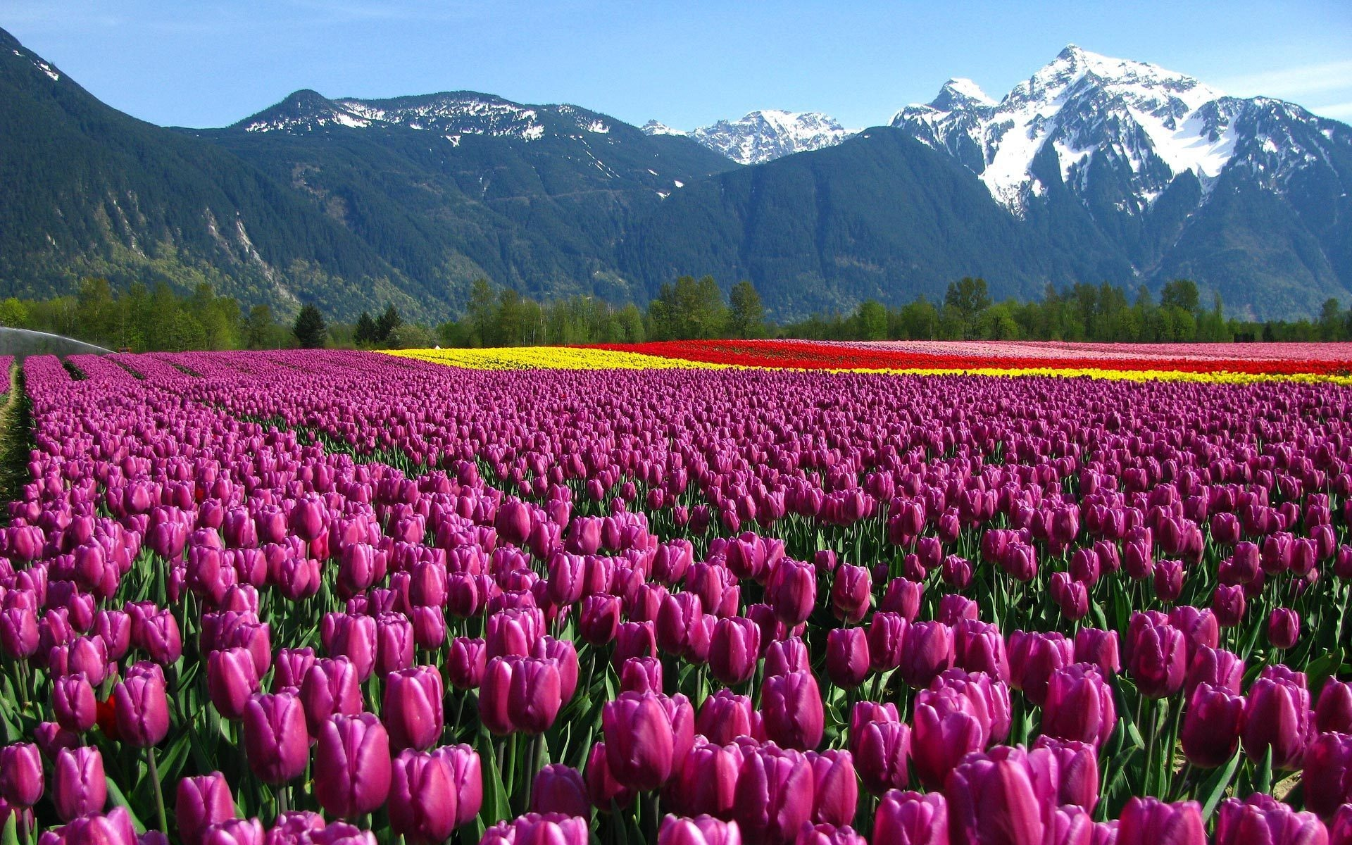
Tulip Fields in the Netherlands

Slide 3
Tulips in Netherlands
Came to Netherlands in mid-16th century and quickly become a symbol of the region.
Tulips bloom between mid-March to the end of May and attract tourists from all over the world.
9 million bulbs produced annually.
Account for 25% of agricultural exports.

Slide 4
Growing Tulips
Best to plant tulips in the Fall.
Require a “chilling time” to bloom.
Need to be planted in well-drained and airy soil (flooding can be devastating to tulips).
Once they start to grow, require lots of sunlight.

Slide 5
Climate Change in the Netherlands
Observed temperature rise is about twice global average.
Precipitation may increase by as much as 5%.
Higher risk of flooding
Increases in sea levels affect negative elevation areas.

Slide 6
Tulip Germination Experiment
Goal: Get bulbs to germinate.
Data:
  210 bulbs from 12 different “populations” collected from the fields.
  Each population randomly split into 7 groups (30 in each group) and assigned to one of 7 different chilling times in the lab (0, 2, 4, …, 12 weeks).
  Response was if bulb germinated (sprouted).
  Note: 30 x 7 x 12 = 2520 rows

Slide 7
Tulip Experiment
Research Questions
What is the effect of chilling time for the different species of tulips? Is it the same across the species? Which species are the same/different?
Is there an ideal chilling time for each species? If so, is it the same for all species?
Given climate change conditions, winters are expected to decrease from 10 to 9 weeks in the coming few years. What effect will this decrease in chilling time have on the probability of germination for each species? Is it the same for all species?

Slide 8
Rules for the Final
Reports must be done on your own – please minimize talk between each other.
Final reports are 20 minute oral presentations. Submit your slides on Gradescope before your presentation time. You can sign up for a presentation slot with the link on Canvas.
I’m available to answer coding and “how” questions but not “what” questions.

Slide 9
Expectations for the Final
Two proposed models:
  One in the linear model framework (includes lasso/ridge, splines, logistic, etc.)
  One machine learning method (trees/forests, neural nets, SVM, discriminant analysis, KNN, etc.)
Audience: Dr. Fisher
Answer the research questions explicitly
  Use visualizations, especially as it’s a presentation and pictures are worth 1000 words (and this slide has too much text for a real presentation, on purpose… but it is an instruction slide and I’m striving for clarity)

Slide 10
Expectations for the Final
Follow the rubric
  Fully describe the techniques you use and tell me why it’s good for this scenario!
  Clearly state and justify any assumptions in whatever model you use.
  I want to see uncertainties whenever your method permits it.

Slide 11
Expectations for the Final
Especially focus on the BOLD parts of the rubric
  EDA: find peculiarities/challenges in the data and in using the data to answer the research questions (with good plots/figures)
  Propose models that appropriately address both the data's limitations and the research questions.
  Model Choice: IS/OOS vs. interpretability
  Answering research questions well, with good figures when you can/when appropriate.
  Did I mention using helpful visualizations? ;)

