Slide 1

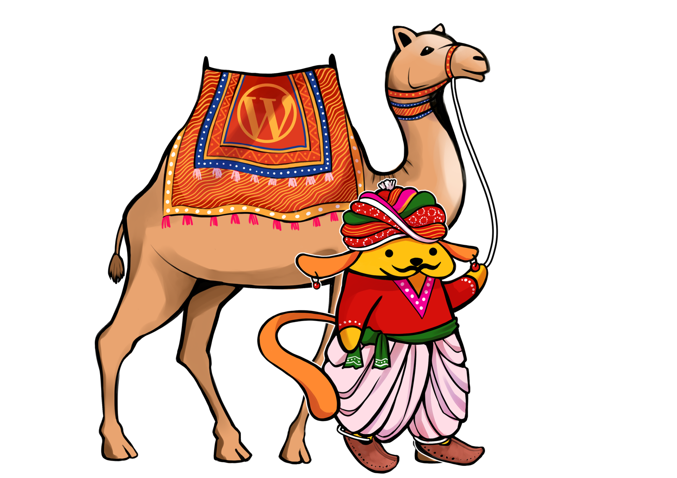
खम्मा घणी! WordCamp Rajasthan 2026
Ek WordPress,
Hazaar Sites
WordPress Multisite — the Rajasthani joint family of the web: kya hai, kisko chahiye, setup, challenges aur unke solutions
Prathamesh Palve
Technical Lead, CampusPress & Edublogs · @prathameshp
4 Oct 2026 · Rajasthan International Centre, Jaipur · #wcrajasthan
Notes:
Khamma Ghani Jaipur! Padharo mhare desh — aur aaj padharo mhare network mein. Main Prathamesh, aur aaj hum baat karenge us feature ki jiske baare mein sab sunte hain par koi poochta nahi: WordPress Multisite. Ek install, hazaar sites. Seatbelt baandh lo, camel ki sawari shuru.

Slide 2


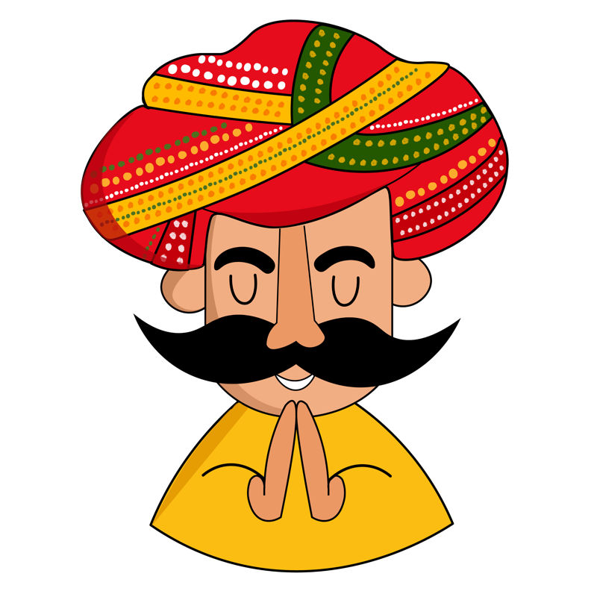


Khamma Ghani, main hoon Prathamesh
Din mein Multisite networks sambhalta hoon. Raat mein mummy ko samjhata hoon ki main karta kya hoon.
Roz hazaaron sites ka babysitter hoon!
8+ saal
CampusPress
WordPress support, platform ops aur technical leadership
Technical Lead — universities aur schools ke bade Multisite networks
Community
Contributor
Co-organiser, WordPress Thane Meetup · WordCamp speaker
Marathi & Hindi translations · forum support · WPTV
☰ Menu
Notes:
Quick intro. CampusPress aur Edublogs pe hum education ke liye bahut bade Multisite networks chalate hain — migrations, SSO, plugin governance, performance, incidents. To jo bhi aaj bolunga, woh production ke zakhmon se seekha hai.

Slide 3





Aaj ki Thaali: Menu
Kisi bhi tile pe click karo, seedha wahin pahunchoge. Har slide ka “☰ Menu” button wapas yahin laata hai.
01
02
03
Multisite kya bala hai?
Koi use bhi karta hai?
Kab lo, kab nahi
Haveli wala funda
Myth busting
Plus ek quiz
04
05
06
Setup ki zaroorat
File & DB structure
Dard aur Dawa
Checklist & wp-config
Single vs Multisite
Challenges → solutions
Notes:
Yeh interactive menu hai — Slide Show mode mein kisi bhi tile pe click karo. Audience se poochho: kaunsa pehle khaayein? (Spoiler: hum order mein hi chalenge.)

Slide 4




Multisite kya bala hai?
Single site = apna 1BHK flat. Multisite = poori haveli: ek chhat, kai kamre, ek Thakur Sa.
Ek core, anek sites
1 WordPress install
core + plugins + themes
Ek hi WordPress codebase se sau, hazaar sites chalti hain.
Plugins & themes shared
1 Database
har site ki apni tables
Super Admin install karta hai, site admin bas activate karta hai.
Content alag, users common
Site 1
jaipur
Site 2
jodhpur
Site 3
udaipur
Site 4
bikaner
Har site ki apni tables; users ek hi pool se aate hain.
Network Admin = Thakur Sa
Ek update = saari sites update
Ek dashboard se poori haveli ka control.
☰ Menu
Notes:
Multisite WordPress core ka built-in feature hai, koi plugin nahi. Ek install, ek database, lekin har site ki apni posts/options tables. Users aur plugins/themes poore network mein shared. Super Admin = Thakur Sa — sab unke haath mein.

Slide 5



“Multisite koi use bhi karta hai?”
Haan bhai, karta hai! Aur shayad aap roz unki sites padhte ho.
Afwaah vs Asliyat
WordPress.com
Universities & schools
Multisite toh dead feature hai
Core ka part hai, har release ke saath maintain hota hai
Khud Multisite pe chalta hai
Har department, har class ki site
Media houses
Franchises & brands
Sirf badi companies ke liye
2 se 20,000 sites tak, jahaan parivaar ek jaisa ho
Har shehar ka regional edition
Har outlet / branch ki site
Bahut complex, mat chhedo
Setup 10 minute ka; mehnat governance mein hai
Government & NGOs
Multilingual
Har vibhaag ek network mein
Hindi, Marwari, English: ek-ek site
☰ Menu
Notes:
Yeh sabse bada stereotype hai: 'Multisite? Woh koi use karta hai kya?' WordPress.com khud Multisite pe chalta hai. Edublogs aur CampusPress education ke liye bade networks chalate hain. Newsrooms, franchises, sarkari vibhaag — sab. Audience se poochho: kitne logon ne kabhi Multisite banaya hai? Haath uthao! Ab kitne logon ne use production mein chalaya? ... Dekha, yahi farak hai.

Slide 6


Kab lo Multisite, aur kab bilkul nahi
Haan, Multisite lo
Ruko, alag ghar do
Sites ka DNA same: wahi plugins, wahi theme family
Ek central team, central control aur governance
Users ko kai sites pe ek hi login chahiye
Nayi site minute mein spin-up karni hai (template se)
Updates & security ek jagah se sambhalni hai
Har site ko alag plugins, alag PHP, alag hosting chahiye
Clients ko apna server aur full admin control chahiye
Site kal bechni ya network se alag karni hai
Ek plugin se kaam chal jaaye (jaise multilingual)
Sirf isliye ki naam cool lagta hai
Jaise: university, newsroom, franchise
Jaise: agency ke 25 alag-alag clients
Golden rule: Sites ek parivaar jaisi hain? Multisite. Sirf padosi hain? Alag-alag ghar.
☰ Menu
Notes:
Multisite ka decision technical se zyada organisational hai. Agar sites ek hi team chalati hai aur ek jaisi hain, Multisite jadoo hai. Agar agency ke 25 alag clients hain jinke apne hosts aur apne plugins hain, Multisite unhe ek hi ghar mein zabardasti bithana hai — roz jhagda hoga.

Slide 7
Haath Uthao! Multisite ya Single?
Har case pe vote karo, phir “Jawab dekho” dabao.
A
B
C
D
University with 400 department sites
Agency with 25 clients
Pizza chain with 60 city outlets
Aapka blog + mummy ka recipe blog
Ek IT team, ek brand, ek login
Har client ka alag host, alag bill
Same design, local menu & offers
Do sites, do log, zero IT team
Jawab dekho →
Jawab dekho →
Jawab dekho →
Jawab dekho →
☰ Menu
Notes:
Interactive part! Har case padho, audience se haath uthwao: Multisite wale ek taraf, Single wale doosri taraf. Phir 'Jawab dekho' pe click karo.

Slide 8
Jawab haazir hai
A · Multisite
B · Single sites
Ek team, ek brand, ek login: textbook case. CampusPress roz yahi karta hai.
Alag clients, alag hosts, alag billing. Ek ki galti sab pe na gire.
C · Multisite
D · Single site
Brand central, menu local. Nayi branch = nayi site, 2 minute mein.
2 sites ke liye Multisite = 2 mehmaanon ke liye shaadi ka tent.
← Quiz pe wapas
☰ Menu
Notes:
Jisne D ke liye Multisite bola — aapko main personally ek dal-baati free mein dunga, par Multisite nahi. Rule simple hai: shared ownership + shared stack = Multisite.

Slide 9





Setup ki zaroorat: pehle checklist, phir magic
Multisite-friendly hosting
wp-config.php
Kuch shared hosts mana karte hain, pehle pooch lo
/* Step 1: network ka darwaza kholo */
define( 'WP_ALLOW_MULTISITE', true );
/* Step 2: Tools → Network Setup */
/* Step 3: generated code paste karo */
define( 'MULTISITE', true );
define( 'SUBDOMAIN_INSTALL', false );
define( 'DOMAIN_CURRENT_SITE', 'jaipur.test' );
define( 'PATH_CURRENT_SITE', '/' );
define( 'SITE_ID_CURRENT_SITE', 1 );
define( 'BLOG_ID_CURRENT_SITE', 1 );
/* Step 4: dobara login → Network Admin */
Pretty permalinks + rewrites
Apache mod_rewrite ya Nginx rules ready
Subdomain? Wildcard DNS + SSL
*.example.com ka DNS record aur wildcard cert
Full backup + plugins deactivate
Files aur DB dono. “Backup nahi liya” = horror story
WP-CLI access
Shortcut: wp core multisite-convert
Badi network ka asli jeevan-saathi
☰ Menu
Notes:
Setup asaan hai, taiyari zaroori hai. Step 1: wp-config mein WP_ALLOW_MULTISITE. Step 2: Tools > Network Setup, subdomain ya subdirectory chuno. Step 3: jo code WordPress de, wp-config aur .htaccess mein paste karo, dobara login karo. Ya WP-CLI se ek line: wp core multisite-convert.

Slide 10
Ghar ka pata kya rakhein?
Subdomain, subfolder ya apna domain: network banate waqt hi socho, baad mein badalna dard hai
Subdomain
Subdirectory
Domain mapping
jodhpur.example.com
example.com/jodhpur
jodhpur.in
Har site apni pehchaan wali lagti hai
Wildcard DNS + wildcard SSL chahiye
Badi networks ka favourite
Ek domain, ek SSL: sabse simple
SEO authority ek hi domain pe
Purani (1 mahine+) site pe option band milta hai
Core mein built-in (WP 4.5+)
Site URL network admin se badlo
DNS, SSL aur cookies ka dhyaan rakho
Best for: schools, cities, brands
Best for: departments, languages
Best for: alag brand, apna domain
☰ Menu
Notes:
Fun fact: agar aapki WordPress install ek mahine se purani hai, Network Setup subdirectory option disable kar deta hai, taaki purane permalinks se takraav na ho. Domain mapping ab core mein hai, plugin ki zaroorat nahi — bas DNS aur SSL sahi rakho.

Slide 11
File structure: files ek, tables anek
Single Site 1BHK flat
Multisite Poori haveli
Maroon
= Multisite mein naya ya badla hua
~10
nayi tables har nayi site pe
wordpress/
├─ wp-config.php
├─ .htaccess
└─ wp-content/
├─ plugins/
├─ themes/
└─ uploads/2026/10/
Database
wp_posts wp_postmeta
wp_options wp_terms …
wp_users wp_usermeta
wordpress/
├─ wp-config.php ← + MULTISITE
├─ .htaccess ← network rules
└─ wp-content/
├─ plugins/ ← sab ke liye
├─ mu-plugins/ ← network-wide
├─ sunrise.php ← optional
└─ uploads/sites/2/2026/10/
Database
wp_posts → wp_2_posts, wp_3_posts …
Global: wp_blogs wp_site wp_sitemeta
wp_blogmeta wp_signups
Shared: wp_users wp_usermeta
Sab kuch ek site ka. Simple, seedha.
Code shared, content alag-alag kamron mein.
☰ Menu
Notes:
Single site mein sab ek jagah. Multisite mein files wahi rehti hain, lekin wp-config mein constants, .htaccess mein naye rewrite rules, uploads har site ke liye uploads/sites/<id>/ mein. Database mein main site wp_ prefix rakhti hai, baaki wp_2_, wp_3_ ... Plus global tables: wp_blogs, wp_site, wp_sitemeta, wp_blogmeta, wp_signups, wp_registration_log. Users sab ke common. Isiliye 1000 sites = 10,000 se zyada tables. Yaad rakhna, agle slide mein yahi dard banega.

Slide 12



Dard aur Dawa #1: performance & scale
Haveli badi ho to bijli ka bill bhi bada aata hai
DARD (problem)
DAWA (solution)
Database bloat
1,000 sites × ~10 tables = 10,000+ tables
Object cache + DB sharding
Redis/Memcached; HyperDB ya LudicrousDB se DB split
Ek plugin, poora network down
Network-activate kiya, sab sites ka jhatka
Staging + plugin governance
Pehle staging network, approved list, rollback plan
WP-Cron ki laziness
Cron sirf visit pe chalta hai, so rahi sites miss
Real server cron
DISABLE_WP_CRON + har site pe wp cron event run --due-now
Uploads ka pahaad
uploads/sites/* chupchaap TBs tak pahunch jaata hai
Offload + quotas
Media S3/CDN pe; Network Settings mein upload space limit
☰ Menu
Notes:
Yeh woh problems hain jo 10 sites pe nahi dikhti, 1000 pe neend uda deti hain. Object cache must hai. Bahut badi networks mein DB ko multiple servers pe baanto. Plugin ko network-activate karne se pehle staging network pe test karo — ek fatal error, poori haveli andhere mein. Cron ko traffic ke bharose mat chhodo.

Slide 13



Dard aur Dawa #2: operations & people
Joint family mein asli jhagde log aur kaagaz-patr ke hote hain
DARD (problem)
DAWA (solution)
Ek site andar/bahar migrate karna
IDs, prefixes, uploads/sites/N paths sab badalte hain
WP-CLI + Multisite-aware tools
wp search-replace --url / --network, per-site export & backups
Domain mapping & SSL
Cookie errors, redirect loops, “Not secure” warning
Core domain mapping + auto SSL
Har domain ka cert automate; COOKIE_DOMAIN sambhal ke
Plugin compatibility
get_option vs get_site_option, switch_to_blog() bhool gaye
Multisite pe test karo
Network vs site settings alag; “Network: true” header samjho
Roles ka confusion
Site admin plugin install nahi kar sakta, unfiltered_html band
Clear roles + kam Super Admins
Role guide likho, onboarding karo, Super Admin VIP pass rakho
☰ Menu
Notes:
Technical se zyada process ki problems. Site ko network se nikaalna ya laana — table prefix, blog_id, uploads path sab badalte hain, isliye WP-CLI aur Multisite-aware migration tools. Developers ke liye: network options aur site options alag hain, switch_to_blog ke baad restore_current_blog bhoolna mat. Aur Super Admin ka role sirf 2-3 logon ko — sabko Thakur Sa mat banao.

Slide 14
Jugaad nahi, WP-CLI: survival kit
1,000 sites pe click-click karoge to Diwali se Holi aa jaayegi
$ wp site list --fields=blog_id,url
Network ki saari sites ki list
$ wp site create --slug=jodhpur --title="Jodhpur"
Nayi site, 2 second mein
$ wp plugin activate my-plugin --network
Plugin poore network pe on
$ wp search-replace old.test new.test --network
Saari site tables mein URL badlo
$ wp --url=jodhpur.example.com cache flush
Kisi ek site pe command chalao
$ wp super-admin list
Dekho Thakur Sa kaun-kaun hain
☰ Menu
Notes:
Live demo ka time ho to yahan 2-3 commands chala ke dikhao. --url flag Multisite ka jaadu hai: kisi bhi WP-CLI command ko kisi ek site pe target karo. --network flag poore network pe.

Slide 15
Teen baatein ghar le jao
Padharo mhare network!
1
Multisite parivaar ke liye hai, padosiyon ke liye nahi
Same stack + same team = haan. Warna alag ghar.
2
Setup 10 minute, governance zindagi bhar
Staging, plugin policy, roles, backups: pehle din se.
3
Scale pe cache, cron aur WP-CLI hi asli dost
Object cache, real cron, --network & --url.
Dhanyavaad! Sawaal poochho, sharmao mat.
profiles.wordpress.org/prathameshp
rajasthan.wordcamp.org/2026
#wcrajasthan
☰ Menu
Notes:
Summary: Multisite parivaar hai — pyaar bhi, jhagde bhi; management sahi ho to maza hi maza. Dhanyavaad WordCamp Rajasthan! Q&A ke dauraan koi bhi topic chahiye to Menu se wahin jump kar sakte hain.

