Slide 1
Google Search Trend Analysis with Python
Understanding Public Interest Across Time and Regions
By Rituraj Singh

Slide 2
Problem Statement
With over 8.5 billion Google searches daily, understanding what people are searching for can reveal deep insights into public interest, market demand, and emerging trends.
Businesses, educators, and marketers need real-time data to make informed decisions. This project provides a way to analyze and visualize search trends using Python and Google Trends data.

Slide 3
Why This Project Matters
- It automates the search analysis process
- It answers real business questions using real-time data
- It provides dynamic visualizations for instant insight
- Anyone can reuse it by changing just one keyword

Slide 4
What Business Questions Are Answered?
1. Which countries search the keyword the most?
2. How does interest vary across the world (map view)?
3. What is the trend of the keyword over time?
4. How do related keywords compare?
5. What are the actionable insights from the data?

Slide 5
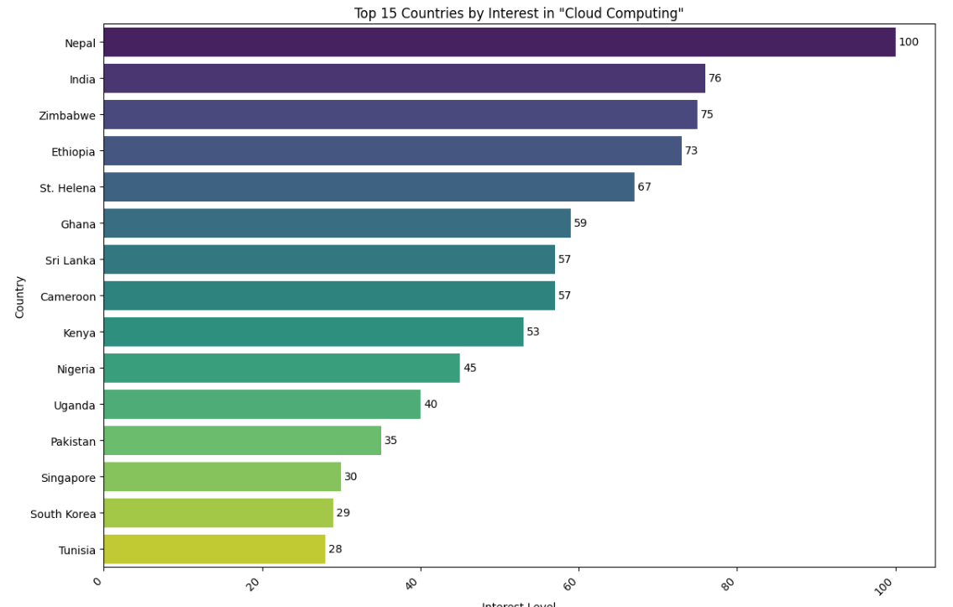
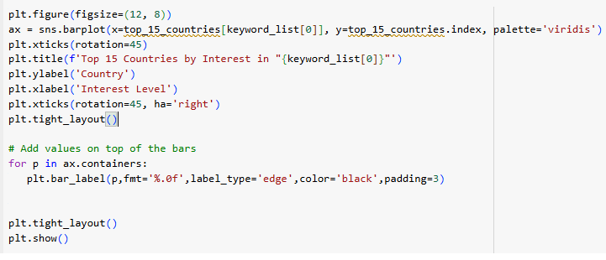
Top 15 Countries by Search Interest
Insight: Nepal, India, and Zimbabwe show the highest interest in 'Cloud Computing'.

Slide 6
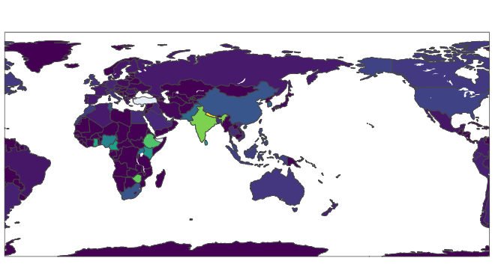
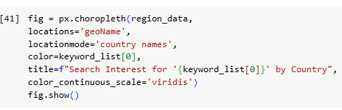
Search Interest by Country (Map View)
Insight: India, Ethiopia, and Nigeria stand out with strong regional interest.

Slide 7
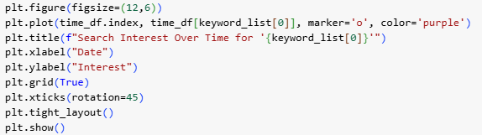
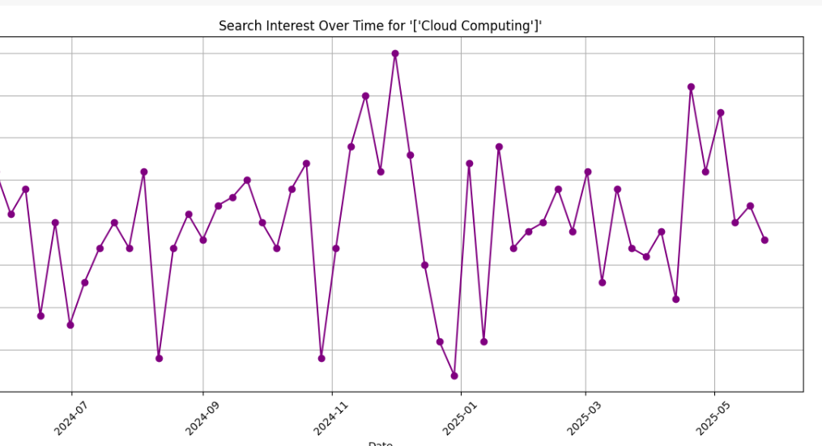
Search Trend Over Time
Insight: Search interest peaked in Nov–Dec 2024 and dropped in Aug 2024 and Jan 2025.

Slide 8
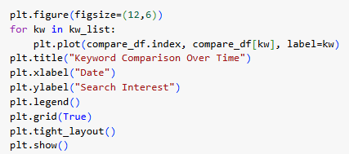
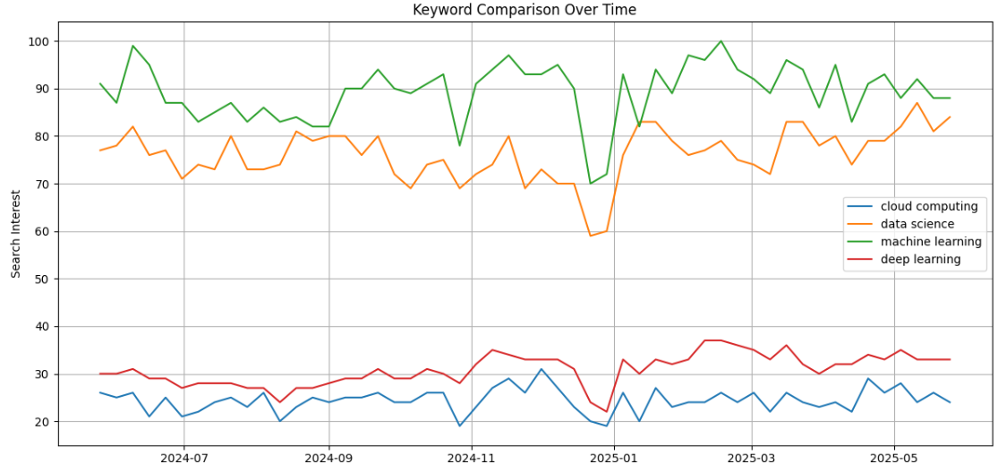
Keyword Comparison Over Time
Insight: Machine learning leads overall; cloud computing trends more steadily but lower in interest.

Slide 9
Business Impact
- Helps marketers time campaigns and ads
- Informs SEO and content strategy
- Supports educators in course launches
- Helps startups validate product demand
- Enables data-driven decision making

Slide 10
Summary & Conclusion
This project enables real-time, keyword-based trend analysis using Python.
✔ Easy to reuse — just change the keyword
✔ Instant insights — from geography to time-based trends
✔ Helps multiple departments make smarter decisions
This tool is a step towards data-driven strategy and awareness.

