Slide 1
Bluetooth Low Energy (BLE) Communication Process
by Sage Mooneyham

Slide 2
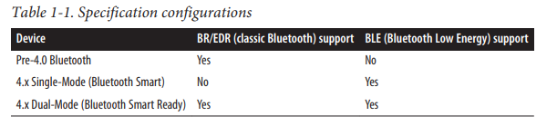
Background
Relatively new technology (introduced in 2010)
Digital Radio Protocol
Transmits via Radio Waves
Designed for low power consumption, bandwidth, complexity
Classic Bluetooth is not directly compatible with BLE

Slide 3
BLE and the ISM Radio Band
ISM: Industrial, Scientific, Medical
Range of frequencies reserved for ISM purposes.
Frequency ranges must be defined and allotted, as devices operating on the same/similar frequencies can interfere with each other
BLE operates on the 2.4 GHz ISM band (2.4000 – 2.4835 GHz range)
40 channels of 2 MHz spacing (37 for connection, 3 for advertising)
Operates in the same frequency as Bluetooth Classic and Wifi

Slide 4
Frequency Hopping Spread Spectrum (FHSS)
Method by which the carrier frequency hops to different channels in the range
BLE uses FHSS to reduce potential interference and eavesdropping
NextChannel = (CurrentChannel + Hop) % 37
Hop is defined randomly at connection time between two devices
These hops occur multiple times a second, sending data in bursts
BLE goes a step further, using a variation of FHSS

Slide 5
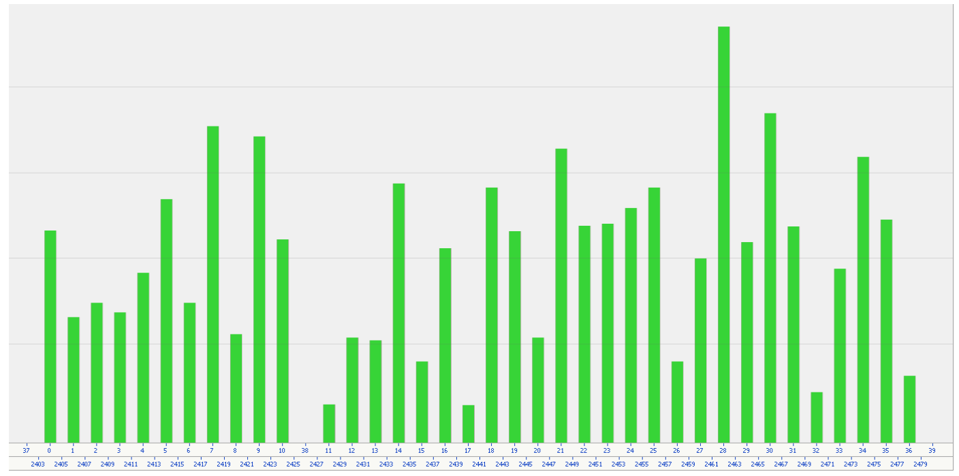
Adaptive Frequency Hopping (AFH)
Works the same as Frequency Hopping Spread Spectrum
Main device in connection creates a channel map
Continuously updates status of channels and shares with connection

Slide 6
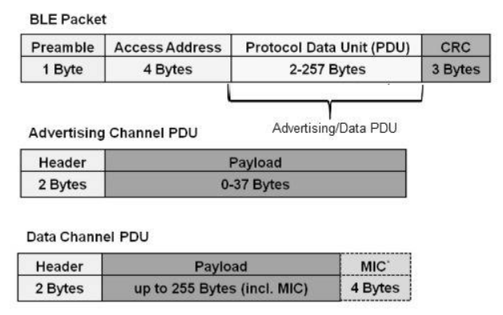
BLE Packet Format (v4.2)
Preamble: used for synchronization
Access Address: Random value (distinguishes devices on same channel)
PDU: Protocol Data Unit
Differs based on channel type
Header: formatting
Payload: message being sent
MIC: message integrity check
CRC: Cyclic Redundancy Check

Slide 7
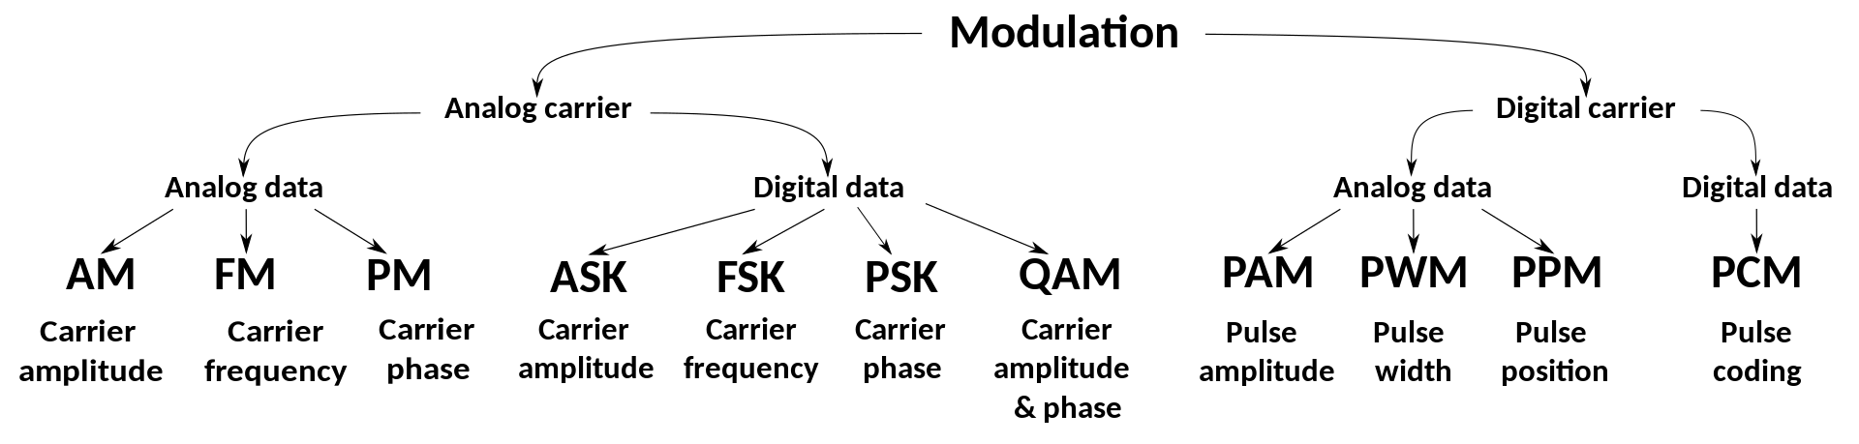
Signal Modulation
Generally, signals are low frequency, and need to be modulated (coded/packaged) in order to be properly transmitted.
Especially important in long range wireless communication
Amplitude, Frequency, and Phase Modulation
BLE uses a variation of Frequency Modulation
Gaussian Frequency Shift Keying (GFSK)

Slide 8
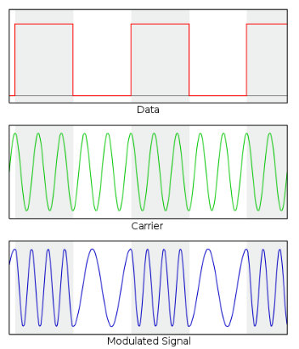
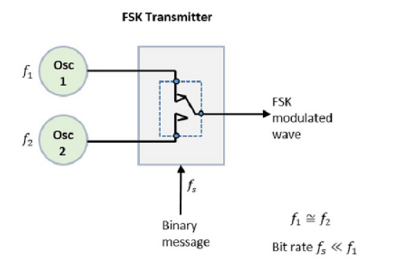
Frequency Shift Keying
In FSK, frequency of the carrier signal is shifted(changed) to multiple discrete frequencies based on the digital signal
Binary FSK is used (switch between 2 frequencies)
Gaussian FSK applies Gaussian filter to carrier
Reduces sideband power and interference
Data Throughput: 1 Mbps

Slide 9
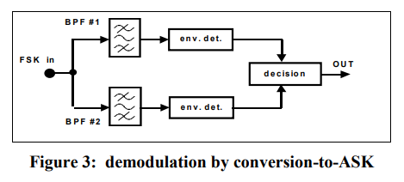
Synchronous Demodulation
Data must be demodulated (unpacked) when at receiver.
Performed through the use of two bandpass filters and envelope detectors
Envelope detectors take the shape of the peak of a signal, and return the original shape of the intended message
From here, a decision circuit compares the inputs, and chooses which input is most likely the original message

Slide 10
Sources
https://en.wikipedia.org/wiki/Bluetooth_Low_Energy#:~:text=Bluetooth%20Low%20Energy%20technology%20operates,has%2040%202%2DMHz%20channels.
https://www.bluetooth.com/blog/how-bluetooth-technology-uses-adaptive-frequency-hopping-to-overcome-packet-interference/
https://en.wikipedia.org/wiki/Frequency-shift_keying
https://www.tutorialspoint.com/digital_communication/digital_communication_frequency_shift_keying.htm
https://www.eng.auburn.edu/~troppel/courses/TIMS-manuals-r5/TIMS%20Experiment%20Manuals/Student_Text/Vol-D1/D1-07.pdf

