Slide 1
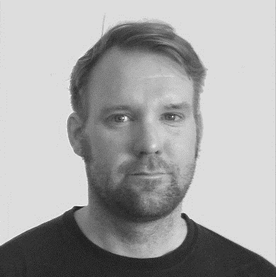
Managing Python Packages with pip
Reindert-Jan Ekker
@rjekker http://nl.linkedin.com/in/rjekker

Slide 2
Dependencies
Packages
Find, download and install
Manage
Virtual environments
Project dependencies
Create, use and manage
Best practices
Recommended tools
NOT: creating and shipping
Overview

Slide 3
Modules in this Course
pip
Package management
Virtual environments
Projects and dependencies
virtualenvwrapper
Making venv more convenient
Other tools

Slide 4

Audience
New Python developers
Go from simple scripts to larger projects
Use third-party modules
Basic Python skills
Python installed

Slide 5
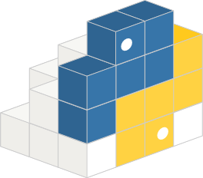

A Package Is Not a Package
A directory containing
an __init__.py file
Used with import
A Python
distribution package

Slide 6
Python Distribution Package
Versioned archive file
Contains Python packages, modules, and other resource files
Used to distribute a Release
What an end-user will download and install

Slide 7
Getting started
Project with a third-party dependency
Check for presence of pip

Slide 8
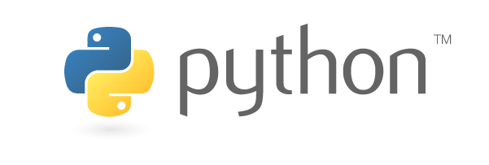
Do I Need to Install pip?
pip comes pre-installed with
Python 2 >=2.7.9
Python 3 >=3.4
If you downloaded from python.org
Older versions
Go to http://pip-installer.org
Follow instructions under "Installation"
If you downloaded from python.org

Slide 9

Anaconda
Anaconda Python distribution
Mainly used for Data Science
Custom package manager: conda
Includes and supports pip

Slide 10
Windows
Configuring PATH
Run pip

Slide 11
Windows
No need to install pip
Configure your PATH

Slide 12
Mac
Don't use default Python
It's not meant for development
Install Python using Homebrew: https://brew.sh
Or download from https://python.org

Slide 13
Linux
Comes with python (probably 2)
May need to install python 3 and/or pip
Use package manager
Might not install latest pip (but that's ok)

Slide 14
Linux
Install pip
Run pip
Install pip for python3
Run that

Slide 15
Managing packages with pip
Installing packages
Removing packages
Listing packages
Inspecting packages
Getting help
Searching packages

Slide 16

Best Practice
Always work inside a virtual environment
Don't use pip with sudo

Slide 17
Managing Packages with pip
# Installing a package
# (will also install its dependencies)
python -m pip install requests
python -m pip install six Django Keras # multiple installs
# Removing a package (but NOT its dependencies)
python -m pip uninstall requests
python -m pip uninstall six Django Keras

Slide 18
Managing Packages with pip (2)
# Upgrade a package
python -m pip install –U requests
# Install in user home (if necessary)
python -m pip install --user requests

Slide 19
Finding Package Information
# List all installed packages
python -m pip list
# Get info on a specific package
python -m pip show requests

Slide 20

Getting Help
Pip built-in help: pip help
For specific command: pip help install
Or visit http://pip-installer.org
The cheese shop: https://pypi.org

Slide 21
Where are packages installed?
The sys.path variable
Installing for other python versions

Slide 22
A better way to call pip

Slide 23
Installing pip
Managing Packages
pip install
pip uninstall
pip list
pip show
The cheese shop
Package Locations
Calling pip
python -m pip
Summary

