Slide 1
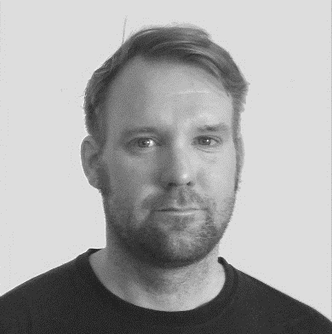
Setting up Your Project with Virtual Environments
Reindert-Jan Ekker
@rjekker http://nl.linkedin.com/in/rjekker

Slide 2
Why virtual environments
Create and explore a virtual environment
Using virtual environments with projects
Project dependencies
Overview

Slide 3
Problems with System-wide Installs
Multiple projects with conflicting dependencies
Conflicts with system dependencies
Multi-user systems
Testing code against different python and library versions

Slide 4
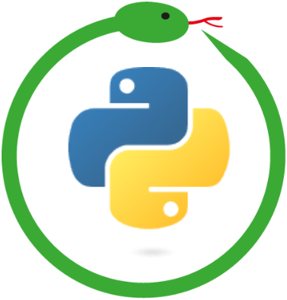
Virtual Environments
Isolated context for installing packages
Always work inside a virtual environment
No global installs anymore
Create a virtual env. for every project
Isolate project dependencies
No more conflicts with other projects

Slide 5
Starting a project
Create a virtual environment
Explore the virtual environment

Slide 6
Working inside a virtual environment
Activating the environment
Running python and pip
Installing a package
Deactivate

Slide 7
Creating a Virtual Environment
python -m venv myvenv
python3 -m venv myvenv
# Python versions <= 3.3: venv not built-in
# Need to install virtualenv package first
virtualenv myenv
# Deprecated
pyvenv myvenv

Slide 8
Activating a Virtual Environment
# Run the activate script inside the virtual environment
# On linux/Mac OS:
reindert@pc:~/dev/$ . myvenv/bin/activate
# On Windows:
C:\Users\reindert\dev> myvenv\Scripts\activate.bat
# On Windows (Powershell):
C:\Users\reindert\dev> myvenv\Scripts\activate.ps1

Slide 9
After Activation
# The prompt will show the name of the active venv
(myvenv) reindert@pc:~/dev/$
# You are now ready to install packages
# And work on your project
# When you're done, leave the virtual environment
(myvenv) reindert@pc:~/dev/$ deactivate
# To remove a virtual env., simply delete the directory

Slide 10
In an Active Virtual Environment
python refers to interpreter in venv
Same for pip
Packages are installed inside the venv
Don't interfere with other projects

Slide 11
Requirements
Syncing dependencies with your team

Slide 12
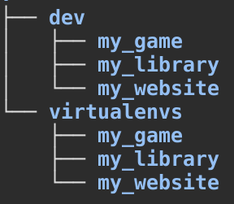
Projects and Virtualenvs
Projects
Contain source code
Are under version control
Virtual environments
Contain packages, tools, python, etc.
Keep them separate from your projects
Usually: 1 venv per project
Can have multiple venvs per project
Or a single venv for multiple projects

Slide 13
requirements.txt
# After installing packages
python -m pip freeze > requirements.txt
# Resulting file (put this in version control):
certifi==2018.11.29
chardet==3.0.4
idna==2.8 (..etc..)
# To install all dependencies
python -m pip install -r requirements.txt

Slide 14
Specifying Versions
docopt == 0.6.1 # Must be version 0.6.1
keyring >= 4.1.1 # Minimum version 4.1.1
coverage != 3.5 # Anything except version 3.5

Slide 15
Versions and pip
python -m pip install flask==0.9
python -m pip install 'Django<2.0' # Mind the quotes!
# Upgrade to latest version
python -m pip install -U flask
# Upgrade pip itself
# Take care not to overwrite system pip
python -m pip install -U pip

Slide 16
Practical Applications

Slide 17
Working with virtual environments
Pycharm
VS Code
A real-world project from Github
Testing with Tox

Slide 18
Why virtual environments
Create and explore a virtual environment
Using virtual environments with projects
Project dependencies
Overview

