Slide 1

Making Simple Plots
Reindert-Jan Ekker
@rjekker http://nl.linkedin.com/in/rjekker

Slide 2
Making simple plots
Introducing the Pandas plot API
Showcasing various types of plots
Preparing your data for plotting
Overview

Slide 3
Introducing the Pandas Plot API
df.plot()
Selecting data to plot
Showcasing plot types

Slide 4
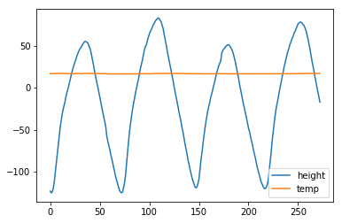
df.plot()
Creates a line plot of all columns
X axis taken from index
Y axis taken from data
Legend added automatically

Slide 5
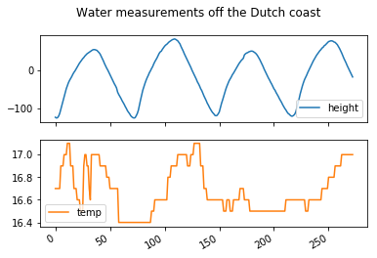
df.plot(
title="Water measurements...",
subplots=True
)

Slide 6
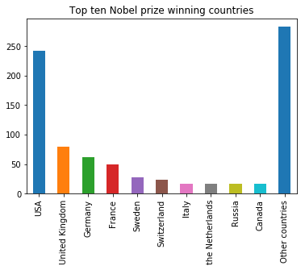
Plot types:
line (default)
bar, df.plot.bar(), etc.
box
pie
and others...

Slide 7
Three Steps for Simple Plots
Prepare the script
Prepare the data
Choose the right plotting function

Slide 8
Three Steps for Simple Plots
Prepare the script
Prepare the data
Choose the right plotting function

Slide 9
Preparing the Script
%matplotlib inline
import pandas as pd
import matplotlib.pyplot as plt
The first line is specific for Jupyter Notebook; more about this in the next module

Slide 10
Preparing the Data
Data in columns? If not: transform the DataFrame
Select columns to plot
Select rows to plot
Create a suitable index (x axis)
Rename columns and index
(legend, x axis label)

Slide 11
ax=df.plot.bar(...)
ax=df.plot(kind='bar')

Slide 12
Making simple plots
Introducing the Pandas plot API
Showcasing various types of plots
Preparing your data for plotting
Summary

