Slide 1
Machine Learning
Bayees theorem

Slide 2
Bayess theorem
Consider a factory where we want to add some analytics to it
Consider two machines where one machine produces spanners
And other machine also produces the spanners

Slide 3


Slide 4
Bayees theorem
Now we have got whole pile of spanners. The workers go through them and checks out for the defected spanners
What is the probabiltiy of machine 2 giving a defective spaner?.

Slide 5
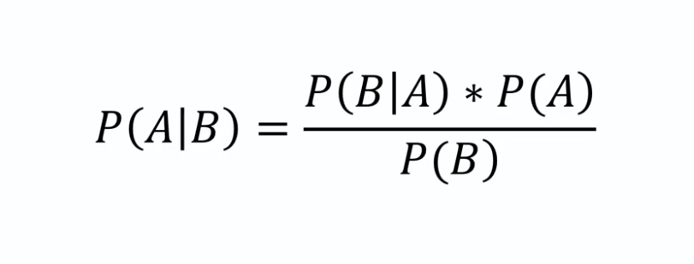

Slide 6
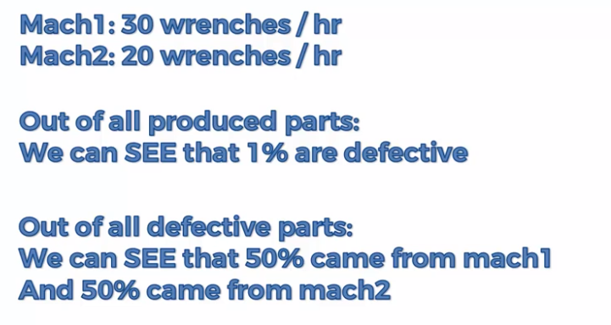

Slide 7
Bayees theorem
What are the insight we have got from the question?
1. Combinely Mach1 and Mach2 producing 50 wrenches per hour
2. If we pick any wrench that mibe defective or not from mach 1 is 30/50=0.6
3. If we pick any wrench that mibe defective or not from mach 1 is 20/50=0.4
4. If i pick a wrench which is defective is 1%

Slide 8
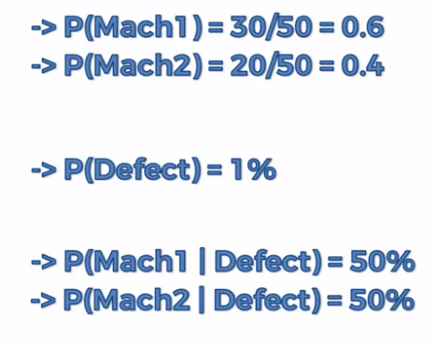

Slide 9
Bayees theorem
P(defect/mach2)=p(mach2/defect)*p(defect)/p(mach2)
=0.5*0.01/0.4=0.0125
If we are producing 10000 parts then,ach 2 produces 125 defective wrenches

Slide 10
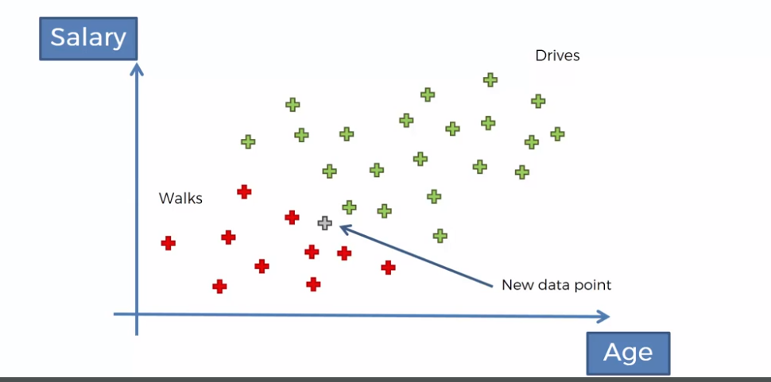

Slide 11
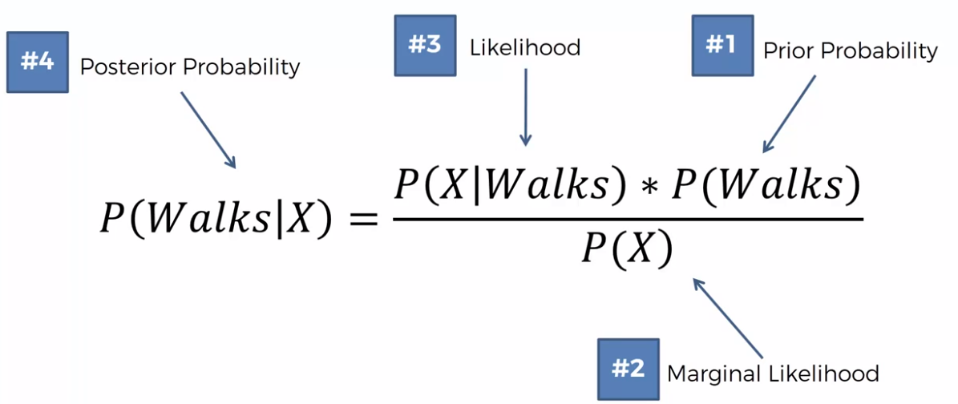

Slide 12
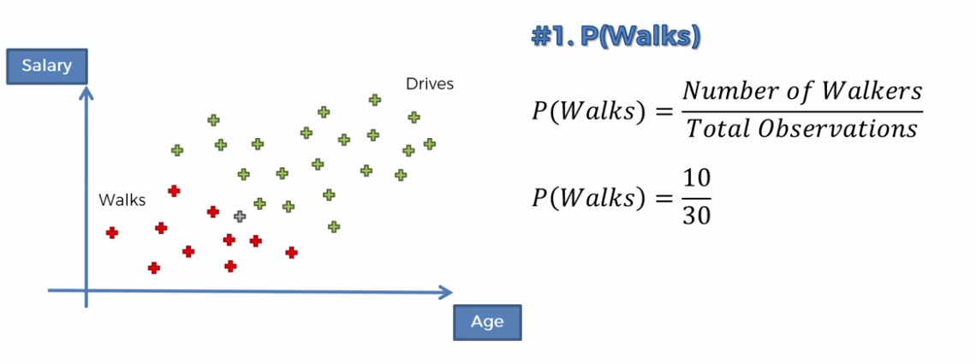

Slide 13
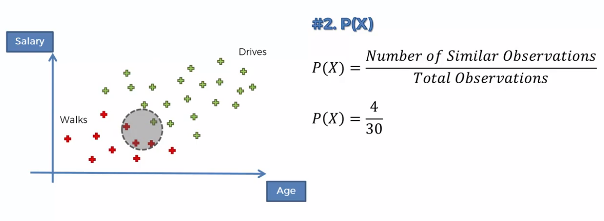

Slide 14
Naive bayess
Calculating likelihood is the complex problem
What is the probability that somebody wh walks exhibits the features x?
The answer is what set of datapoints fall into that circle when somebody walks

Slide 15
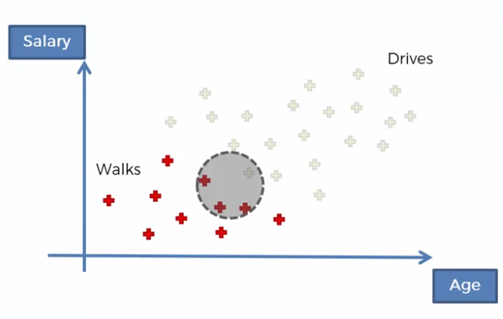
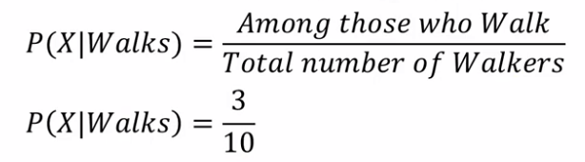

Slide 16
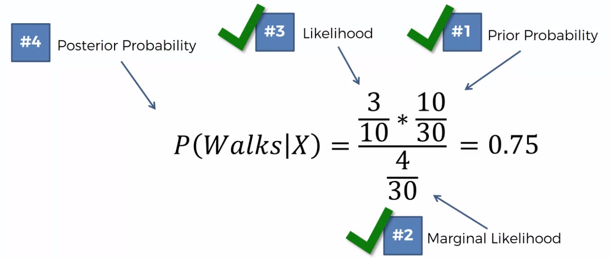

Slide 17
