Slide 1
Machine Learning
Decision tree classifier

Slide 2
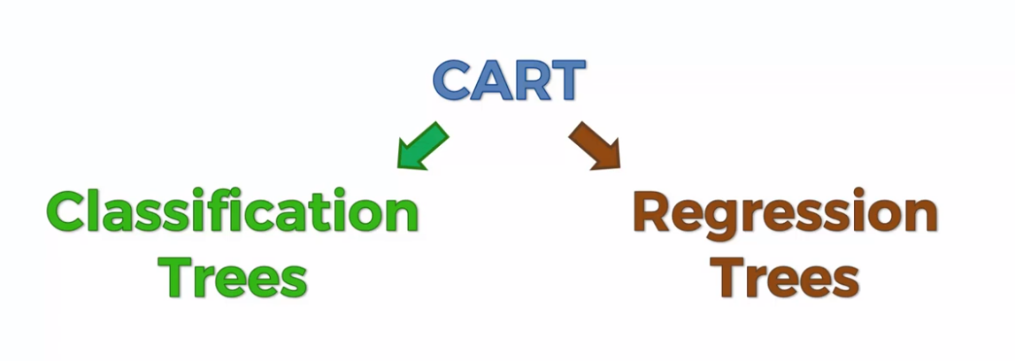

Slide 3
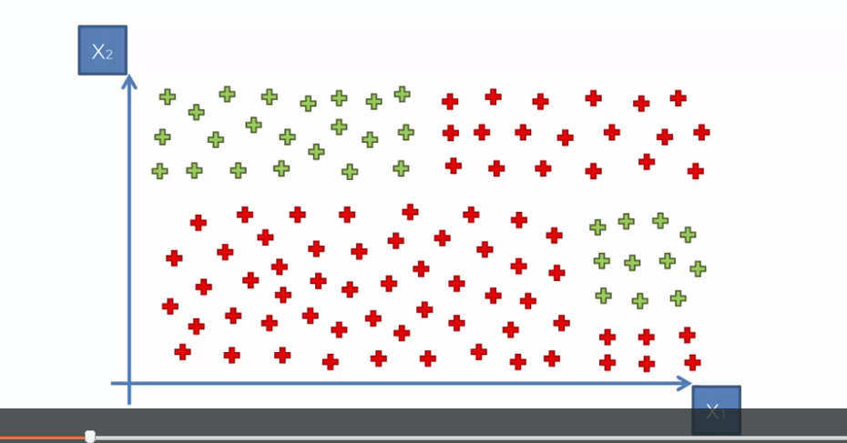

Slide 4
