Slide 1
Machine Learning
Hierarchial

Slide 2
Hierarchial Clustering
Hierarchial means is used to cluster your data.
It is mainly used to discover the categories or similar data in our dataset

Slide 3
Hierarchial
How many groups we can dentify by looking at the graph
We will consider this agglomerative approach
i.e we do the process from bottom to top

Slide 4
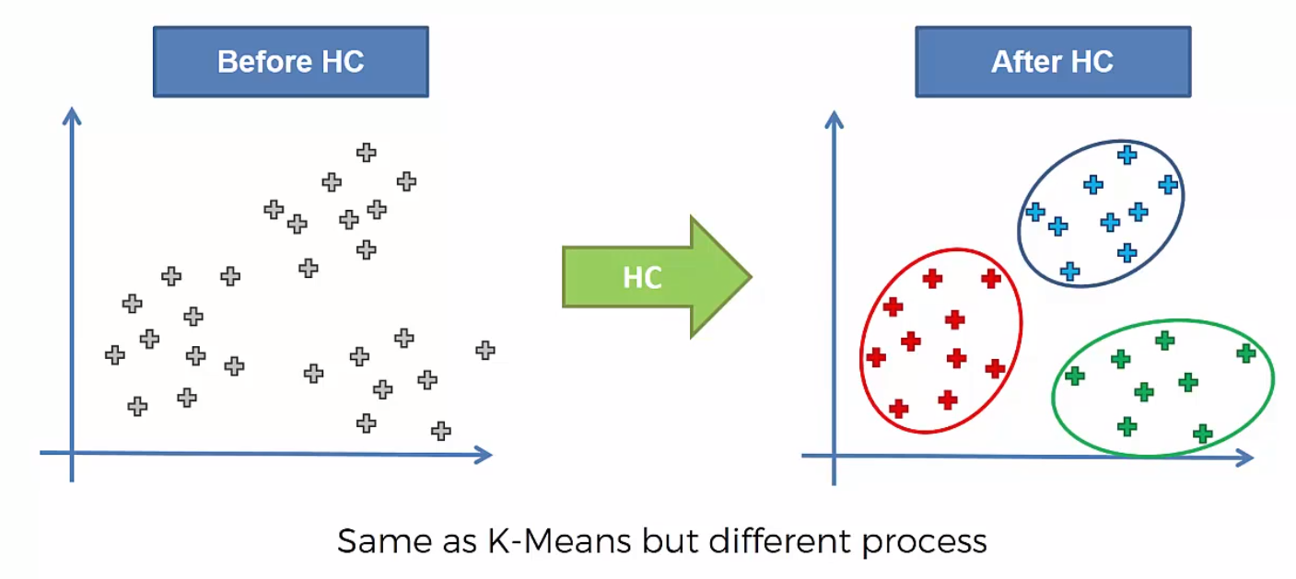
Hierarchial

Slide 5
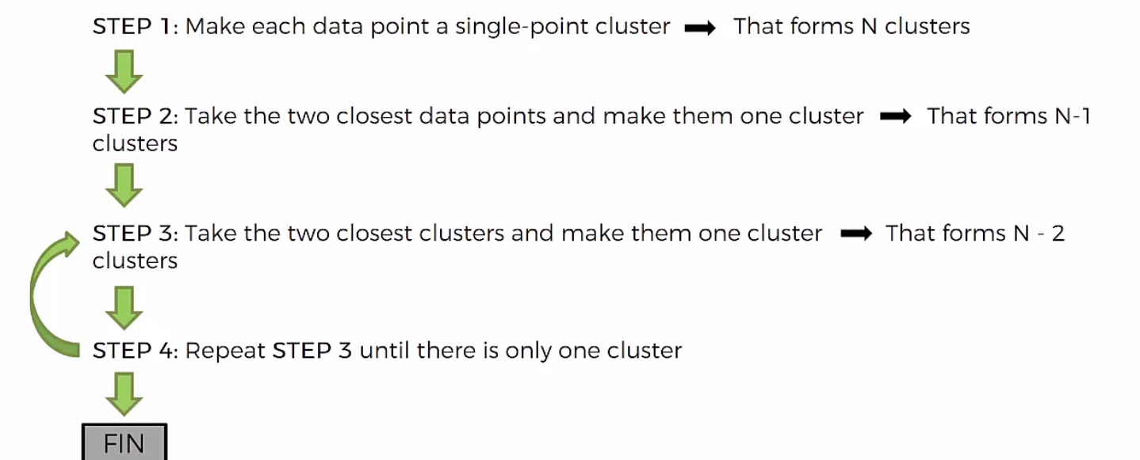
Hierarchial

Slide 6
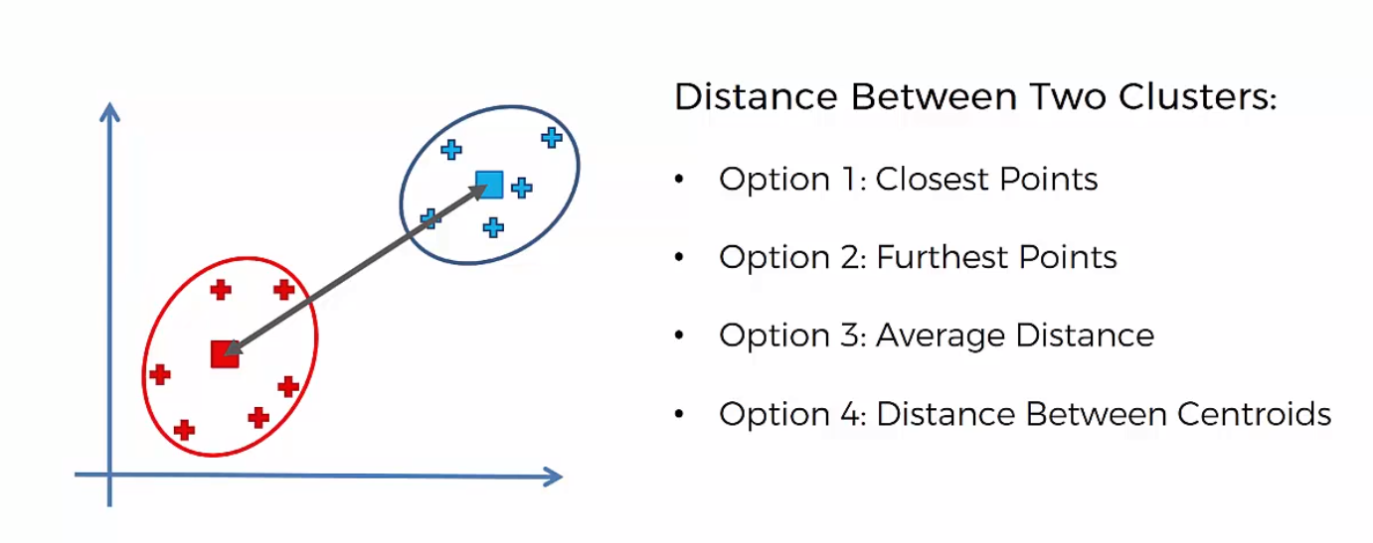
Hierarchial

Slide 7
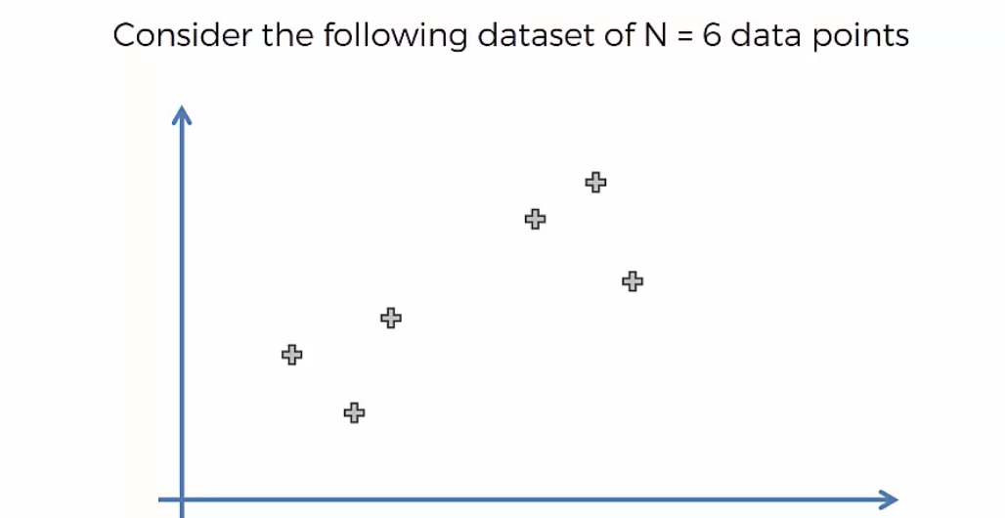
Hierarchial

Slide 8
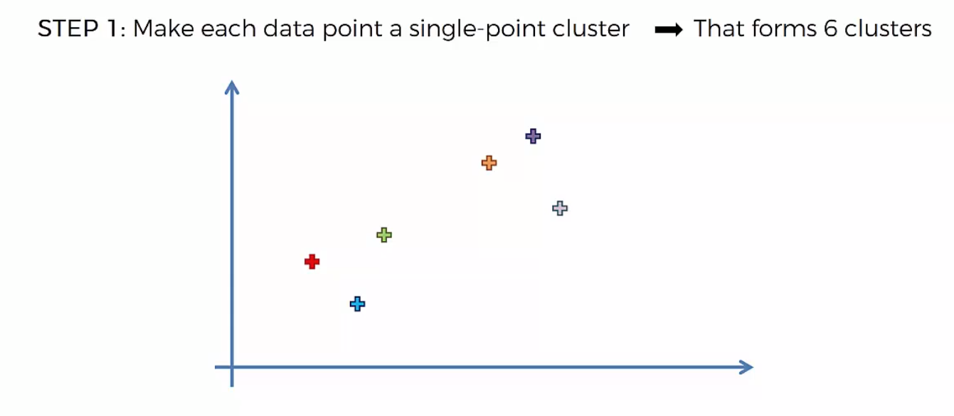
Hierarchial

Slide 9
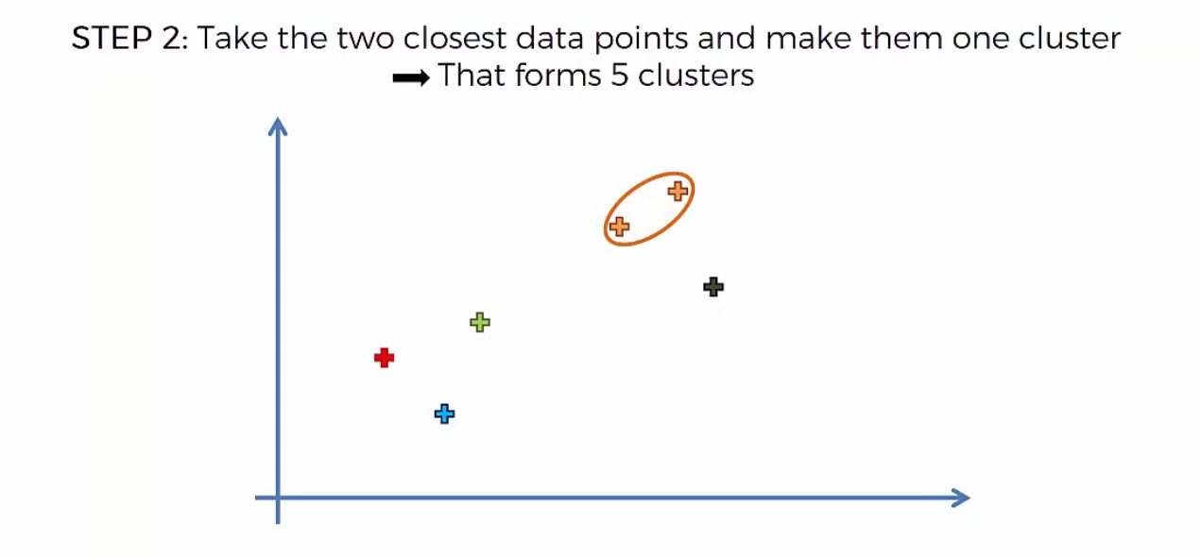
Hierarchial

Slide 10
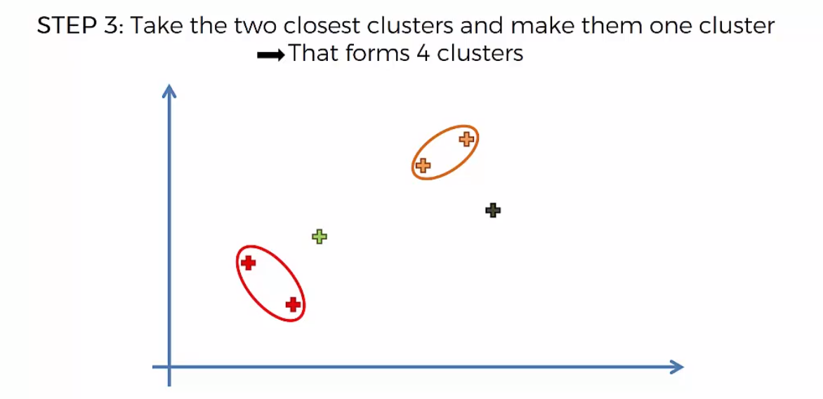
Hierarchial

Slide 11
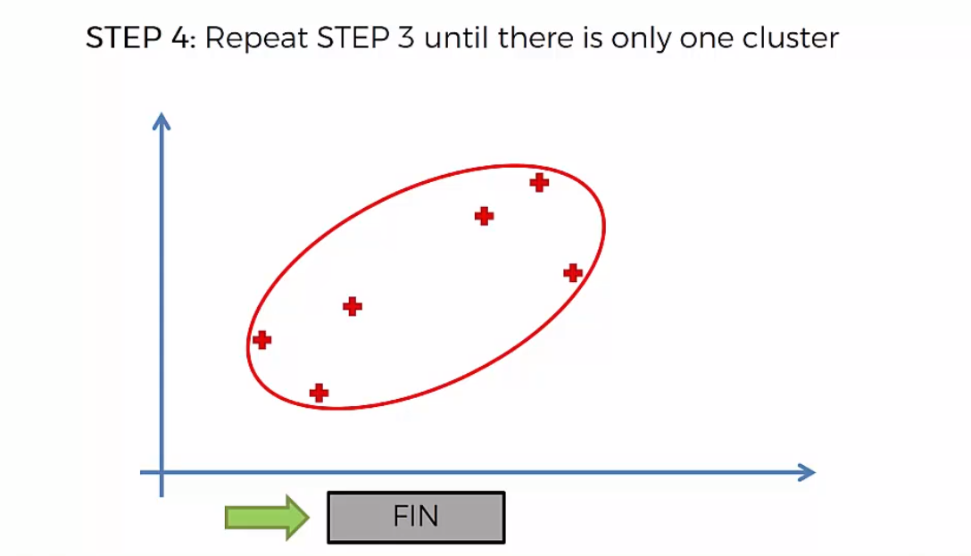
Hierarchial

Slide 12
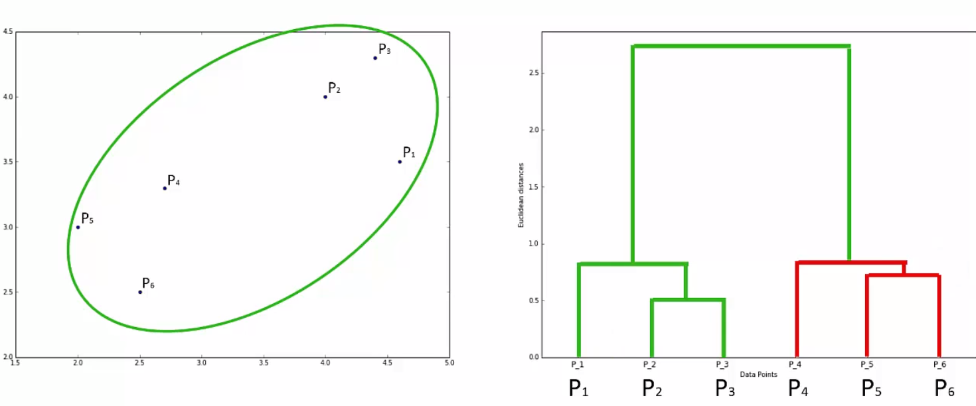
Hierarchial

Slide 13
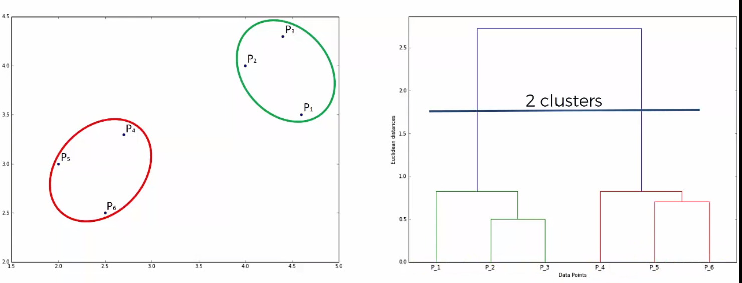
Hierarchial

Slide 14
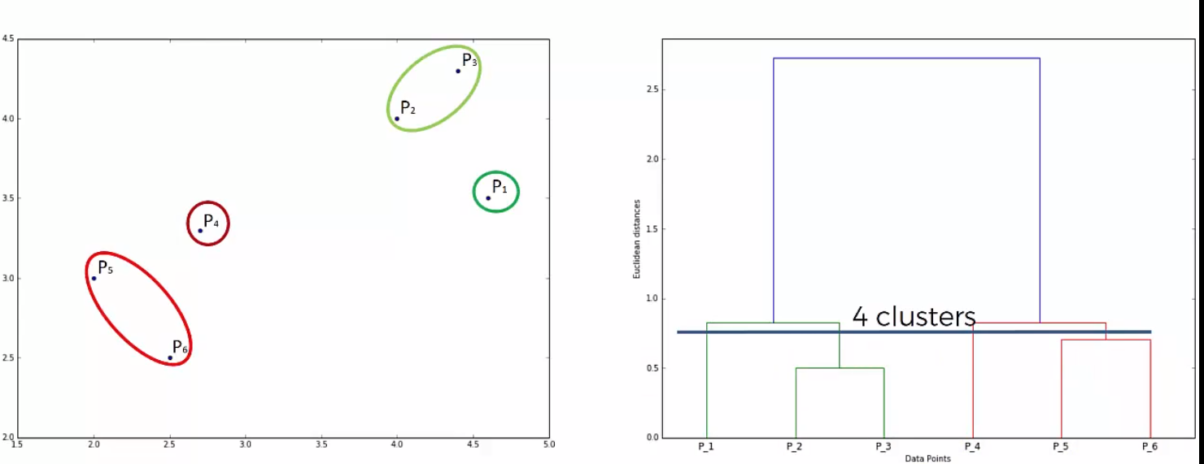
Hierarchial

Slide 15
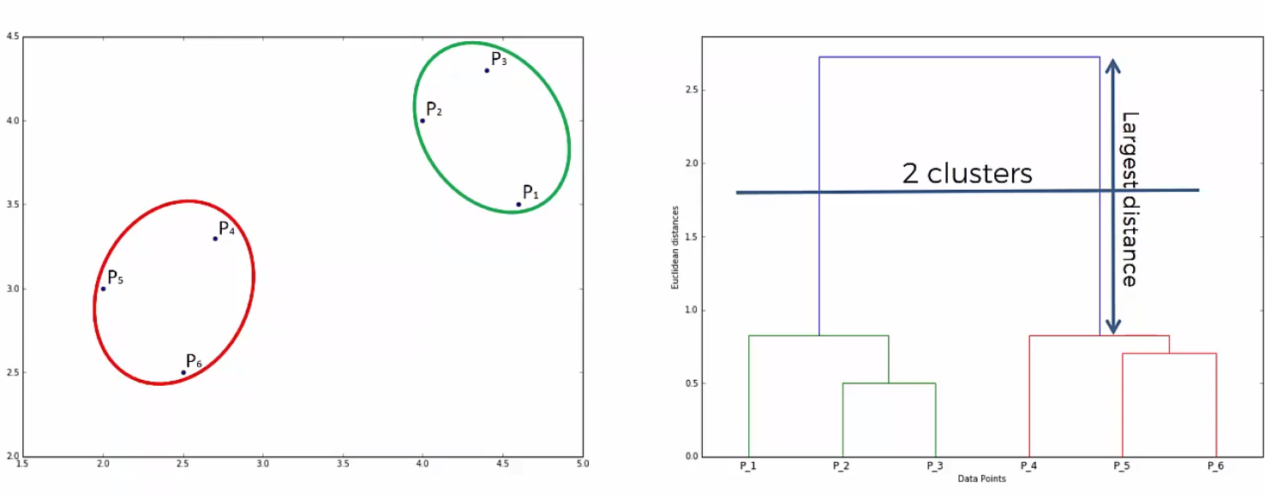
Hierarchial

