Slide 1
Machine Learning
Kmeans

Slide 2
Machine Learning
Machine learning is an application of artificial intelligence (AI) that provides systems the ability to automatically learn and improve from experience without being explicitly programmed.
Machine learning focuses on the development of computer programs that can access data and use it learn for themselves.

Slide 3
Supervised Machine Learning
The majority of practical machine learning uses supervised learning.
Supervised learning is where you have input variables (x) and an output variable (Y) and you use an algorithm to learn the mapping function from the input to the output.
Y = f(X)
The goal is to approximate the mapping function so well that when you have new input data (x) that you can predict the output variables (Y) for
that data.
It is called supervised learning because the process of an algorithm learning from the training dataset can be thought of as a teacher supervising the learning process. We know the correct answers, the algorithm iteratively makes predictions on the training data and is corrected by the teacher. Learning stops when the algorithm achieves an acceptable level of performance.

Slide 4
Supervised Machine Learning
Classification: A classification problem is when the output variable is a category, such as “red” or “blue” or “disease” and “no disease”.
Regression: A regression problem is when the output variable is a real value, such as “dollars” or “weight”.

Slide 5
Unsupervised ML
Unsupervised learning is where you only have input data (X) and no corresponding output variables.
The goal for unsupervised learning is to model the underlying structure or distribution in the data in order to learn more about the data.
These are called unsupervised learning because unlike supervised learning above there is no correct answers and there is no teacher. Algorithms are left to their own devises to discover and present the interesting structure in the data.

Slide 6
Unsupervised ML
Unsupervised learning problems can be further grouped into clustering and association problems.
Clustering: A clustering problem is where you want to discover the inherent groupings in the data, such as grouping customers by purchasing behavior.

Slide 7
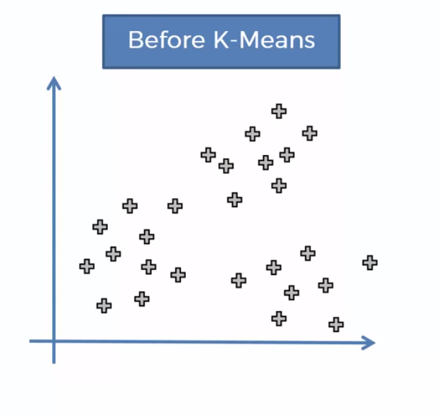
Kmeans
K means is used to cluster your data.
It is mainly used to discover the categories or similar data in our dataset

Slide 8
Kmeans
How many groups we can dentify by looking at the graph
Kmeans takes decisions easily and group similar data which are called as cluster

Slide 9
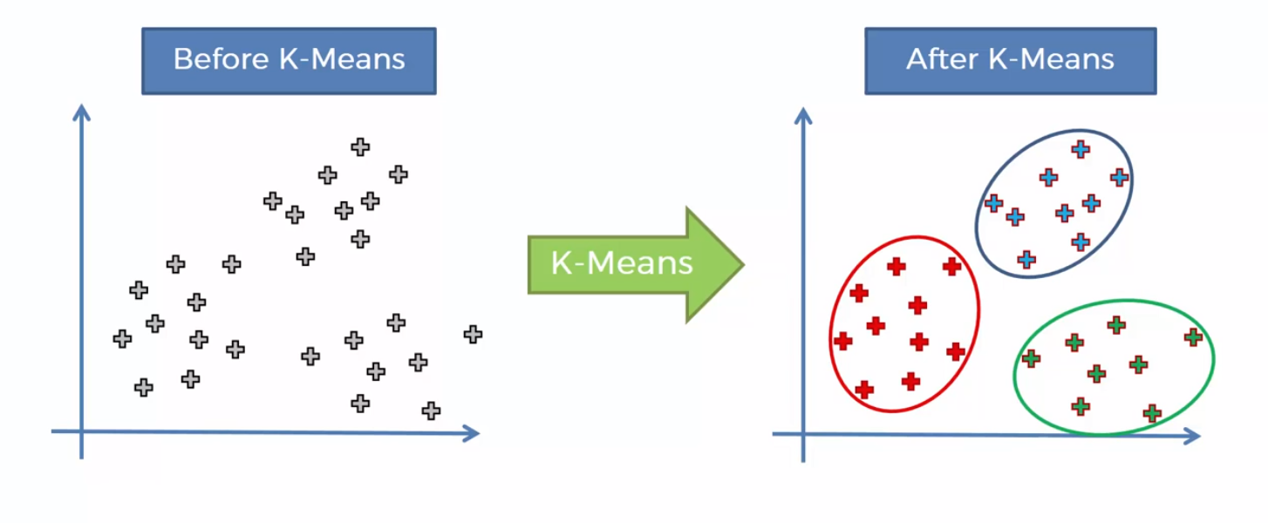
Kmeans

Slide 10
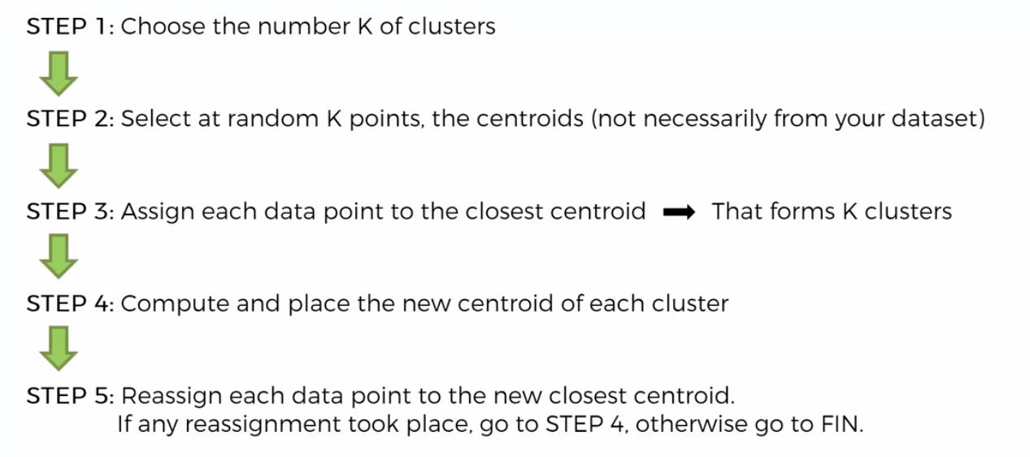
Kmeans

Slide 11
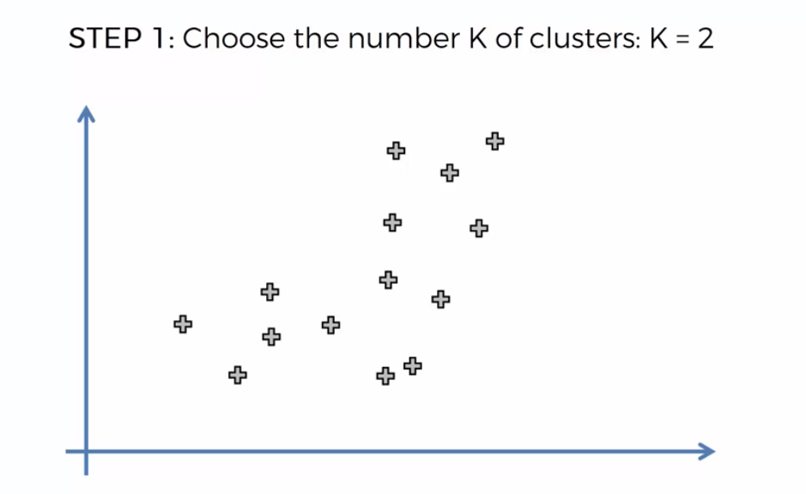
Kmeans

Slide 12
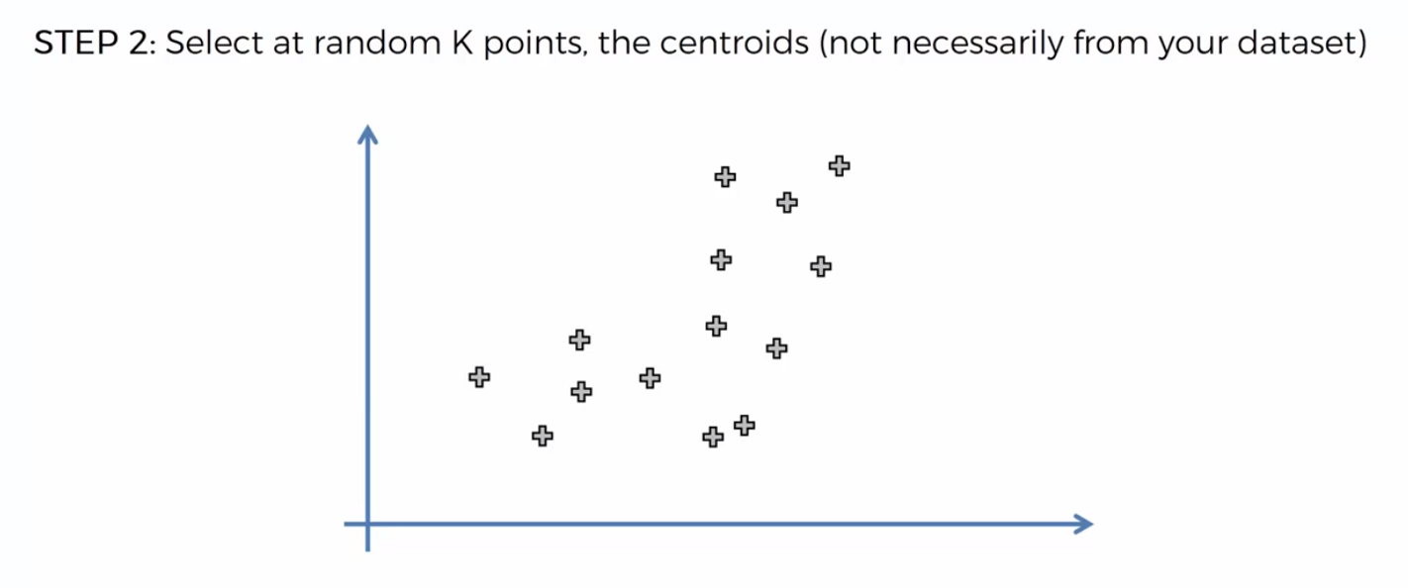
Kmeans

Slide 13
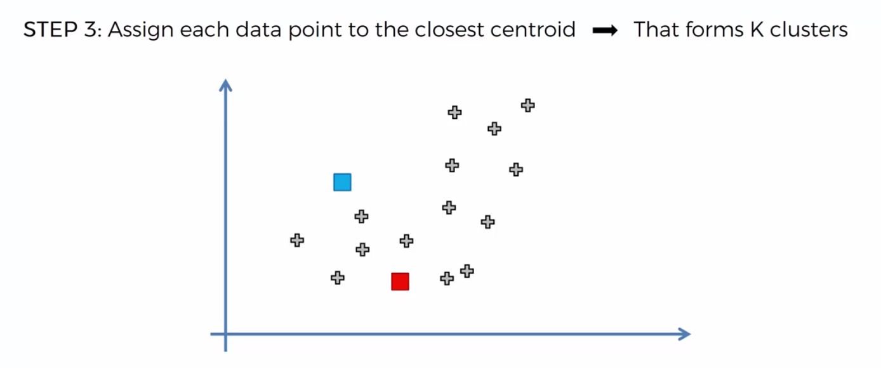
Kmeans

Slide 14
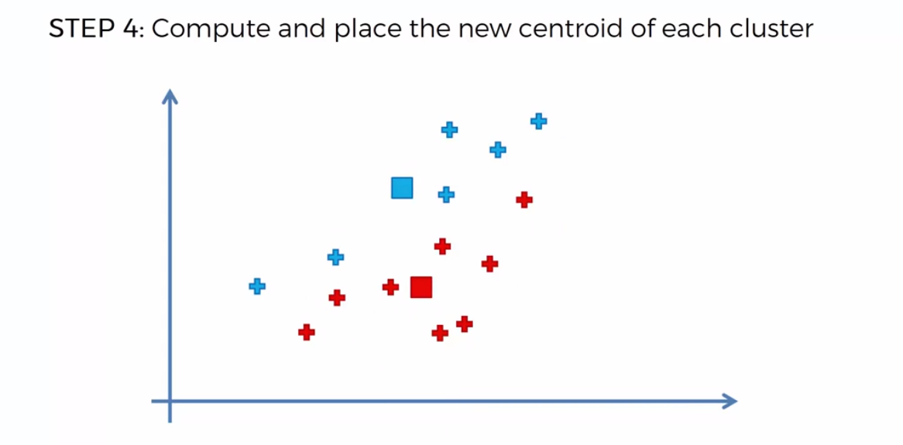
Kmeans

Slide 15
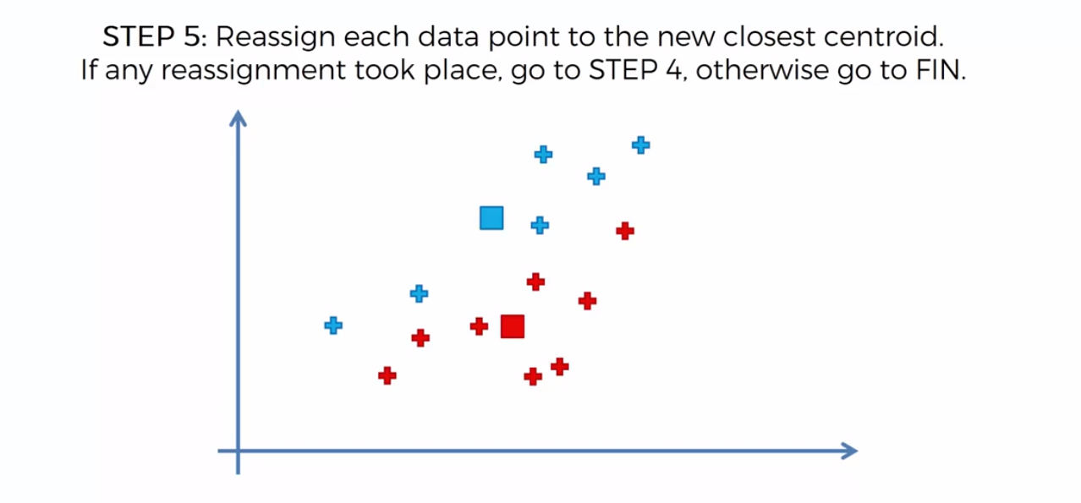
Kmeans

Slide 16
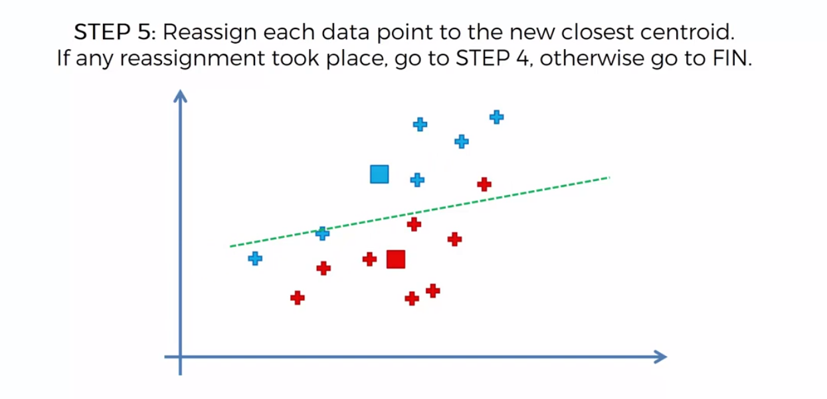
Kmeans

Slide 17
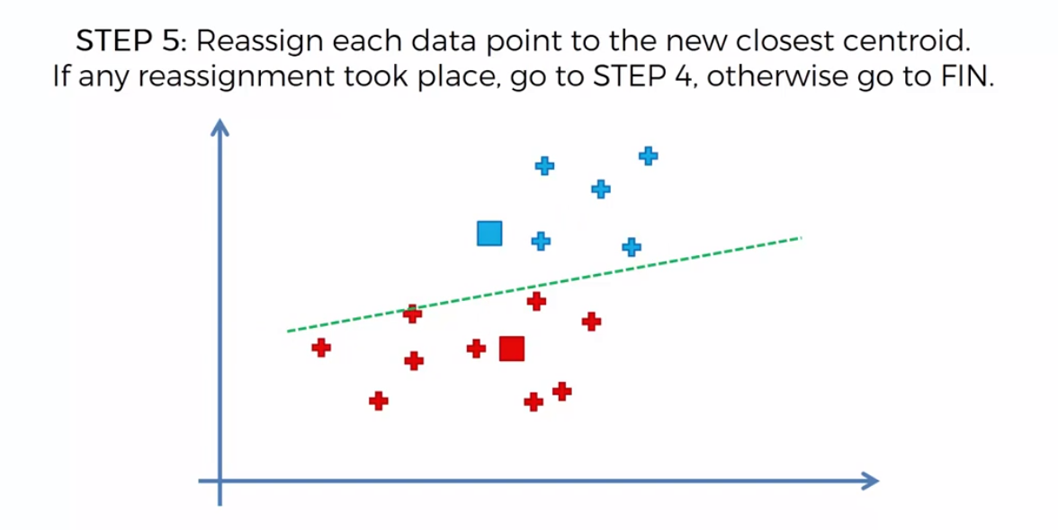
Kmeans

Slide 18
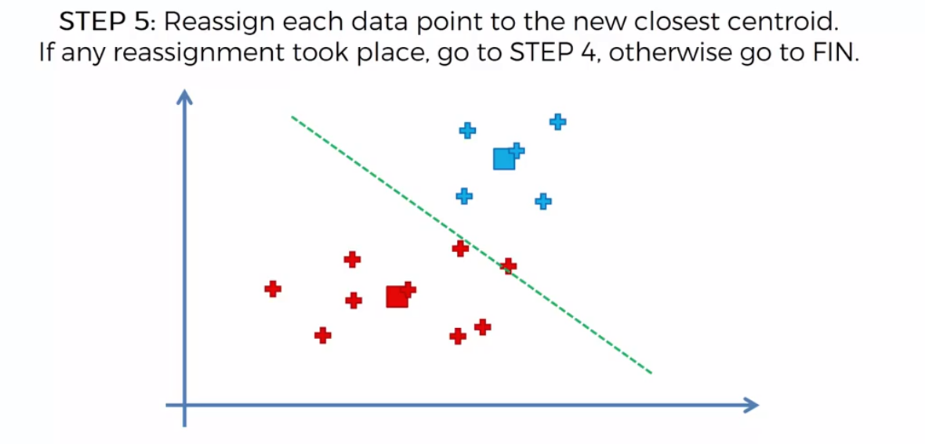
Kmeans

Slide 19
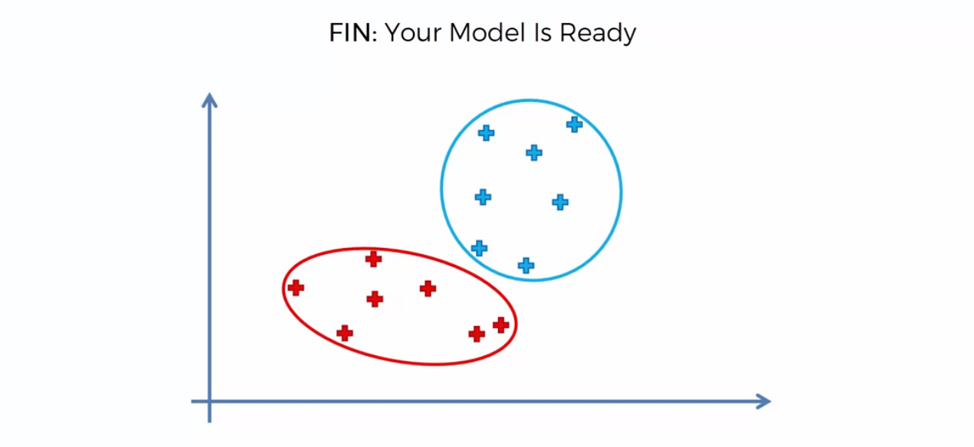
Kmeans

Slide 20
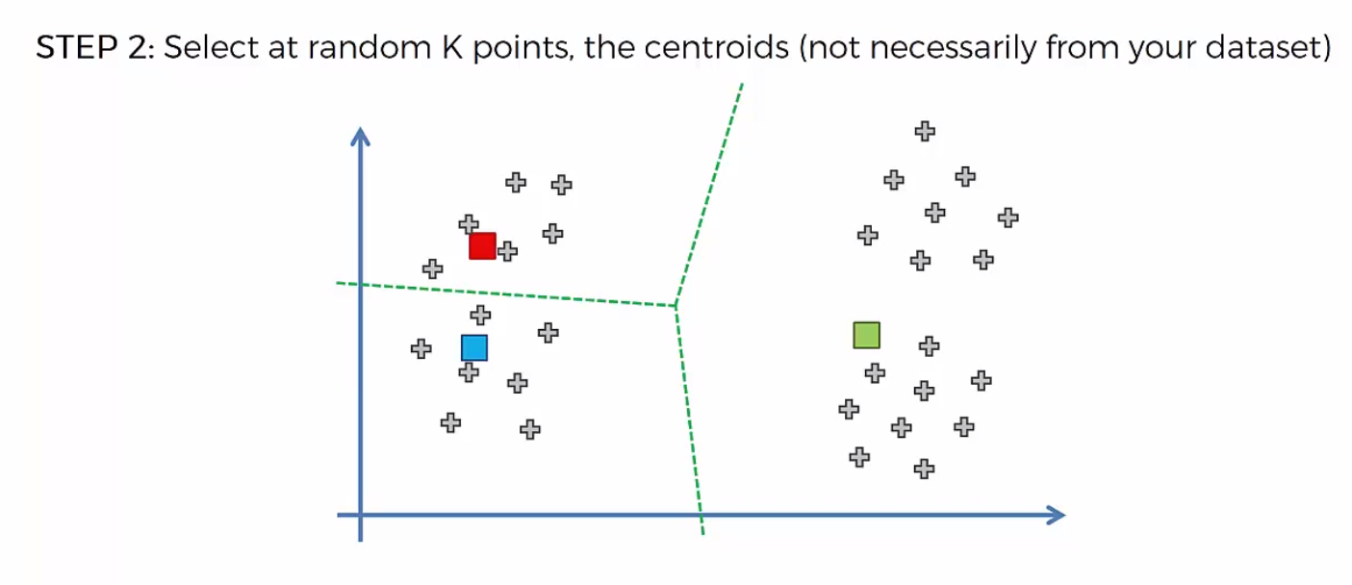
Kmeans

Slide 21
Kmeans
Choosing the right number of clusters is a difficult task
How to choose it?.
We can choose by using the metric called with in clusters sum of squares

Slide 22
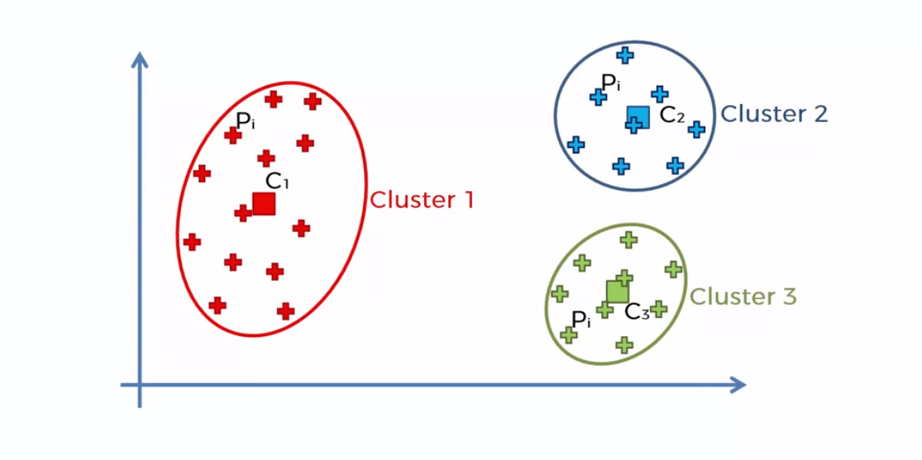
Kmeans

Slide 23
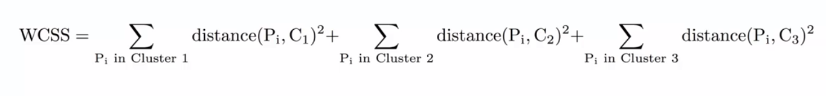
Kmeans

Slide 24
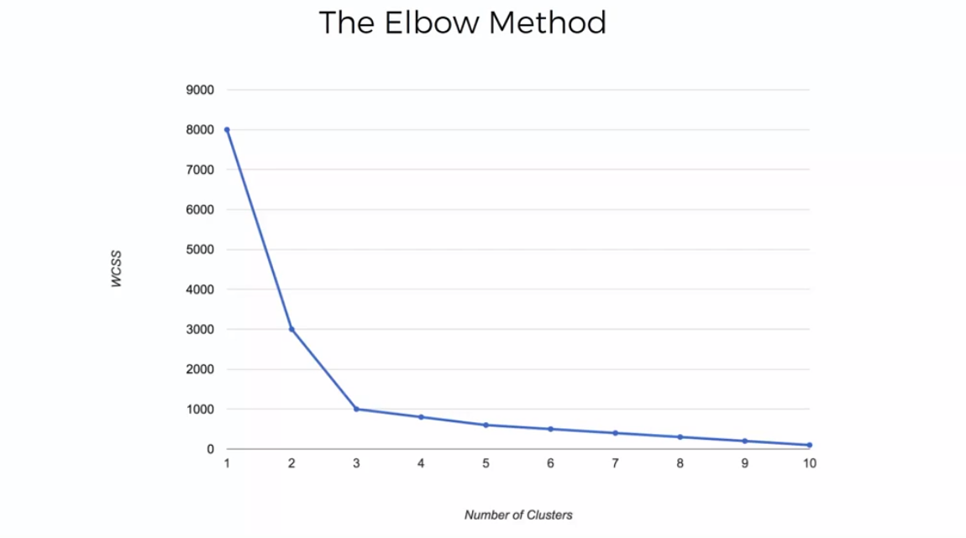
Kmeans

