Slide 1
Machine Learning
Polynomial Regression

Slide 2
Polynomial Regression
Simple linear= y=b0+b1x1
Multiple linear regression=y= b0+b1x1+b2x2+.......bnxn
Polynomial regression
y=b0+b1x1+b2x1^2....bnx1^n

Slide 3
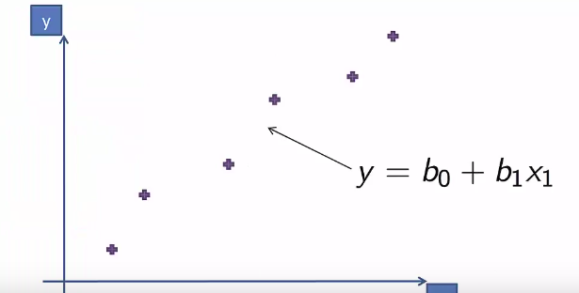
polynomial Regression

Slide 4
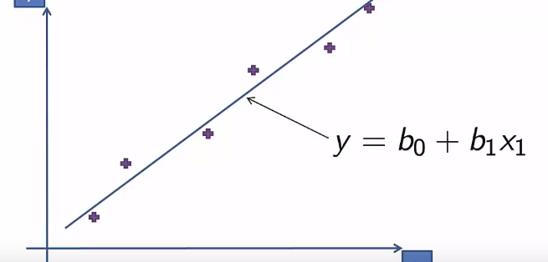

Slide 5
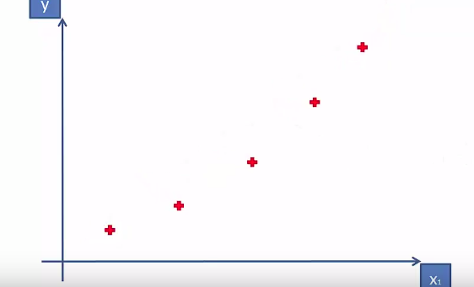

Slide 6
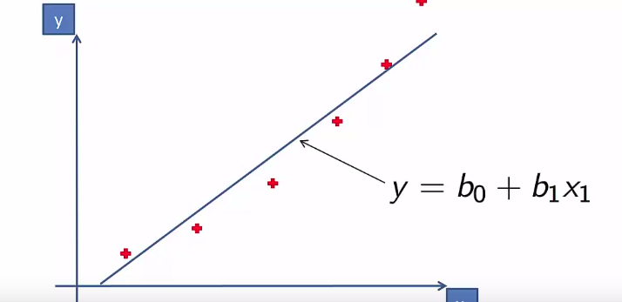

Slide 7
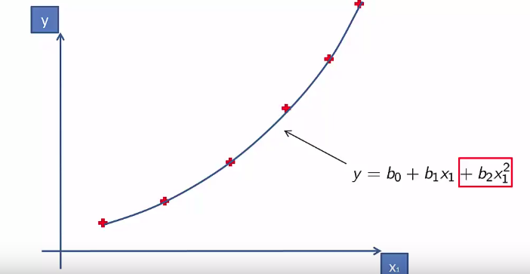

Slide 8
Data Preprocessing
# Importing the dataset
dataset = read.csv('Position_Salaries.csv')
dataset = dataset[2:3]
# Splitting the dataset into the Training set and Test set
# # install.packages('caTools')
# library(caTools)
# set.seed(123)
# split = sample.split(dataset$Salary, SplitRatio = 2/3)
# training_set = subset(dataset, split == TRUE)
# test_set = subset(dataset, split == FALSE)

Slide 9
Fitting the model
# Feature Scaling
# training_set = scale(training_set)
# test_set = scale(test_set)
# Fitting Linear Regression to the dataset
lin_reg = lm(formula = Salary ~ .,
data = dataset)
# Fitting Polynomial Regression to the dataset
dataset$Level2 = dataset$Level^2
dataset$Level3 = dataset$Level^3
dataset$Level4 = dataset$Level^4
poly_reg = lm(formula = Salary ~ .,
data = dataset)

Slide 10
Fitting the model
# Feature Scaling
# training_set = scale(training_set)
# test_set = scale(test_set)
# Fitting Linear Regression to the dataset
lin_reg = lm(formula = Salary ~ .,
data = dataset)
# Fitting Polynomial Regression to the dataset
dataset$Level2 = dataset$Level^2
dataset$Level3 = dataset$Level^3
dataset$Level4 = dataset$Level^4
poly_reg = lm(formula = Salary ~ .,
data = dataset)

Slide 11
Visualising data
library(ggplot2)
ggplot() +
geom_point(aes(x = dataset$Level, y = dataset$Salary),
colour = 'red') +
geom_line(aes(x = dataset$Level, y = predict(lin_reg, newdata = dataset)),
colour = 'blue') +
ggtitle('Truth or Bluff (Linear Regression)') +
xlab('Level') +
ylab('Salary')

Slide 12
Visualising data
# Visualising the Polynomial Regression results
# install.packages('ggplot2')
library(ggplot2)
ggplot() +
geom_point(aes(x = dataset$Level, y = dataset$Salary),
colour = 'red') +
geom_line(aes(x = dataset$Level, y = predict(poly_reg, newdata = dataset)),
colour = 'blue') +
ggtitle('Truth or Bluff (Polynomial Regression)') +
xlab('Level') +
ylab('Salary')

Slide 13
Predicting data
# Predicting a new result with Linear Regression
predict(lin_reg, data.frame(Level = 6.5))
# Predicting a new result with Polynomial Regression
predict(poly_reg, data.frame(Level = 6.5,
Level2 = 6.5^2,
Level3 = 6.5^3,
Level4 = 6.5^4))

