Slide 1
Machine Learning
Decision tree regression

Slide 2
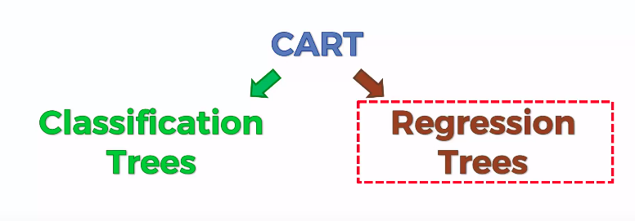
Decision tree Regression

Slide 3
Decision tree
Decision tree builds regression or classification models in the form of a tree structure.
It breaks down a dataset into smaller and smaller subsets while at the same time an associated decision tree is incrementally developed.
The final result is a tree with decision nodes and leaf nodes. A decision node has two or more branches , each representing values for the attribute tested.
Leaf node represents a decision on the numerical target. The topmost decision node in a tree which corresponds to the best predictor called root node. Decision trees can handle both categorical and numerical data.

Slide 4
Decision tree
When to use classification vs regression tree
Classification trees, as the name implies are used to separate the dataset into classes belonging to the response variable. Usually the response variable has two classes: Yes or No (1 or 0). For binary splits however, the standard CART procedure is used. Thus classification trees are used when the response or target variable is categorical in nature.
Regression trees are needed when the response variable is numeric or continuous. For example, the predicted price of a consumer good. Thus regression trees are applicable for prediction type of problems as opposed to classification.

Slide 5
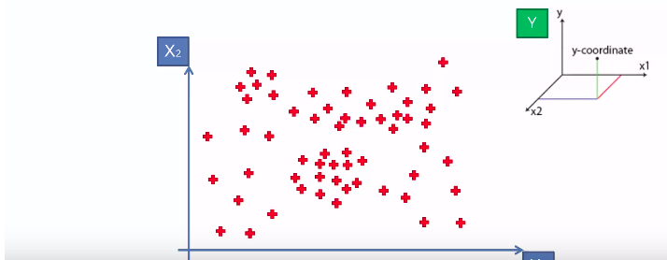
Decision tree
Decision tree is a 2-D regressor so we use only the independent variables to predict y which we cannot see in the below graph

Slide 6
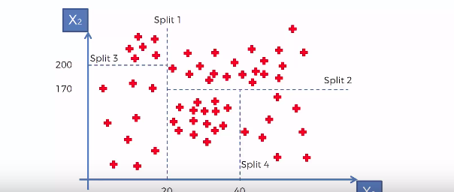
Decision tree

Slide 7
Decision tree
Splitting is done through informaion entropy
Information entropy is something where the information for a particular group is maximum
Something which adds value to the group
Information entropy is the average rate at which information is produced by a stochastic source of data.
Algorithm stops when certain amount of informative data is reached
When the data reaces less than 5% then the algoritm knows that to top splitting

Slide 8
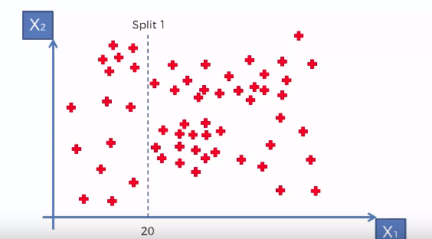
Decision tree

Slide 9
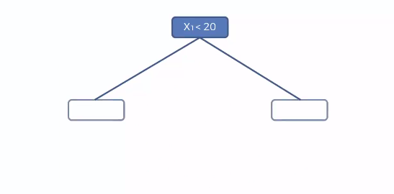
Decision tree

Slide 10
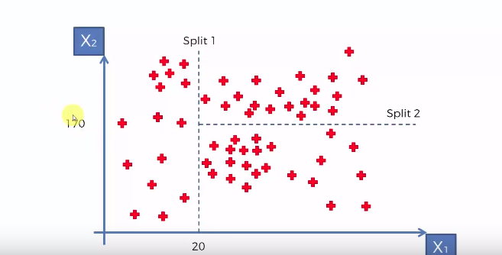
Decision tree

Slide 11
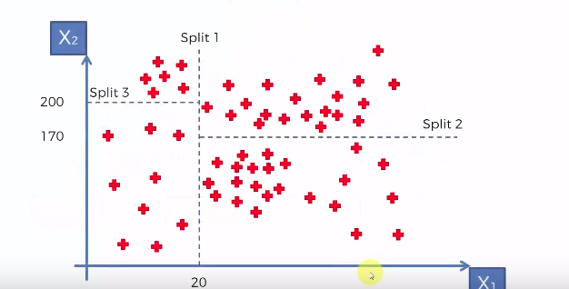
Decision tree

Slide 12
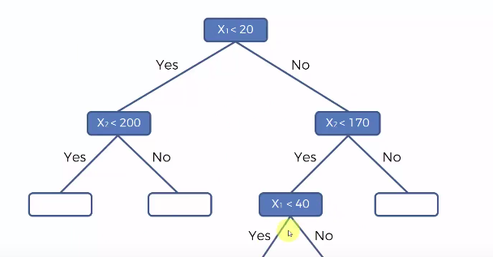
Decision tree

Slide 13
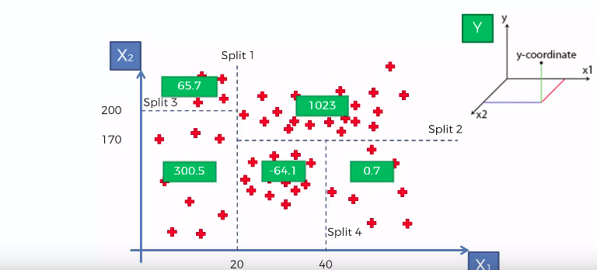
Decision tree

