Slide 1
Machine Learning
Random Forest Regression

Slide 2
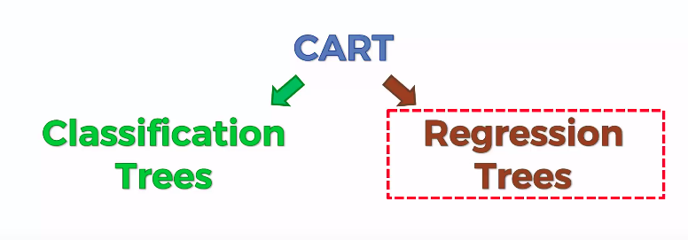
Decision tree Regression

Slide 3
Ensembling methods
Ensemble learning helps improve machine learning results by combining several models. ... Ensemble methods are meta-algorithms that combine several machine learning techniques into one predictive model i

Slide 4
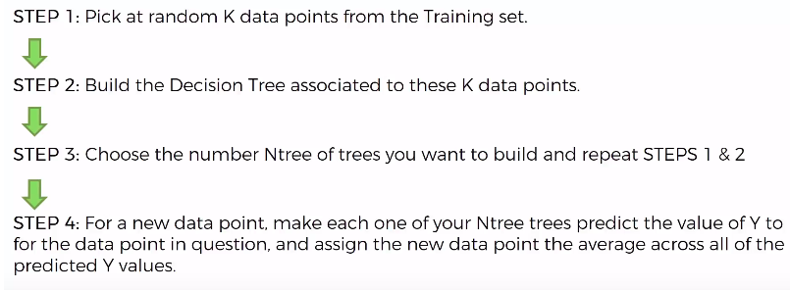
Random Forest

Slide 5
Data preprocessing
dataset = read.csv('Position_Salaries.csv')
dataset = dataset[2:3]
# Splitting the dataset into the Training set and Test set
# # install.packages('caTools')
# library(caTools)
# set.seed(123)
# split = sample.split(dataset$Salary, SplitRatio = 2/3)
# training_set = subset(dataset, split == TRUE)
# test_set = subset(dataset, split == FALSE)
# Feature Scaling
# training_set = scale(training_set)
# test_set = scale(test_set)

Slide 6
Fitting the model
library(randomForest)
set.seed(1234)
regressor = randomForest(x = dataset[-2],
y = dataset$Salary,
ntree = 500)
# Predicting a new result with Random Forest Regression
y_pred = predict(regressor, data.frame(Level = 6.5))

Slide 7
Data Visualisation
library(ggplot2)
x_grid = seq(min(dataset$Level), max(dataset$Level), 0.01)
ggplot() +
geom_point(aes(x = dataset$Level, y = dataset$Salary),
colour = 'red') +
geom_line(aes(x = x_grid, y = predict(regressor, newdata = data.frame(Level = x_grid))),
colour = 'blue') +
ggtitle('Truth or Bluff (Random Forest Regression)') +
xlab('Level') +
ylab('Salary')

Slide 8
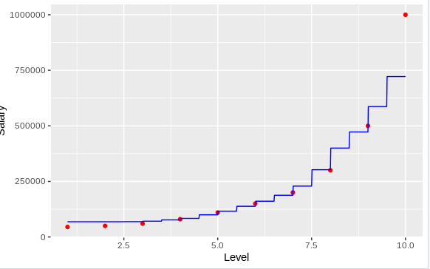
Visual representation

