Slide 1
Machine Learning
R Squared intuition

Slide 2
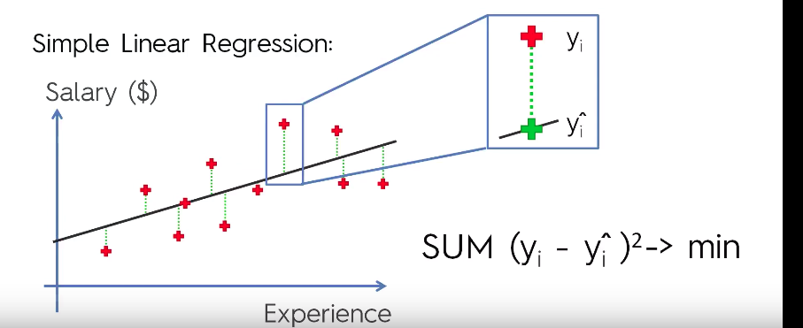
R squared

Slide 3

R squared
We square the residual and we add the sum of each residual and the smallest point that fits is the best line we have got for predicting
Thats how linear regressor is built
The value has got a name and that is called sum of squares of residuals

Slide 4
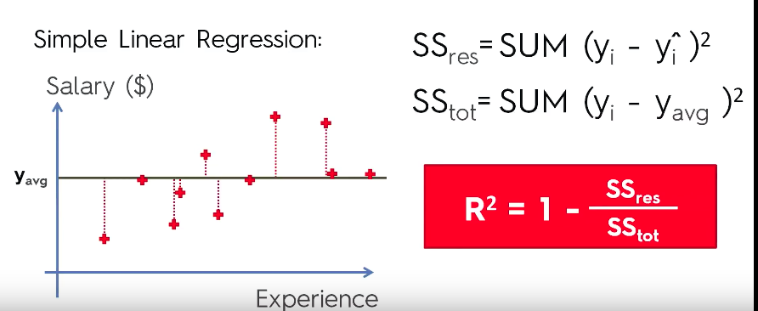
R squared
Now lets just take an average line and do the same intuition
And now do the summation for difference between actual data points and the avergae points which is drawn perpendicular to average line
This is called as total sum of squares

Slide 5
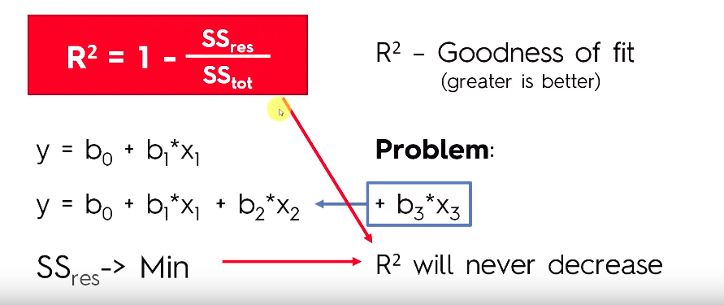
Adjuted R square
As we have applied R square to linear regressor the same process is used for multiple linear regressor
The greater the rsqaure the more the accuracy, the better the model is build

Slide 6
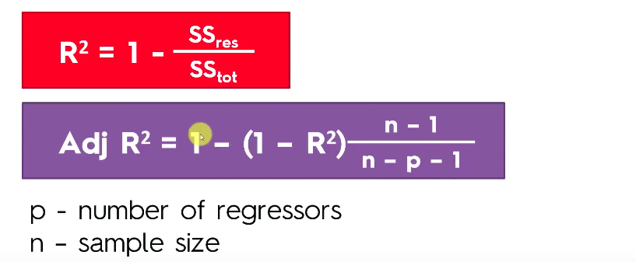
Adjuted R square

Slide 7
Mean Squared error
In statistics, the mean squared error or mean squared deviation of an estimator measures the average of the squares of the errors—that is, the average squared difference between the estimated values and what is estimated.
from sklearn.metrics import mean_squared_error
from math import sqrt
Python
rms = sqrt(mean_squared_error(y_test, y_pred))
R
rmse<-sqrt(mean(test_set$Salary-y_pred)^2)
summary(regressor)
mae<-mean(abs(test_set$Salary-y_pred))

Slide 8
Mean Squared error
The Mean Squared Error (MSE) is a measure of how close a fitted line is to data points. For every data point, you take the distance vertically from the point to the corresponding y value on the curve fit (the error), and square the value. Then you add up all those values for all data points, and, in the case of a fit with two parameters such as a linear fit, divide by the number of points minus two.** The squaring is done so negative values do not cancel positive values. The smaller the Mean Squared Error, the closer the fit is to the data. The MSE has the units squared of whatever is plotted on the vertical axis.
Another quantity that we calculate is the Root Mean Squared Error (RMSE). It is just the square root of the mean square error. That is probably the most easily interpreted statistic, since it has the same units as the quantity plotted on the vertical axis.
Key point: The RMSE is thus the distance, on average, of a data point from the fitted line, measured along a vertical line.

Slide 9
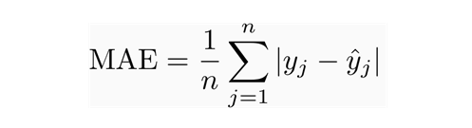
Mean absolute error
MAE measures the average magnitude of the errors in a set of predictions, without considering their direction. It’s the average over the test sample of the absolute differences between prediction and actual observation where all individual differences have equal weight.

Slide 10
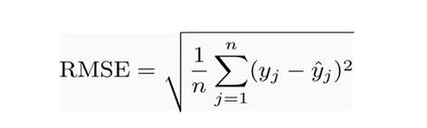
RMSE
RMSE is a quadratic scoring rule that also measures the average magnitude of the error. It’s the square root of the average of squared differences between prediction and actual observation.

Slide 11
Comparisions
Similarities: Both MAE and RMSE express average model prediction error in units of the variable of interest. Both metrics can range from 0 to ∞ and are indifferent to the direction of errors. They are negatively-oriented scores, which means lower values are better.
Differences: Taking the square root of the average squared errors has some interesting implications for RMSE. Since the errors are squared before they are averaged, the RMSE gives a relatively high weight to large errors. This means the RMSE should be more useful when large errors are particularly undesirable. The three tables below show examples where MAE is steady and RMSE increases as the variance associated with the frequency distribution of error magnitudes also increases.

