Slide 1
Machine Learning
Linear rgression assumptions

Slide 2
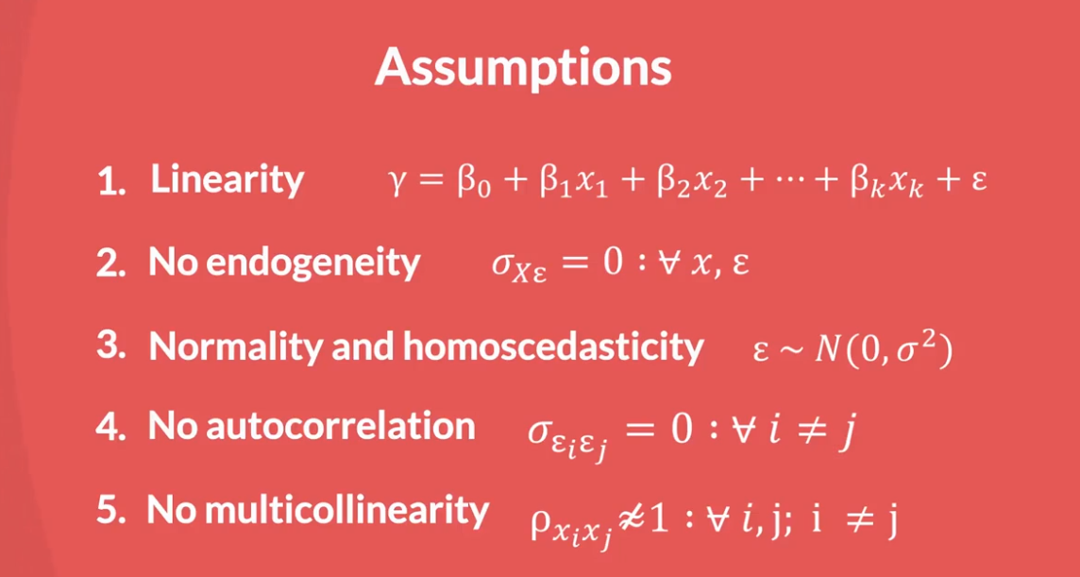
Assumptions

Slide 3
Assumptions
Inorder to bulid a good model in linear regression we need to cross-check with all the assumptions of linear regression
1.Linearity – multiplication of coefficient with variables to predict

Slide 4
Linearity
A solution or example that is not trivial. Often, solutions or examples involving the number zero are considered trivial. Nonzero solutions or examples are considered nontrivial. For example, the equation x + 5y = 0 has the trivial solution (0, 0).
A linear regression is the simplest non-trivial solution

Slide 5
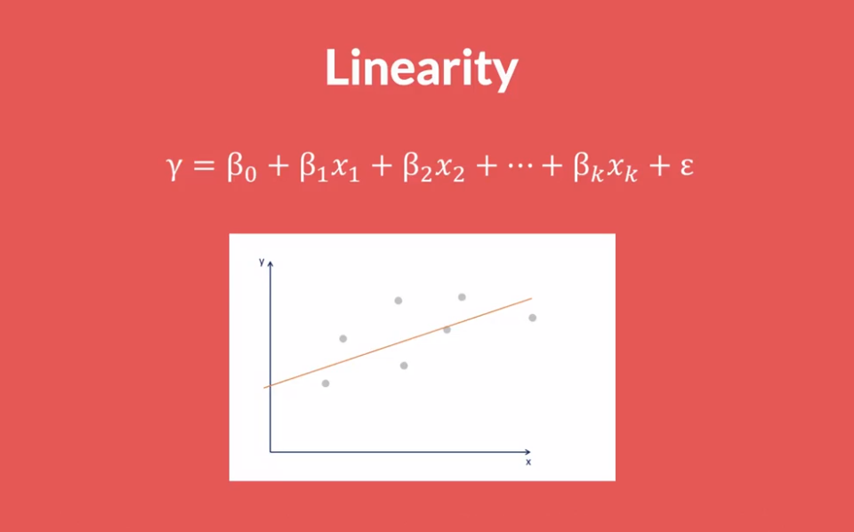
Linearity

Slide 6
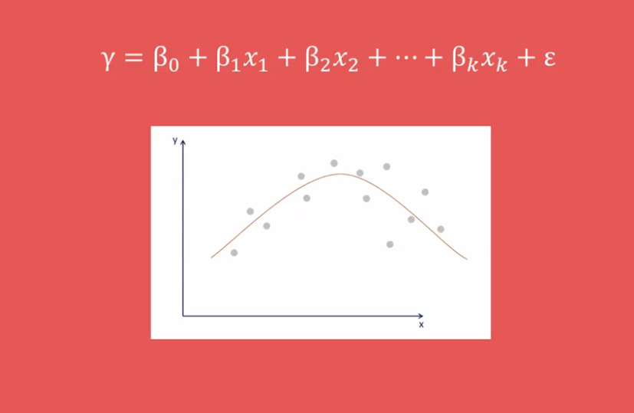
Linearity

Slide 7
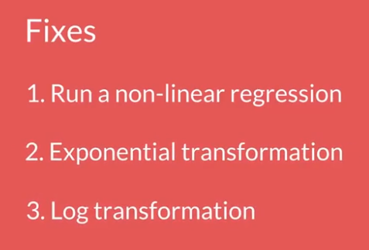
Linearity

Slide 8
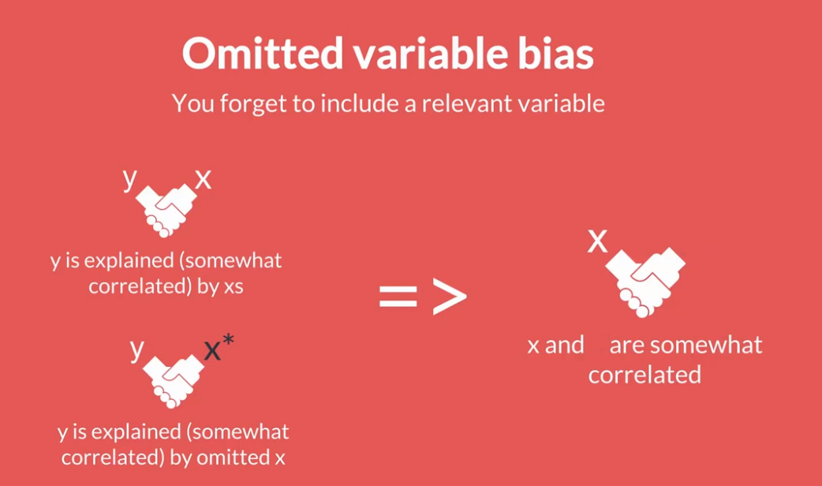
No Endogeneity

Slide 9
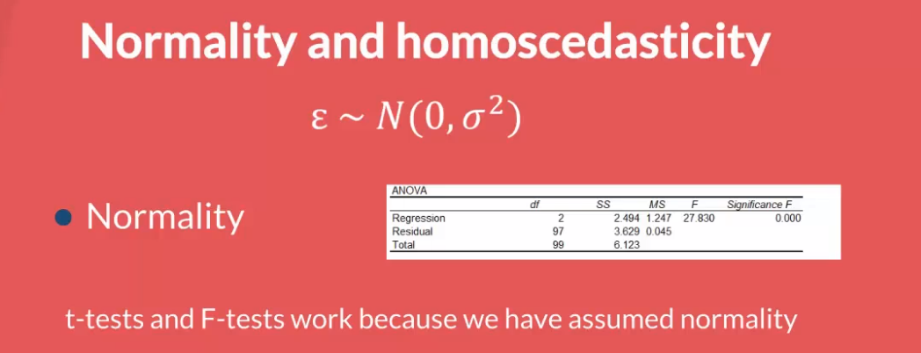
Normality and Homoscedasticity

Slide 10
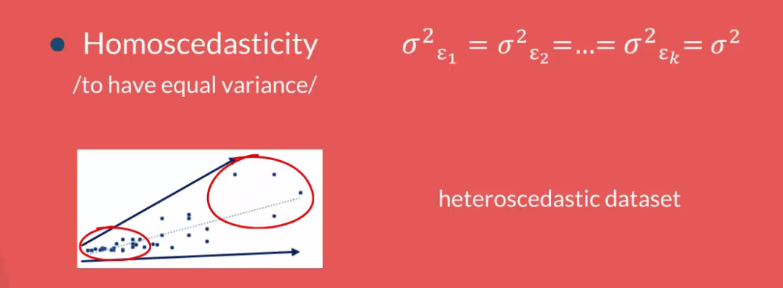
Normality and Homoscedasticity

Slide 11
No multi collinearity
Three or more lines lying on the same line are called collinear points
In statistics, multicollinearity is a phenomenon in which one predictor variable in a multiple regression model can be linearly predicted from the others with a substantial degree of accuracy.
There should be no multi collinearity

