Slide 1
Machine Learning
Multiple Linear Regression

Slide 2
Dataset
Analysing the dataset.
The dataset we are going to use is startups data for this regression technique
Our dataset contains categorical data so we will concentrate on how dummy variables work
We will learn how data affects on profit of a startup
Define independent variables and dependent variables

Slide 3
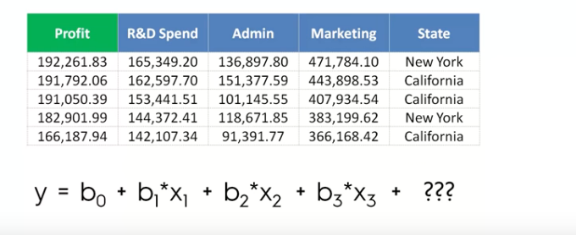
Multiple Linear Regression

Slide 4
Multiple Linear Regression
Inorder to add categorical data to regression models we use dummy variables
First we need to find all the categories involved in the data
For every category you found we need to create a new column

Slide 5
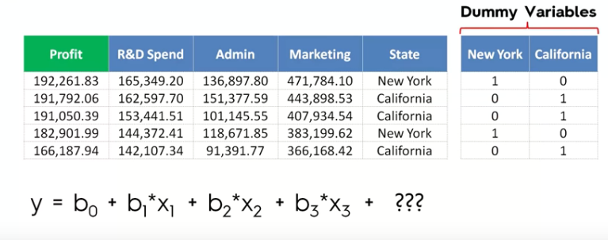
Multiple Linear Regression

Slide 6
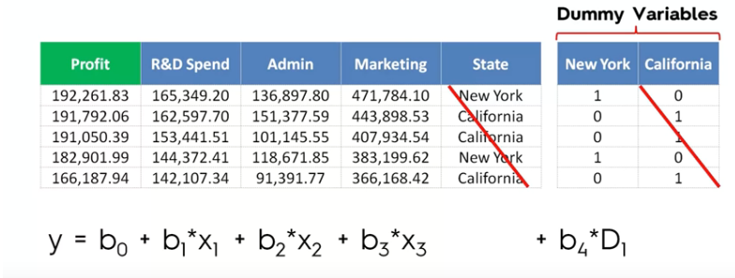
Multiple Linear Regression
After defining dummy variables we can easily define our regression model

Slide 7
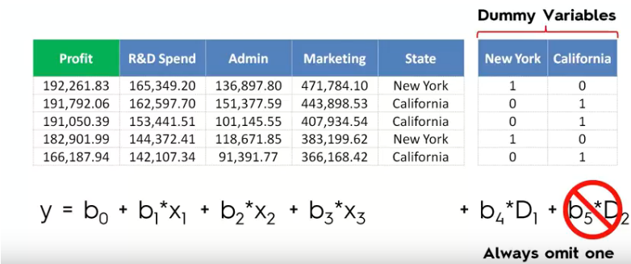
Multiple Linear Regression
Dummy variable trap how to avoid it

Slide 8
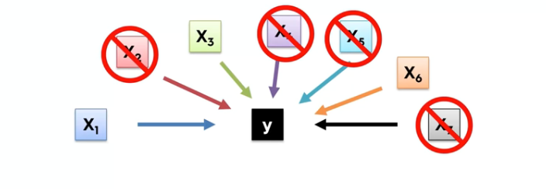
Multiple Linear Regression

Slide 9
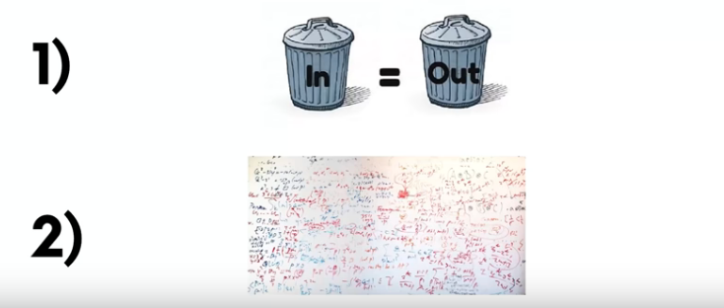
Multiple Linear Regression

Slide 10
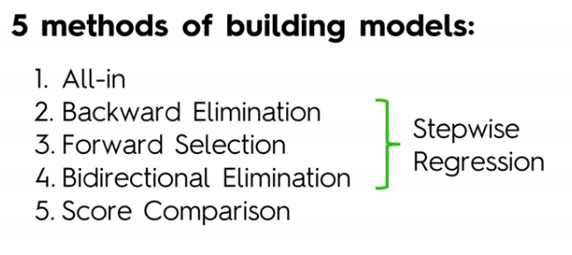
Multiple Linear Regression

Slide 11
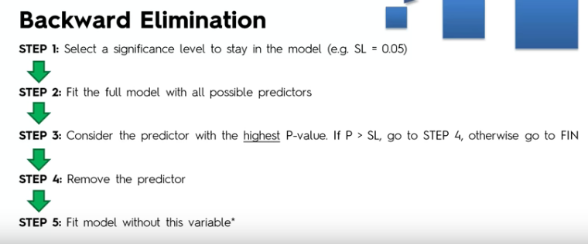
Multiple Linear Regression

Slide 12
Multiple Linear Regression
A small p-value (typically ≤ 0.05) indicates strong evidence against the null hypothesis, so you reject the null hypothesis. A large p-value (> 0.05) indicates weak evidence against the null hypothesis, so you fail to reject the null hypothesis.

Slide 13
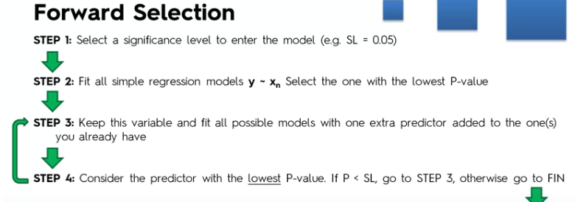
Multiple Linear Regression
.

