Slide 1
Machine Learning
Multiple Linear Regression

Slide 2
Dataset
Analysing the dataset.
The dataset we are going to use is startups data for this regression technique
Our dataset contains categorical data so we will concentrate on how dummy variables work
We will learn how data affects on profit of a startup
Define independent variables and dependent variables

Slide 3
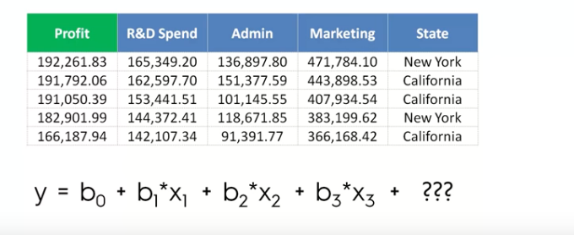
Multiple Linear Regression

Slide 4
Multiple Linear Regression
Inorder to add categorical data to regression models we use dummy variables
First we need to find all the categories involved in the data
For every category you found we need to create a new column

Slide 5
Data Preprocessing
# Importing the libraries
import numpy as np
import matplotlib.pyplot as plt
import pandas as pd
# Importing the dataset
dataset = pd.read_csv('50_Startups.csv')
X = dataset.iloc[:, :-1].values
y = dataset.iloc[:, 4].values
# Encoding categorical data
from sklearn.preprocessing import LabelEncoder, OneHotEncoder
labelencoder = LabelEncoder()
X[:, 3] = labelencoder.fit_transform(X[:, 3])
onehotencoder = OneHotEncoder(categorical_features = [3])
X = onehotencoder.fit_transform(X).toarray()

Slide 6
Data Preprocessing
# Avoiding the Dummy Variable Trap
X = X[:, 1:]
# Splitting the dataset into the Training set and Test set
from sklearn.cross_validation import train_test_split
X_train, X_test, y_train, y_test = train_test_split(X, y, test_size = 0.2, random_state = 0)

Slide 7
Fitting the model
# Fitting Multiple Linear Regression to the Training set
from sklearn.linear_model import LinearRegression
regressor = LinearRegression()
regressor.fit(X_train, y_train)
# Predicting the Test set results
y_pred = regressor.predict(X_test)

Slide 8
Backward elimination Preparation
We are going to need a library which is known as stats models
Then we need to do a little trick then we are good to go
Install stats models “conda install -c anaconda statsmodels”
Import statsmodels.formula.api as sm
Now we dont have a variable for coefficient b0 so create b0 first
import statsmodels.formula.api as sm
X=np.append(arr=np.ones((50,1)).astype(int),values=X,axis=1)
Now we need to create a optimal variable X for y and initialise it
Remove all variables which are statistically significant

Slide 9
Backward elimination Preparation
X_opt=X[:,[0,1,2,3,4,5]]
regressor_ols=sm.OLS(endog=y,exog=X_opt).fit()
regressor_ols.summary()
X_opt=X[:,[0,1,3,4,5]]
regressor_ols=sm.OLS(endog=y,exog=X_opt).fit()
regressor_ols.summary()
X_opt=X[:,[0,3,4,5]]
regressor_ols=sm.OLS(endog=y,exog=X_opt).fit()
regressor_ols.summary()
X_opt=X[:,[0,3,5]]
regressor_ols=sm.OLS(endog=y,exog=X_opt).fit()
regressor_ols.summary()
X_opt=X[:,[0,3]]
regressor_ols=sm.OLS(endog=y,exog=X_opt).fit()
regressor_ols.summary()

