Slide 1
Machine Learning
Multiple Linear Regression

Slide 2
Dataset
Analysing the dataset.
The dataset we are going to use is startups data for this regression technique
Our dataset contains categorical data so we will concentrate on how dummy variables work
We will learn how data affects on profit of a startup
Define independent variables and dependent variables

Slide 3
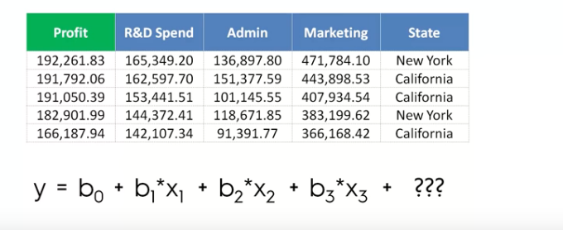
Multiple Linear Regression

Slide 4
Multiple Linear Regression
Inorder to add categorical data to regression models we use dummy variables
First we need to find all the categories involved in the data

Slide 5
Data Preprocessing
# Importing the dataset
dataset = read.csv('50_Startups.csv')
# Encoding categorical data
dataset$State = factor(dataset$State,
levels = c('New York', 'California', 'Florida'),
labels = c(1, 2, 3))
# Splitting the dataset into the Training set and Test set
# install.packages('caTools')
library(caTools)
set.seed(123)
split = sample.split(dataset$Profit, SplitRatio = 0.8)
training_set = subset(dataset, split == TRUE)
test_set = subset(dataset, split == FALSE)

Slide 6
Fitting the model
# Fitting Multiple Linear Regression to the Training set
regressor = lm(formula = Profit ~ .,
data = training_set)
# Predicting the Test set results
y_pred = predict(regressor, newdata = test_set)

Slide 7
Backward elimination Preparation
We are going to need a function which is known as summary
Then we need to do a little trick then we are good to go
regressor = lm(formula = Profit ~ R.D.Spend+Administration+Marketing.Spend+State,
data = training_set)
summary(regressor)

