Slide 1
Machine Learning
Random forest classifier

Slide 2
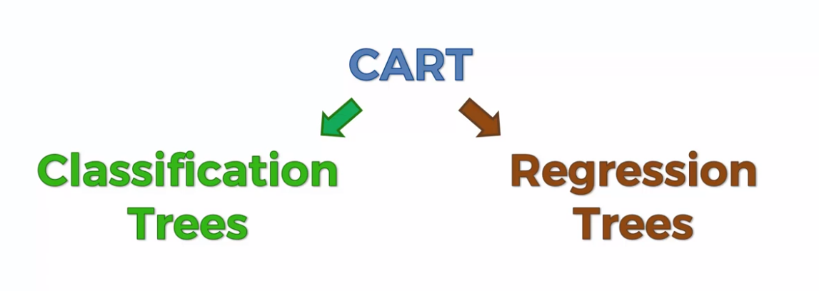

Slide 3
