Slide 1
100 Thousand Dollar Professions Across the
United States
AI Boot Camp Project 1
Team Members:
MARWA BENSALEM
SAMI CHOWDHURY
ROBERT FERRARI
MILEN KING

Slide 2
Project Overview
Project Purpose / Description
Our project highlights career paths across the U.S. with $100K+ salaries, offering people a clear understanding of high-paying roles across different fields.
This resource is crafted for anyone looking to increase their earning potential or find a stable career path, providing practical guidance to make informed career decisions based on qualifications and opportunities.

Slide 3
Project Overview
Goals/Questions to be addressed
Which States had the highest earners?
What education levels are amongst the highest earners?
What profession or professions are amongst the highest earners?

Slide 4
Project Overview
Overview of data collection, cleanup and exploration process
Data Collection:
Census Data: Includes demographic, education, and income details.
BLS Data: Contains job titles, employment statistics, and wage information.
Data Cleanup:
Removed duplicates, NaN values, and outliers.
Standardized column names
Data Transformation:
Mapped occupation codes between datasets to enable merging.
Separated national and state-level data for focused analysis.
Data Exploration:
Analyzed relationships between education, occupation, and income.
Visualized state-level and national trends in wages and employment.

Slide 5
Project Overview
Approach taken to achieve goals
Utilize GeoPandas to graph heatmap of United States to visualize wage gradients
Bar, pie, box-and-whisker plots to create distributions of variables
Analyze correlations between variables to determine relationships

Slide 6
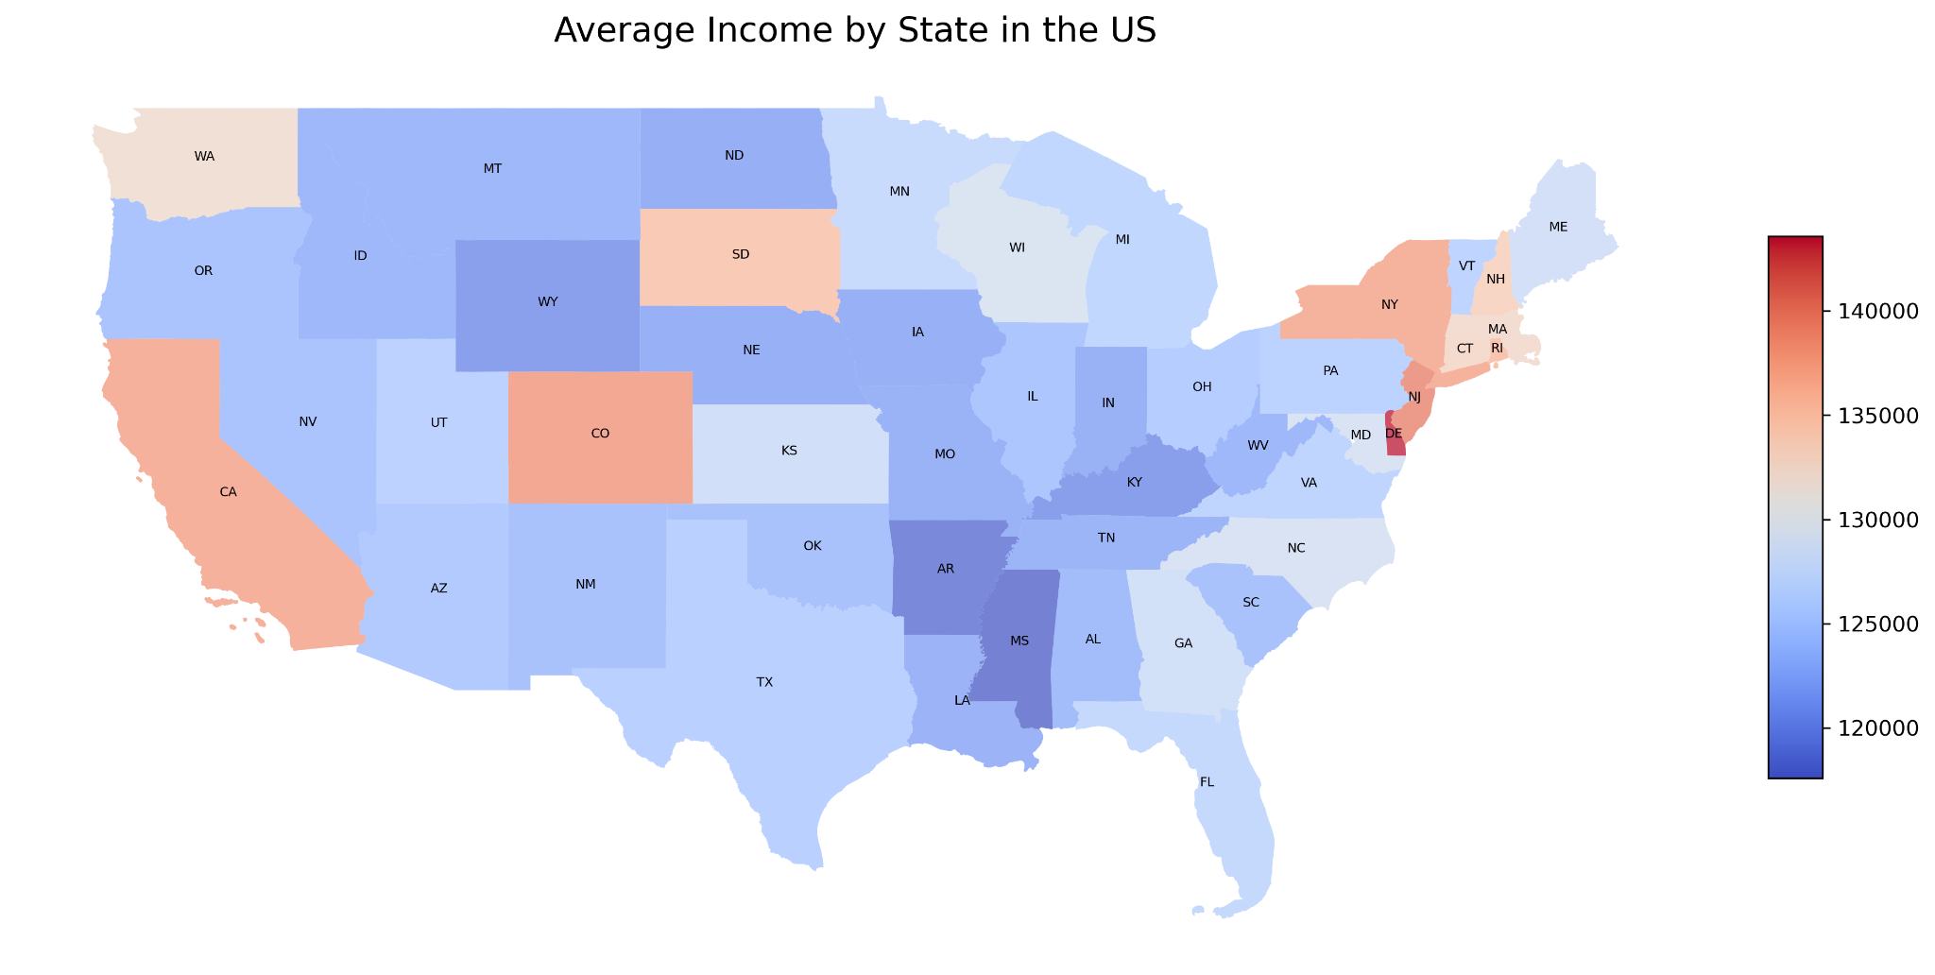
Result/Conclusion 1
The average income per state shows concentrations in certain geographic areas.
North East down to the Atlantic.
East Central to Mid North.
CA, CO, SD, and WA in the West

Slide 7
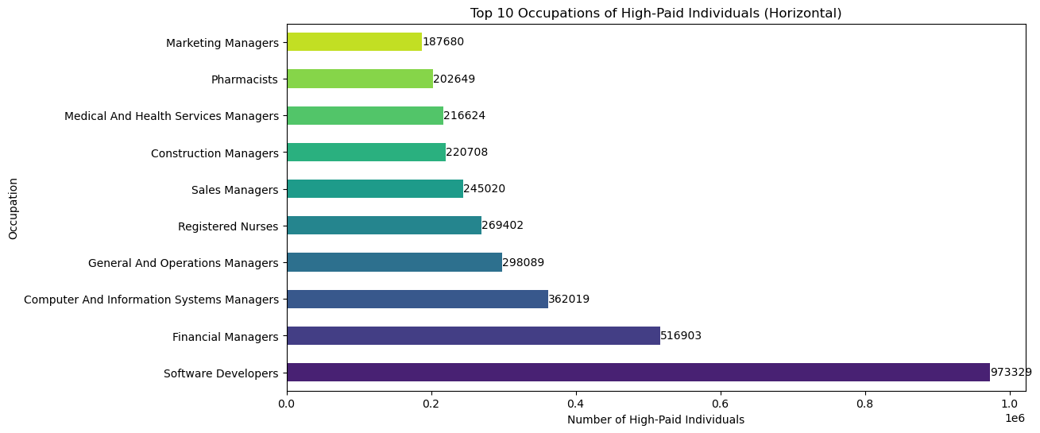
Result/Conclusion 2
The highest number of individuals earning +$100K generally have managerial roles. The industries are mostly in Technology, Operations, and Healthcare.
Software Developers and CIS Managers
Financial Managers and Operations Managers
Registered Nurses and Pharmacists

Slide 8
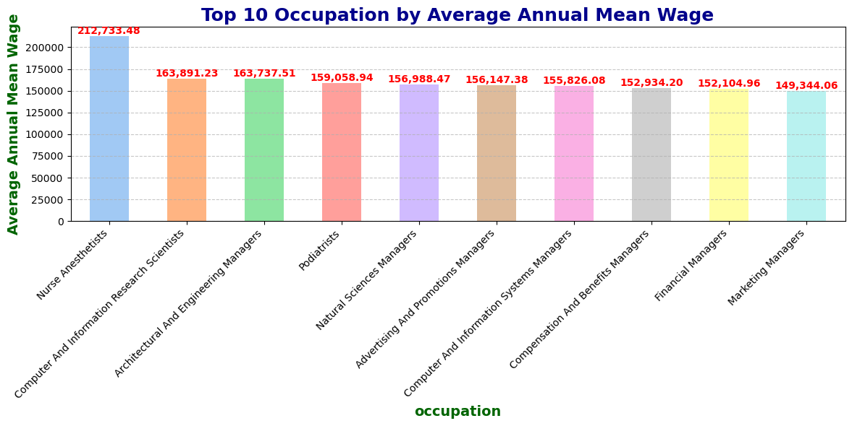
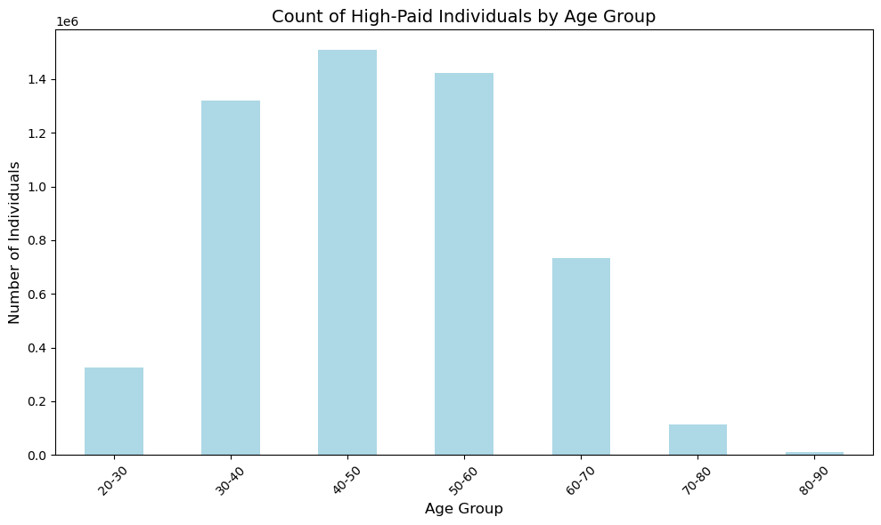
Result/Conclusion 3
The highest average income roles are still generally managers
Science and Healthcare professions
The age distribution is normal with the majority of individuals between 40 to 50 years old

Slide 9
Geographic and Industry Trends:Delaware, California, and Texas top the list for high-paid individuals due to strong industries like tech and finance.
Top Occupations and Education:Software developers and financial managers are the most common high-paid roles.
Demographics and Correlation:Ages 35–54 dominate high-paid demographics, with males leading in count but females earning competitive wages.
Summary

Slide 10
Differentiating national and state-level data in BLS required filtering to focus on state-specific insights.
Mapping education as a factor was challenging due to incompatible or missing data fields.
Aligning education data with geographic maps needed extra processing for accuracy.
Handling data inconsistencies and ensuring proper merges across datasets required careful validation.
Problems Encountered

Slide 11
Summarize any additional questions that surfaced, what your group might research next if more time was available, or share a plan for future development.
New Questions:
What drives gender income disparities despite similar education levels?
How do urban vs. rural incomes differ within states?
Future Research:
Explore industry-specific wage trends.
Analyze income shifts over time.
Next Steps:
Use machine learning for income prediction and pattern discovery.
Build interactive dashboards for better data exploration.
Future Considerations

