Slide 1

HEART DISEASE FEATURE PREDICTION
AI Boot Camp Project 2
Team Members:
ROBERT FERRARI (lead) - TAMARA FREEMAN - LAETITIA GERME - VINAYAK GROVER

Slide 2
Project Overview
Project Purpose / Description
Identify the most important factors in the development of cardiovascular disease in humans
Accomplish by gathering distinct datasets from unique studies including from Center of Disease Control Division for Heart Disease and Stroke Prevention (DHDSP)
Use anonymous patient attribute measurements including body conditions, habits, and abilities
What features are most correlated with one another?
How accurate can our machine learning models predict the presence of heart disease?

Slide 3
Project Overview
Overview of data collection, cleanup and exploration process
Data collection from Kaggle and CDC produced well-populated datasets
Cleanup involved encoding categorical variables, populating null values, removing extraneous records outside of scope, scaling, and identifying correlations
Splitting the data into train and test sets produced model scores and resampling facilitated balanced response outcomes

Slide 4
Project Overview
Approach taken to achieve goals
Test various machine learning models including KNN, Logistic Regression, Support Vector Machine, and Random Forest
Select the optimal model with high accuracy score that performs well without overfitting
Extract features with the most influence on the model scores and compare across the different datasets

Slide 5
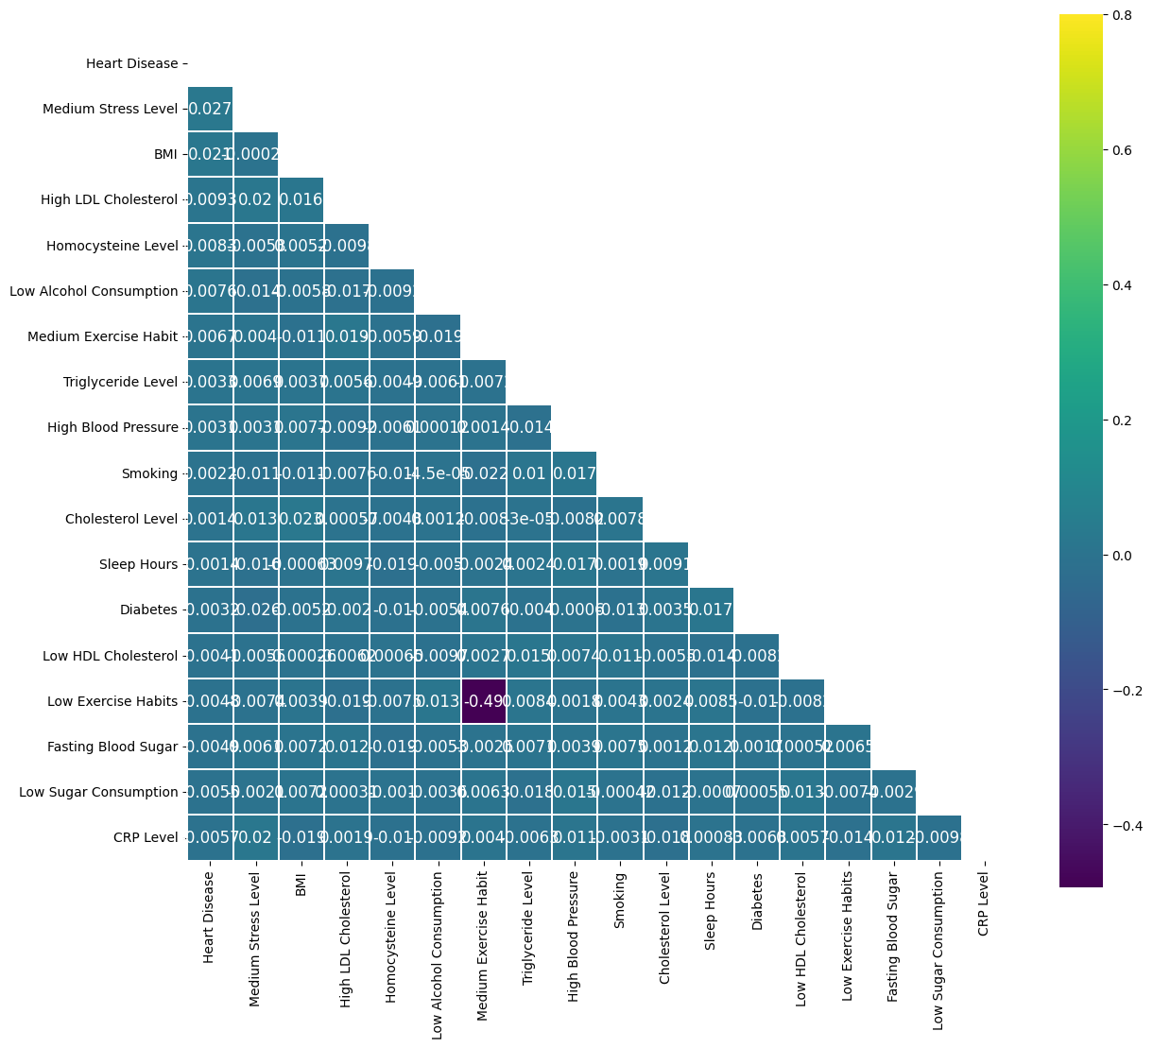
Result/Conclusion 1
Low Exercise Habits strongly correlate with Low HDL Cholesterol (-0.49), highlighting the impact of exercise on good cholesterol.
Diabetes correlates with Fasting Blood Sugar, as expected.
BMI shows mild positive correlations with High LDL Cholesterol and Cholesterol Levels.
Other factors, like CRP Level and Heart Disease, show negligible correlations.
Takeaway: Exercise and BMI are the most actionable factors influencing health outcomes based on these correlations.

Slide 6
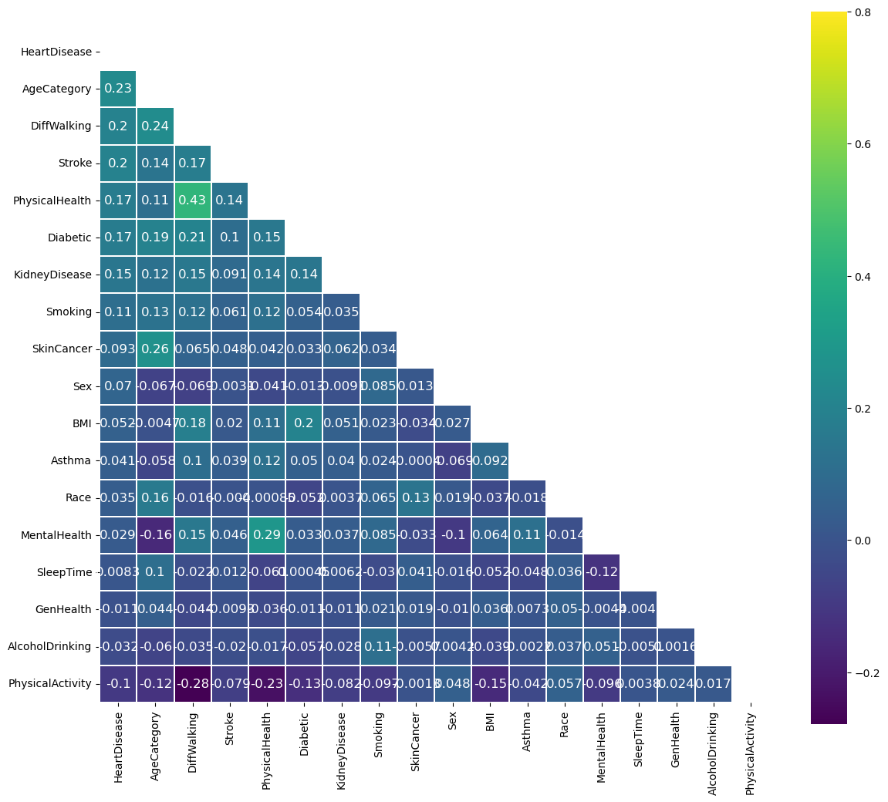
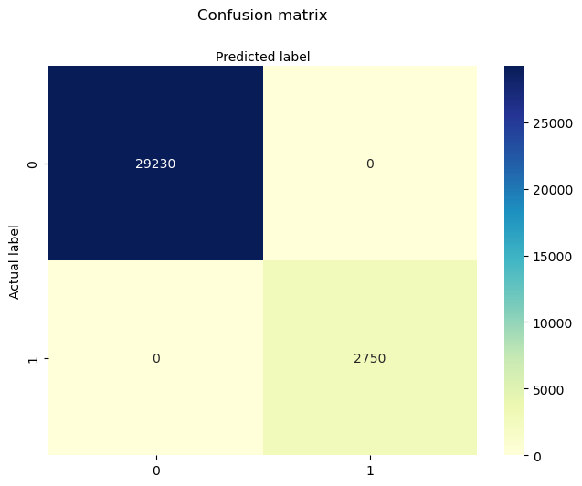
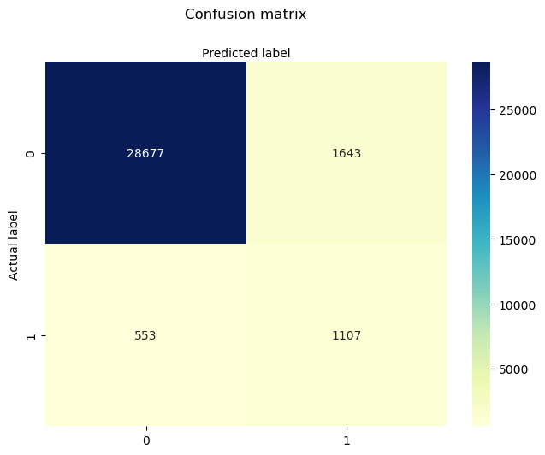
Result/Conclusion 2
Logistic regression classifier score: 0.93
Highest features are Age, Physical Health, Pre-existing Conditions
Resampling was used for hypertuning
PCA was used for feature reduction

Slide 7
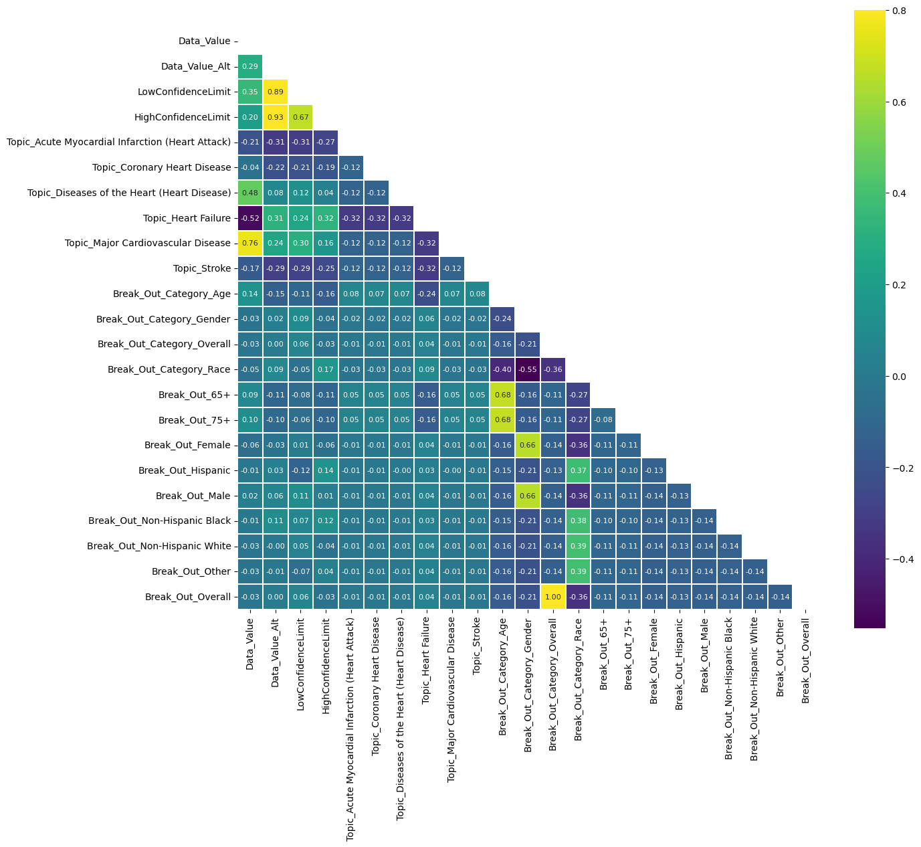
CMS Cardiovascular Disease Data Correlation Matrix
Result/Conclusion 3
Higher positive or negative (>.5 or <-.5)
Data Value and Topic_Heart Failure = -0.52
Data Value and Topic_Major Cardiovascular Disease = 0.76
Age and both 65+ and 75+ = 0.68
Gender and both Female and Male = 0.66
Data Value Alt and Low Confidence = 0.89
Data Value Alt and High Confidence = 0.93
Moderately positive or negative>.4
Data Value and Topic_Diseases of the Heart (Heart Disease) = 0.48
Other notable correlations:
Data Value and Low Confidence = 0.35
Data Value and High Confidence = 0.20
Notes:
Next Step Recommendations:
Limit data to Heart Failure & Diseases of the Heart (Heart Disease) - Results i 23k rows
Cardiovascular Disease? It was well correlated but could be considered broader that heart disease.
Following the above results in
23,514 rows remaining the dataset.
If the “Overall” rows are omitted, 20,394 rows.
If only the “Overall” rows are used then 3,120 rows remain
Consider dropping race and overall categories
Results in 8320 rows

Slide 8
CMS Cardiovascular Disease Data
Data source: | Kaggle copy of CMS CVD data
Result/Conclusion 3
Conclusion: Both classification models are able to predict instances of Heart Disease and Heart Failure with reasonable accuracy. Random Forest Classifier is better. However, I view this dataset as more of a way to capture what CMS has tracked regarding CVD instead of predicting whether or not someone will get heart disease.
Model | DecisionTreeClassifier
Data Shape | 42111 rows and 24 columns
Accuracy | 0.91
Precision | 0.90
Recall | 0.89
Model Config | random state = 7
Model | RandomForestClassifier
Data Shape | 42111 rows and 24 columns
Accuracy | 0.92
Precision | 0.92
Recall | 0.91
Model Config | random state = 7 The below were informed by RandomizedSearchCV: max_depth = 10, max_features=None, min_samples_leaf = 4, min_samples_split= 11, n_estimators= 122

Slide 9
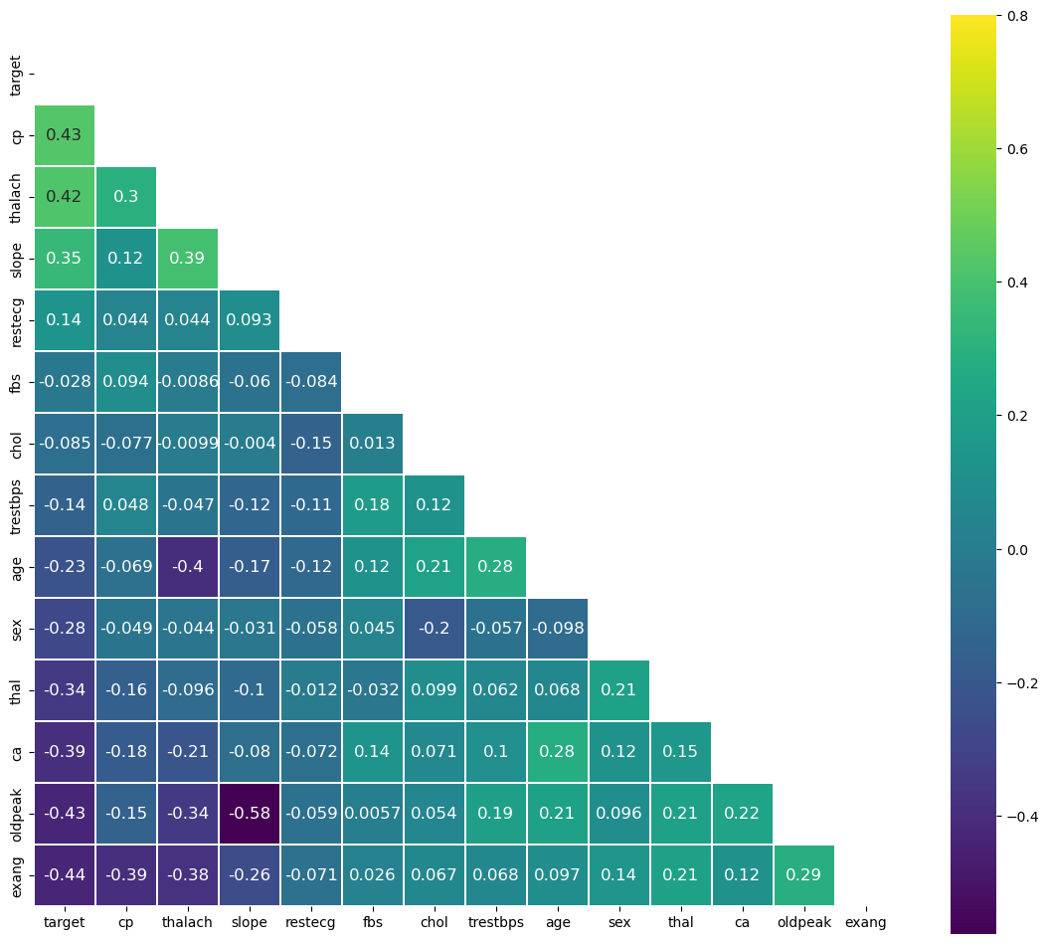
Electrocardiogram Data
Data source: | Kaggle copy of UC Irivne Study
Result/Conclusion 4
SVM Linear Kernel Classification score: 0.92
ECG measurements are very correlated in predicting heart disease presence.
Positive features include chest pain, maximum heart rate, slope of curve, etc.
Negative features include exercise induced pain, curve depression, number of colored vessels, etc.
Takeaway: Routine check ins of heart health with electrocardiograms can lead to profound early detection of heart disease. Tangible symptoms such as chest and exercise pain can indicate developing disease

Slide 10
Summary
Age and Physical Health seem to be the most influential factors in determining heart disease. Features correlated to Physical Health supported this such as Pre-Existing Conditions (Stroke, Diabetic, etc.) and activities such as exercise
Features individually do not have relatively high correlations to heart disease prediction but can combine to accuracy above 90%. Principal components with highly weighted features are the most important
Resampling techniques assisted in better tuned models that prioritized higher accuracy on the underrepresented heart disease present population

Slide 11
Create alternate approaches to combining datasets at a group level rather than patient level
Select features more judiciously to simplify predictive power
Explore more varied machine learning techniques like gradient boost classifier, neural network, etc.
Future Considerations

