Slide 1




Frontrunning Block Attack in PoA: A Case Study
2022 IEEE International Conference on Blockchain and Cryptocurrency
Xinrui Zhang¹, Qin Wang², Rujia Li^{1,3}, Qi Wang¹
¹ Southern University of Science and Technology
² CSIRO Data61
³ University of Birmingham
Notes:
Firstly, I’ll give a brief introduction of the consensus algorithm we are going to talk about.

Slide 2





A PoA Network
Single point attack
$$Sealer_{1}$$
Node
Clique:
Ethereum’s Geth
GoChain
Binance Chain
POA Network
ConsenSys
…
Node
$${Sealer}_{3}$$
$$Sealer_{2}$$
$$Sealer_{0}$$
Node
Notes:
PoA which stands for Proof-of-Authority is one of the main-stream ways to achieve consensus in blockchain networks.This figure shows the general idea of how PoA works. Among all nodes in the entire network, certain nodes are granted with the authority to seal blocks. We call them sealers.
Theoretically, blockchain’s safety can be guaranteed as long as most nodes are honest.
However, in practice, there are some loopholes left open for single point attack. Especially, we are talking about Clique protocol in this work.
Due to its better performance, Clique are widely adopted by many projects like Ethereum’s Geth client, GoChain, Binance chain, POA network and ConsenSys, which means its vulnerability may have a great impact on cryptocurrency market.

Slide 3
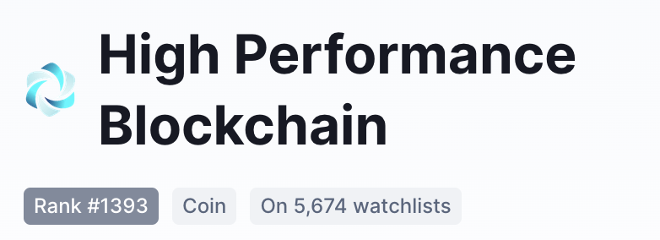



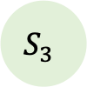
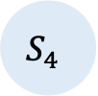
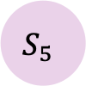
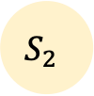
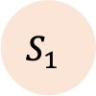
Possible Damage
Frontrunning Block Attack
HPB ($10,128,116 as of Jan.)
$$S_{1}$$
$$S_{2}$$
$$S_{5}$$
$$S_{3}$$
$$S_{4}$$
Attacked
Notes:
We performed our attack by falsifying related codes and imitate sealing leader’s priority in consecutive epochs. Due to the failure of verifications, we can successfully take the leader’s position continuously with a single node, which makes it possible to perform frontrunning block attack, and holding the priority during block confirmation.
Our target blockchain High Performance Blockchain has a market cap of $10,128,116, as of January. The underestimation may damage the fairness of target blockchains and therefore causes considerable financial loss to both traders and honest miners. We believe this work can act as, at least, a warning case for Clique variants to avoid repeating such design mistakes.

Slide 4
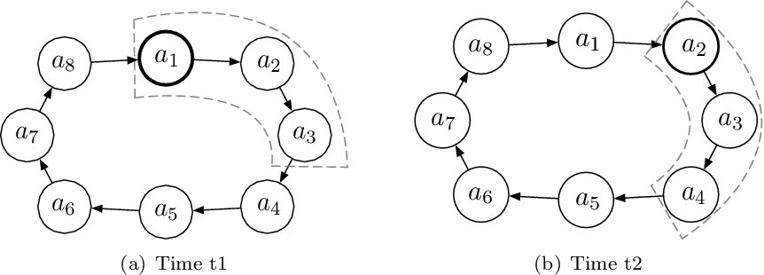
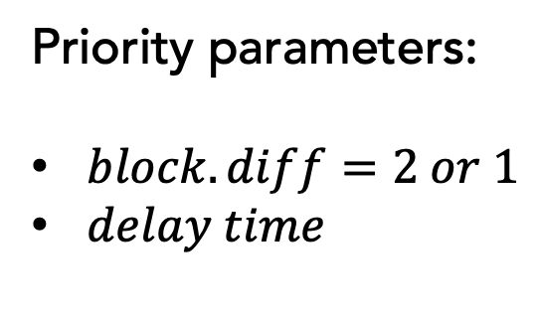
Clique’s Block Proposal and Conformation
2
2
2
Priority parameters:
$block.diff=2 or 1$
$delay time$
2
1
2
1
1
2
✔️accept
❌
[1] Stefano De Angelis, Leonardo Aniello, Roberto Baldoni, Federico Lombardi, Andrea Margheri, and Vladimiro Sassone. Pbft vs proof-of-authority: Applying the cap theorem to permissioned blockchain. 2018.
Notes:
Here’s how Clique achieves consensus. The largest minority of sealers are elected to seal blocks in each epoch. As Angelis et al. depicts in this figure, sealers follow the rotation schema. A portion of them can seal a block in each epoch, but only one, the “leader”, possesses the highest priority.
There are mainly 2 parameters determines the conformation priority, “difficulty” and “delay”.

Slide 5
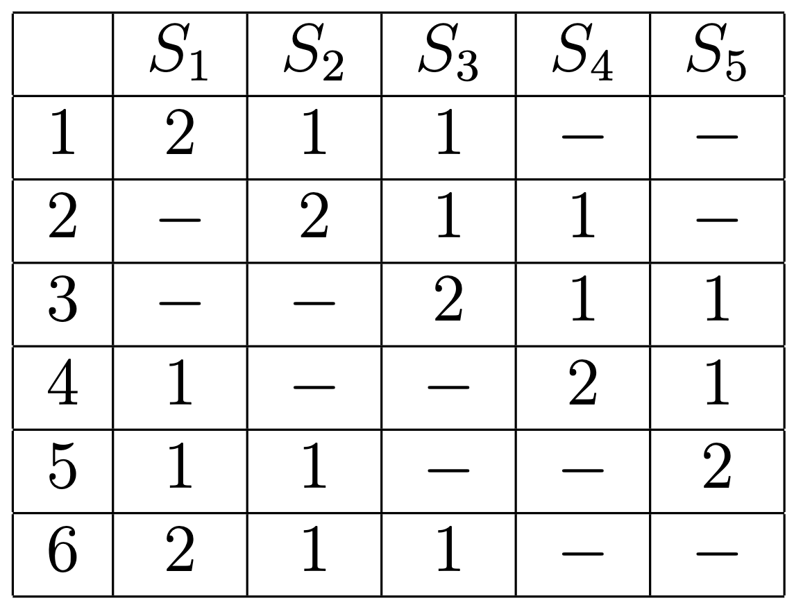
Clique Rotation Schema
Local HPB private chain Centos 7 x86\_64
5 Sealers
1 Malicious sealer
block generation rate: 1 block per 5 seconds
Notes:
Following the rotation schema, sealers that have recently signed a block are excluded from sealing during certain epochs.
In our experiment, we established a HPB local private blockchain with 5 authority nodes. All honest nodes execute the original program, and the one malicious node executes the program compiled from tampered source code.
This table distinctly shows the way that sealers and difficulty priorities rotate.

Slide 6
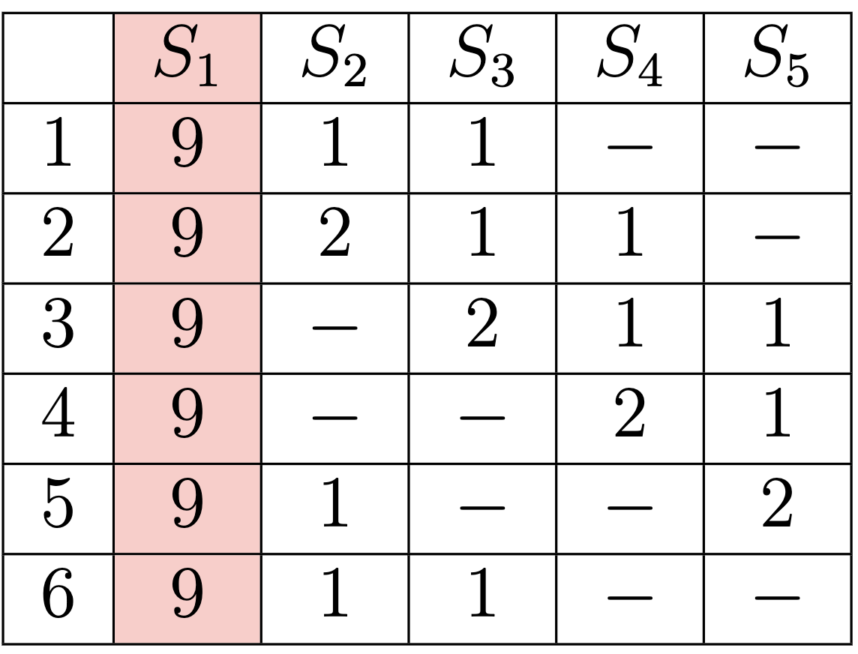
Ideal Attack
Local HPB private chain Centos 7 x86\_64
5 Sealers
1 Malicious sealer
block generation rate: 1 block per 5 seconds
Notes:
An ideal single point attack may look like this figure, a malicious node can ignore the rotation rule and keep sealing blocks with the highest priority.

Slide 7
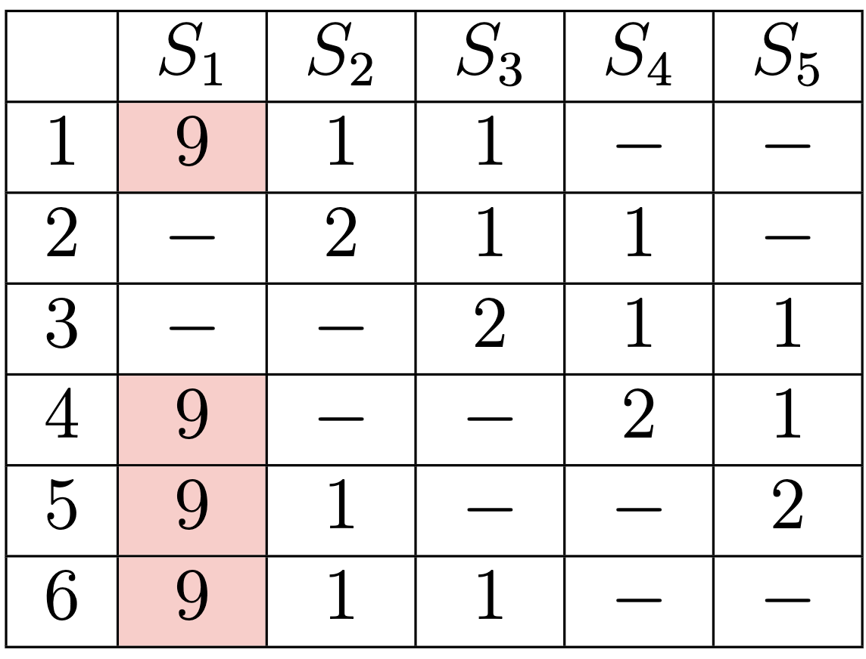
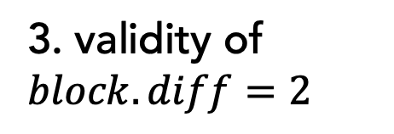
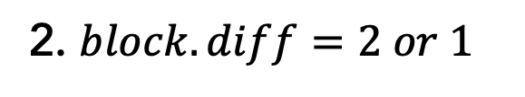
Verification Conditions of Clique
1. Recently signed (rotation schema)
Procedure Verify
2. $block.diff=2 or 1$
3. validity of $block.diff=2$
Notes:
Clique itself has a verification procedure on the block receivers’ side. Ideally, They would check whether the block’s sealer has recently signed another block, and whether the block difficulty is restricted to 1 or 2, if so, whether it’s valid to issue a block with difficulty 1 or 2.
Here’s an example of the relationship between an ideal attack and the verification procedure.
If the first verification is properly deployed, the evil node cannot seal a block when it has signed recently. But it can still issue a block with invalid difficulty.

Slide 8
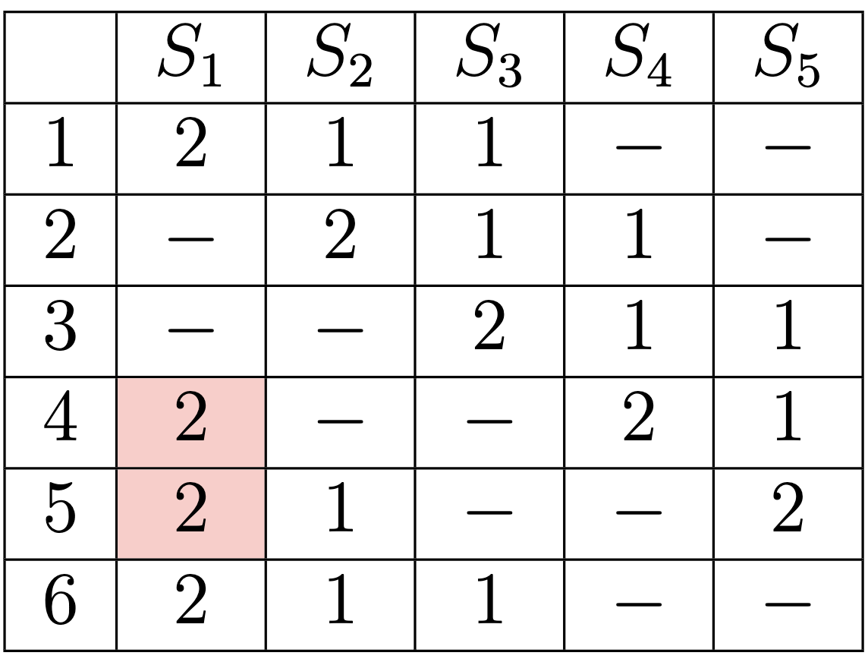
Verification Conditions of Clique
1. Recently signed (rotation schema)
Procedure Verify
2. $block.diff=2 or 1$
3. validity of $block.diff=2$
Notes:
If the second verification is deployed, the highest difficulty a block can have would be restricted to 2.

Slide 9
Verification Conditions of Clique
1. Recently signed (rotation schema)
Procedure Verify
2. $block.diff=2 or 1$
3. validity of $block.diff=2$
Notes:
If all 3 verifications are effective, in this case, the evil node could hardly perform the single point attack.

Slide 10
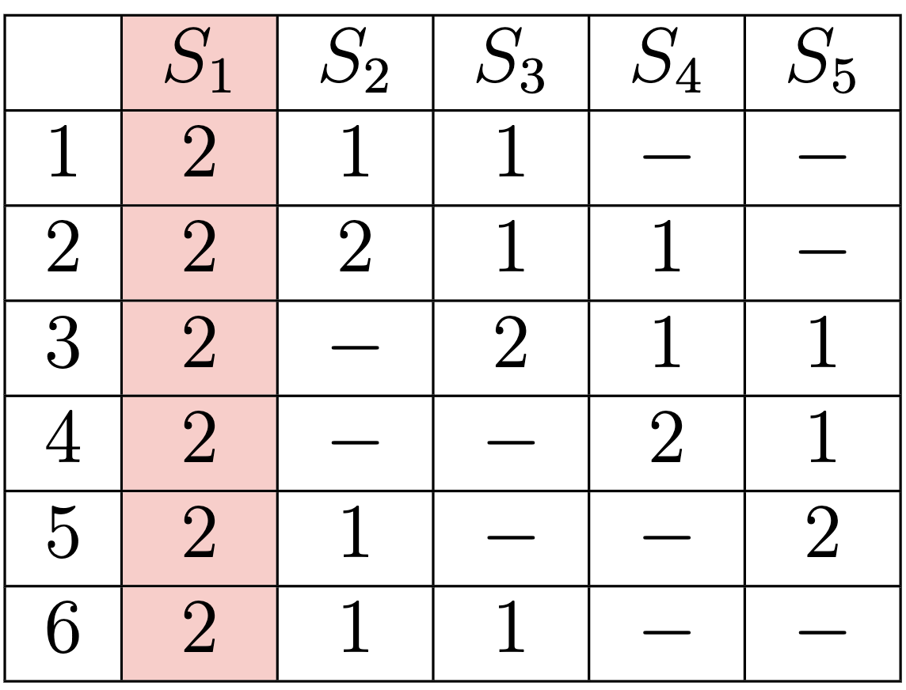
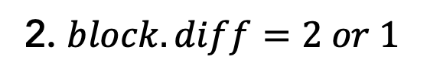
Attacks on Target Blockchain (HPB)
Code-level logic error
1. Recently signed (rotation schema)
Procedure Verify
2. $block.diff=2 or 1$
3. validity of $block.diff=2$
Problem reported and got fixed ✔️
Notes:
The comparison emphasized the importance of Clique’s verification. However, some clique-based protocols used by commercial blockchains may underestimate it, including High Performance Blockchain (HPB) as our case study. We found their verification on step 1 and 3 are not effective. Therefore, with only a single node, we can successfully keep possessing the priority in block confirmation and take over accounting right of the following chain.
For this code-level logic error appears in implementation, fixing the error may plug into the loophole, and a fully evaluation of security guarantees may avoid similar problems. With an example of a commercial blockchain, we strongly recommend future projects to pay more attention on algorithm logic which may be neglected in practice. Notably, we now have reported our recommendation fixes to their official team and got their approval.

Slide 11
References
[1] G. Wood, “Poa private chains,” https://github.com/ethereum/guide/blob /master/poa.md, Nov. 2015, accessed: Dec., 2021.
[2] P. Szilágyi, “Eip-225: Clique proof of authority consensus protocol,” 2017, ethereum Improvement Proposals, accessed: Dec.,2021. [Online]. Available: https://eips.ethereum.org/EIPS/eip-225
[3] A. Ordian, “pairty-ethereum,” https://github.com/openethereum/parity-e thereum, Feb. 2020, accessed: Dec., 2021.
[4] C. N. Samuel, S. Glock, F. Verdier, and P. Guitton-Ouhamou, “Choice of ethereum clients for private blockchain: Assessment from proof of authority perspective,” in Proceedings of the 2021 IEEE International Conference on Blockchain and Cryptocurrency (ICBC). IEEE, 2021, pp. 1–5.
“Gochain,” https://gochain.io/, 2021, accessed: Dec., 2021.
[5]“Posa in binance smart chain,” https://github.com/binance-chain/white paper/blob/master/WHITEPAPER.md, 2021, accessed: Dec., 2021.
Parity Technologies (UK) Ltd, “Poa network,” https://github.com/poane twork/openethereum, 2021, accessed: Dec., 2021.
[6] “Consensys quorum,” https://github.com/ConsenSys/quorum/blob/maste r/consensus/clique/clique.go, 2021, accessed: Dec., 2021.

Slide 12
References
[7] Q. Wang, R. Li, Q. Wang, S. Chen, and Y. Xiang, “Exploring unfairness on proof of authority: Order manipulation attacks and remedies,” http: //arxiv.org/abs/2203.03008, 2021.
[8] S. De Angelis, L. Aniello, R. Baldoni, F. Lombardi, A. Margheri, and V. Sassone, “PBFT vs proof-of-authority: Applying the CAP theorem to permissioned blockchain,” in Proceedings of the 2018 Italian Conference on Cybersecurity (ITASEC), 2018, pp. 1–11.
[9] A. Kosba, A. Miller, E. Shi, Z. Wen, and C. Papamanthou, “Hawk: The blockchain model of cryptography and privacy-preserving smart contracts,” in Proceedings of the 2016 IEEE symposium on security and privacy (SP). IEEE, 2016, pp. 839–858.
[10] P. Daian, S. Goldfeder, T. Kell, Y. Li, X. Zhao, I. Bentov, L. Breidenbach, and A. Juels, “Flash boys 2.0: Frontrunning in decentralized exchanges, miner extractable value, and consensus instability,” in Proceedings of the 2020 IEEE Symposium on Security and Privacy (SP). IEEE, 2020, pp. 910–927.
[11] HPB, “High performance blockchain (hpb),” https://www.hpb.io/, Aug. 2021, accessed: Dec., 2021.
Go Ethereum Team, “Private network tutorial,” https://geth.ethereum.or g/docs/getting-started/private-net, 2021, accessed: Dec., 2021.
[12] The go-hpb Authors, “High performance blockchain (hpb) – chain generation,” https://github.com/hpb-project/go-hpb/blob/master/consens us/prometheus/chain_generation.go, Aug. 2021, accessed: Dec., 2021.

Slide 13
Frontrunning Block Attack in PoA: A Case Study
2022 IEEE International Conference on Blockchain and Cryptocurrency
Xinrui Zhang¹, Qin Wang², Rujia Li^{1,3}, Qi Wang¹
¹ Southern University of Science and Technology
² CSIRO Data61
³ University of Birmingham
Notes:
Firstly, I’ll give a brief introduction of the consensus algorithm we are going to talk about.

