Slide 1
150
T1
Execution of T1
Physical time axis
Stretched logical time axis
Timestamp 150 on time axis
T1 (CRT): R (B), W (A = B + 1), W (C = B – 1)
T2 (IRT): W(A = A * 2 )
T3 (IRT): W(C = C+ 2 )
Client 1
Not blocked
100
199.0
ts=199.1
199.2
200
A
OK,
anticipated
ts = 200
…
T2
T1
Prepare T1
Commit
ts = 200
Read value b
50
130
150
200
B
OK,
anticipated
ts = 170
T1
Prepare T1
90
Commit
ts = 200
Read value b
C
T3
T1
ts=120
…
199.0
199.1
…
200
169.0
169.1
190
Client 2
Not blocked

Slide 2
T1
A CRT
T2
An IRT
Physical time axis
Stretched logical time axis
150
Timestamp 150
T1 (CRT): R (B), W (A = B + 1), W (C = B – 1)
T2 (IRT): W(A = A * 2 )
T3 (IRT): W(A = A+ 2 )
Client 1
Not blocked
Not blocked
100
ts=120
199.0
ts=199.1
…
200
A
199.2
Pre. T1
OK
anticipated
ts = 200
Exe. T2
Com. T1
Exe. T3
Exe. T1
Prepare T1
Commit
ts = 200
Read value b
output
B
Exe. T1
50
150
200

Slide 3
A
Prepare T1
100
199.0
200
B
OK,
anticipated
ts = 200
Commit
ts = 200
T2
Read value c
T1
150
200
Client 2
T1
D
50
T3
Client 2
T1：CRT
R (C)
W (A = C + 1)
W (D = C – 1)

Slide 4
T1
A CRT
T2
An IRT
Physical time axis
Stretched logical time axis
150
Timestamp 150
T1 (CRT): R (B), W (A = B + 1), W (C = B – 1)
T2 (IRT): W(A = A * 2 )
T3 (IRT): W(A = A+ 2 )
Client 1
A
Pre. T1
Recv. T2
Com. T1
Recv. T3
Exe. T1
Exe. T2
Exe. T3
Prepare T1
OK
Commit
Read value b
output
B
Exe. T1

Slide 5
T1
A CRT
An IRT
Physical time axis
Stretched axis
150
Timestamp 150
T2
T1 (CRT): R (B), W (A = B + 1)
T2 (IRT): W(A = A * 2 )
T3 (IRT): W(B = B + 2 )
Region 1
A
Pre T1
Recv T2
Com T1
Exe T1
Com T2
Exe T2
Prepare
OK
Commit
Read A
Region 2
waiting for inputs
B
Recv T1
Com T1
Recv. T3
Com. T3
Exe T1
Exe T3

Slide 6
Region 1
100
T2.ts=120
200
A
Pre T1
Recv T2
Com&Exe T2
Com T1
Exe T1
OK
anticipated
ts = 200
Commit
ts = 200
read A
Prepare
Region 2
Time axis stretched
B
Recv T1
Recv T3
Com&Exe T3
Exe T1
50
150
199.0
T3.ts=199.1
199.2
200
…

Slide 7
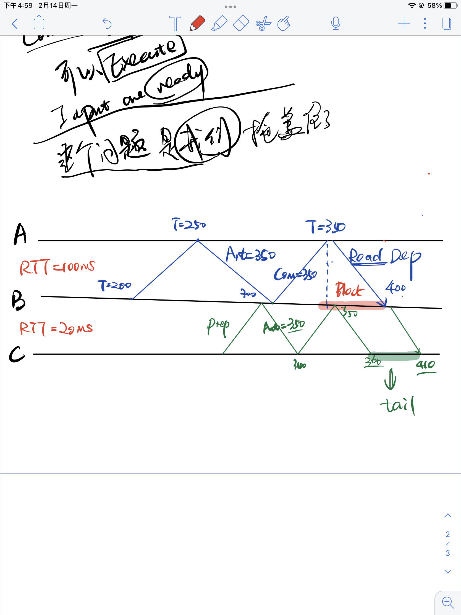
Extension

Slide 8
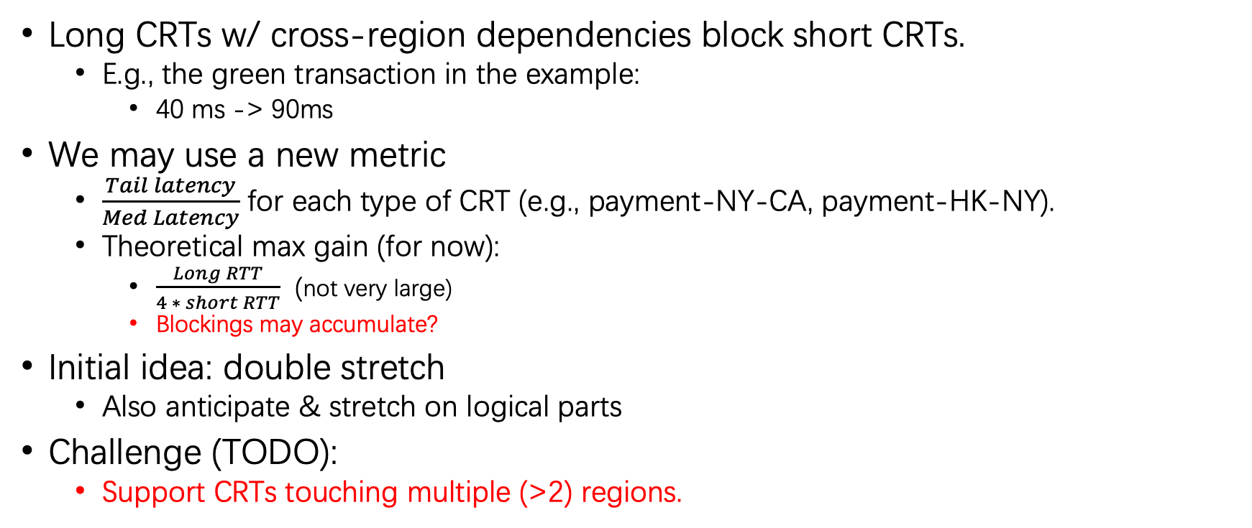
DAST Ex1: Protocol
Long CRTs w/ cross-region dependencies block short CRTs.
E.g., the green transaction in the example:
40 ms -> 90ms
We may use a new metric
$\frac{Tail latency}{Med Latency}$ for each type of CRT (e.g., payment-NY-CA, payment-HK-NY).
Theoretical max gain (for now):
$\frac{Long RTT}{4 ∗ short RTT}$ (not very large)
Blockings may accumulate?
Initial idea: double stretch
Also anticipate & stretch on logical parts
Challenge (TODO):
Support CRTs touching multiple (>2) regions.

Slide 9
DAST Ex2: Theory
Formalize the consistency model of DAST.
We did not make this as our contribution in our Conference paper.
May be beneficial for other databases w/ partial replication model.
Strict Serializability
Regular Sequential Serializability
DAST
Process-ordered Serializability
One-copy Serializability
Snapshot Isolation
Repeatable Read
…
Strong
Weak

