Slide 1
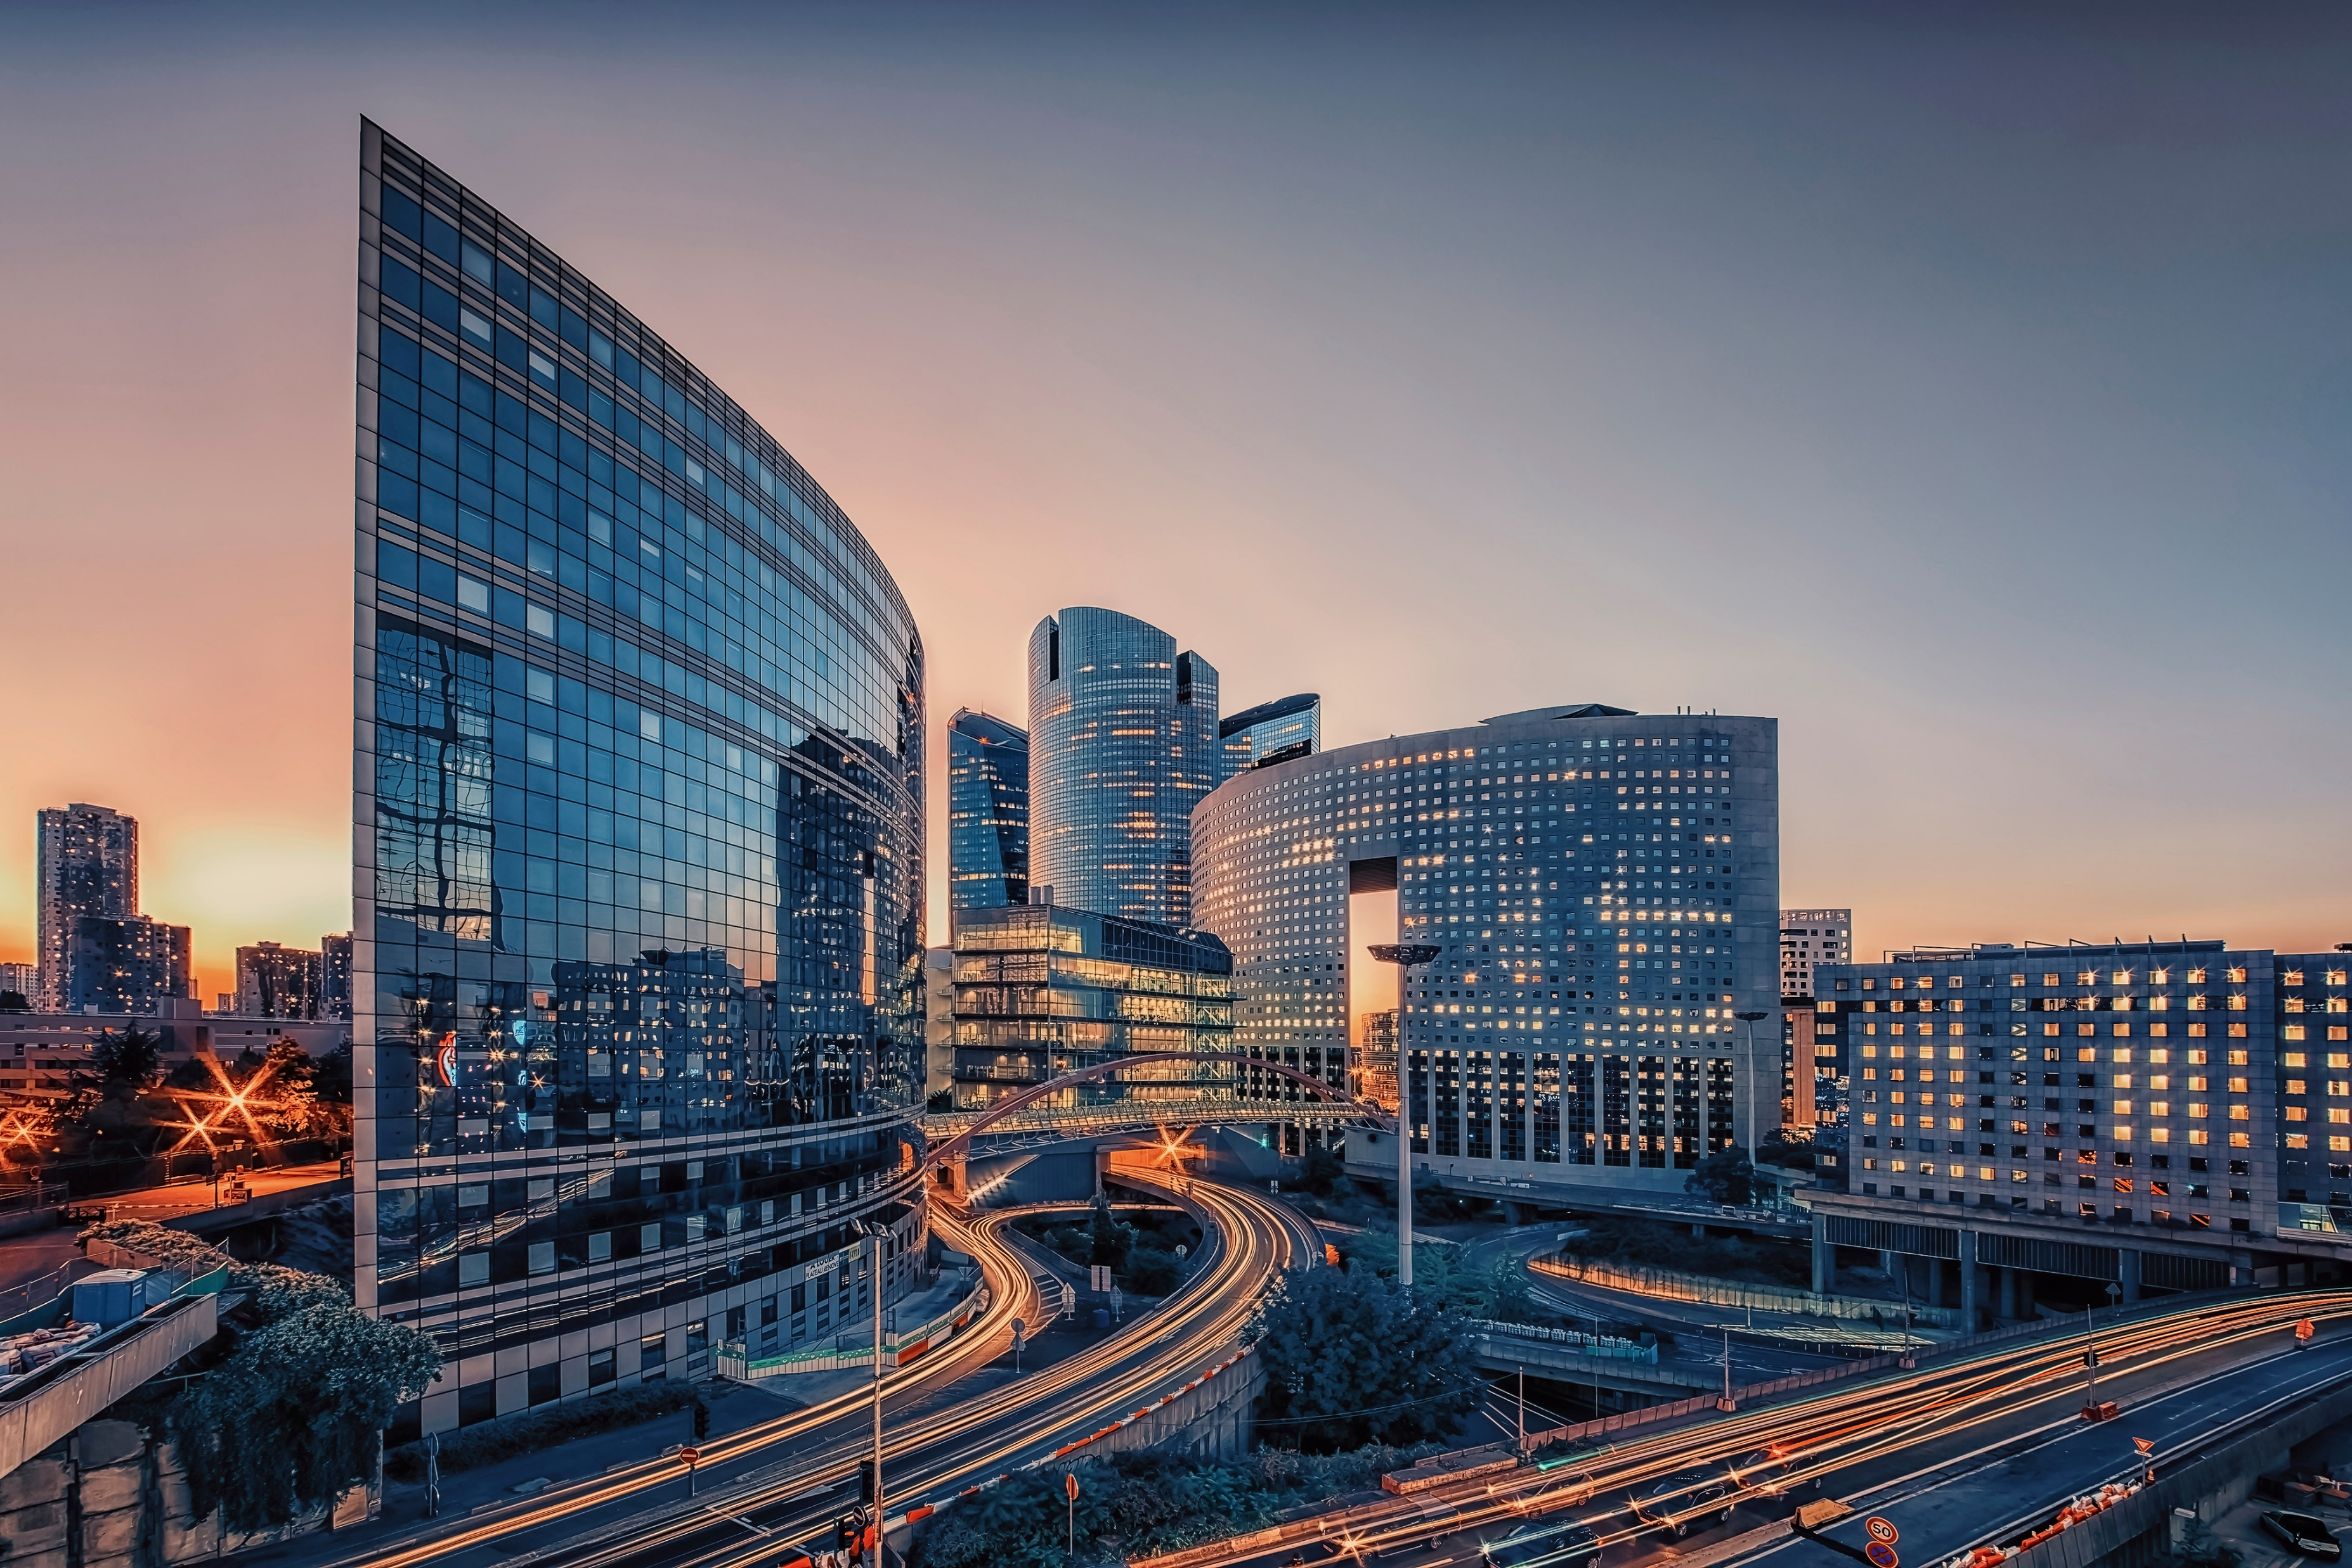
History of the Modern Day Economy

Slide 2








Mercantilism (16th–18th century)
Focused on accumulating gold and silver. Nations controlled trade and colonies to gain wealth. Economic power was tied to political and military strength.

Slide 3
Industrial Revolution (18th–19th century)
Introduction of machines, factories, and mass production. Shift from agriculture to industry and urban living. Rise of capitalism and new social classes.

Slide 4
Classical Capitalism (19th century)
Guided by thinkers like Adam Smith advocating laissez-faire economics. Belief in free markets and minimal government intervention.

Slide 5
Great Depression (1930s)
Severe global economic crisis caused by stock market crash and weak banking systems. Led to unemployment and poverty worldwide. Governments began regulating markets and providing welfare.

Slide 6
Bretton Woods System (1944 onwards)
Creation of IMF and World Bank to stabilize world economies. US dollar became the standard currency in global trade.

Slide 7
Neoliberalism (1980s)
Policies promoting free markets, privatization, and globalization. Spread of international trade and investments.

Slide 8
Rise of Asian Economies (Late 20th century)
Japan, South Korea, China, and other Asian countries became major players in world trade.

Slide 9
Digital & Global Economy (21st century)
Driven by technology, the internet, and
e-commerce. Economies are interconnected, with faster trade, outsourcing, and global supply chains.

Slide 10
WATCH VIDEO History of the Modern Day Economy

Slide 11
Individual Activity: Key Events List
1. Write down five (5) important events in the history of the modern-day economy.
2. For each event, give a short explanation (2–3 sentences) about why it is important.
3. Arrange the events in chronological order (from oldest to newest)
RUBRICS:
-Criteria for EvaluationContent Accuracy (40%)
Events are correct and historically accurate.
-Completeness (30%) – All 5 events are included with explanations.
-Clarity (20%) – Work is easy to understand and well-arranged.
-Neatness (10%) – Clean, organized, and readable output.
TOTAL-----------100%

