Slide 1



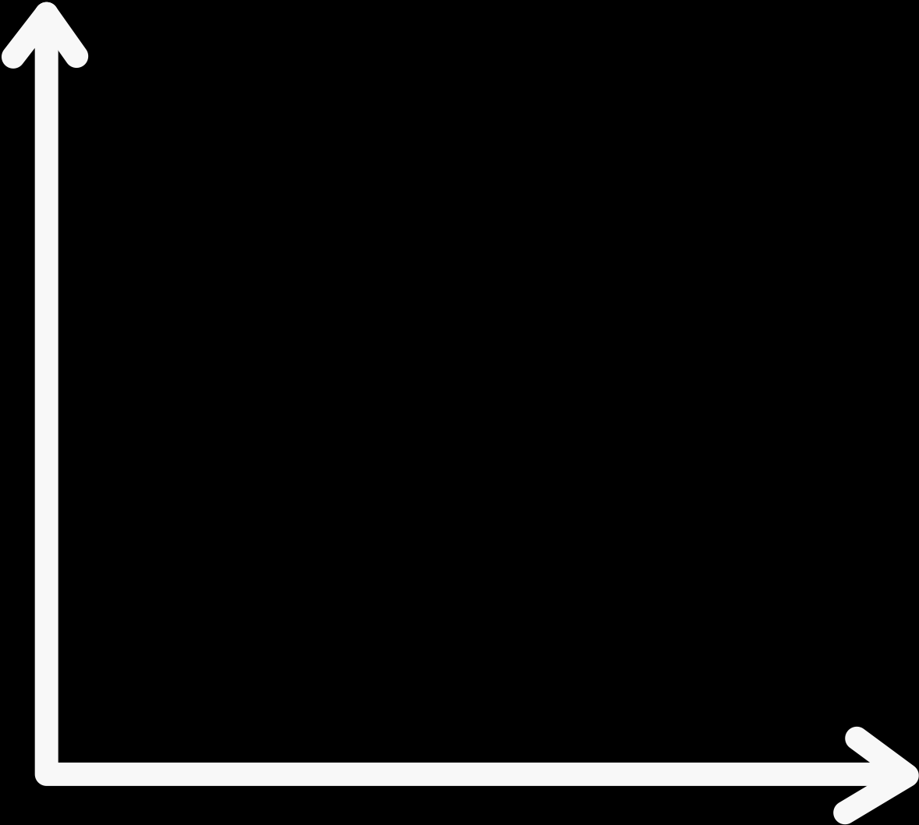

THE CONTEMPORARY
WORLD
PROF. DR. JACKELYN L. LEGASPI

Slide 2
Individual activity no. 2
Create a POSTER representing global inequality through visual storytelling.
2. Posters should include:
Title or slogan: A catchy and meaningful phrase that captures the theme (e.g., "A World Divided: Education for Some, Not for All", "Health is a Privilege, Not a Right")
3. Presentation and Reflection
Have students present their posters to the class.
    During the presentation, they should:
Explain their visual choices and how they represent inequality in education, healthcare, economy, or politics.
Share the message or emotion they want the viewers to take away.

Slide 3
criteria
Creativity and Originality-20%
Clarity of Message- 20%
Visual Appeal and Design- 20%
Accuracy and Relevance- 20%
Presentation and Explanation- 20%
TOTAL- 100 %

Slide 4
🌍 Definition of Inequality
Inequality refers to the uneven distribution of resources, opportunities, and rights among individuals or groups. It can exist in various forms, including:
Economic Inequality: Differences in income, wealth, and access to financial resources.
Educational Inequality: Disparities in access to quality education, school facilities, and learning opportunities.
Healthcare Inequality: Unequal access to medical services, treatment, and overall health outcomes.
Political Inequality: Imbalances in representation, participation, and influence in political decision-making.
Social Inequality: Discrimination or unequal treatment based on factors such as race, gender, class, or religion.
Inequality often results in injustice and limited opportunities for certain groups, creating barriers to social and economic mobility.

Slide 5





Five Examples of Global Inequality in Terms of Economy and Politics

Slide 6


Five Examples of Global Inequality in Terms of Economy and Politics
Wealth Disparity Between Nations
The Global North (e.g., the US, Germany, and Japan) holds the majority of the world’s wealth, while many Global South countries (e.g., in Sub-Saharan Africa and South Asia) struggle with poverty and underdevelopment.
According to reports, the richest 1% of the world's population owns nearly half of global wealth, while billions of people live on less than $5.50 a day.

Slide 7
Five Examples of Global Inequality in Terms of Economy and Politics
Unequal Access to Political Power and Representation
In many countries, marginalized groups (women, ethnic minorities, and indigenous peoples) have limited political representation.
For example, as of recent years, women hold only about 26% of parliamentary seats globally, despite making up half of the population.

Slide 8
Five Examples of Global Inequality in Terms of Economy and Politics
Income Inequality Within Countries even in wealthy nations, there are large gaps between the rich and poor. In the United States, the top 10% of earners hold nearly 70% of the country’s wealth, while the bottom 50% collectively own just 2.5%.

Slide 9
Five Examples of Global Inequality in Terms of Economy and Politics
Political Influence of Wealthy Nations Wealthier countries often have greater influence in global organizations such as the United Nations, World Bank, and International Monetary Fund (IMF).For instance, the G7 nations (all from the Northern Hemisphere) shape major global economic policies, while many developing countries have limited influence.

Slide 10
Five Examples of Global Inequality in Terms of Economy and Politics
Unequal Trade and Economic Policies
Developing countries often face unfair trade practices, such as export tariffs, agricultural subsidies in wealthier nations, and restricted access to global markets.
For example, African nations export raw materials but import costly finished products, limiting their economic growth potential.

Slide 11
Economic and Political Relevance of ASEAN and Latin America as Regional Groups in the Globalized World

Slide 12
Economic Relevance

Slide 13
ASEAN (Association of Southeast Asian Nations)
Major Trading Bloc: ASEAN is one of the world’s largest trading blocs, with a combined GDP of over $3.6 trillion.
It plays a key role in global trade and investment, particularly in electronics, manufacturing, and agriculture.
Free Trade Agreements (FTAs): ASEAN has trade agreements with major economies such as China, Japan, South Korea, Australia, and New Zealand.
This makes it a significant player in the global supply chain.Regional Economic Integration:
The ASEAN Economic Community (AEC) promotes free movement of goods, services, and skilled labor, boosting economic cooperation and competitiveness.
Emerging Digital Economy: ASEAN is rapidly growing in digital innovation, with countries like Singapore, Malaysia, and Indonesia driving e-commerce, fintech, and digital startups.

Slide 14
Latin America (LATAM)
Rich in Natural Resources: Latin America is a major exporter of agricultural products, minerals, and energy resources.
Countries like Brazil and Argentina lead in soy, coffee, and beef exports, while Chile and Peru dominate copper production.
Trade Agreements and Regional Integration: MERCOSUR (Southern Common Market) fosters free trade and economic cooperation among Argentina, Brazil, Paraguay, and Uruguay.The Pacific Alliance (Mexico, Colombia, Peru, and Chile) promotes free trade and economic integration.
Growing Consumer Market: With over 660 million people, Latin America offers a significant consumer base, attracting foreign investments in retail, technology, and
Manufacturing.Potential for Renewable Energy: The region is expanding its renewable energy sector, particularly in solar and wind power, making it a key player in the global green economy.

Slide 15
POLITICAL RELEVANCE

Slide 16
ASEAN
Regional Stability and Diplomacy: ASEAN promotes peaceful conflict resolution and regional stability through dialogue forums like the ASEAN Regional Forum (ARF) and ASEAN Plus Three.
Geopolitical Influence: ASEAN plays a strategic role in Asia-Pacific diplomacy, balancing relations between global powers like China and the US.
Advocacy for Multilateralism: ASEAN nations advocate for multilateral cooperation, addressing regional issues such as the South China Sea dispute, human rights, and climate change.

Slide 17
Latin America
Political Influence in Global Affairs: Latin American countries play a key role in international organizations like the United Nations (UN) and Organization of American States (OAS), addressing human rights, democracy, and environmental issues.
Advocacy for South-South Cooperation: Latin American nations collaborate with other developing regions to promote fair trade practices and economic independence.
Political Instability and Reform: The region’s frequent political shifts (e.g., populist movements, corruption scandals) impact global markets and diplomatic relations.

Slide 18
Suggestions to Devise Measures/Policies to Narrow the Gap Between the Rich and Poor

Slide 19
Implement Progressive Taxation Policies
1.Increase taxes on the wealthy through a progressive income tax system, where higher earners pay a larger percentage of their income.
2.Enforce capital gains and inheritance taxes to prevent the concentration of wealth across generations.
3.Use the revenue generated from these taxes to fund social welfare programs (e.g., healthcare, education, and housing assistance) that benefit low-income groups.

Slide 20
Improve Access to Quality Education and Skills Development
1.Invest in free or subsidized education for low-income families to promote equal opportunities.
2.Develop vocational and technical training programs that equip individuals with in-demand skills, increasing their employability.
3.Provide scholarships and financial aid to students from disadvantaged backgrounds to reduce the education gap.

Slide 21
Strengthen Labor Laws and Ensure Fair Wages
1.Enforce living wage policies to guarantee that all workers earn enough to meet basic needs, reducing income inequality.
2.Promote equal pay regulations to prevent wage gaps based on gender, race, or ethnicity.
3.Support union rights and collective bargaining, enabling workers to negotiate for fair wages and benefits.

Slide 22
WRITTEN WORK 1: Global Inequality
Instructions: Choose three (3) of the five questions below to answer. Each answer should be brief (around 100–150 words) and must include at least one concrete example from a real-world country or situation. Focus on global issues related to education, healthcare, and the economy.

Slide 23
Essay Questions (Choose 3):
1.How does access to quality education vary between wealthy and low-income countries? Support your answer with a specific example of a country or region and explain how inequality in education affects future opportunities.
2.What are some key barriers to healthcare access in developing countries? Use an example to show how limited healthcare affects communities, especially during health crises like pandemics.
3.In what ways does economic inequality contribute to unequal living conditions globally? Include a real-world case that highlights the gap between rich and poor populations within or between countries.
4.How does gender inequality worsen access to education or health services in certain parts of the world? Give an example of how women or girls face additional challenges due to systemic inequalities.
5.What role do global organizations (like the UN, WHO, or World Bank) play in reducing inequality? Provide an example of a project or initiative that has tried to address one of these global issues.

Slide 24
Thank You!

