Slide 1

Topic: Demographic Transition, Migration, and Urbanization
Objective:
- Understand how demographic changes, migration patterns, and urbanization are interrelated.
- Encourage critical thinking and collaboration using real-world examples.

Slide 2

Introduction
Activity: Quick Think-Pair-Share
“What comes to your mind when you hear the words population growth, migration, and urbanization?”
Steps:
1. Think individually (1 min)
2. Pair up to discuss (3 min)
3. Share insights with the class

Slide 3
Mini Lecture / Input (10 minutes)
Key Concepts:
Demographic Transition – Change from high birth and death rates to low rates.
• Stages 1–4 (sometimes 5): Pre-industrial → Transitional → Industrial → Post-industrial
• Example: The Philippines is in late Stage 3 to Stage 4.
Migration – Movement of people for work, education, or safety.
• Internal vs. International
• Push and Pull factors
Urbanization – Growth of city populations.
• Driven by industrialization and migration.
• Brings opportunities and challenges.

Slide 4
Group Discussion
Group 1,2 &3: Demographic Transition
- What stage is the Philippines in?
- What are the social and economic effects?
Group 4,5 & 6: Migration
- Why do Filipinos migrate abroad or to cities?
- How does migration affect families and communities?
Group 7-8: Urbanization
- What are the advantages and disadvantages?
How can we make cities sustainable and livable?
Group 9-10: Poster Making
Design an infographic showing the stages of demographic transition and their effects.

Slide 5
Group Discussion Instructions
Discuss for 10–15 minutes.
Assign a raporter to summarize.
Encourage examples, stories, or current events.
Goal: Promote collaboration and critical analysis.

Slide 6
Class Sharing
Each group presents for 3–4 minutes.
After each presentation, open the floor for 1–2 questions from other groups.
Note:
Purpose: Promote active listening and peer learning.

Slide 7
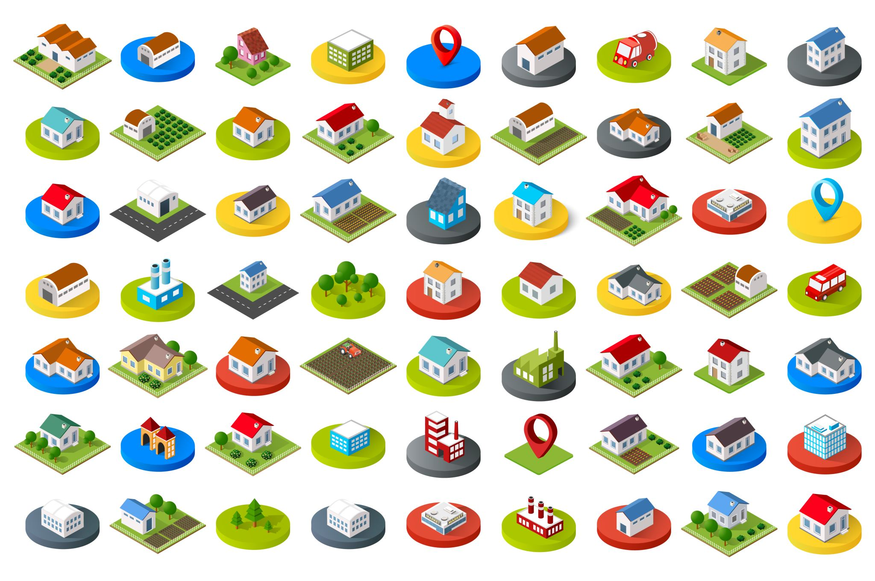
Synthesis
Wrap-Up!
- Population growth influences migration.
- Migration drives urbanization.
- Urbanization shapes demographic patterns.
Reflective Question:
“As future leaders, how can we contribute to sustainable population and urban development in our country?”

Slide 8
Synthesis
Reflective Question:
“As future leaders, how can we contribute to sustainable population and urban development in our country?”
2. “How does migration or urbanization affect my own family or community?”

