Slide 1
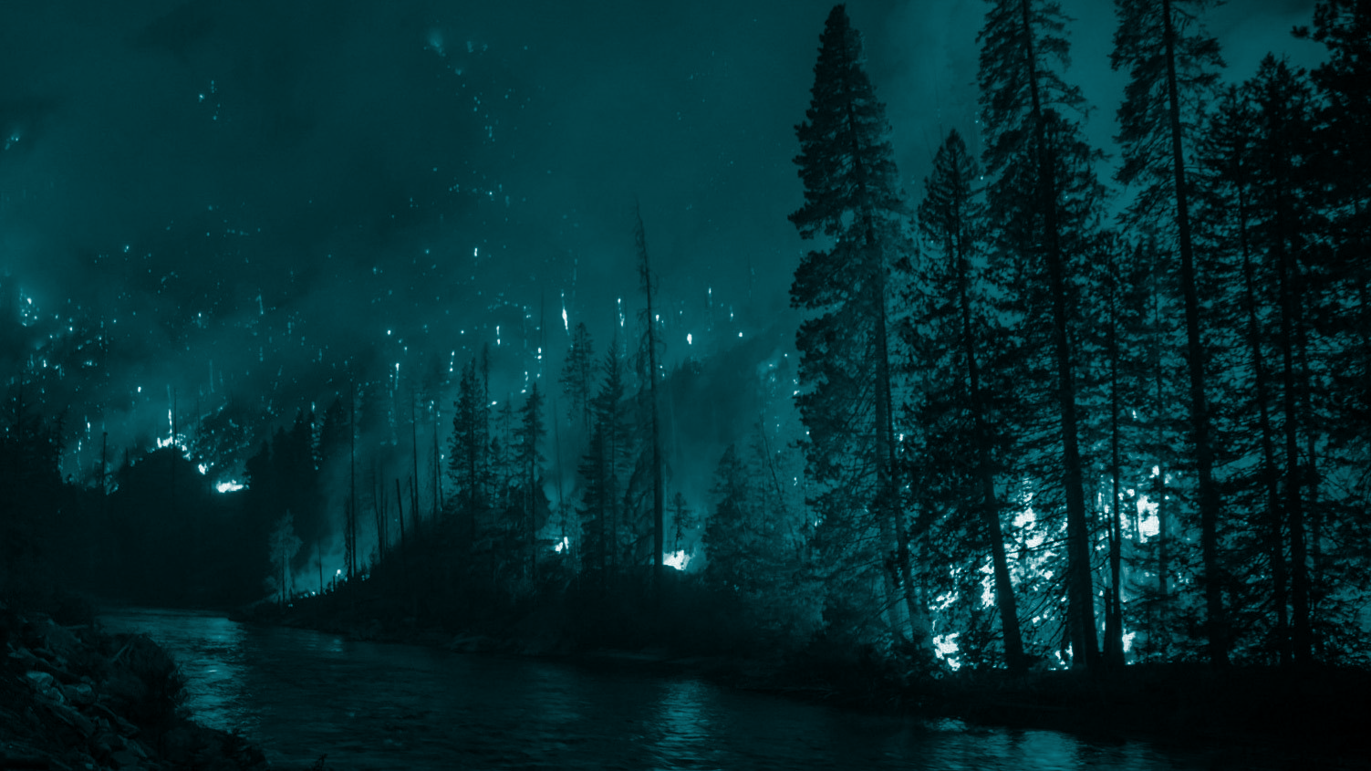
Machine Learning for Predicting Statistical Cause of Wildfires in the United States
Robert Harrison
February 11, 2021
Springboard Project

Slide 2
Motivation
The purpose of the current project is to accurately determine the statistical cause of a particular wildfire given a variety of descriptive data points attaining to that wildfire.
Given a ream of data describing an individual wildfire, is It possible to predict the cause of said fire?

Slide 3
Data Resources
Kaggle Dataset of 1.88 million geo-referenced wildfire records spanning 1992-2015: https://www.kaggle.com/rtatman/188-million-us-wildfires
Originally generated to support Fire Program Analysis (FPA) system
Acquired from federal, state, and local fire organizations

Slide 4
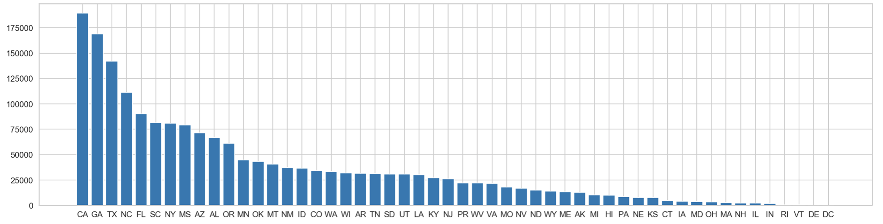
Wildfires by State

Slide 5
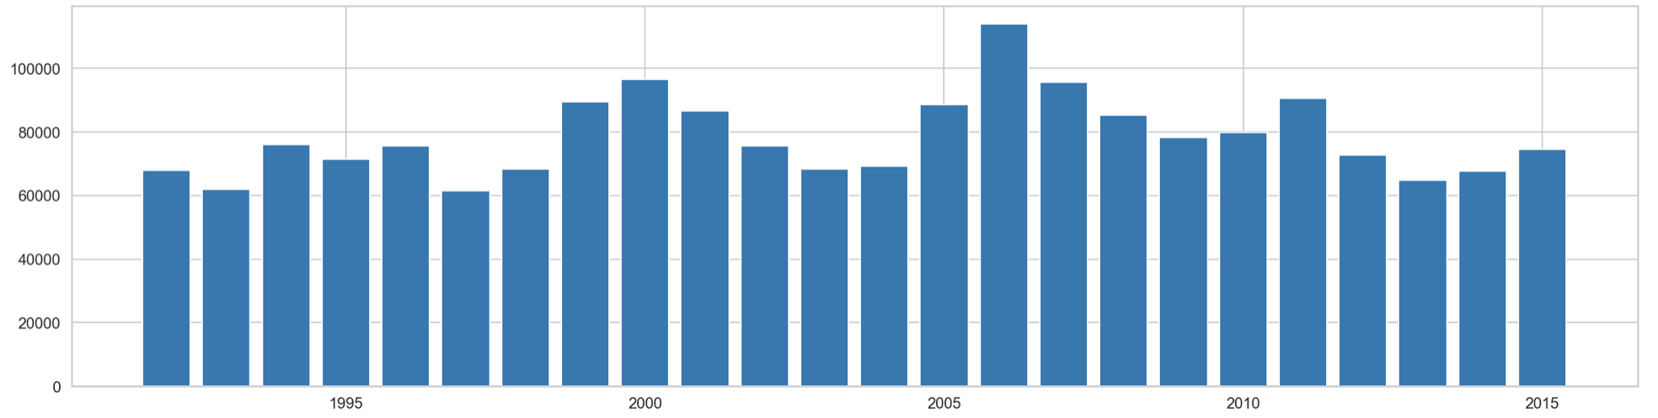
Wildfires by Year

Slide 6
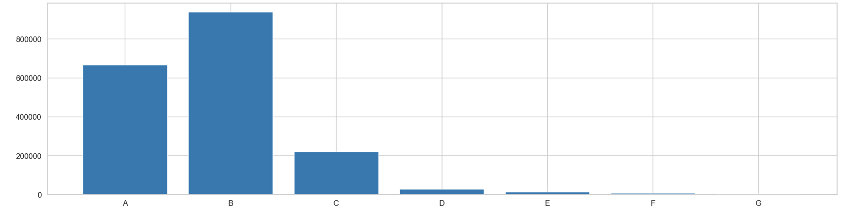
Wildfires by Size Class

Slide 7
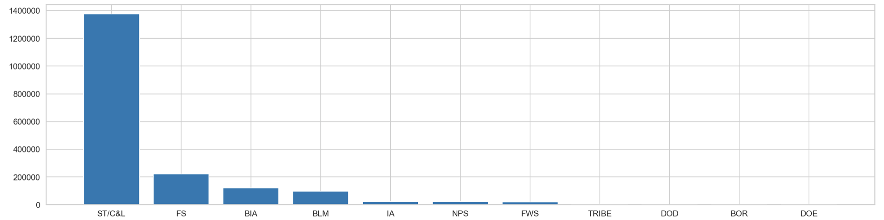
Wildfires by Reporting Agency

Slide 8
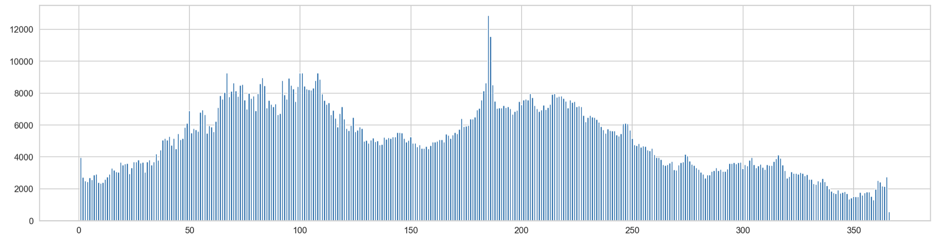
Wildfires by Day of Year (DOY)

Slide 9
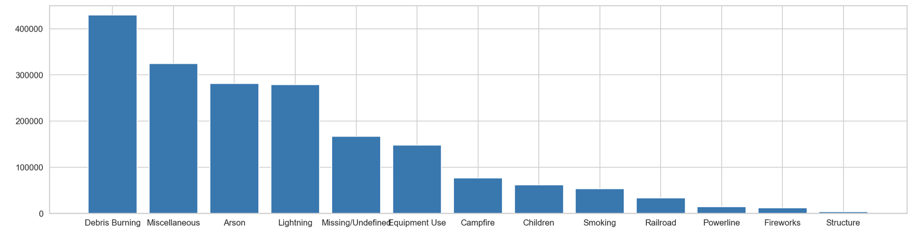
Wildfires by Cause

Slide 10
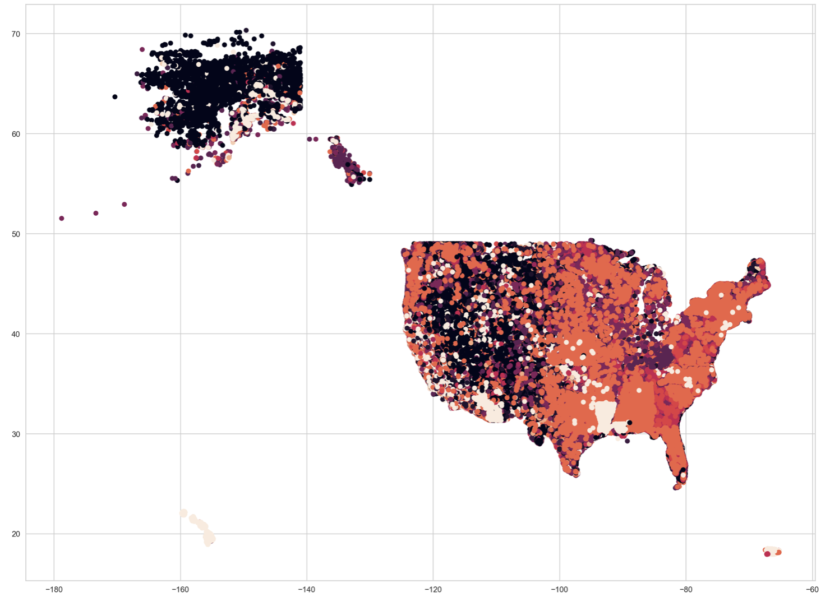

Slide 11
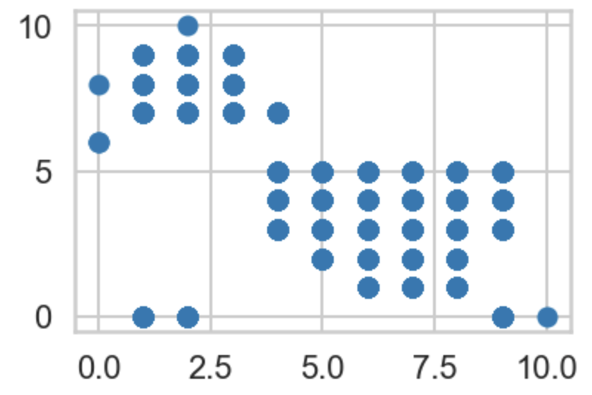
Reducing the Map to a HIlbert Curve

Slide 12
Original Code Maintained on GitHub
https://github.com/rjhar/Springboard/blob/master/wildfire/Wildfire_Project.ipynb

