Slide 1
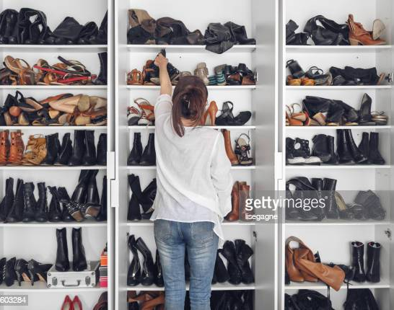
Shoes Galore
Group Project 1
Georgia Tech: Data Science and Analytics Bootcamp
Thea James
Jennifer Long
Rashaye Harris
Mark Alford
Jason DeGrace
Danelle Cook
Avondre Henderson

Slide 2
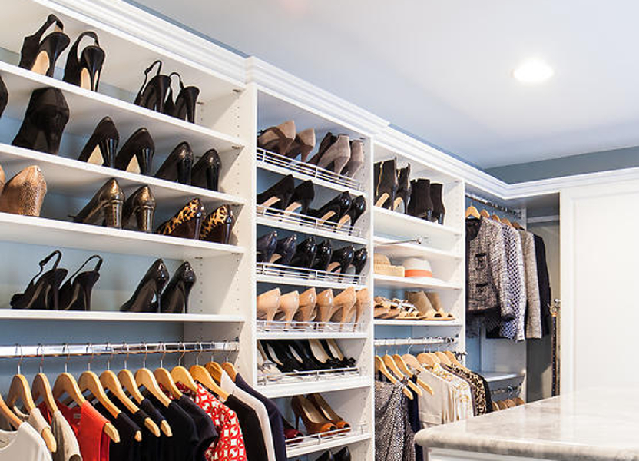
Introduction
Shoe sales are paramount to retail industry sales.
Shoes are the completer to any outfit
The dataset contains information about women’s shoes – color, size, category, several others key pieces.
Our Website: https://data.world/datafiniti/womens-shoe-prices

Slide 3
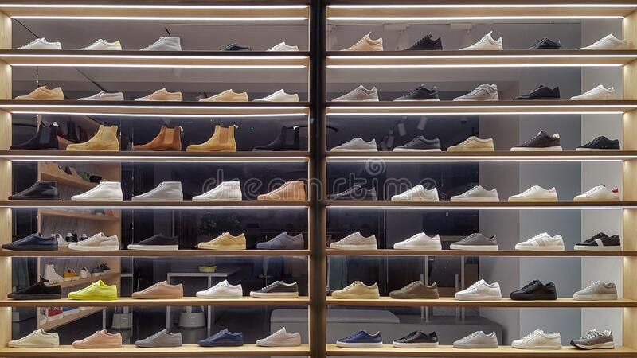
Questions
What are the most popular shoe types made for women (boot, sandal, heels, etc.)?
Does shoe type affect pricing?
Does shoe size affect pricing?
Out of the shoes being produced, what are the top brands that are produced?
What is the average price point of the top brands?
What are the top colors and the average price points of those colors?

Slide 4
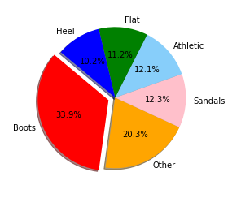
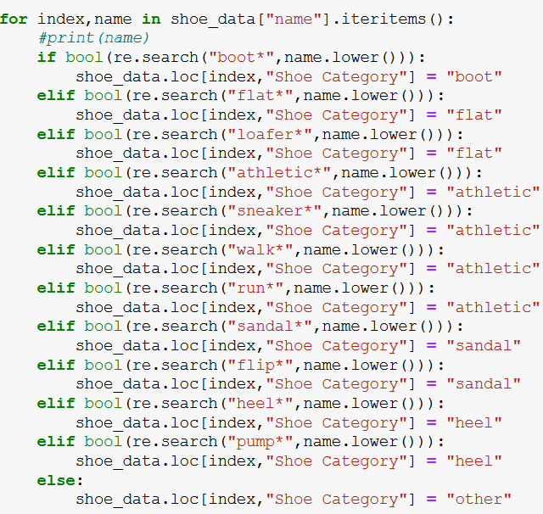
Shoe Types
For all 10,000 shoes, we grouped each shoe into a category of boots, sandals, flats, athletic, heels, and other. Out of those shoes, the most popular category of shoe made for women are boots with a total of 3,393 shoes which accounted for 33.9% of all shoes within the dataset.
In comparison, the least popular category of shoes are heels with a total of 1,017 shoes which accounted for 10.2% of all shoes in this dataset.
We can see that the “other” category which makes up 20.3%, contains shoes that don’t necessarily fit into any of the chosen categories which can suggest that women tend to like a variety of shoe types which may prompt retailers to produce a variety of shoe types.

Slide 5
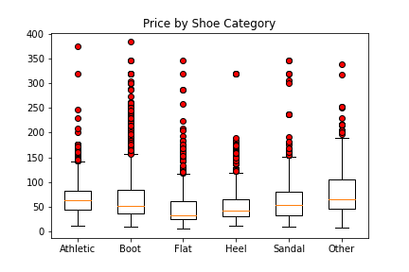
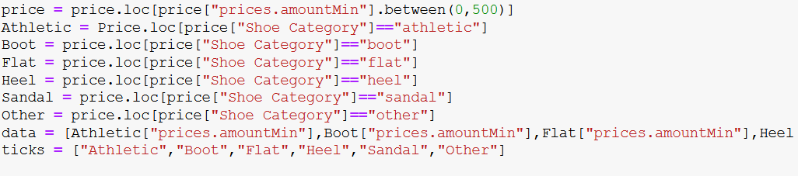
Shoe Price by Type
Median shoe prices run from $33 for flats to $64 for shoes in the ‘other’ category.
The ‘other’ category may reflect higher prices due to more expensive brands having more creative names for their shoes that are not caught by our filters.
Several outliers exist for shoes costing over $100 ($117 is the top whisker for flats).
18 shoes with prices over $500 were removed from the data before analysis.

Slide 6
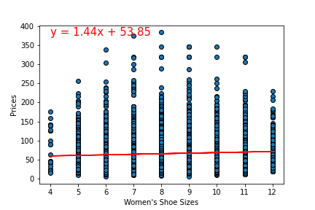
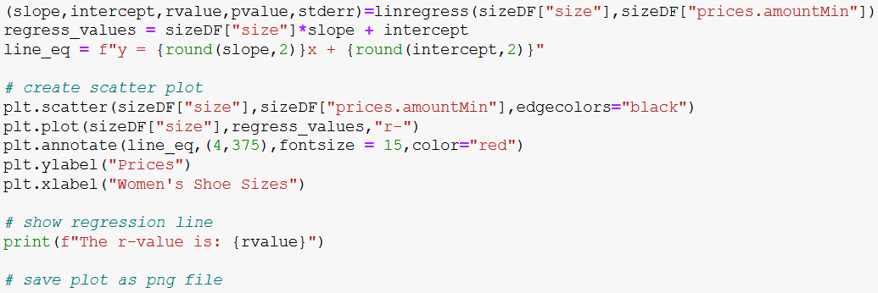
Shoe Price by Size
There is little correlation between shoe prices and sizes (the r-value is: 0.06).
18 shoes with prices over $500 were removed from the data before analysis.
Sizes outside the range 4 to 12 were not analyzed.
Half sizes were rounded down to whole numbers.

Slide 7
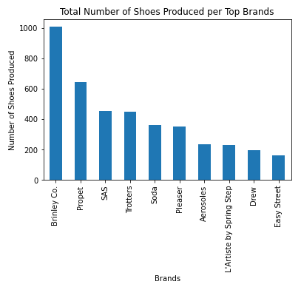
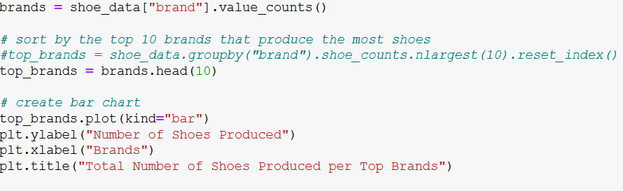
Top Brands
The top 10 brands make up 40.8% of all womens shoes in this data set.
Brinley Co. makes up 24.7% of the top brand of top ten brands of shoes. The bottom 4 brands combined, Aerosoles, L'Artiste by Spring Step, Drew, and Easy Street, make up only 20.1%
The top three brands, Brinley Co., Propet, and SAS, make up 51.5% of all shoes in this data set.

Slide 8
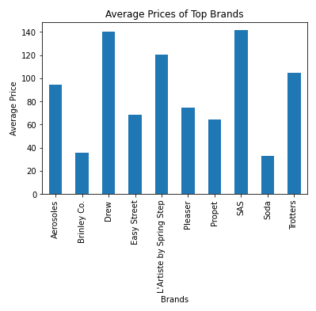
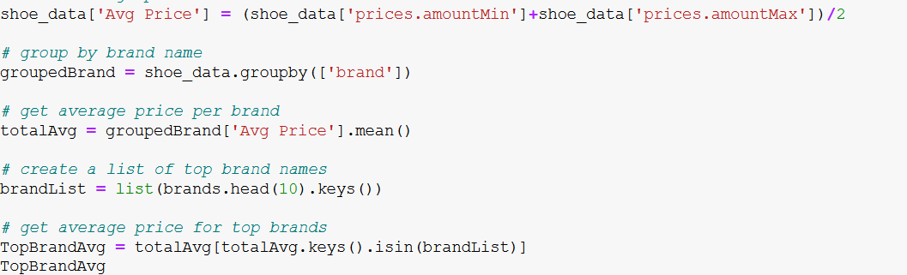
Average Price of Top Brands
The brands Soda and Brinley Co. are the lowest average price at $32.76 and $35.86, respectively.
SAS has an average price of $141.61 and Drew has an average price of $140.20 making these the highest average brands.
The company could earn an extra $1,127.25 a month ($13,527 annually) if they discounted SAS and Drew brand shoes 20% and gained 5 more shoe purchases a month per brand.

Slide 9
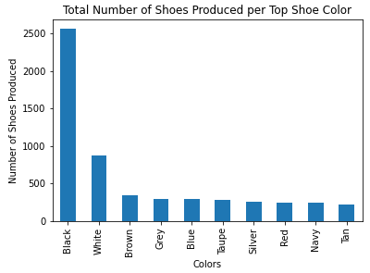
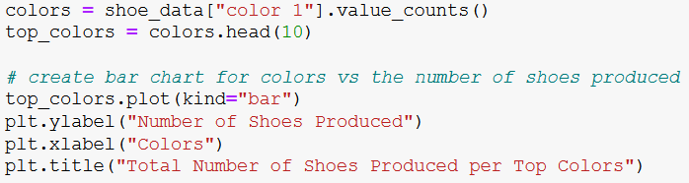
Top Colors
Black shoes represent the majority of shoes produced making up 45.71% of the number of shoes produced amongst the other colors in the top ten shoe color category with a total of 2561 shoes produced.
White shoes came in second making up 15.60% of the number of shoes produced amongst the other colors in the top ten shoe color category with a total of 874 shoes produced.
Out of the top ten colors, tan shoes came in last, making up 3.93% with a total of 220 shoes produced.

Slide 10
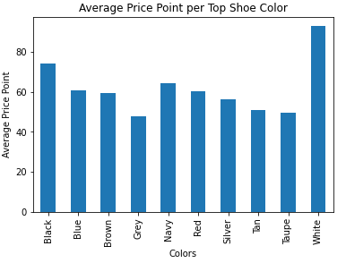
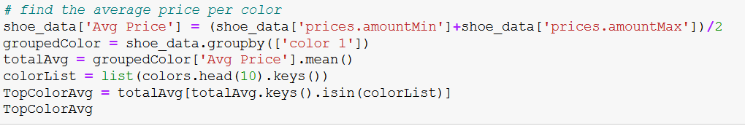
Average Price by Shoe Color
White shoes typically cost the most having an average price point of $92.96.
Black shoes came in second having an average price point of $74.18.
Out of the top ten colors, grey shoes have the lowest average price point coming in at $47.90.

Slide 11
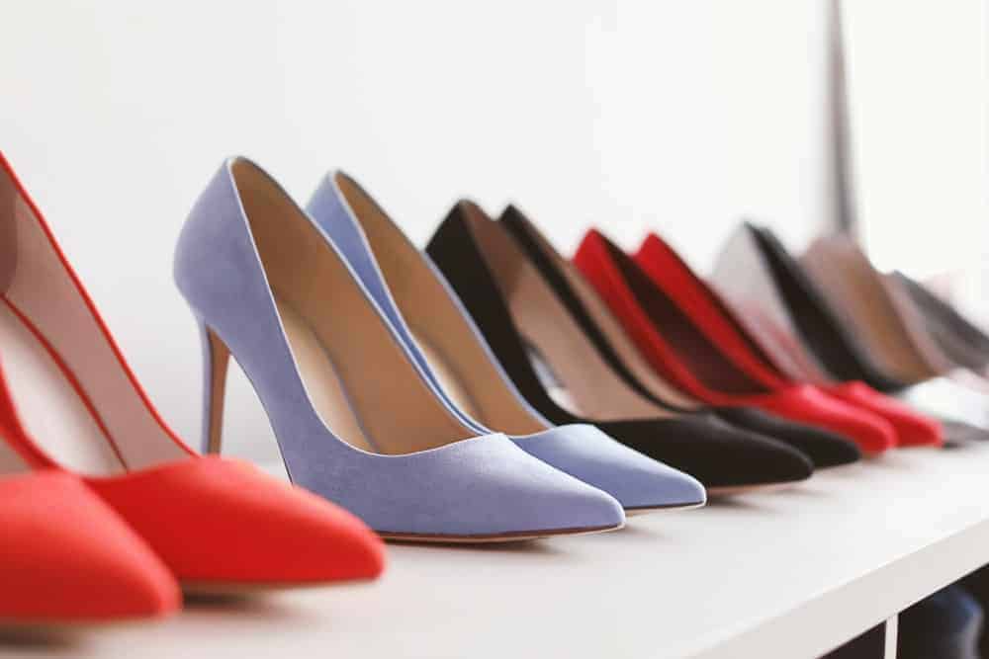
Conclusions and Final Thoughts
Brinley Co. is the most popular brand of shoe.
Most popular shoe category are boots.
Black shoes represent the majority of shoes produced
White shoes typically cost the most
The top brand with the lowest average price is Soda while the top brand with the highest average price is SAS.

Slide 12
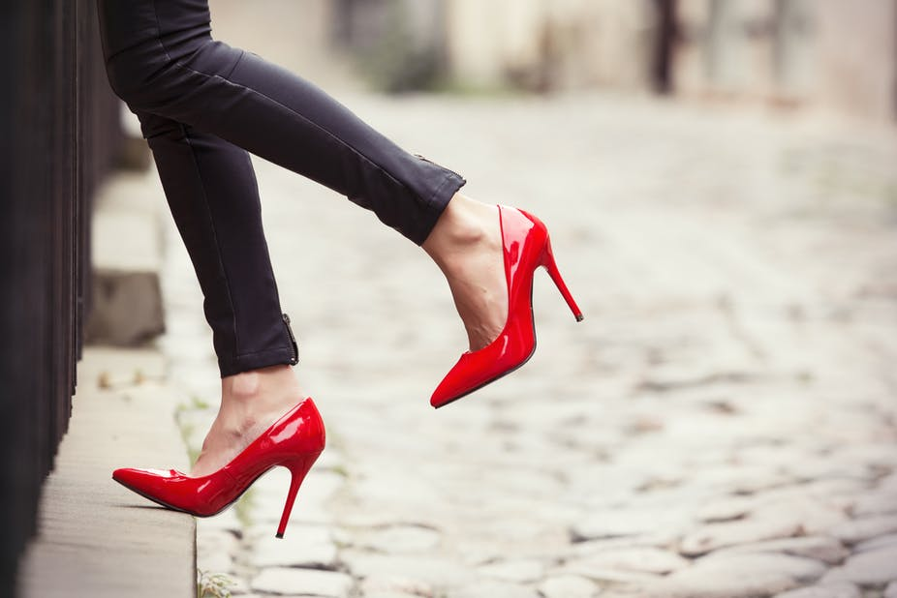
Q&A

