Slide 1
PRELIMINARY QUESTIONS
06/29/2017

Slide 2
QUESTIONS OVERVIEW
These questions are intended to cover basic SQL, Data, and Logic concepts
For some questions, there are no correct/incorrect answers
Please answer each question to the best of your ability
The next following slides (table layouts, column definitions, data) will be used for the SQL questions that follow

Slide 3
STORE_SALES – COLUMN DEFINITIONS
STORE = INTEGER
SALES_DATE = STRING
SALES = DOUBLE
STORE_SALES
STORE
SALES_DATE
SALES
1
01-31-2017
$100
Queries to create table
(using Oracle SQL Developer):
CREATE TABLE STORE_SALES(
STORE INT,
SALES_DATE VARCHAR(10),
SALES DECIMAL(10,2)
);
INSERT INTO STORE_SALES(STORE,SALES_DATE,SALES)
VALUES(1,'01-31-2017',100);
INSERT INTO STORE_SALES(STORE,SALES_DATE,SALES)
VALUES(1,'02-01-2017',110);
INSERT INTO STORE_SALES(STORE,SALES_DATE,SALES)
VALUES(1,'02-02-2017',111);
INSERT INTO STORE_SALES(STORE,SALES_DATE,SALES)
VALUES(2,'01-31-2016',130);
INSERT INTO STORE_SALES(STORE,SALES_DATE,SALES)
VALUES(2,'02-01-2016',132);
INSERT INTO STORE_SALES(STORE,SALES_DATE,SALES)
VALUES(2,'02-02-2016',133);
INSERT INTO STORE_SALES(STORE,SALES_DATE,SALES)
VALUES(2,'02-03-2016',139);
1
02-01-2017
$110
1
02-02-2017
$111
2
01-31-2016
$130
2
02-01-2016
$132
2
02-02-2016
$133
2
02-03-2016
$139

Slide 4
STORE_LOCATION – COLUMN DEFINITIONS
STORE = INTEGER
LATITUDE = DOUBLE
LONGITUDE = DOUBLE
REGION = INTEGER
Queries to create table
(using Oracle SQL Developer):
TABLE STORE_LOCATION(
STORE INT,
LATITUDE DECIMAL(10,6),
LONGITUDE DECIMAL(10,6),
REGION INT
);
INSERT INTO STORE_LOCATION(STORE,LATITUDE,LONGITUDE,REGION) VALUES(1,35.467560,-97.516430,1);
INSERT INTO STORE_LOCATION(STORE,LATITUDE,LONGITUDE,REGION) VALUES(2,39.961180,-82.998790,2);
INSERT INTO STORE_LOCATION(STORE,LATITUDE,LONGITUDE,REGION) VALUES(3,35.686980,-105.937800,1);
INSERT INTO STORE_LOCATION(STORE,LATITUDE,LONGITUDE,REGION) VALUES(4,41.600540,-93.609110,3);
STORE_LOCATION
STORE
LATITUDE
LONGITUDE
REGION
1
35.467560
-97.516430
1
2
39.961180
-82.998790
2
3
35.686980
-105.937800
1
4
41.600540
-93.609110
3

Slide 5
WEATHER – COLUMN DEFINITIONS
LATITUDE = DOUBLE
LONGITUDE = DOUBLE
OBS_DATE = STRING
PRECIP = DOUBLE
Queries to create table
(using Oracle SQL Developer):
CREATE TABLE WEATHER(
LATITUDE DECIMAL(10,7),
LONGITUDE DECIMAL(10,7),
OBS_DATE VARCHAR(10),
PRECIP DECIMAL(10,2)
);
INSERT INTO WEATHER(LATITUDE,LONGITUDE,OBS_DATE,PRECIP) VALUES(35.7478769,95.3696909,'01-31-2017',0.00);
INSERT INTO WEATHER(LATITUDE,LONGITUDE,OBS_DATE,PRECIP) VALUES(35.657295,-97.478256,'01-31-2017',0.00);
INSERT INTO WEATHER(LATITUDE,LONGITUDE,OBS_DATE,PRECIP) VALUES(34.603565,-98.395927,'01-31-2017',1.01);
INSERT INTO WEATHER(LATITUDE,LONGITUDE,OBS_DATE,PRECIP) VALUES(35.9116725,-94.977615,'01-31-2017',0.00);
INSERT INTO WEATHER(LATITUDE,LONGITUDE,OBS_DATE,PRECIP) VALUES(35.657295,-97.478256,'02-01-2017',0.00);
INSERT INTO WEATHER(LATITUDE,LONGITUDE,OBS_DATE,PRECIP) VALUES(35.7478769,-95.3696909,'02-01-2017',2.17);
WEATHER
LATITUDE
LONGITUDE
OBS_DATE
PRECIP
35.7478769
-95.3696909
01-31-2017
0.00
35.657295
-97.478256
01-31-2017
0.00
34.603565
-98.395927
01-31-2017
1.01
35.9116725
-94.977615
01-31-2017
0.00
35.657295
-97.478256
02-01-2017
0.00
35.7478769
-95.3696909
02-01-2017
2.17

Slide 6
QUESTION #1
What would a query to pull total sales look like?
SELECT SUM(SALES) AS Total_Sales FROM STORE_SALES;
What is the result of the query?
TOTAL_SALES
855

Slide 7
QUESTION #2
What would a query to pull sales by region look like?
SELECT REGION,SUM(SALES) AS Sales_by_Region FROM STORE_SALES ss JOIN STORE_LOCATION sl ON ss.STORE=sl.STORE GROUP BY REGION;
What is the result of the query?
REGION | SALES_BY_REGION
1 | 321
2 | 534

Slide 8
QUESTION #3
Write a query to determine how far from each store the PRECIP values were collected.
select sl.STORE,ROUND(ACOS(SIN(sl.LATITUDE*ACOS(-1)/180)*SIN(w.LATITUDE*ACOS(-1)/180) + COS(sl.LATITUDE*ACOS(-1)/180)*COS(w.LATITUDE*ACOS(-1)/180)*COS(w.LONGITUDE*ACOS(-1)/180-sl.LONGITUDE*ACOS(-1)/180) ) * 3981.875,2) AS Distance_in_Miles, w.OBS_DATE,w.PRECIP from STORE_LOCATION sl,WEATHER w order by sl.STORE,w.OBS_DATE;
What is the result of the query?
STORE | DISTANCE_IN_MILES | OBS_DATE | PRECIP
1 | 146.58 | 01-31-2017 | 0
1 | 78.17 | 01-31-2017 | 1.01
1 | 13.36 | 01-31-2017 | 0
1 | 122.85 | 01-31-2017 | 0
1 | 122.85 | 02-01-2017 | 2.17
1 | 13.36 | 02-01-2017 | 0
2 | 848.18 | 01-31-2017 | 0
2 | 738.43 | 01-31-2017 | 0
2 | 713.58 | 01-31-2017 | 0
2 | 927.61 | 01-31-2017 | 1.01
2 | 848.18 | 02-01-2017 | 0
2 | 738.43 | 02-01-2017 | 2.17
3 | 435.03 | 01-31-2017 | 1.01
3 | 596.03 | 01-31-2017 | 0
3 | 617.66 | 01-31-2017 | 0
3 | 477.46 | 01-31-2017 | 0
3 | 596.03 | 02-01-2017 | 2.17
3 | 477.46 | 02-01-2017 | 0
4 | 463.25 | 01-31-2017 | 0
4 | 417.78 | 01-31-2017 | 0
4 | 552.02 | 01-31-2017 | 1.01
4 | 402.24 | 01-31-2017 | 0
4 | 417.78 | 02-01-2017 | 2.17
4 | 463.25 | 02-01-2017 | 0

Slide 9
QUESTION #4
Write a query to determine if PRECIP values impacted store sales.
select sl.STORE,ROUND(ACOS(SIN(sl.LATITUDE*ACOS(-1)/180)*SIN(w.LATITUDE*ACOS(-1)/180) + COS(sl.LATITUDE*ACOS(-1)/180)*COS(w.LATITUDE*ACOS(-1)/180)*COS(w.LONGITUDE*ACOS(-1)/180-sl.LONGITUDE*ACOS(-1)/180) ) * 3981.875,2) AS Distance_in_Miles, w.OBS_DATE,w.PRECIP,ss.SALES from STORE_LOCATION sl,WEATHER w,STORE_SALES ss where sl.STORE=ss.STORE and ss.SALES_DATE=w.OBS_DATE order by sl.STORE,w.OBS_DATE;
Did PRECIP values impact store sales?
Although we could easily find the correlation coefficient of sales with the product of rain and distance, it is statistically unwise to rely on the calculated correlation as the data at hand is very scarce (2 dates).
Moreover most of the weather records are hundreds of miles away from stores, thus it’s harder to establish cause using only this data.
STORE | DISTANCE_IN_MILES | OBS_DATE | PRECIP | SALES
1 | 146.58 | 01-31-2017 | 0 | 100
1 | 78.17 | 01-31-2017 | 1.01 | 100
1 | 13.36 | 01-31-2017 | 0 | 100
1 | 122.85 | 01-31-2017 | 0 | 100
1 | 122.85 | 02-01-2017 | 2.17 | 110
1 | 13.36 | 02-01-2017 | 0 | 110

Slide 10
QUESTION #5
I wrote the following “pseudo-query”:
select sum(sales)
from store_sales
where sales_Date between ‘01-31-2016’ and ‘02-02-2016’
;
What is the result of my query?
SUM(SALES)
395

Slide 11

QUESTION #6
Create an Entity Relationship Diagram for the data found within this image:

Slide 12
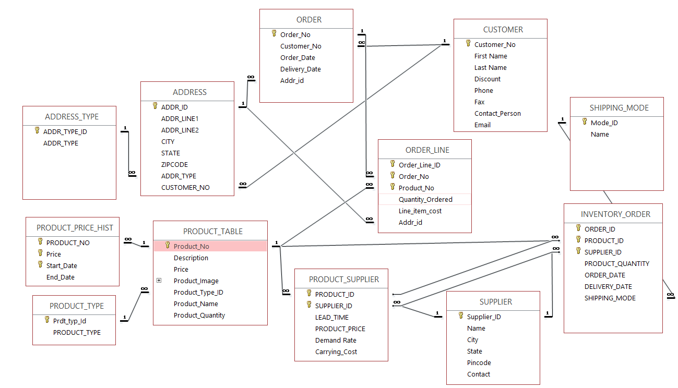
QUESTION #6
Answer: The ER Diagram focusses on Product, Order, Customer which will help in managing Inventory and assess Demand-Supply metrics

Slide 13
QUESTION #7
What is the output of this pseudo-code snippet?
X=0
while [ $X -lt 10 ]
do
X=`expr $X + 1`
echo X = $X
Done
Answer:
X=1
X=2
X=3
X=4
X=5
X=6
X=7
X=8
X=9
X=10

Slide 14
QUESTION #8
You have 3 files. One file has a list of all clubs. One file has a list of all items. One file has a list of which clubs sell what items. Not all clubs sell all items. Write a script that uses these 3 files to create an output matrix that has club numbers across the top, item numbers down the left hand side, and a ‘Y’ at the intersection of club/item if the club sells the item.
Answer:
I have scripted using pandas and xlwt packages in Python 3.x as it was the quickest and the most familiar of the options to implement for me.
I have attached the sample files and output files.
To run the script, please create a folder named ‘Walmart’ in C drive.
Place the attached files inside the folder.
Run the script using python or the IPython notebook
In case you would require a portable windows .exe file, I’d be happy to convert the code base to Python2.x and generate an executable file.
P.S. – I have uploaded the code files on my GitHub repository for your convenience

