Slide 1
KnightShips
Group 3 Large Project

Slide 2
Team and Roles
Ryan Hidalgo – Project manager, C# scripts, and database
Nathaniel McKain – GPS algorithms and gameplay
Ryan Heitz – C# Scripts and Leaderboard
Phuoc Nguyen – PHP backend
Shawn Berkley – Menu scene, integration and C# scripts
Zach Steinberg – C# scripts
Jared Jackson – Gameplay and UI Design

Slide 3
What is KnightShips?
A new take on the classic board game Battleship
GPS based mobile board game
Hide ships in real locations
Outwit your friends by hiding your ships in hard to reach locations
Search and destroy
Walk around your real world environment to look for battleships
Use your current location to deploy devastating attacks around you

Slide 4
Features & Gameplay
Play with up to 8 total players
Lobby System
Host creates a lobby and receives a lobby id
Players join lobby with that id
In-Game GPS functionality
Players are given time to deploy ships on a board mapped to the real world
Move around to attack locations near your GPS position
30 second attack cool down
Attack as many ships as possible before time runs out
Walk around to be able to attack different squares
Point System
Gain and lose points based on ships hit/sunk

Slide 5
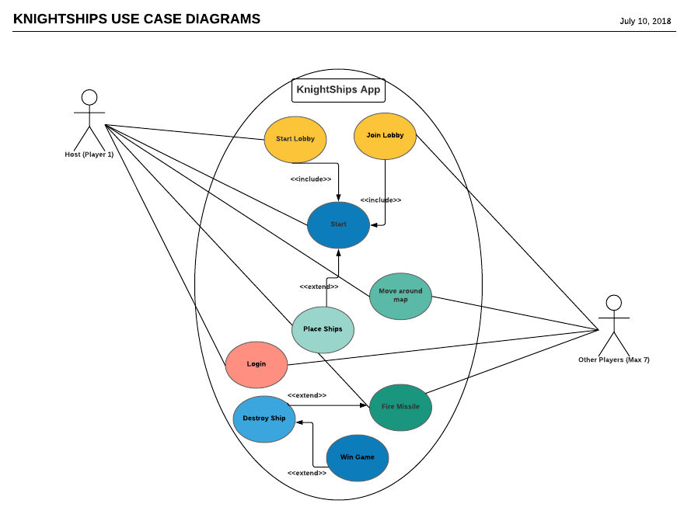
Using The Application

Slide 6
Time Allocation

Slide 7
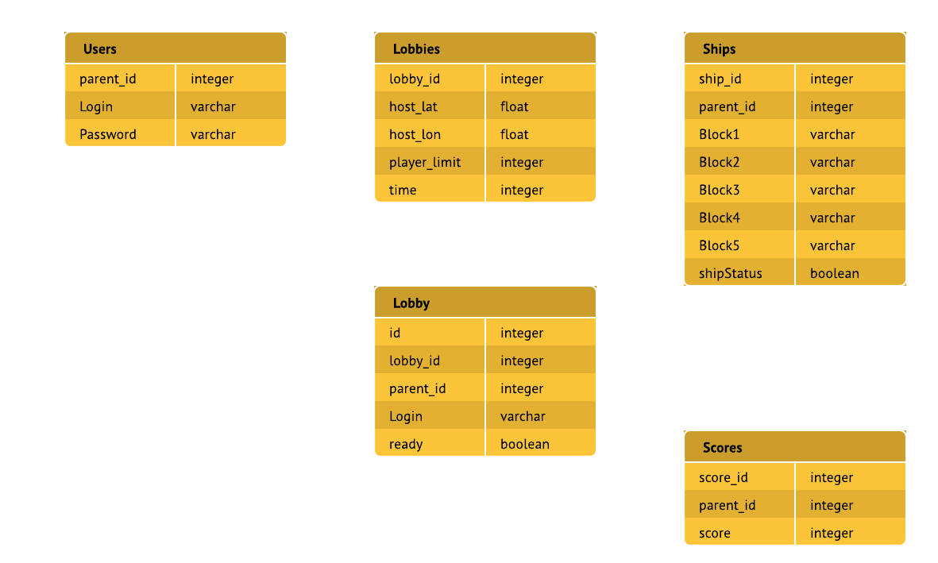
Data Management

Slide 8




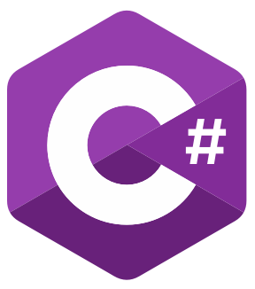

Technology used
Visual Studio
C#
Unity
GoDaddy
HTML
CSS
JavaScript
PHP
cPanel

Slide 9
Technology Implemented
DB/API
Login Information
Lobby selections
UI
Login
Main Menu
Board
Created based on host Location
Place ships
Board locations
Lobby
Attack board locations
Unity and C #
MySql and PHP
Unity and C #

Slide 10
The Breakdown: User Interface
Constructed all the UI panels
The visual display
Link UI panels to scripts
UI input is stored in game objects
Game objects’ scripts send information to database
Local data store
Store information that is relevant in each scene
Time, size of ocean, player count, etc.

Slide 11
The Breakdown: Game Interface
Game Board
Creation of each square on board
C# Integration to simplify each object
Ship Recognition
Calculating touch position to send ship placement to database
Connecting to Lobby
Lobby Ids
Scene Changes

Slide 12
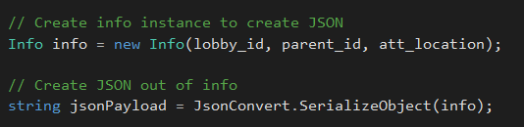
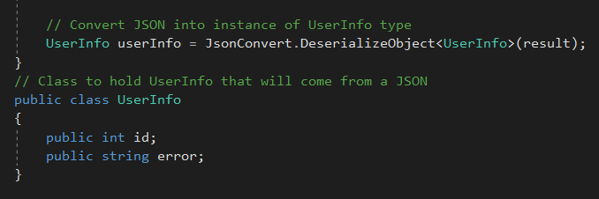
The Breakdown: Data transfer
C# Scripts utilizing NewtonSoft JSON.Net framework
Sending JSON
Taking information from the UI and converting to JSON using SerializeObject
Receiving JSON
Receiving information from PHP and parsing it using DeserializeObject

Slide 13
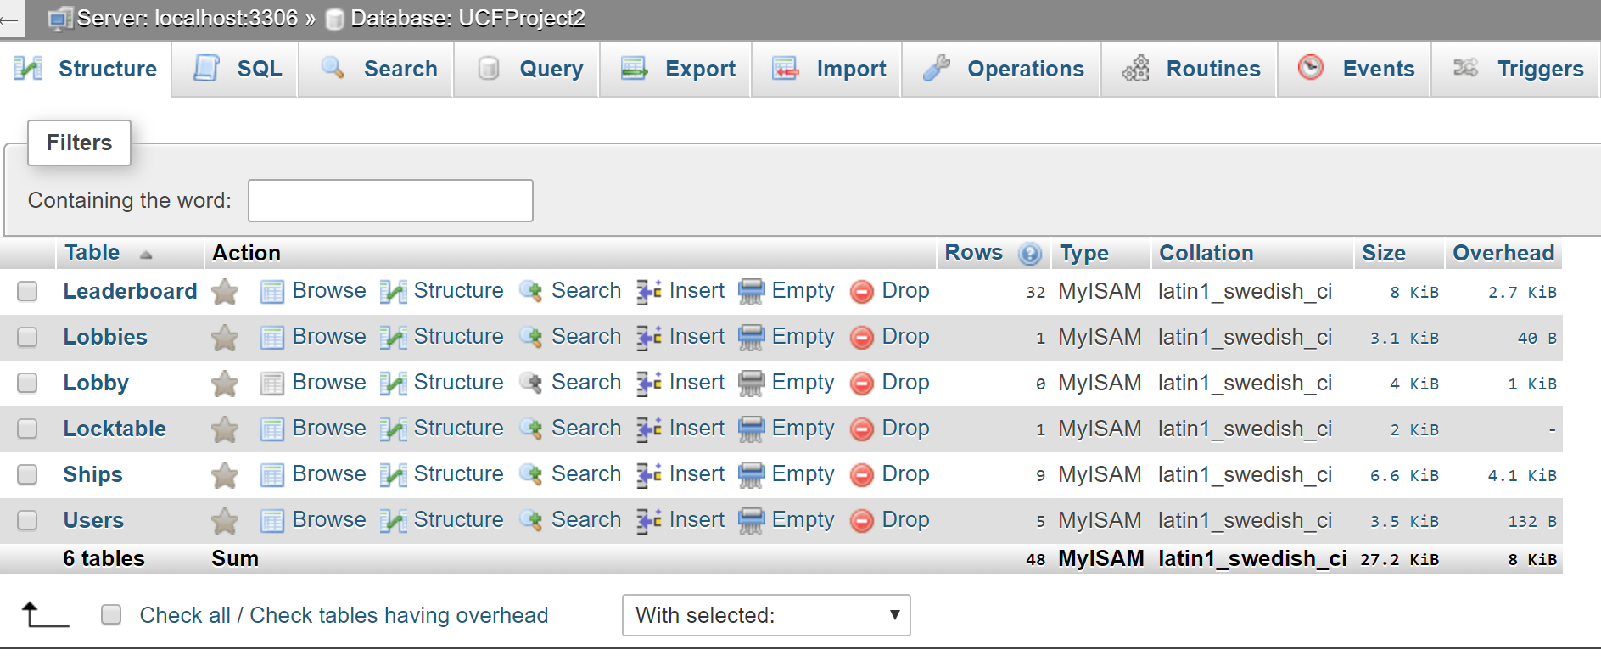
The Breakdown: Backend
Lock Table is used to prevent deadlock when multiple try to access the database.
Only one person can edit the database at a time
ARC was used for testing all the php files
KnightShip’s database

Slide 14
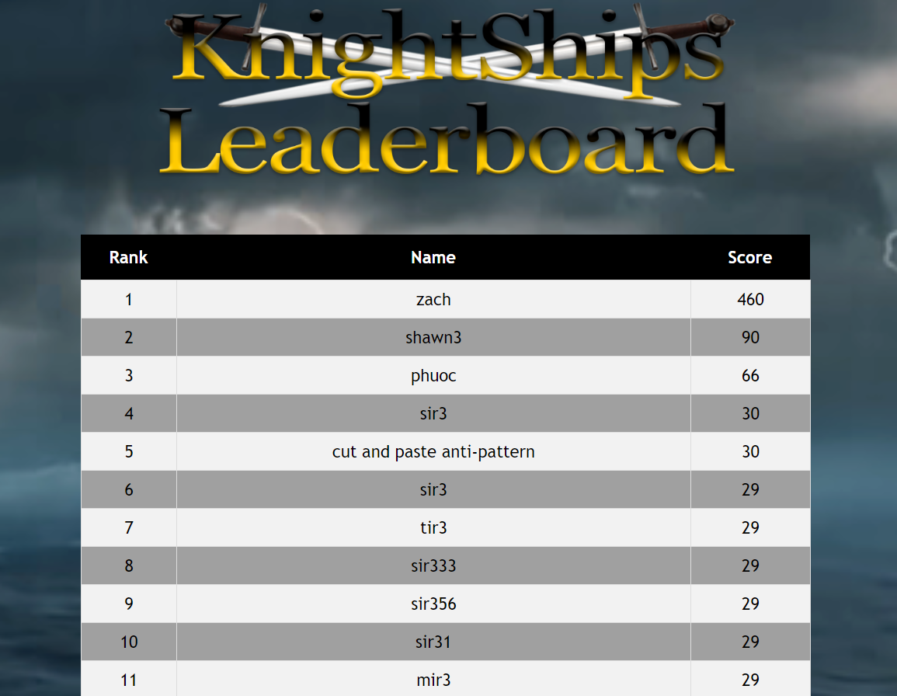
LEADERBOARD
Created web page using GoDaddy
Displays all scores of each user
Sorts scores from highest to lowest.
Leaderboard is updated every few seconds
Accessible through computers and mobile devices

Slide 15
Difficulties
DB/API
GPS Coordinate Storage
Usage of floats instead of doubles
Board
Aspect Ratios
Connection to database
User Interface
Unity Collaboration
Integration of parts
Protected Wi-Fi Connections

Slide 16
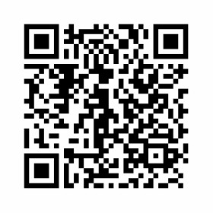
Questions?
Same Code

