Slide 1
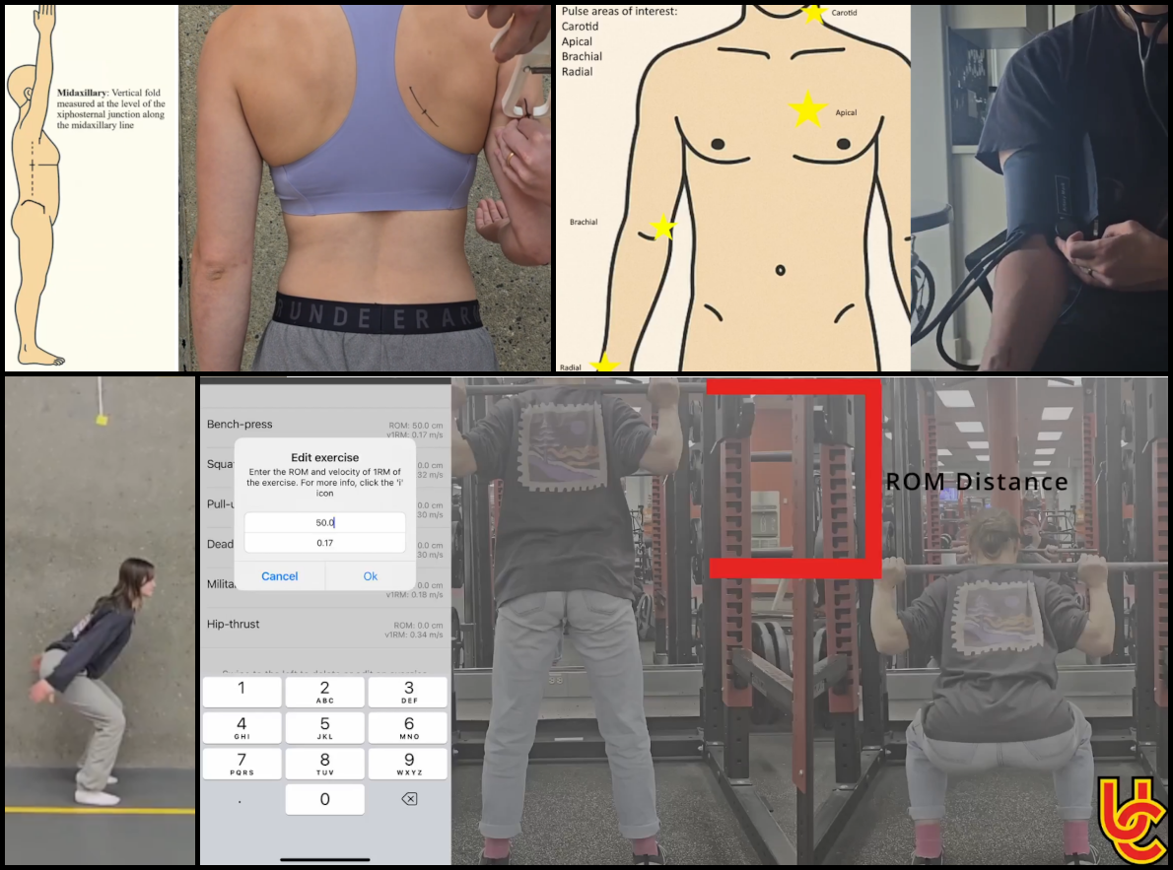
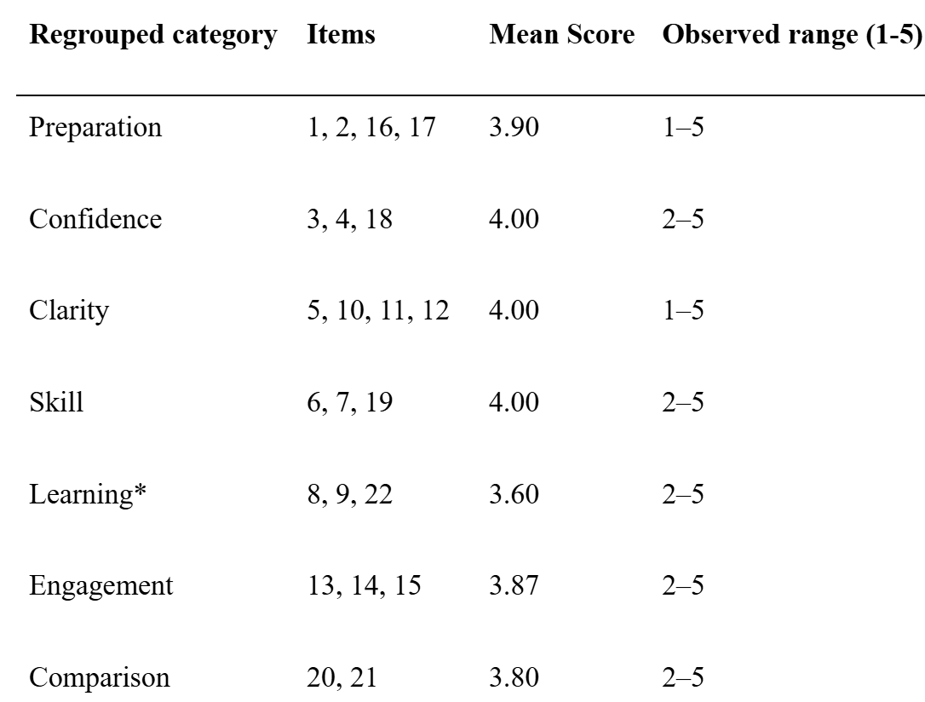
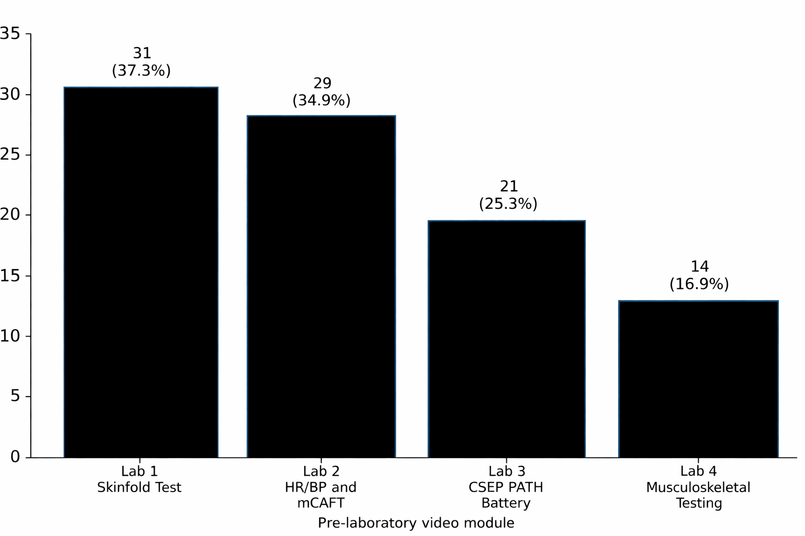
Multimedia for Enhanced Learning and Training (MELT) in Undergraduate Kinesiology Laboratory Education
Andrew Filewich, John Holash, Phd
Faculty of Kinesiology, University of Calgary
Introduction
Background:
Experiential learning is central to kinesiology and other health-related undergraduate programs, where labs translate theory into applied skills. ^{1, 3, 13}
Pre-laboratory videos may reduce cognitive load burden by improving preparedness and procedural clarity before students enter the lab. ^{10, 12}
Purpose:
To evaluate the implementation and perceived instructional value of short multimedia pre-laboratory video modules in Kinesiology 375—Tests and Measurements.
Research Questions
How did students perceive the influence of pre-laboratory videos on preparedness, confidence, procedural understanding, learning efficiency, and skill self-efficacy?
What patterns of video use, reported benefits, challenges, and suggestions emerged across the semester?
Figure 1: Screenshots from pre-lab videos
Results
Video Uptake Lab 1: 31 (37.3%) | Lab 2: 29 (34.9%) Lab 3: 21 (25.3%) | Lab 4: 14 (16.9%) No video exceeded 40% of enrolled students.
Perceived Value of Videos Highest-rated categories & means: Confidence = 4.00 | Clarity = 4.00 | Skill = 4.00
Open-Ended Themes Helpful for: procedural clarity, role preparation, visual demonstration, replayability Challenges: low awareness, content misalignment Suggestions: more videos, greater specificity, shorter length, better alignment
Discussion
Interpretation
Students perceived the videos most positively as supports for preparation, procedural clarity, confidence, and skill performance.
The videos appeared to function more as practical preparatory tools than as highly engaging stand-alone learning resources.^{10, 12}
Pre-laboratory videos may help reduce uncertainty before lab and allow in-person laboratory time to be used more efficiently.^{4, 8}
A key tension in the findings was that positive perceptions among users did not translate into strong whole-class uptake. ⁷
The videos also appeared useful for both “participant” and “coordinator” roles, giving clarity of roles.¹¹
Implementation Consideration
Reported challenges included low awareness of the videos and occasional mismatch between video content and in-lab activities.
These findings suggest that resource quality alone is not enough; visibility, alignment, and integration into course expectations also matter.^{2, 5, 6}
Conclusion
Take Home Message
Pre-laboratory videos may be a useful way to support experiential learning in undergraduate kinesiology laboratories.
Their value appears strongest as a pre-class support for readiness, clarity, and confidence.
This project suggests that multimedia resources mayhelp address the challenge of supporting meaningful experiential learning under limited laboratory time and high cognitive load. ^{3, 9, 14}
Future Direction
Positive perceptions do not guarantee meaningful impact if students do not consistently use the resource.
Instructional design and implementation must therefore be considered together.
Future work should examine both objective learning outcomes and strategies that improve uptake, visibility, and content alignment.
Note. From left to right, top to bottom: Skin Caliper Test, Blood Pressure Test, Vertical Jump Test, Estimated 1 Rep Max Test.
Figure 4
Methods
Design: Exploratory mixed-methods study using descriptive survey data, video viewership analytics, and open-ended responses.
Participants: 83 students were enrolled in Kinesiology 375—Tests and Measurements; 5 completed the end-of-term survey (6%).
Intervention: Four short pre-laboratory videos were created for the first four laboratory sessions. Videos were under 5 minutes and used visual demonstration plus scripted narration.
Comparison point: The fifth laboratory session did not include a video and served as a within-course comparison point.
Data collection: End-of-term survey with 24 Likert-style items across 11 domains and 3 open-ended questions; verified unique view counts were also collected.
Analysis: Quantitative data were summarized descriptively using frequencies, means, and observed ranges; open-ended responses were coded into recurring themes.
Table 1: Descriptive summary of Likert-style categories
Figure 2: Video viewership across modules
Note. Percentages are calculated based on total course enrollment (n = 83).
Note. Means are descriptive summaries of regrouped item categories. Higher scores indicate more favourable perceptions of the instructional videos.
* Item 9 was reverse-coded for the category-level summary because higher scores indicated more favourable perceptions of the laboratory without videos.
References
¹Bapu Ramesh et al., 2026. Journal of Chemical Education, 103(1), 27–35.
²Baptiste et al., 2021. Advances in Physiology Education, 45(4), 685–693.
³Coyte, 2023. FEBS Open Bio, 13(10), 1810–1830.
⁴de Jong, 2010. Instructional Science, 38(2), 105–134.
⁵Kirkwood, 2006. Computers & Education, 47(3), 316–331.
⁶Kirkwood, 2008. Journal of Computer Assisted Learning, 24(5), 372–382.
⁷Kruskie et al., 2025. Anatomical Sciences Education, 18(5), 448–461.
⁸Mayer, 2024. Educational Psychology Review, 36(1), 8.
⁹Onyeaka et al., 2023. Biochemistry and Molecular Biology Education, 51(1), 29–38.
¹⁰Rathnayaka et al., 2024. European Journal of Engineering Education, 49(1), 113–138.
¹¹Ribosa & Duran, 2022. Educational Research Review, 37, 100475.
¹²Rodgers et al., 2020. European Journal of Engineering Education, 45(2), 292–304.
¹³Royse et al., 2024. Journal of Microbiology & Biology Education, 25(2), e00011-24.
¹⁴Sweller, 1988. Cognitive Science, 12(2), 257–285.
Contact:
Andrew.Filewich@ucalgary.ca
RJHolash@ucalgary.ca
Supported by the Taylor Institute for Teaching and Learning SOTL Grant, University of Calgary)

