Slide 1
Supplement 233
Patient Model Gender Enhancements
WG-06
Robert Horn
20 June 2023

Slide 2
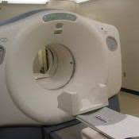
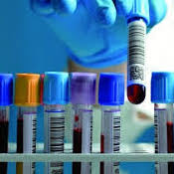

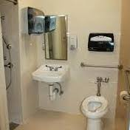
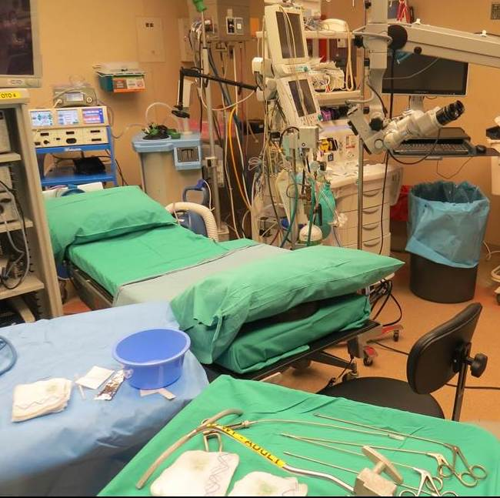
Use Case
F->M transgender patient presents for imaging and admit.
Anatomic Female but undergoing hormone transition.
Female
Anatomy
Gender Identity = M
Sex for Imaging Use = F
Sex for Lab = M or more complicated
Sex for clinical devices (for OR set-up) = F
Female & Male
Hormones
Female
& Male
Birth Sex, Administrative Sex, Sex, Gender Identity are not consistently used or understood
Female
Set-up

Slide 3
Background
Vocabulary Working Group Project begun Spring 2019
Informative HL7 Specification (Jan 2021) Ballot, Published Aug 2021
Describes logical model for sex and gender identity data representation
Weekly (Monday 4p ET) web calls and HL7 Confluence content site (http://hl7.me/GHP)
Participation from external SDO (DICOM, IEEE, some NCPDP), US, Canadian & Australian governments, LGBTQIA+, EHR (Epic, Allscripts), AMA, ACP, ACLA etc.
Use cases here
JAMIA publication - https://academic.oup.com/jamia/article/29/2/354/6382238
The time has come! (EG: USPSTF Approach to Addressing Sex and Gender When Making Recommendations for Clinical Preventive Services. JAMA. Oct 25, 2021. doi:10.1001/jama.2021.15731
HL7 Cross Paradigm IG: Gender Harmony - Sex and Gender Representation (in ballot preparation)
Notes:
Note that the JAMIA article is open access, and that there is a correction link in the article to correct some important typos.

Slide 4
Changes since January WG-06 Meeting
Sex for Clinical Use (SFCU) → Sex Parameters for Clinical Use (SPCU)
Harmonization between HL7 v2/FHIR/CDA (reconciled in FHIR. HL7 v2 and CDA will follow)
Change in encoding of FHIR extension (Patient.genderIdentity → Patient.extension [PGenderIdentity])
Various refinements (e.g., HL7 v2 name type)
Removed Sex at Birth attribute from Sup 233 (recomended encoding in use case)
Removed Recorded Sex and Gender (HL7 postponed and removed for now)
All HL7 ballot comments addressed in DICOM use case.
Remaining Open Items transferred from HL7 Ballot to Sup 233
4
Notes:
Sex Parameter for Clinical Use (SPCU) - a parameter that provides guidance on how a recipient should apply settings or reference ranges that are derived from observable information such as an organ inventory, recent hormone lab tests, genetic testing, menstrual status, obstetric history, etc.. This property is intended for use in clinical decision making, and indicates that treatment or diagnostic tests should consider best practices associated with the relevant reference population. The standard sexParameterForClinicalUse extension may be used to communicate this property.

Slide 5
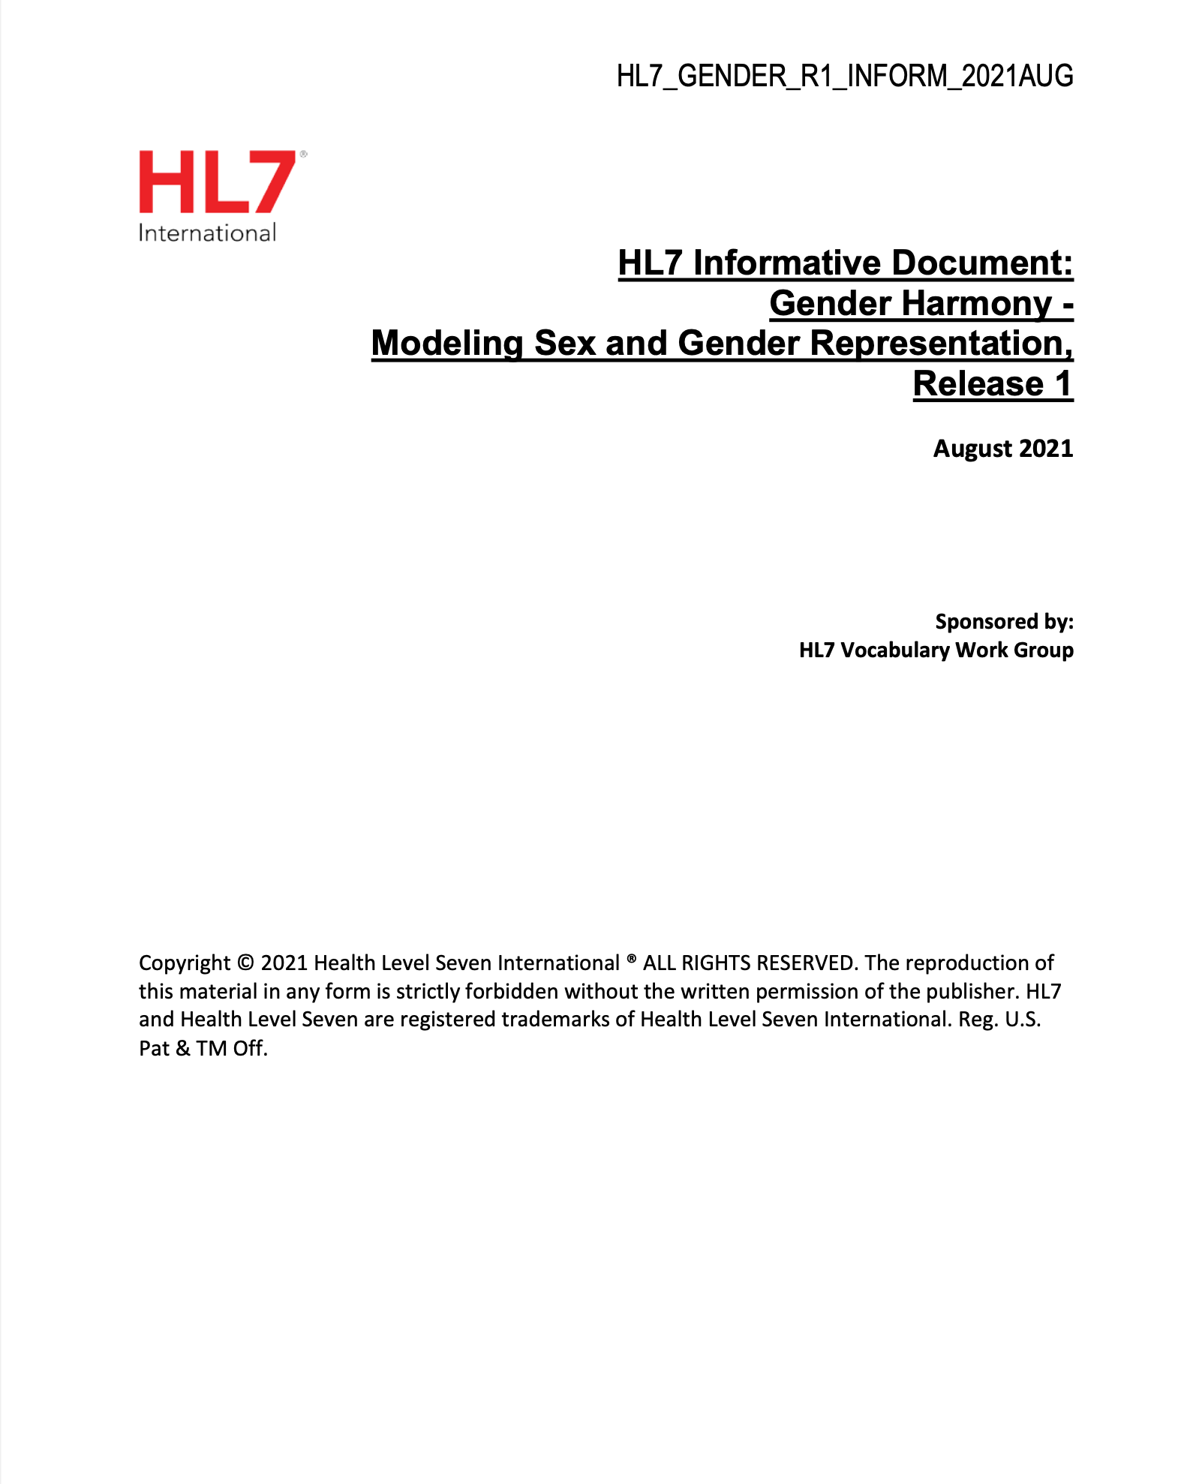
Hl7 Logical Model
Background
Current State overview
Impact on clinical care
Sex and Gender in:
Quality measurement
Reporting in Payment for Care
Data Analysis
Model
Implementation Guidance
Appendices

Slide 6
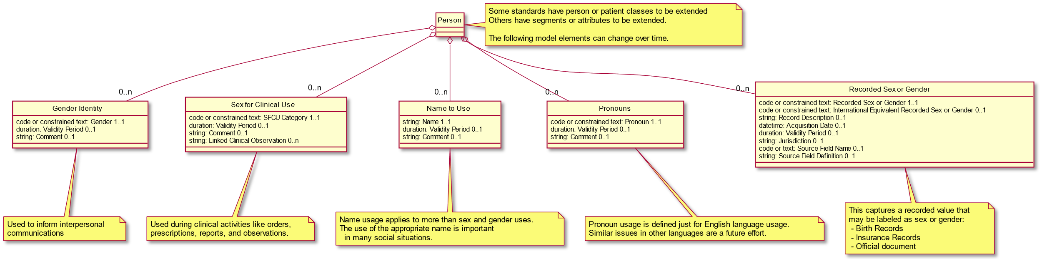
Gender Harmony Logical Model
This is an abstract class model that each standard will need to map into the specific concrete classes used

Slide 7
GH Element Specifics
Gender Identity (GI)
Source:
Patient only
Is always Patient level datum
May change between studies
Use:
Appropriate clinical interactions
Not intended for clinical assessments or payment functions
May, or may not, be aligned with the proper value for a clinical, administrative or legal based decision
IE: this is not administrative, legal, or clinical
Sex Parameters For Clinical Use (SPCU)
Source:
Clinician
Clinical rules system
Clinical observations
May be a “Patient level datum” but are often specific to a particular use (order, procedure, etc.)
May change between studies
Use when patient physiology determines appropriate:
Tests, drugs, procedures
Reference ranges, methods, algorithms, pathways
Analysis and diagnostic methods
selecting and describing subjects for clinical trial and other research activities

Slide 8
GH Element Specifics-3
Name to Use (NtU)
Source:
Patient
Is always Patient level datum
May change between studies
Use:
All clinical interactions
Establish therapeutic relationship
Use in reports, instructions, guidance, etc.
If “legal” name needed, send NtU in addition
Pronouns
Source:
Patient
Is always Patient level datum
May change between studies
Use:
Where appropriate in clinical interactions
Establish therapeutic relationship
Use in reports, instructions, guidance, etc.

Slide 9
Proposed HL7 Minimum Value Sets
Sex Parameters for Clinical Use (SPCU)
Gender Identity
Term | Definition
Female | Identifies as female gender. UMLS/SNOMED: 446141000124107
Male | Identifies as male gender. UMLS/SNOMED 446151000124109
Nonbinary | Identifies as nonbinary gender. UMLS/SNOMED 33791000087105
Term | Definition
Female-typical | Available data indicates that diagnostics, analytics, and treatments should consider best practices associated with female reference populations.
Male-typical | Available data indicates that diagnostics, analytics, and treatments should consider best practices associated with male reference populations.
Specified | Available data indicates that diagnostics, analytics, and treatment best practices may be undefined or not aligned with sex-derived reference populations. Additional information (usually, but not always, in the form of comments and/or observations) is available, but it does not align with typical male or female parameters, reference ranges, etc.
Unknown | No information can be provided.
Gender Identity should allow many other phrases but these are the minimum required.
Expect local extensions. E.g., Canada has a national SNOMED extension for “two spirit”.
UMLS and SNOMED codes have been established.
Corresponding DICOM CID xxx1 Person Gender Identity
SPCU of “Specified” will often be accompanied by comments and/or URI to provide the specified ranges to used, procedures, to follow, etc. URIs may reference clinical reports, hospital policies, etc.
Corresponding DICOM CIDxxx2 Sex Parameters for Clinical Use

Slide 10
Proposed HL7 Minimum Value Sets
Pronouns
Term | Definition
He, Him, His, Himself | English personal pronouns, typically associated with masculinity, that are requested by a person to be used by them.
She, Her, Hers, Herself | English personal pronouns, typically associated with femininity, that are requested by a person to be used by them.
They, Them, Their, Theirs, Themself | English personal pronouns, typically not associated with masculinity or femininity, that are requested by a person to be used by them.
Based on LOINC answer list for Personal Pronouns - Reported, LL5144-2 Personal pronouns / Answers: 10; Scale: Nom; Code: -; Score: -.
Corresponding DICOM CIDxxx4 Third Person Pronouns

Slide 11
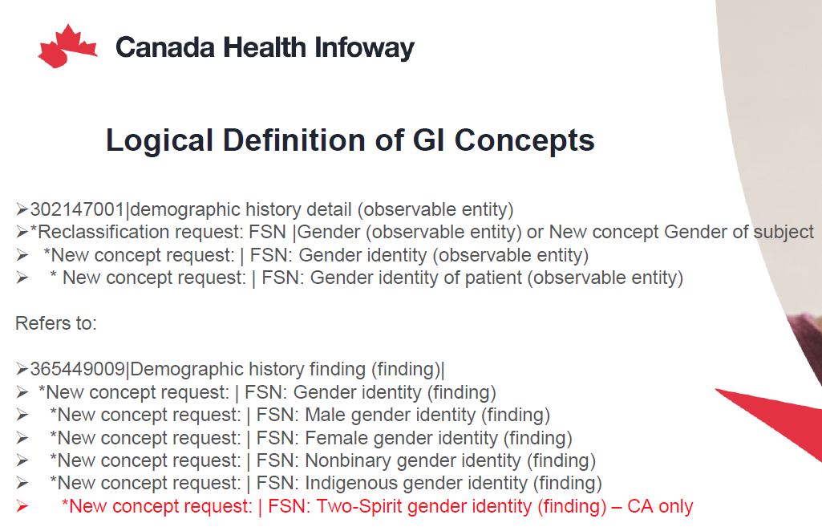
Gender Identity
NEW SNOMED CONCEPTS
Requested as part of Canada Health Infoway’s (Canadian national release center for SNOMED) Sex and Gender Work Group, in collaboration with HL7 Gender Harmony Project
Improves the specificity of concepts related to Gender Identity

Slide 12
HL7 Harmonization Strategy
Initial publication and balloting of a Logical Model (completed)
Publication and balloting of an Implementation Guide that applies to HL7v2, CDA, and FHIR. Coordinated balloting of changes to HL7v2, CDA, and FHIR:
HL7v2 adds segments, clarifies some existing elements like PID-8, and refers to the Implementation Guide in normative sections.
CDA adds attributes, elements, and templates, clarifies some existing attributes, and refers to the Implementation Guide in normative sections
FHIR adds attributes, elements, codes, and extensions, clarifies some existing attributes, and refers to the Implementation Guide in normative sections

Slide 13
DICOM Strategy
Add optional attributes to the Patient Study Module and to various normalized services. These optional attributes match those in the HL7 logical model and FHIR.
Updates and adds some CIDs. New codes are defined by DICOM for SPCU. (WG-06 change and open issue.)
Clarifies use of Patient’s Sex (0010,0040) so that it matches the definition used by HL7v2. Current attribute definition only lists the enumerated values.
Provides examples of use of the optional attributes, and examples of some of the workflow and implementation considerations. These are accompanied by links to the related portions of HL7 v2, CDA, and FHIR published standards.

Slide 14
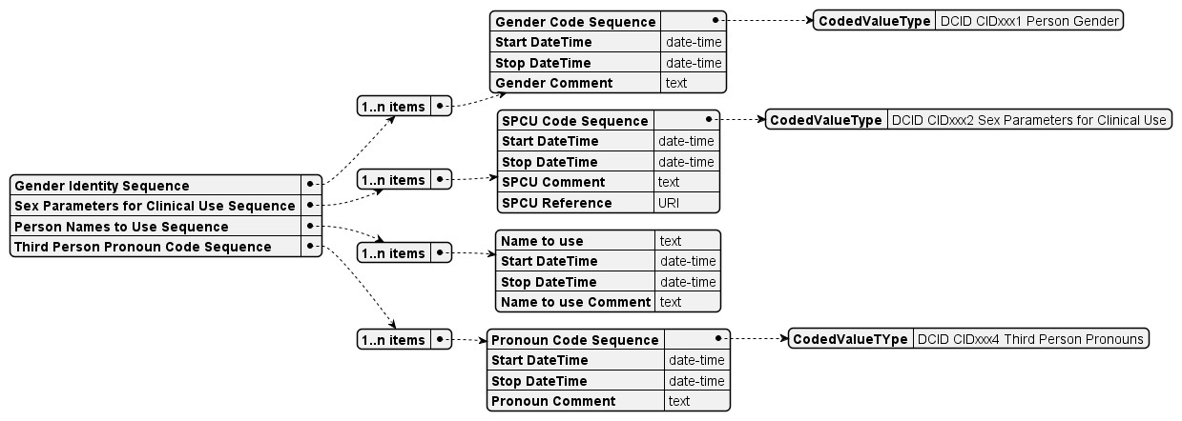
Structure of the additions to Patient Study Module

Slide 15
Modules Modified
The modifications add the same optional sex and gender attributes to the following modules:
Patient Demographics Module (Normalized)
Performed Procedure Step Relationship (Normalized)
Patient Study Module (Composite)
Unified Procedure Step Relationship Module (Normalized)
The definition of Patient’s Sex (0010,0040) is updated. The original definition only specified the enumerated codes to be used. It is updated to match HL7 v2 PID-8 updates. (Short form: this attribute is set according to hospital policy.)

Slide 16
Services Modified
The modified modules result in updates to the following services:
Study Root SOP Class Group (C-FIND)
Modality Performed Procedure Step
Modality Worklist
Relevant Patient Information Model
Substance Approval Query
Unified Procedure Step

Slide 17
Other Modifications
Application level confidentiality profiles updated
New and updated CID
CID 7455 Sex
New CID Person Gender Identity
New CID Sex Parameters for Clinical Use (SPCU)
New CID Third Person Pronouns
New DICOM codes for SPCU

Slide 18
Ongoing Development
Working Group 6 – Ad Hoc committee for Sex and Gender
Work in Progress sharing using Github
Publicly readable
Open for public comment and pull requests
Only editors can write or update
https://github.com/rjhorniii/dicom-sup233-wip

