Slide 1
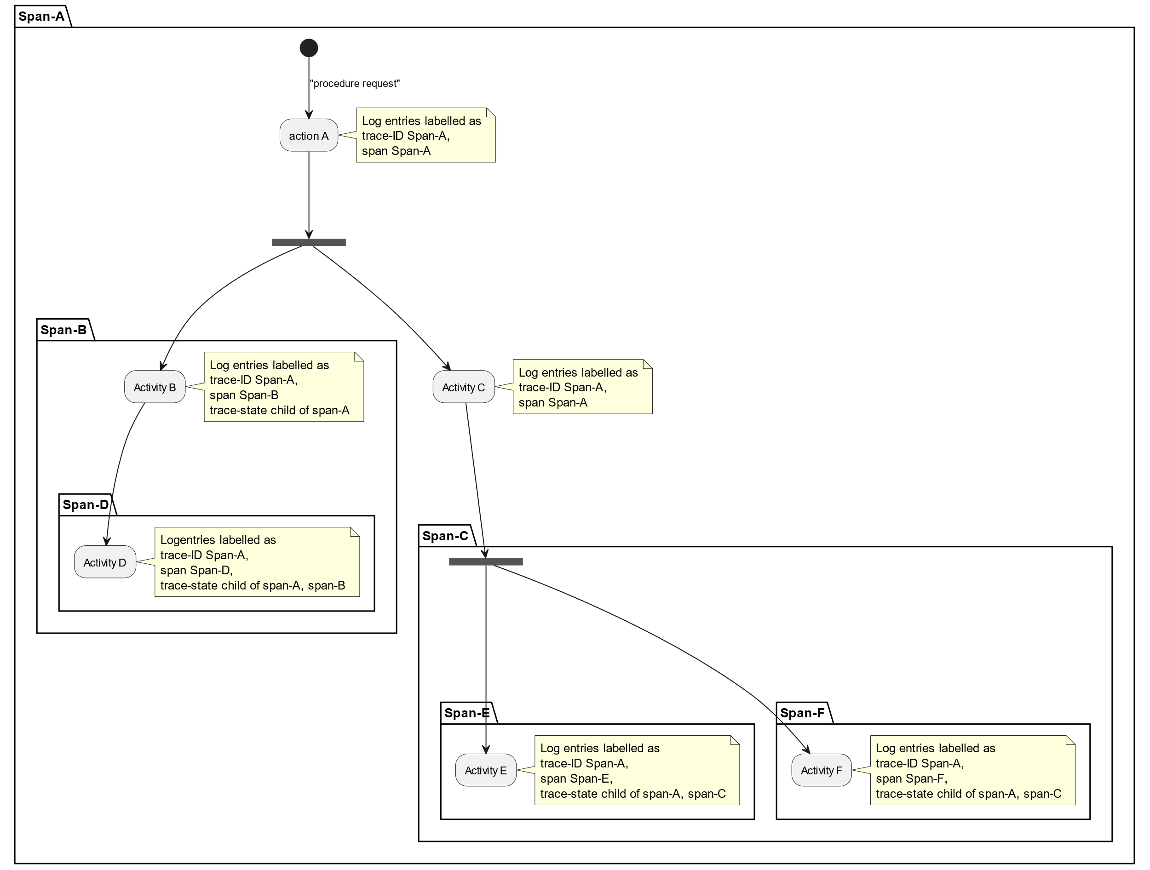
W3C problem statement
Imagine a procedure starts with a request:
Action A generates some log messages and then starts activity B on a different system.
Activity B generates logs to logging system B
Action A starts Activity C, generating more logs to logging system A
Activity B starts Activity D on a different system.
Activity D generates logs to logging D.
Etc.
How do you find the event logs related to “procedure request” among all the millions of log messages on all those logging systems?

Slide 2
Explain transition period (some update, some not)

Slide 3
How to convey trace parameters in active messages.

