Slide 1


Strength and Conditioning for the Van Life Athlete
RJ Humphreys

Slide 2
Case Study: Define the Problem
Case Study
Population – climbing athletes, specifically living away from home
Goal – maintain and improve strength and conditioning while traveling
Physiological challenge - limited training equipment and resources
Notes:
Describe the individual or population involved (e.g., athlete, sedentary adult, older adult, clinical patient).
Present the problem or goal (e.g., improve VO₂max, prepare for a marathon, reduce hypertension, manage overtraining).
Clearly state the physiological challenge or performance objective.

Slide 3


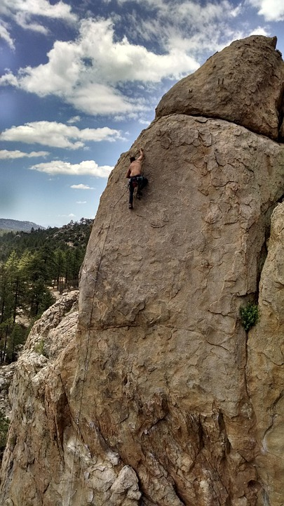
Case Study
Van life → part time or full-time dwelling in a van
Van life athlete → outdoor athletes living in a van for accessibility to outdoor sports
Notes:
Describe the individual or population involved (e.g., athlete, sedentary adult, older adult, clinical patient).
Present the problem or goal (e.g., improve VO₂max, prepare for a marathon, reduce hypertension, manage overtraining).
Clearly state the physiological challenge or performance objective.

Slide 4
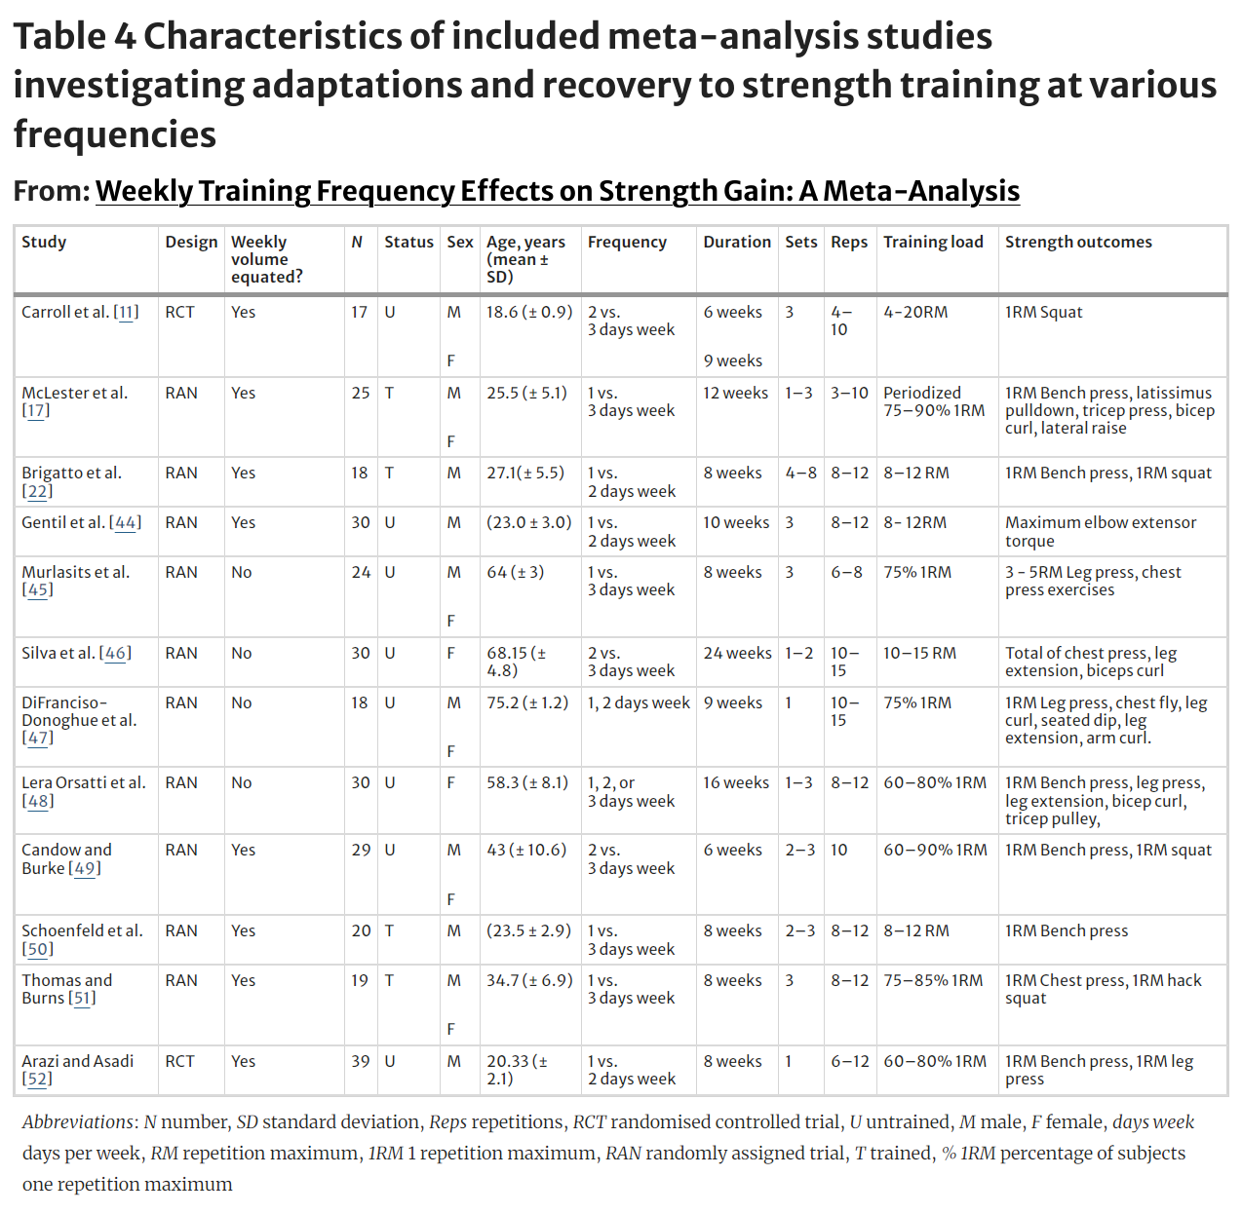
Literature Review: Periodization Plan
Research supports multiple periodization planning strategies for success (Moesgaard et al, 2022., Grgic et al, 2018., Harries et al, 2015).
Increase in training age, increase in training plan novelty (Harries et al, 2015).
Frequency increased strength and volume, but not when total volume is accounted for (Grgic et al, 2018).
Notes:
Summarize and critically evaluate at least 3 peer-reviewed sources relevant to your case.
Explain physiological concepts, mechanisms, and evidence-based practices related to the case.
Provide context for your proposed training intervention.

Slide 5
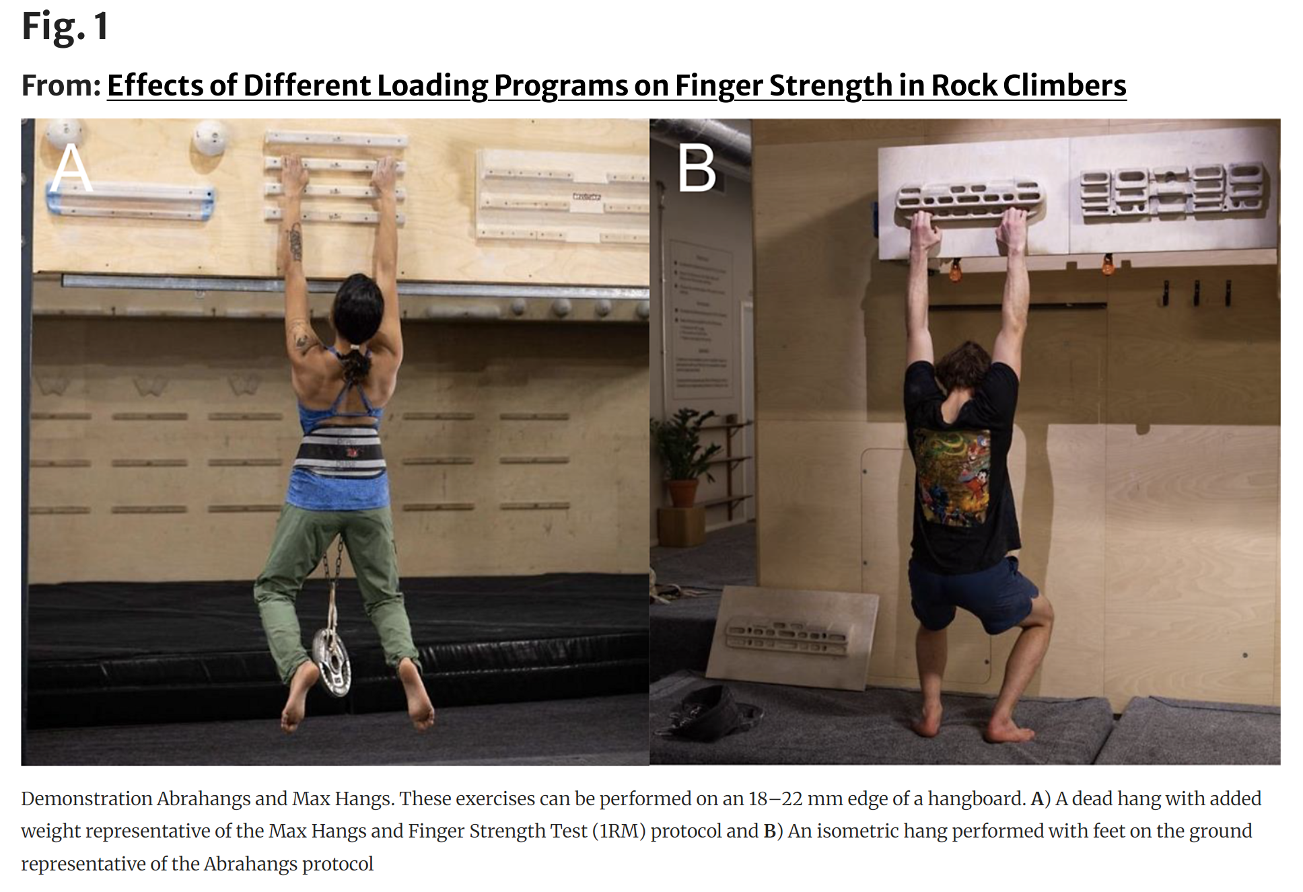
Literature Review: Training Modality
Space conscious training tools, hangboard and kettlebell
Hangboard training is an effective training modality to increase finger strength and endurance (Hermans et al, 2022, López-Rivera & González-Badillo, 2019), training intensity can vary drastically and yield the same training results (Gilmore et al, 2024).
Kettlebell swings and training improved muscle strength, explosiveness and endurance (Lake & Lauder, 2012)
Notes:
Summarize and critically evaluate at least 3 peer-reviewed sources relevant to your case.
Explain physiological concepts, mechanisms, and evidence-based practices related to the case.
Provide context for your proposed training intervention.

Slide 6
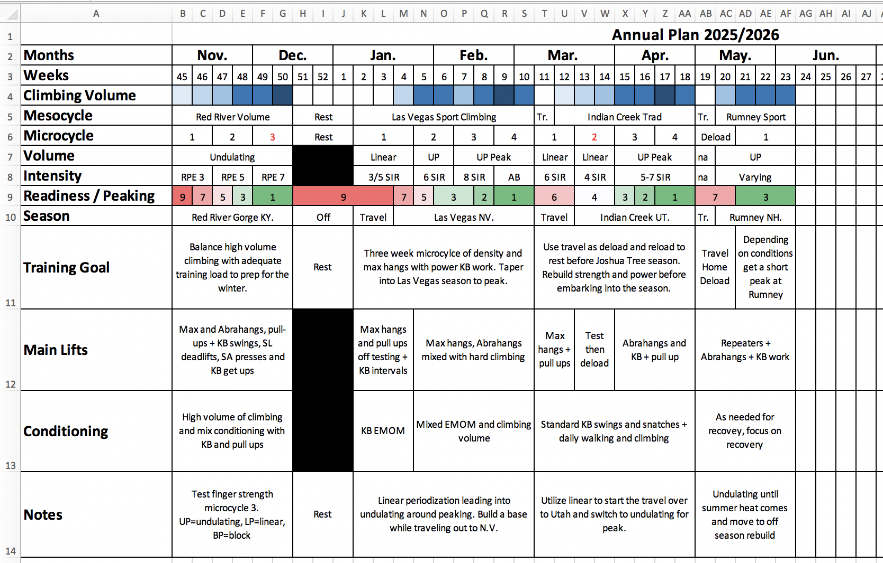
Methods: Proposed Periodized Plan
Notes:
Outline a detailed training plan based on a periodization model (e.g., linear, undulating, block).
Justify your choices using physiological rationale and research.
Include a general overview of phases (e.g., macrocycle, mesocycles, microcycles) and a description of intensity, frequency, recovery, and progression.
Address individualization (age, fitness level, goals, health status)

Slide 7
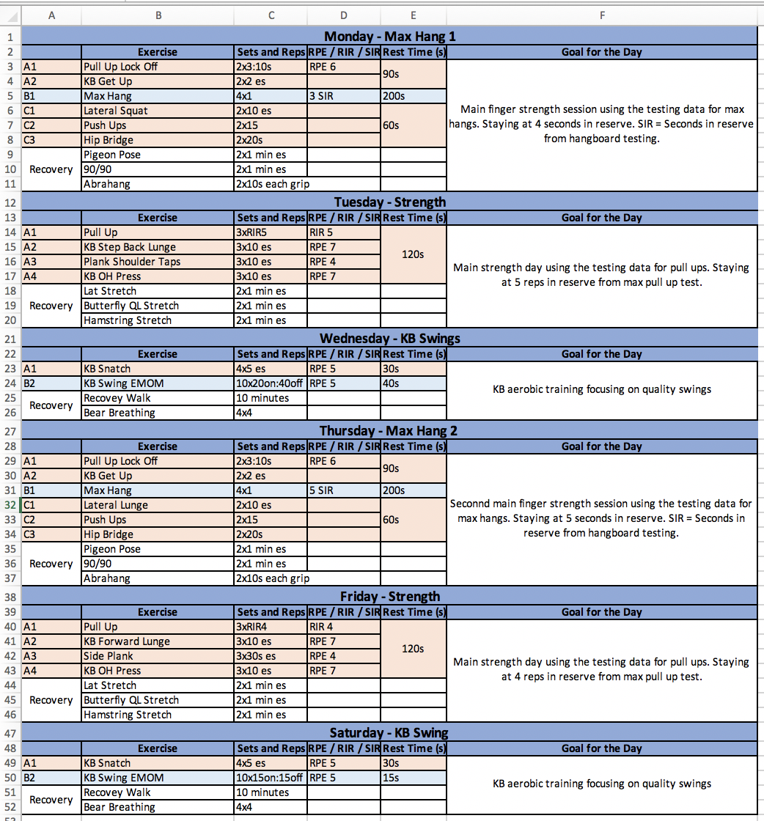
Methods:
Microcycle 1
Travel Mesocycle
March 9th, April 4th
2-week linear travel plan
2-week block strength
Max hang focus
KB aerobic intervals
Notes:
Outline a detailed training plan based on a periodization model (e.g., linear, undulating, block).
Justify your choices using physiological rationale and research.
Include a detailed description of 1 microcycle.
Address individualization (age, fitness level, goals, health status).

Slide 8
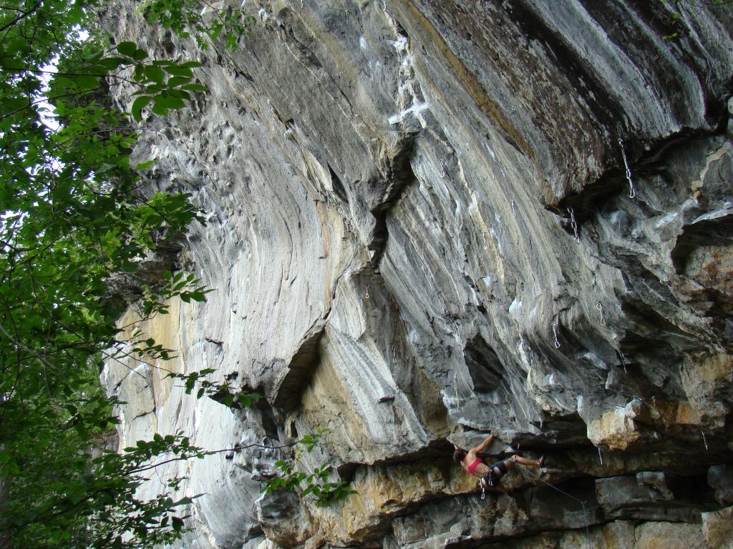
Results: Expected Outcome
Prevent detraining
Organize travel time for training blocks
Increase finger strength and endurance
Maximize climbing experience at each location
This Photo by Unknown Author is licensed under CC BY-SA
Notes:
Describe the physiological or performance outcomes you expect based on your intervention.
Use literature to support your projections (e.g., improvements in VO₂max, strength, lactate threshold, insulin sensitivity, etc.).

Slide 9
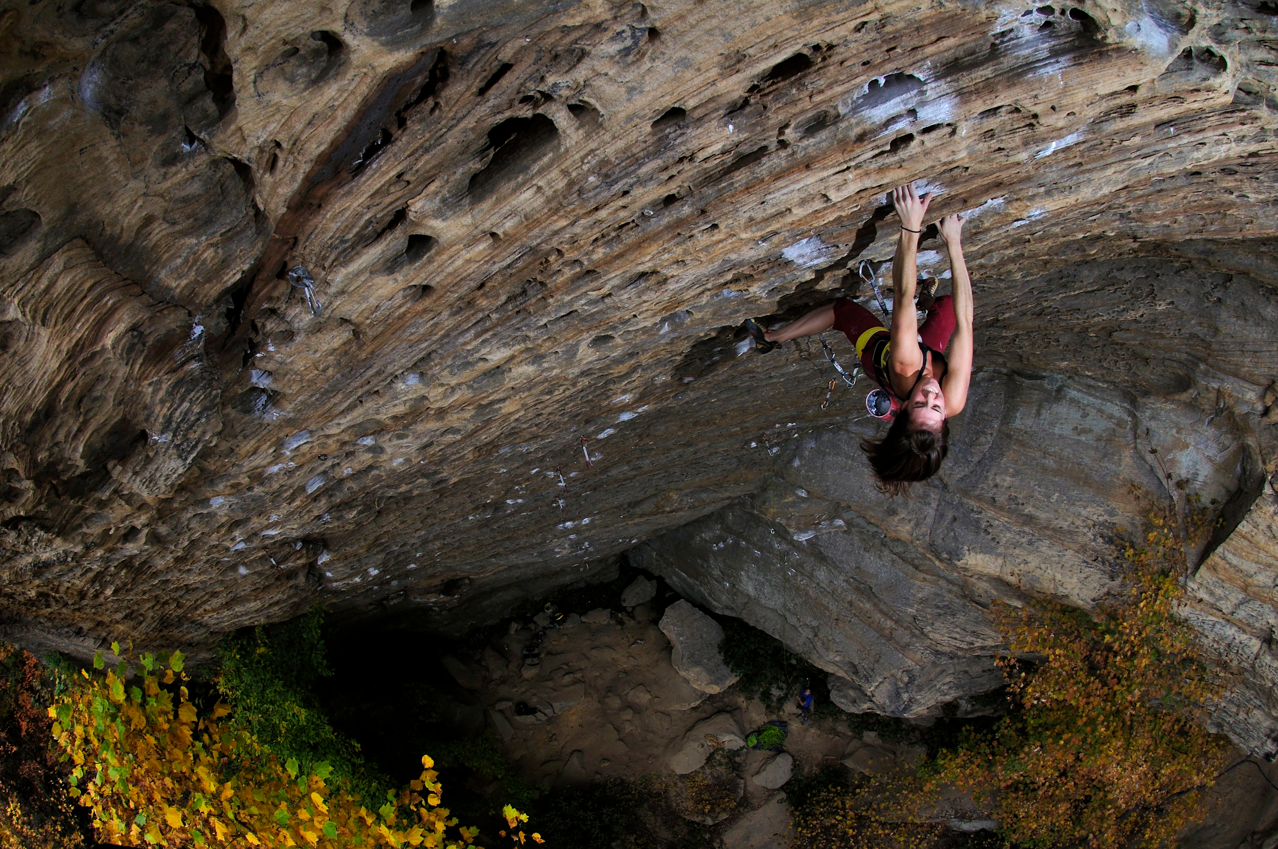
Discussion
Strengths
  Simple
  Adaptable plan
Limitations
  Variety
  Compound loads
Broad Application
  Traveling teams
  Outdoor athletes
  People with limited available training equipment
Notes:
Reflect on the strengths and limitations of your proposed intervention.
Discuss how this case informs broader applications in training or clinical practice.
Identify any potential risks or contraindications.

Slide 10

Conclusion
Training is adaptable
Simple works
Notes:
Summarize the key takeaways and the value of an evidence-based approach in exercise prescription.

Slide 11
References:
Falatic J. A., Plato A. P., Holder C., Finch D., Han K., & Cisar J. C. (2015). Effects of Kettlebell Training on Aerobic Capacity. Journal of Strength and Conditioning Research. 29(7):1943-7. doi: 10.1519/JSC.0000000000000845.
Gilmore K. N., Klimek P., Abrahamsson E., & Baar K. (2024). Effects of Different Loading Programs on Finger Strength in Rock Climbers. Journal of Sports Medicine. 10(1) 125. doi: 10.1186/s40798-024-00793-7.
Grgic J., Schoenfeld J. B., Davies B. T., Lazinica B., Krieger W. J., & Pedisic Z. (2018). Effect of Resistance Training Frequency on Gains in Muscular Strength: A Systematic Review and Meta-Analysis. Journal of Sports Medicine. 48(5)1207-1220. doi: 10.1007/s40279-018-0872-x.
Harries K. S., Lubans R. D., & Callister R. (2015) Systematic review and meta-analysis of linear and undulating periodized resistance training programs on muscular strength. Journal of Strength Conditioning Research. 29(4) 1113-25. doi: 10.1519/JSC.0000000000000712.
Hermans E., Saeterbakken H. A., Vereide V., Nord S. O. I., Stien N., & Andersen V. (2022). The Effects of 10 Weeks Hangboard Training on Climbing Specific Maximal Strength, Explosive Strength, and Finger Endurance. Frontiers in Sports and Active Living. 27(4)888158. doi: 10.3389/fspor.2022.888158.
Lake P. J., & Lauder A. M. (2012). Kettlebell swing training improves maximal and explosive strength. Journal of Strength and Conditioning Research. 26(8) 2228-33. doi: 10.1519/JSC.0b013e31825c2c9b.
López-Rivera E., & González-Badillo J. J. (2019). Comparison of the Effects of Three Hangboard Strength and Endurance Training Programs on Grip Endurance in Sport Climbers. Journal of Human Kinetics. 66 183-195. doi: 10.2478/hukin-2018-0057.
Moesgaard L., Beck M. M., Christiansen L., Aagaard P., & Lundbye-Jensen J. (2022). Effects of Periodization on Strength and Muscle Hypertrophy in Volume-Equated Resistance Training Programs: A Systematic Review and Meta-analysis. Journal of Sports Medicine. 52(7) 1647-1666. doi: 10.1007/s40279-021-01636-1. Epub 2022 Jan 19.

