Slide 1
LGS Master's Programs: Tuition Pricing & Scholarship Analysis
Emory Laney Graduate School — Phase 2 (v2)
April 23, 2026

Slide 2
Executive Summary — Top 5 Findings
1.
MDP is Emory's costliest and most-discounted master's
$108k average gross, $49k net, 55% discount rate across 135 full-load students over the 8-year panel ($8.4M in LGS scholarships).
2.
Two programs operate at 0% discount
Data Science (n=11) and MBID (n=8) show gross = net for every full-load student. Obvious candidates for a pricing review.
3.
Enrollment is bimodal
Computer Science (154) and MDP (135) together account for 59% of the 493-student sample; eight other programs share the remaining 41%.
4.
Computer Science is 86% international — and still ~49% discounted
Emory competes for these students on price as well as visa-friendliness; aid does not scale down as international share rises.
5.
Emory sits mid-pack against peers
Annualized gross tuition ~$47–51k across Data/CS, Economics, and General buckets — below Columbia/NYU ($65–91k) and above Georgia Tech's in-state rates ($31–41k).

Slide 3
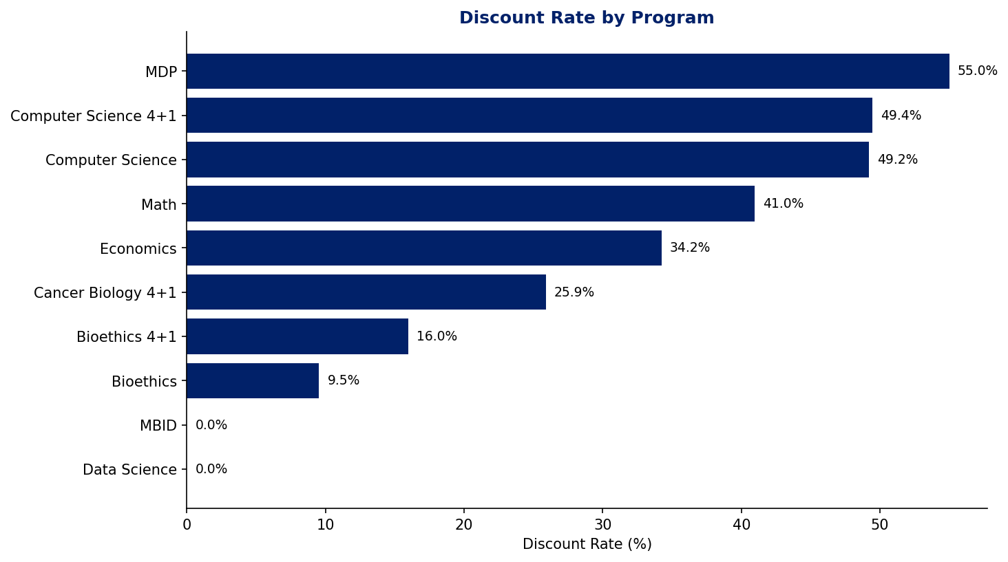
Discount rates vary six-fold across programs — MDP tops the list at 55% while Data Science and MBID give nothing
3

Slide 4
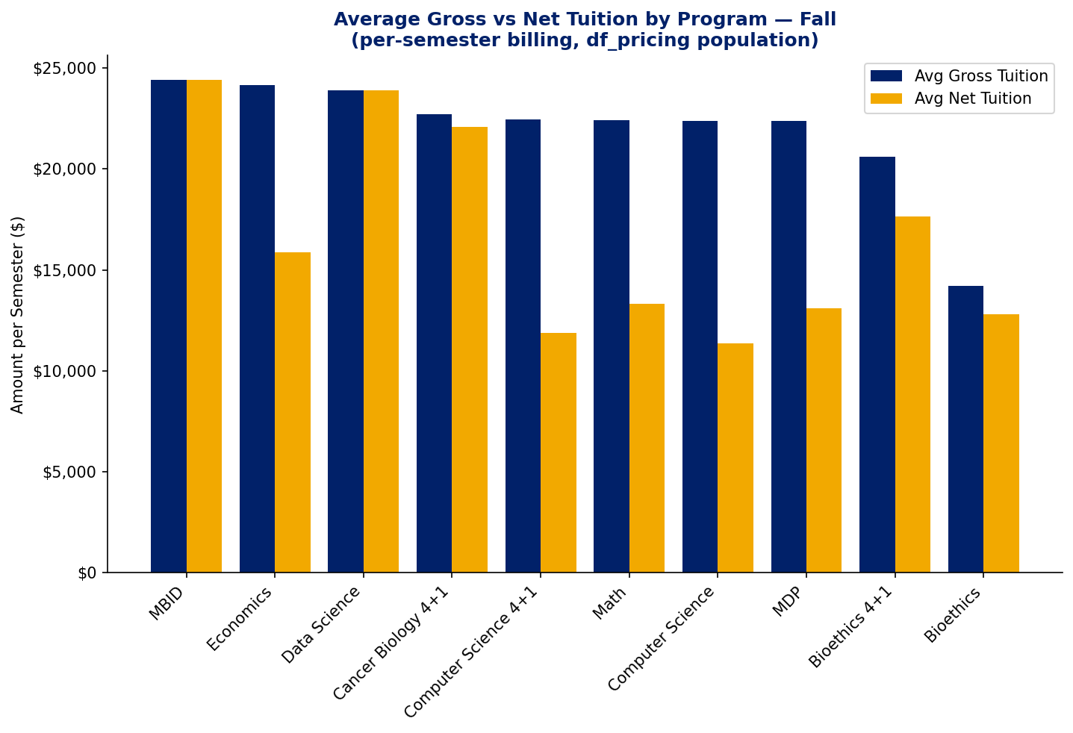
Fall billing is tight across programs — Economics discounts most at the per-semester level
df_pricing population (gross tuition ≥ $20k). Sorted by Fall gross tuition.
4

Slide 5
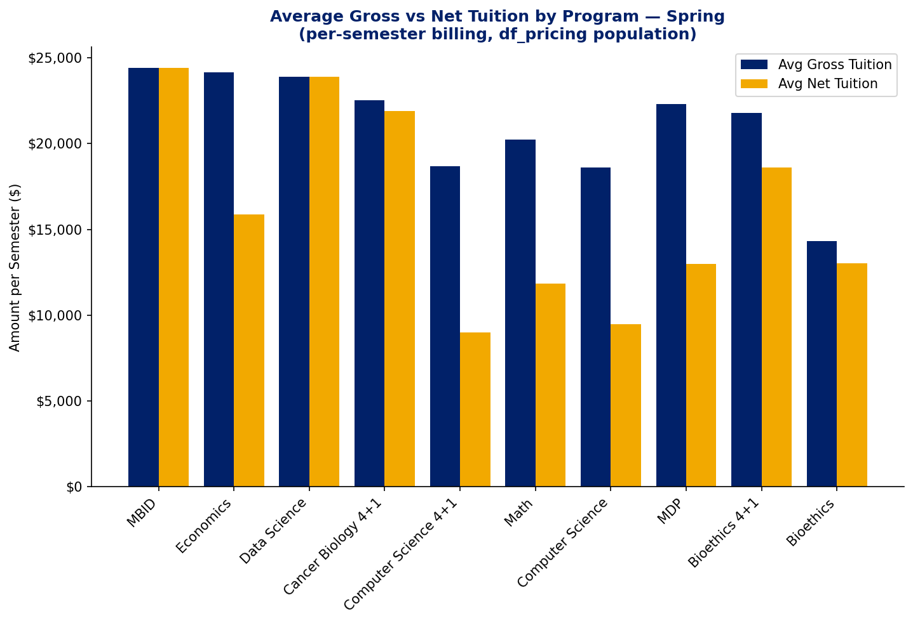
Spring mirrors Fall with one exception — CS 4+1 shows the largest proportional discount
df_pricing population (gross tuition ≥ $20k). Sorted by Fall gross tuition.
5

Slide 6
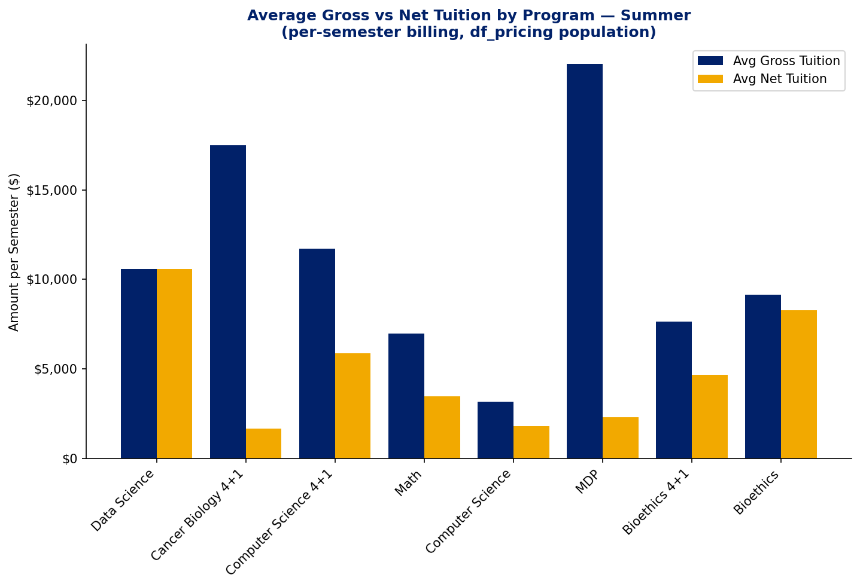
Summer is where MDP's scholarship strategy concentrates — near-zero net on $22k gross
df_pricing population (gross tuition ≥ $20k). Sorted by Fall gross tuition.
6

Slide 7
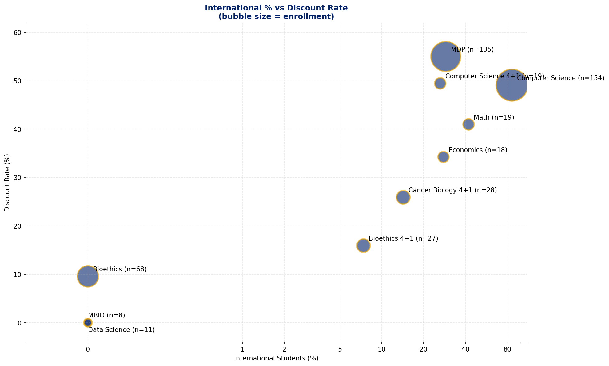
High international share doesn't come with lower aid — CS is 86% international and 49% discounted
Full population (n=487). Bubble size = enrollment; x-axis on log scale to spread the cluster of programs near 0%.
7

Slide 8
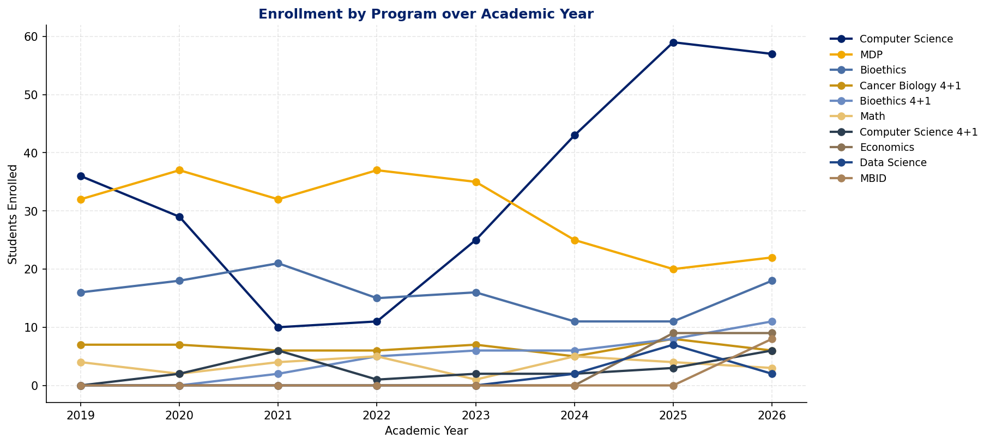
Computer Science enrollment has roughly doubled since 2022 — driving nearly all of Emory's LGS master's volume growth
8

Slide 9
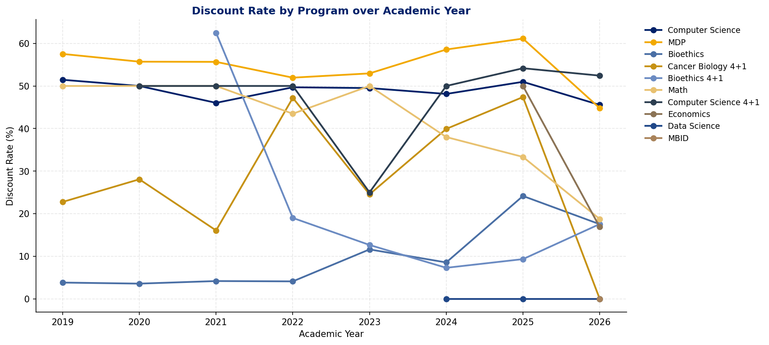
Discount rates are broadly stable year-over-year — no program is systematically tightening aid
9

Slide 10
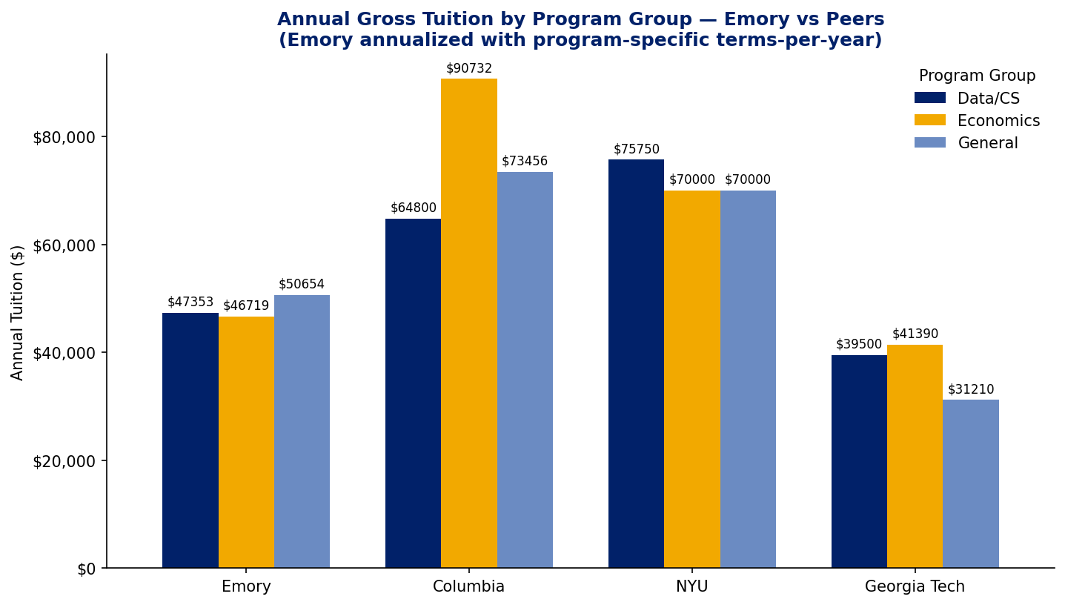
Emory's annualized tuition ($47–51k) undercuts Columbia/NYU by $20–40k and sits above Georgia Tech's in-state rates — mid-market positioning
10

Slide 11
Recommendations
01
Audit Data Science & MBID scholarship eligibility
Both programs show 0% kept LGS scholarship across the 8-year panel (Data Science n=11, MBID n=8). Reconcile the raw FA ledger against the filtered scholarship feed to confirm whether this is a data anomaly or a deliberate full-pay carve-out — and if deliberate, decide whether it is costing yield against discounted peers.
02
Review CS aid strategy relative to international demand
Computer Science is 86% international and still discounts ~49% per student — the highest international share and one of the deepest discounts in the portfolio. Test whether tighter aid materially shifts yield given that Columbia/NYU charge $20–40k more in absolute terms.
03
Capitalize on the peer pricing gap
Annualized gross tuition ($47–51k) sits well below Columbia/NYU ($65–91k) and clearly above Georgia Tech in-state ($31–41k). With CS enrollment roughly doubling since 2022, demand is responding — modeling selective sticker-price increases in the most-demanded programs (CS, MDP) is the lowest-risk revenue lever.
04
Stabilize MDP discount rate with a formal aid policy
MDP discounts at 55% career-wide and concentrates the give in Summer (~$22k gross → ~$2k net per Summer term). Year-to-year the rate drifts in a 55–60% band, which suggests the practice is implicit. Codify the rule (eligibility, award size, term distribution) so future cohorts are predictable and the rate can be tuned deliberately rather than by drift.
11

Slide 12
Data Notes & Methodology
• Source data: institutional Excel exports of gross tuition billed and LGS scholarship awards; 8-year panel spanning AY 2019 through AY 2026.
• Net tuition is clipped at zero. In rare cases a kept scholarship exceeds billed tuition for a partial-term student; we report that student as paying $0 rather than a negative amount.
• Scholarship filter retains descriptions containing 'lgs' and drops external/federal awards (Pell, GRFP, Yellow Ribbon, Americorps, etc.) plus generic LGS 'special' awards, so discount rates reflect institutional aid only.
• Small-n programs are merged: ECONMS + ECON4P1MS → Economics; DATASCIMS + QTMMS → Data Science; DEVPRACMDP + HUMANRTCRT → MDP.
• Annualization for peer comparison uses program-specific terms-per-year (from the Information Sheet plus empirical seasonal distribution) rather than a blanket 2-term assumption. This corrects a ~33% understatement for 3-term programs such as MDP and Data Science.
• Programs with zero kept scholarship (Data Science, MBID) are retained in the summary with a 0% discount rate — this is intentional and flags potential pricing discrepancies.
• v2 pricing filter (df_pricing): avg gross/net tuition, discount rate, and peer benchmark exclude 11 of 493 student-program rows with total billed tuition under $20,000. These reflect single-course or partial-term billings with ~$0 scholarship that were depressing averages and compressing the gross-vs-net gap. Enrollment counts, international mix, and per-year trend charts continue to use the full population.

